Slide 1
Text to Printable Parts
Which knowledge helps an LLM write, check and repair CAD code?
Michael Laager · CAP 6938 AI Knowledge Systems · Fall 2026
Notes:
Hi, I'm Michael. My project is an agent that turns a plain-language request into a 3D-printable STL file. The question behind it: which kinds of knowledge actually help a language model write, check and repair CAD code, and does the answer change with the model?

Slide 2
WHY CAD CODE, NOT A MESH
Text → mesh
Text → CAD code (CadQuery)
• Looks plausible
• No exact sizes, holes or wall thickness
• Nothing to check or fix
• Exact and parametric
• Editable afterwards
• Checkable: run it, measure it, repair it
A request in plain words → a checked STL file ready for the printer
Notes:
3D printers are everywhere, but designing a part still means learning CAD. Most text-to-3D models output a mesh directly: it can look right, but you can't ask it for a 40 millimetre hole and trust the result. Instead, the LLM writes CadQuery, which is Python CAD code. That's exact, you can edit it, and above all you can check it: run the code, measure the solid, and send any error back to the model.

Slide 3
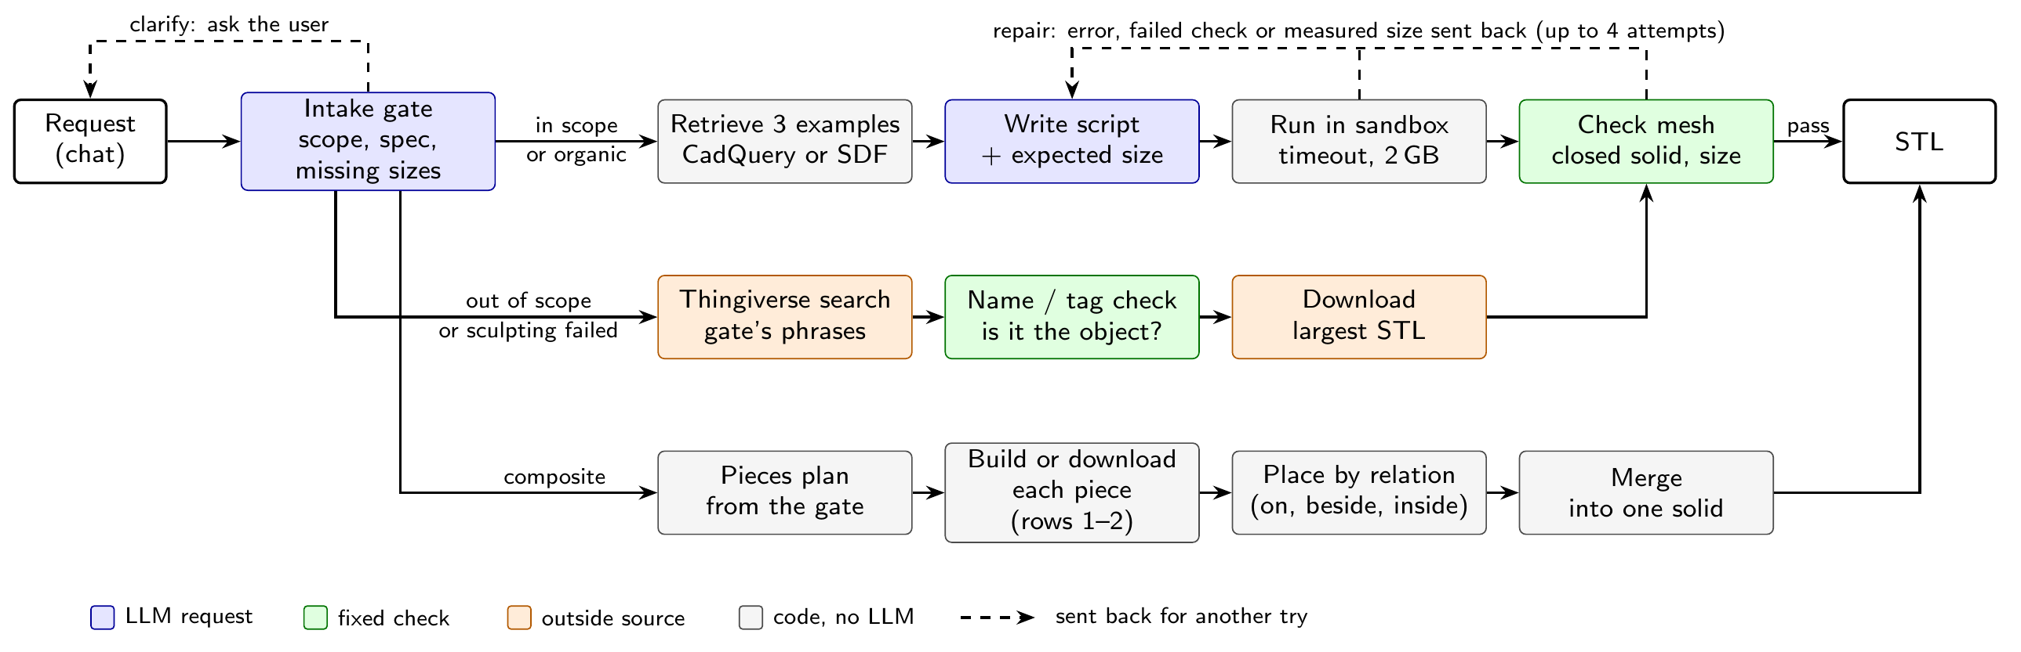
THE AGENT
Notes:
One request goes through an intake gate, a single LLM call that decides the scope and asks for missing sizes. For a mechanical part, we retrieve three similar examples from a hand-checked library of 26, the model writes a script plus the size it expects, we run it in a sandbox and check the mesh is a closed solid of the right size. Any failure goes back to the model, up to four attempts. Organic objects are sculpted with SDF code through the same loop, or downloaded from Thingiverse.

Slide 4
FOUR KINDS OF KNOWLEDGE
1
2
3
4
Retrieved examples
Execution feedback
Model weights
Outside repository
RAG over 26 hand-checked CadQuery examples (TF-IDF, top 3)
Script errors, mesh checks and measured size sent back
7 builders: API, local, and a 4B model fine-tuned on verified builds
Thingiverse download vs. sculpting with SDF code
Do examples help, and which models?
How much does the repair loop add?
Is the gap size or running locally?
Organic shapes: sculpt or download?
Underneath every shape result: how far can a visual LLM judge be trusted?
Notes:
The course is about knowledge systems, so I framed the agent as drawing on four kinds of knowledge. Retrieved examples, that's RAG. Feedback from actually running the code. Knowledge in the weights: which model, how big, and whether fine-tuning a small one helps. And an outside repository, Thingiverse, versus sculpting with code. Each one maps to a research question, plus one underneath all of them: can we trust an LLM judge to say the shape is right?

Slide 5
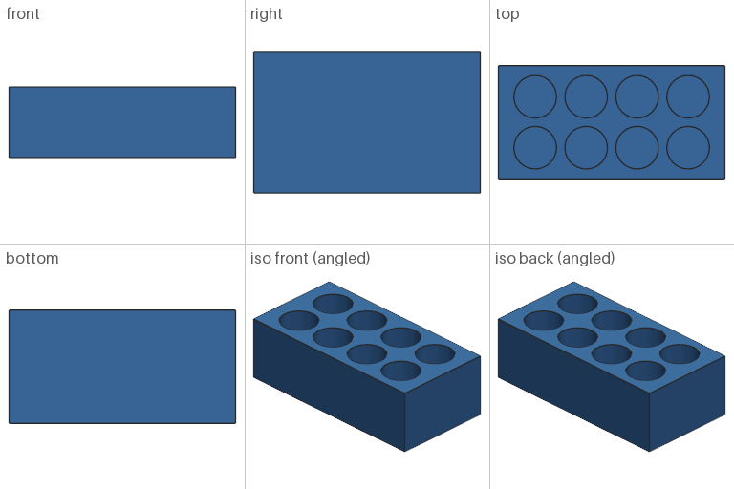
HOW WE MEASURED IT
78
7 + 1
requests: 48 mechanical
+ 30 organic
builder models
+ Thingiverse
2,118
96%
runs (3 per case
and setup)
judge accuracy on
146 hand-graded parts
Right size: measured. Right shape: visual LLM judge.
What the judge sees: six views of the finished part
Notes:
The benchmark has 48 mechanical parts, each with a hand-written reference solution and expected size, and 30 organic objects. Seven builder models plus Thingiverse, three runs each: 2,118 runs in one pre-planned round. Right size is measured directly. Right shape needs a visual judge: we render six views, like this, and a multimodal model scores them. I picked the judge out of four by grading 146 parts by hand, blind; Sonnet agreed best, at 96 percent.

Slide 6
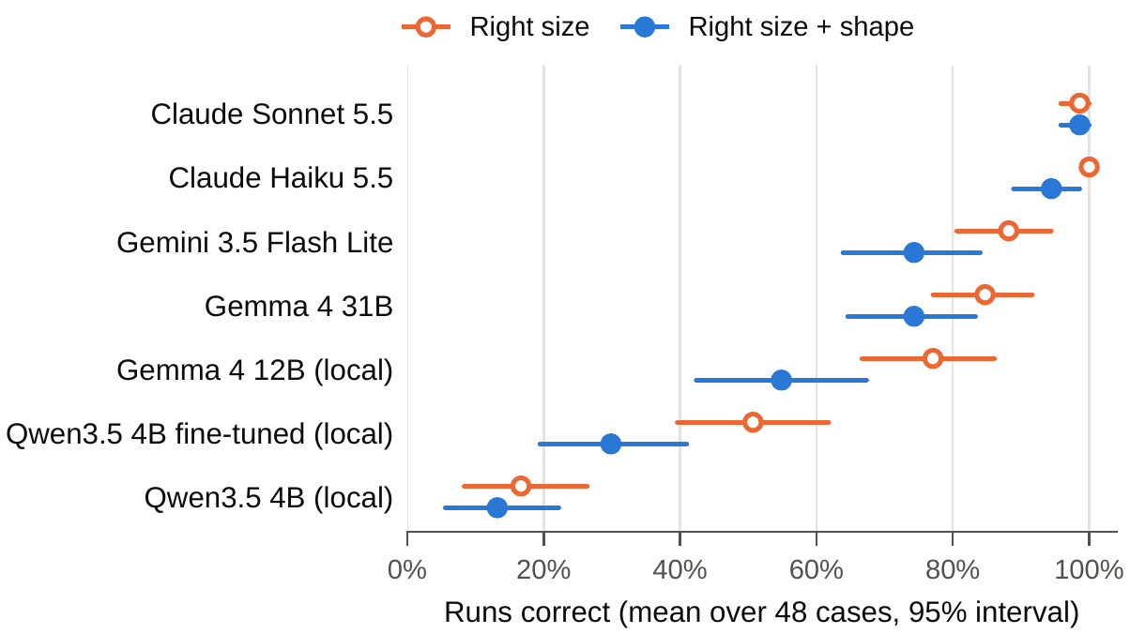
THE MODEL MATTERS MOST
99%
Claude Sonnet 5.5: right size + shape
+19 pts
Gemma 4 31B vs 12B (same family):
the local gap is mostly size
Orange vs blue gap: right size, wrong shape. Only the judge catches it.
Notes:
First, the model. Claude Sonnet builds the right part 99 percent of the time, Haiku 94. Gemini Flash Lite and Gemma 4 31B are at 74, our local default Gemma 4 12B at 55, and the small Qwen 4B at 13 before fine-tuning. Is the local gap about running locally or about size? Gemma 31B and 12B are the same family: the 31B is 19 points better, so it's mostly size.

Slide 7
DO RETRIEVED EXAMPLES HELP?
Builder | RAG | No RAG | Diff. | 1st try
Claude Sonnet 5.5 | 99% | 98% | +1 | 97 / 96
Claude Haiku 5.5 | 94% | 95% | −1 | 97 / 90
Gemini 3.5 Flash Lite | 74% | 74% | +1 | 67 / 55
Qwen 4B fine-tuned | 30% | 18% | +12 * | 28 / 10
Qwen 4B base | 13% | 10% | +3 | 10 / 8
74% = 74%
Gemini Flash Lite with and without examples
55% → 67%
its first-try rate: examples help it get
there sooner, repair closes the gap
The fine-tuned Qwen saw 3 examples in every training prompt: its +12 is RAG and training format together.
Right size + shape on the 48 main cases, with 3 retrieved examples or none.
1st try: correct on the first attempt, RAG / none. * p = 0.04; the rest is noise.
Notes:
Retrieved examples, the RAG part. For the API models they make no measurable difference to the end result: Gemini Flash Lite builds the right part 74 percent of the time with or without them, and the Claude models are within a point. They only change how fast: Gemini's first-try rate goes from 55 to 67 percent, and without examples the repair loop makes up the gap. The one clear gain is the fine-tuned Qwen, plus 12 points. But that model only ever saw prompts with three examples during training, so taking them away also takes away the format it learned. That measures training format as much as retrieval.

Slide 8
FINE-TUNING A SMALL LOCAL MODEL
1,052
verified teacher builds
(QLoRA, 4-bit, on one RTX 3080)
85K → 25K
tokens per correct part
Organic: valid mesh 3% → 36%, but right shape only 1%. It learned code that runs, not the shape.
Notes:
Can fine-tuning close the gap for a small local model? We trained Qwen 3.5 4B with QLoRA on 1,052 teacher conversations from Sonnet and Gemini Flash Lite, kept only when the part passed the checks, repairs included. Right size triples, from 17 to 51 percent, right shape more than doubles, and it needs a third of the tokens per correct part. But it is still 25 points below the 12B model. On organic shapes it learned to write SDF code that runs, but not to sculpt the object.

Slide 9
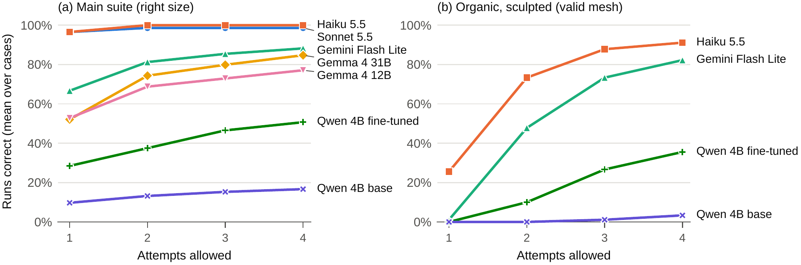
THE REPAIR LOOP
67% → 88%
Gemini Flash Lite
52% → 85%
Gemma 4 31B
1% → 82%
Gemini, sculpting
Notes:
Execution feedback. This shows how many runs are correct if we stop after one, two, three or four attempts. Strong models are right first time, so there's little to fix. Mid-strength models gain the most: Gemini Flash Lite goes from 67 to 88 percent, Gemma 31B from 52 to 85. On the right, sculpting organic shapes: Gemini's first attempt gives a valid mesh only 1 percent of the time, after four attempts 82: sculpting only works because of the loop.

Slide 10
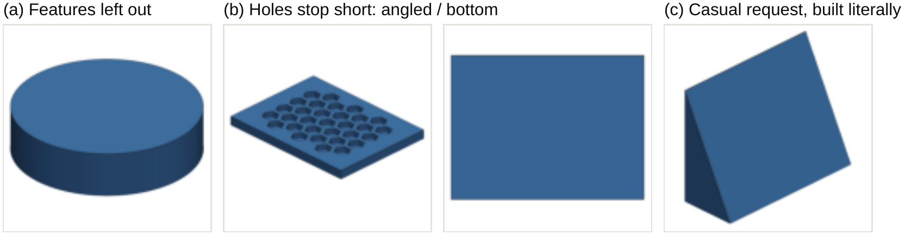
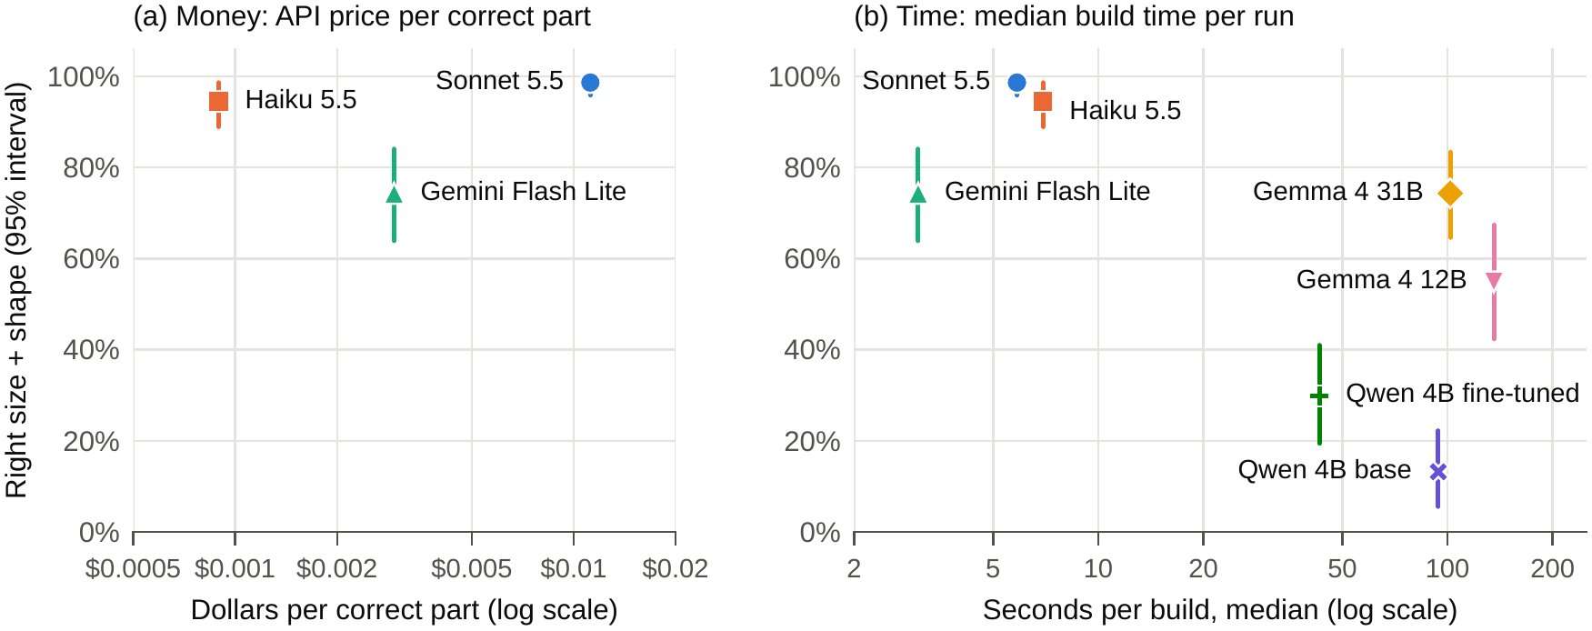
FAILURES AND COST
Right size, wrong shape: a feature left out, holes that stop short, a loose request built literally
$0.0009
per correct part, Haiku
(Sonnet $0.011, Gemini FL $0.0029)
136 s
median build, Gemma 4 12B locally
(Gemini FL 3 s, Sonnet 6 s)
Notes:
What goes wrong? The commonest failure is the right size but the wrong shape, so only the judge catches it: a feature left out, holes that stop short, a loose request built too literally. Cost: Haiku is cheapest per correct part at under a tenth of a cent, Sonnet about a cent; Gemma 4 12B runs locally but takes a median 136 seconds per build. The whole round cost about $8.58 at Anthropic and $2.15 at Google.

Slide 11
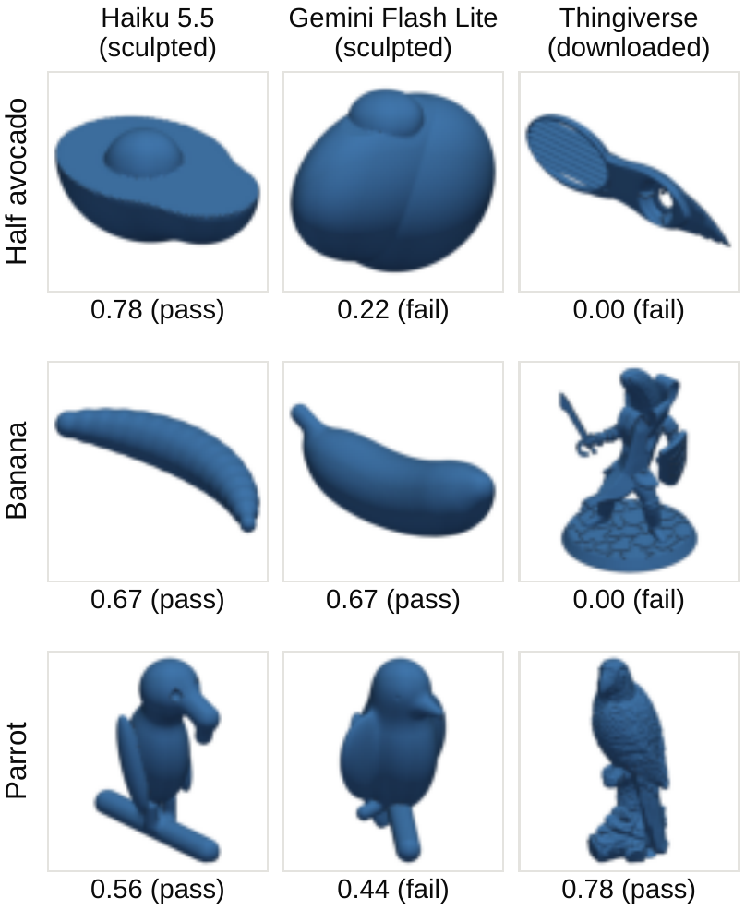
SCULPT OR DOWNLOAD?
Right shape on 30 organic objects:
Haiku, sculpted: 82%
Gemini, sculpted: 52%
Thingiverse download: 37%
Downloads match the name, not always the object
Notes:
For organic shapes that code can't easily build, is it better to sculpt with code or download a model? Sculpting with a strong model wins: Haiku gets the shape right 82 percent of the time, Gemini 52, and the first matching Thingiverse download 37. The downloads fail in a funny way: the name matches but the object doesn't. The half avocado is an avocado peeler and the banana is a banana-headed knight. Sometimes a download wins, like this 3D-scanned parrot.

Slide 12
TAKEAWAYS
1
Weights matter most
Next
Model size or fine-tuning moves right size + shape by 17–24 points
2
Feedback lifts mid-strength models
• Harder benchmark (Sonnet is at 99%)
• Evaluate the intake gate and the full app
• Judge inside the build loop: repair wrong shapes
• Edit a built part instead of rebuilding
+21 to +33 points from repair; sculpting depends on it
3
Examples help only format-dependent models
Fine-tuned 4B +12 pts; API models no change
4
Sculpting beats downloading
Haiku 82% vs Thingiverse 37% on organic shapes
Notes:
To sum up. Weights matter most: model size and fine-tuning move results by 17 to 24 points. Execution feedback helps mid-strength models most and is what makes sculpting possible. Retrieved examples only help models that depend on the format. And for organic objects, sculpting with a strong model beats downloading. Next steps: a harder benchmark, since Sonnet is at the ceiling, evaluating the intake gate, and running the judge inside the loop so a wrong shape can be repaired like a wrong size.

Slide 13
QUESTIONS & DEMO
Notes:
Switch to the app for the live demo.

