Slide 1
SALES ENGINEER TRACK · CARD D
Memoria
A voice-first sales engineer that interviews the rep, researches the deal,
builds a verified campaign, and remembers every account.
Any company · any product · github.ibm.com/hazem-awadalla/memoria
Notes:
Memoria is the sales engineer track build. One line: it interviews the rep by voice, does the research, builds the campaign, checks every claim, and gets sharper on each account because it remembers.

Slide 2
THE PROBLEM
Final-pitch prep is scattered, and AI tools forget
Context lives in the rep's head
Generic AI invents specifics
Every session starts from zero
Stack, stakeholders, objections and competitive moves sit in call notes and memory, not in one place.
Plausible statistics, customer names and benchmarks with no source. One wrong number costs the deal's credibility.
The objection raised on Tuesday's call is gone by Thursday's prep. The pitch order never adapts.
Card D test question, asked every session: “Tomorrow’s call is the final pitch. What’s our strategy?”
Notes:
Three pains. Prep lives in heads and call notes. Generic AI writes plausible copy with invented numbers. And every chat starts from zero, so the new objection from last call never makes it into the plan.

Slide 3
WHAT MEMORIA DOES
Interview, research, personas, campaign, verify, remember
01
02
03
04
05
06
Interview
Research
Personas
Campaign
Verify
Remember
Voice discovery,
MEDDPICC slots,
one question per turn
Uploaded docs and
web research become
a numbered evidence ledger
Buying committee,
every statement evidenced
or labelled a hypothesis
Positioning, objection
matrix, battle card,
pitch order, outreach
Every claim checked
against the ledger;
one revision, then human review
Per-tenant memory store;
objections superseded,
never deleted
Assets out: slide decks (.pptx), documents and whitepapers (.docx + .pdf), blogs (.md + .html), email sequences (.eml).
Every fact carries an evidence marker; missing proof becomes a visible placeholder, never an invention.
Notes:
Walk the pipeline left to right. The interview is the only part the rep has to sit through; everything after runs in the background while the screen shows each stage.

Slide 4
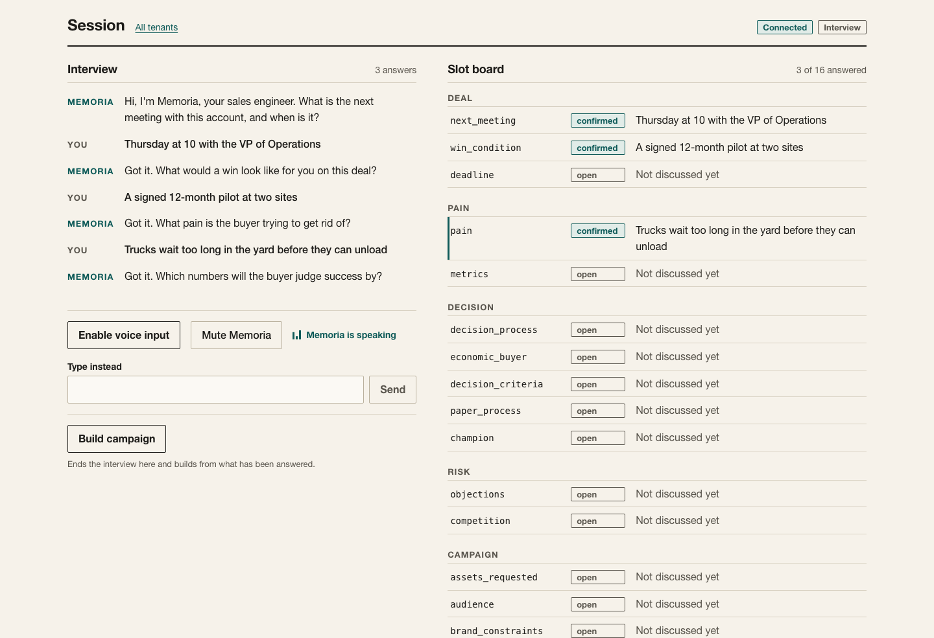
LIVE DEMO · THE INTERVIEW
Memoria interviews the rep by voice
Whisper on WebGPU
Speech-to-text in the browser. Audio stays on the device.
Kokoro voice
Text-to-speech in a Podman container, streamed per sentence. 0.54 s for a first sentence.
One question per turn
Priority order: meeting, pain, metrics, decision, buyer, objections, competition.
Notes:
Speech-to-text is Whisper running on WebGPU inside the browser, so audio never leaves the laptop. Memoria's voice is Kokoro, served from a Podman container, streamed sentence by sentence. Typing works too. Every answer lands in the slot board on the right with the rep's exact words as evidence.

Slide 5
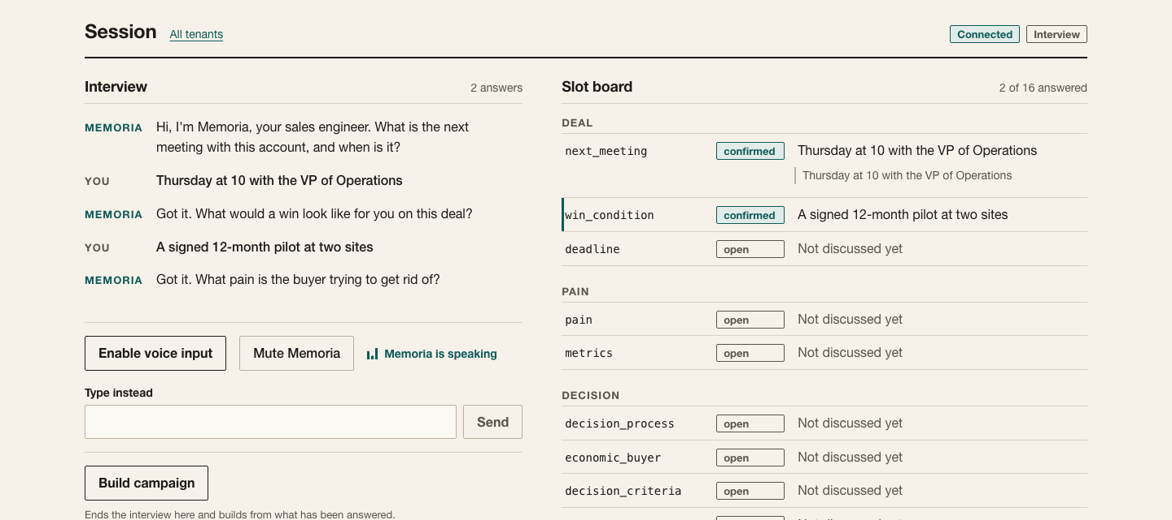
LIVE DEMO · DISCOVERY
Every answer becomes evidence on the slot board
Notes:
Sixteen slots, grouped Deal, Pain, Decision, Risk, Campaign. Status is confirmed, unsure, open or conflict. Conflict fires when the rep contradicts memory, and Memoria asks which is current instead of guessing.

Slide 6
ARCHITECTURE
Three zones: browser, Podman, Anthropic
BROWSER
PODMAN
ANTHROPIC
Next.js UI
web · Next.js :3000
Messages API · claude-sonnet-5-5
Whisper on WebGPU
api · FastAPI :8000
web_search / web_fetch
Audio playback queue
tts · Kokoro :8880
Managed Agents + memory stores
Two lanes: the interview is interactive and streamed; the campaign build runs in the background.
The model writes structured JSON; FastAPI renders the files deterministically, so every claim is checked before rendering.
Notes:
Three zones. Browser: Next.js plus Whisper on WebGPU. Podman: the web, api and tts containers. Anthropic: Claude Sonnet 5.5 on the Messages API for the chain, with structured outputs and caching, web search for research, and Managed Agents with one memory store per tenant for long-term memory.

Slide 7
TRUST
Evidence or nothing
E# ledger
[PLACEHOLDER: ...]
Every fact: one-sentence claim, verbatim quote, source, date. IDs assigned by code, not trusted from the model.
Where proof is missing, the asset says so visibly. No invented statistics, customers, quotes or benchmarks.
Verifier gate
One revision, then a human
Each claim is supported, unsupported, contradicted or opinion. Pass only if every claim holds.
Needs revision triggers one reviser pass. A second failure ships with a needs-human-review verdict.
Notes:
This is the part that makes it safe to send. Retrieval and research produce a numbered ledger, E1, E2 and so on, with a verbatim quote, source and date. The code assigns the IDs, not the model. Every asset must cite them. A strict verifier checks each claim; unsupported claims get one revision, then the asset ships flagged for human review.

Slide 8
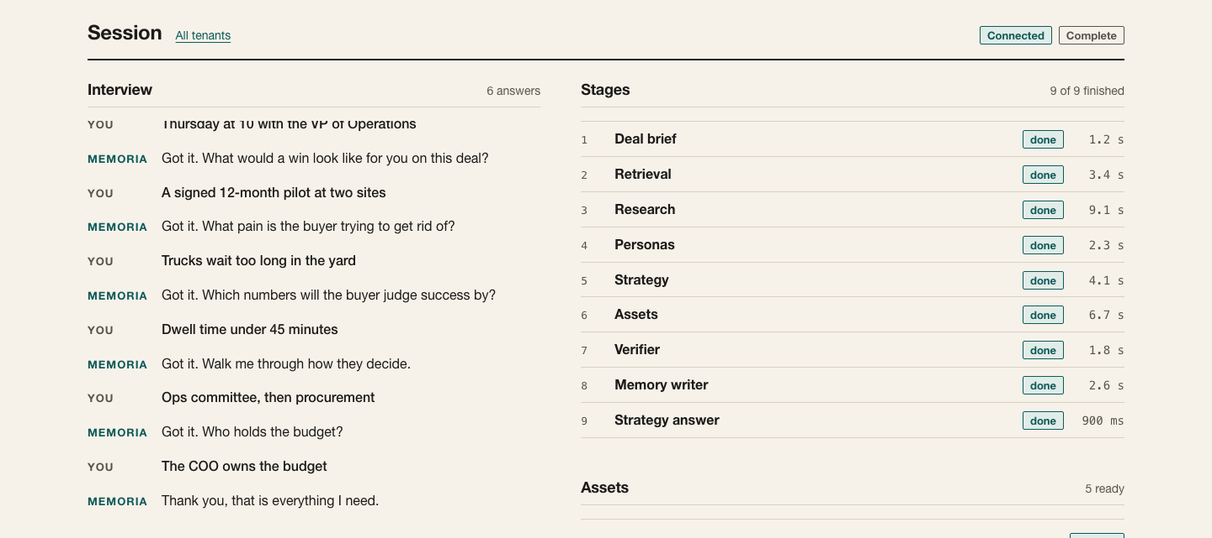
LIVE DEMO · THE CAMPAIGN
Nine stages, five verified assets, ready to download
Notes:
Stage timeline on the right with durations. Each asset shows its verdict, how many placeholders the rep still needs to fill, and download links for every format.

Slide 9
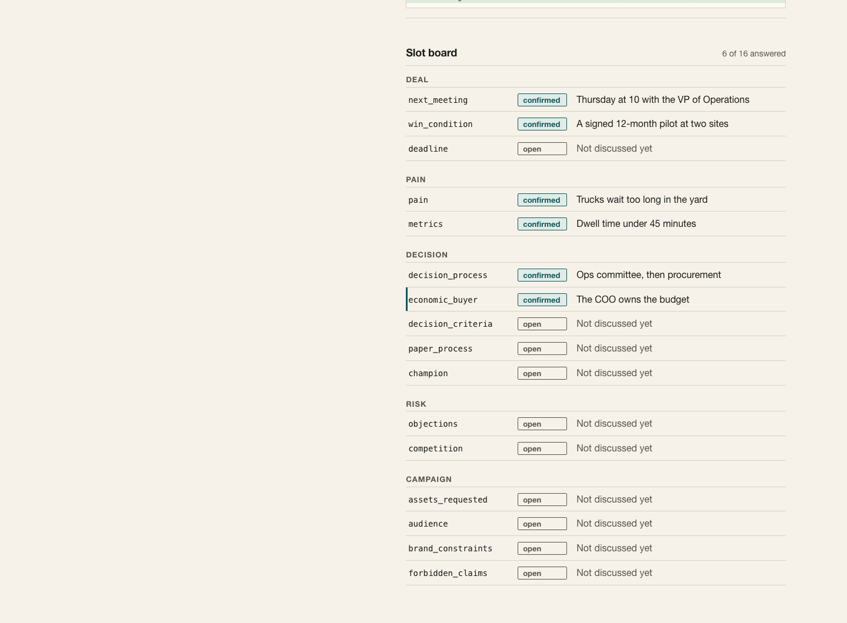
MEMORY · CARD D
Session two is sharper because Memoria remembers
Round 1
Customer stack, earlier objections, current pitch deck.
Round 2
New objection from the latest call, plus a competitive update.
Session 2 answer
Opens “Since our last session: ...”, answers the new objection, reorders the pitch.
One store per tenant
Isolation is tested: a canary planted in one tenant must never appear in another’s output.
Notes:
Round one: stack overview, earlier objections, the pitch deck. Round two: a new objection from the latest call and a competitive update from product management. Same question both times. In session two the answer leads with what changed and the pitch order moves. The memory diff shows exactly what Memoria chose to remember.

Slide 10
ENGINEERING
Built test-first, measured before tuned
505
120
23
3
backend tests passing
web unit tests
Playwright end-to-end tests
fictional tenants, one holdout
Eval: a simulated rep plays a hidden fact sheet in speech-to-text style; deterministic checks for slot recall, the new objection,
the competitive update, pitch-order change, superseded objections and tenant isolation; one-criterion LLM judges for the rest.
Fake mode swaps every external service for deterministic fakes, so the full stack runs in CI with no API calls.
Notes:
Built by seven parallel tracks, each test-driven, then integrated. Numbers are from the final run. The eval follows the design constitution: multiple trials, rate plus pass@k and pass^k, a holdout tenant we never tune on.

Slide 11
STATUS
What is proven, and what is next
PROVEN TODAY
NEXT
Live interview on Claude Sonnet 5.5 through the real UI
Kokoro voice in Podman, through the API
Full pipeline end to end in fake mode, UI and CLI
All five asset types rendered and downloadable
Session-two answer leads with what changed (fake mode)
Baseline eval in live mode: 5 trials per task, holdout tenant
Session two on live Managed Agents memory
Whisper on WebGPU on presenter hardware
Full podman compose stack in one command
Rendered-asset visual review; footnotes in .docx
Notes:
Be straight with the room. Everything on the left was run today. The right column is what we have not yet measured, and the eval harness exists to measure it.

