Slide 1
ADSI Inverter Dashboard
Application Overview v2.4.8
Prepared by Engr. Clariden D. Montano, REE

Slide 2
Project Overview
The ADSI Inverter Dashboard is a SCADA-based monitoring and control platform. It consolidates live telemetry, analytics, ML-driven forecasting, and remote operations into one desktop interface.
Main Highlights:
Real-time inverter and node-level telemetry with supervised control
ML-trained day-ahead forecasting with cap-aware data reconstruction
Solcast integration via free Toolkit - no paid API subscription required
Dynamic per-inverter availability (first non-zero PAC to last zero PAC)
Plant Output Auto Capping for automated generation curtailment
Gateway/Remote architecture with secure replication and standby DB
Cloud backup and restore via OneDrive or Google Drive
Operator messaging, alarm episode tracking, and structured data exports

Slide 3
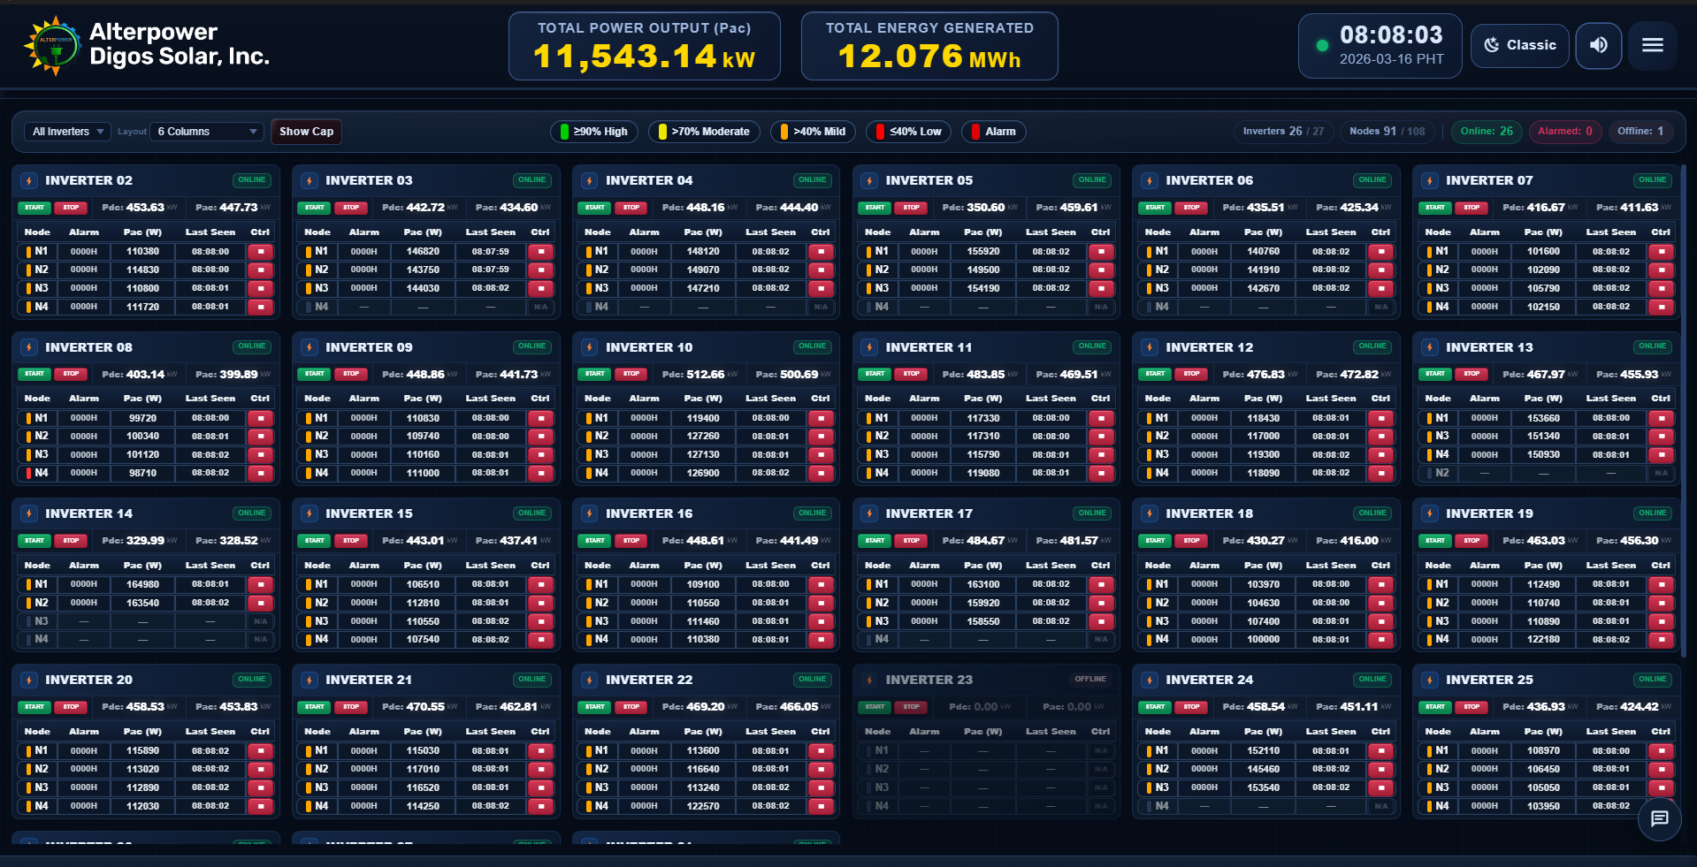
Main Dashboard
Central view of real-time plant output, daily generation (TODAY MWh), fleet status chips, PAC output band indicators, and fast inverter start/stop control.

Slide 4
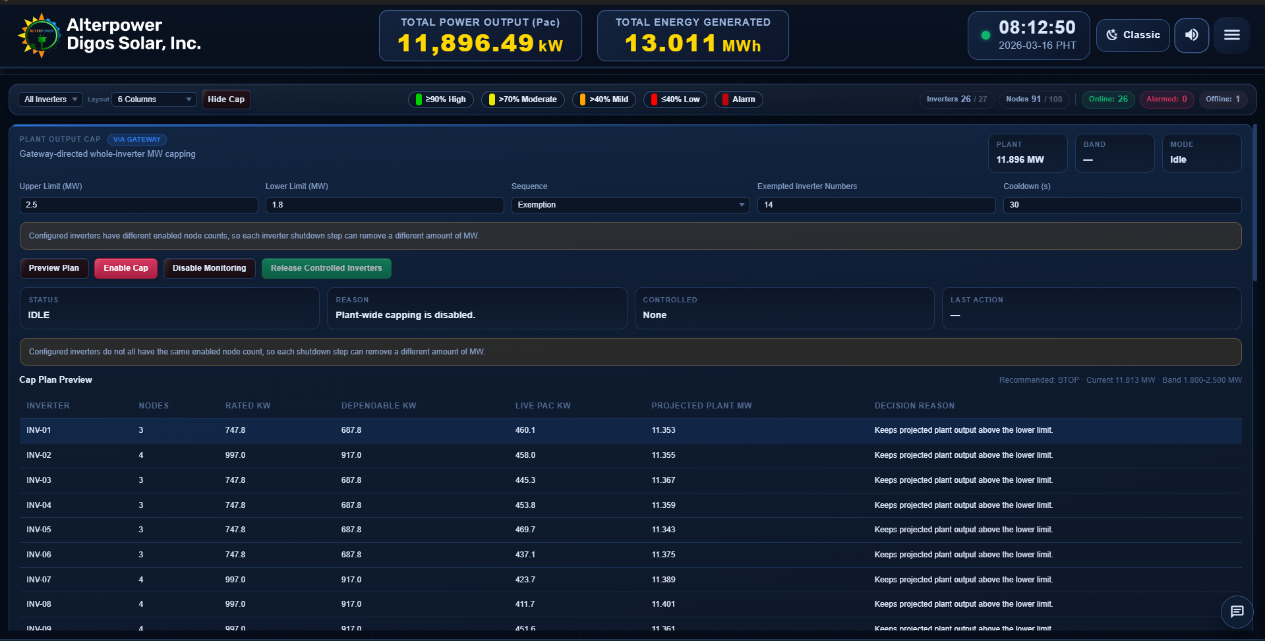
Plant Output Auto Capping
Automatically regulates total plant output within a defined MW band by sequentially stopping and starting whole inverters. Operators set upper and lower limits, exempt specific units, and preview the control plan before activation. Cap-dispatched actions are scope-tagged in the audit log so the ML forecast engine can reconstruct training data accurately.

Slide 5
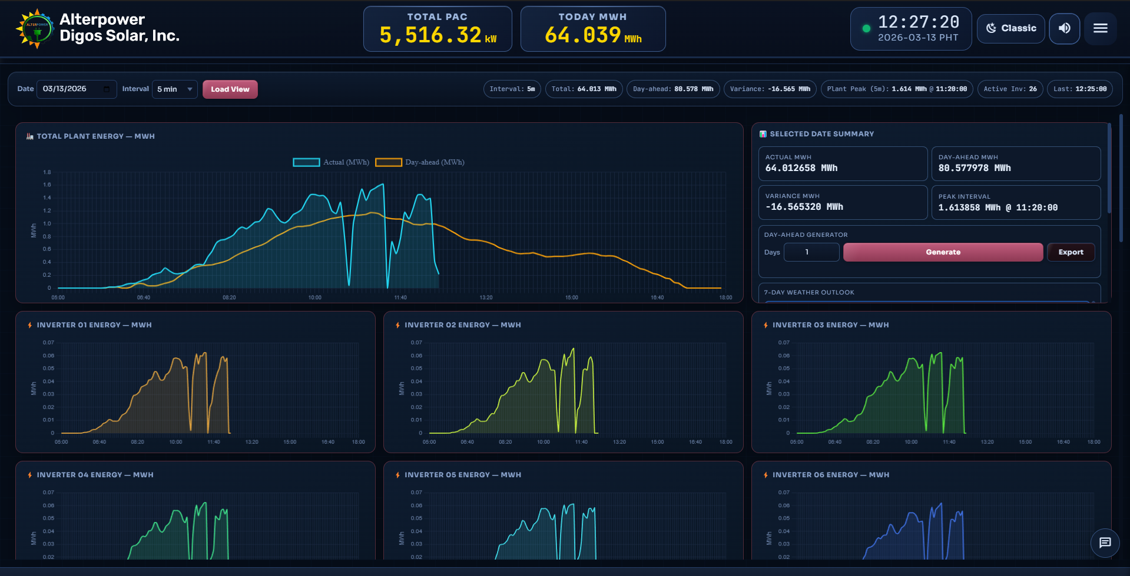
Analytics Dashboard
Interval energy charts with day-ahead forecast overlay, actual vs forecast variance, peak interval tracking, selected date summary metrics, and integrated 7-day weather outlook.

Slide 6
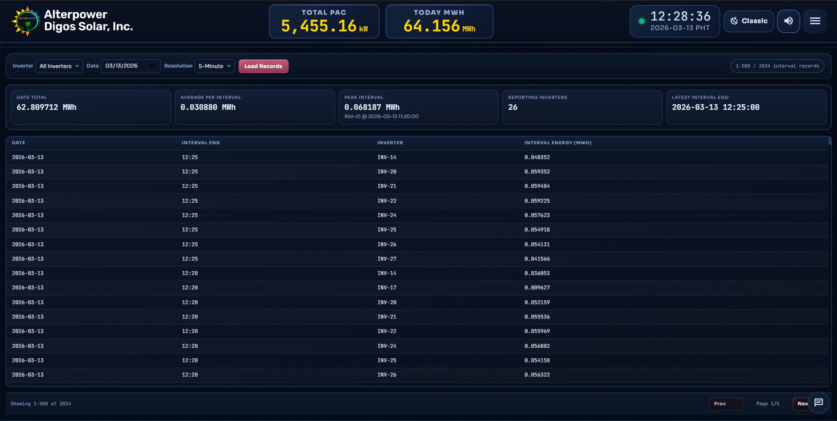
Energy Generation Tracker
Server-computed current-day energy derived from PAC-based 5-minute intervals. Per-inverter KPI tiles with daily energy totals and single-date energy summary export.

Slide 7
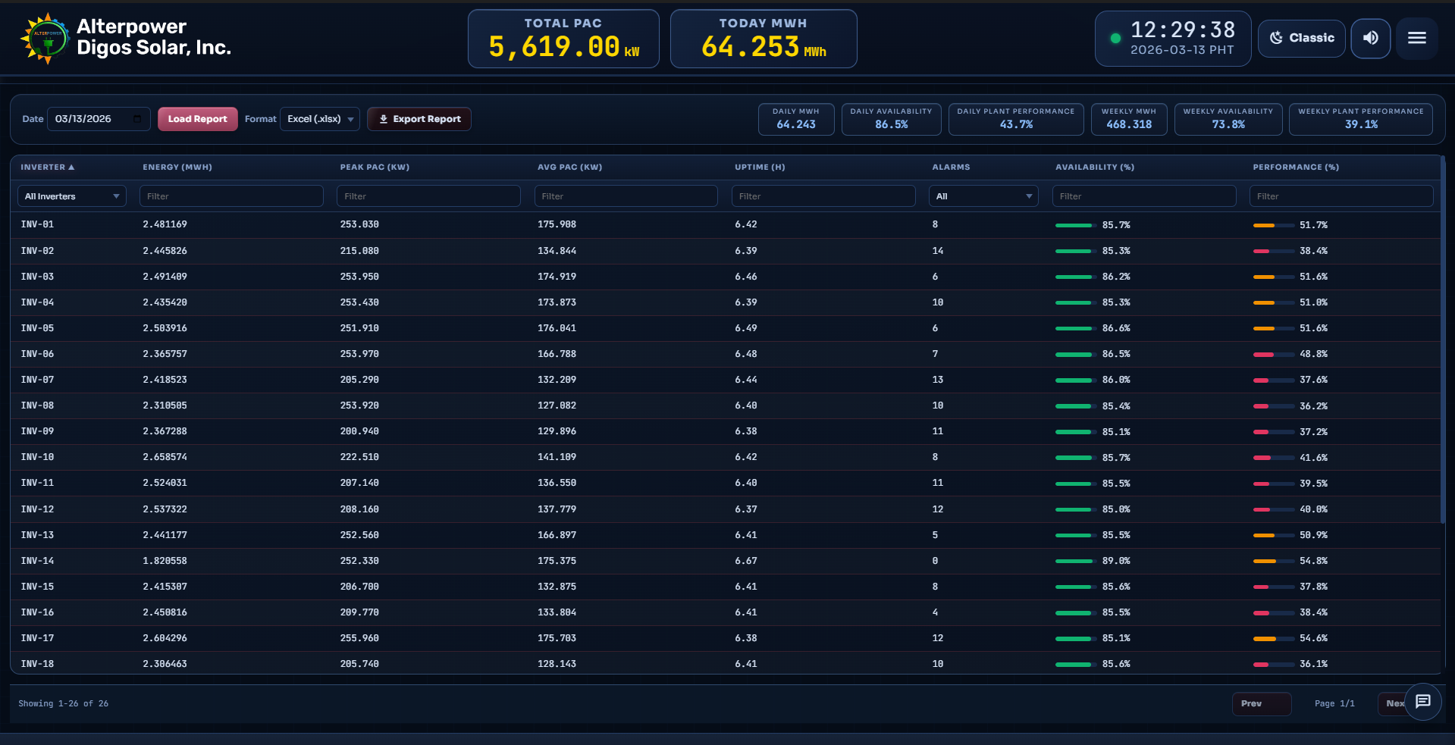
Daily Performance Report
Per-inverter daily report with energy (MWh), peak/avg PAC, uptime, alarm count, dynamic availability (calculated from each inverter actual production window, not a fixed solar window), and performance ratio. Plant availability averages across all configured inverters including inactive ones.

Slide 8
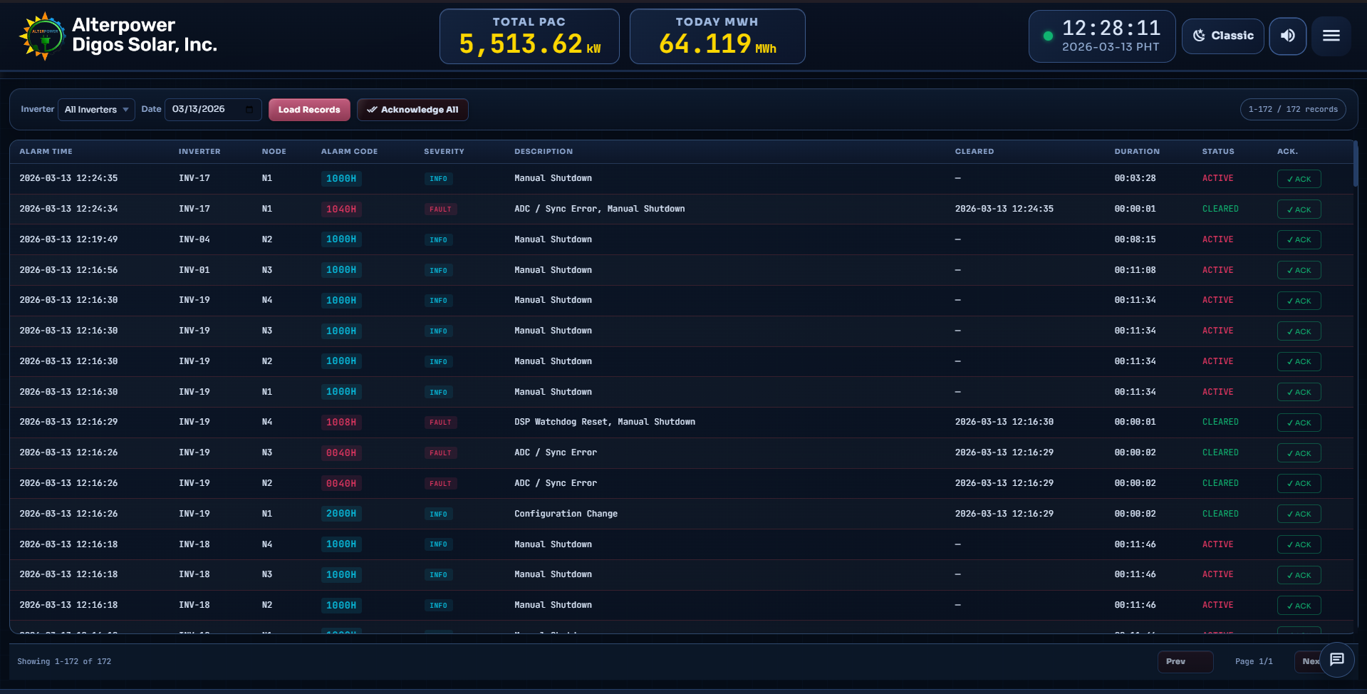
Alarms and Alerts
Episode-based alarm tracking with severity, duration, and acknowledgement state. Alarm sound triggers only for sustained unacknowledged episodes exceeding 5 seconds. Same-node alarm value changes within an active episode do not retrigger sound.

Slide 9
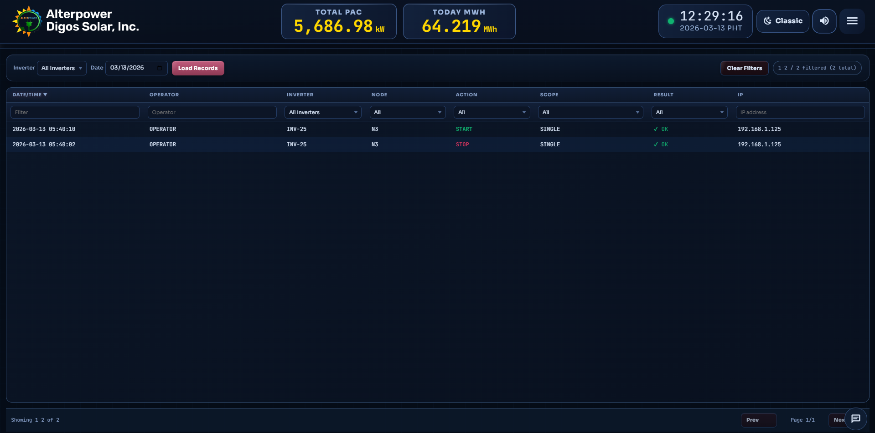
Operations History
Full traceability of all inverter start/stop commands with operator identity, timestamps, and scope tagging. Plant-cap dispatch actions carry scope plant-cap so the forecast training engine can distinguish automated curtailment from manual stops.

Slide 10
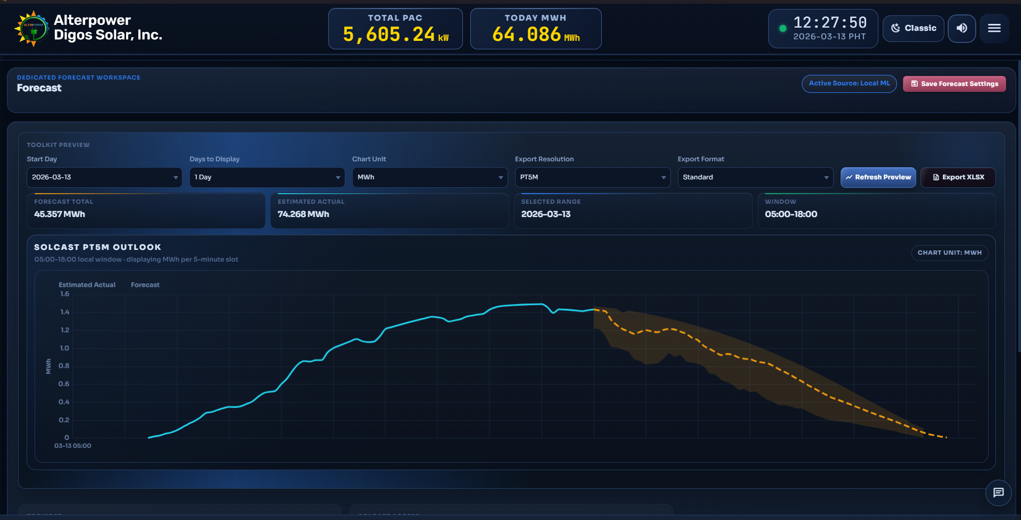
DAY-AHEAD FORECASTING AND SOLCAST

Slide 11
DAY-AHEAD FORECASTING AND SOLCAST
ML-trained day-ahead forecasting with cap-aware data reconstruction, intraday adjustment, and error memory correction.
Solcast Integration - No Paid Subscription Required: The dashboard uses the free Solcast Toolkit embedded chart for solar forecast visualization. The Toolkit URL is constructed server-side from just three operator inputs: Plant Resource ID, Forecast Days (1-7), and Resolution (PT5M to PT60M).
No Solcast API key or paid subscription is needed. The Toolkit is a publicly available visualization tool provided by Solcast at no cost. This eliminates recurring subscription fees while still providing professional-grade solar irradiance forecast data for day-ahead scheduling and intra-day updates.

Slide 12
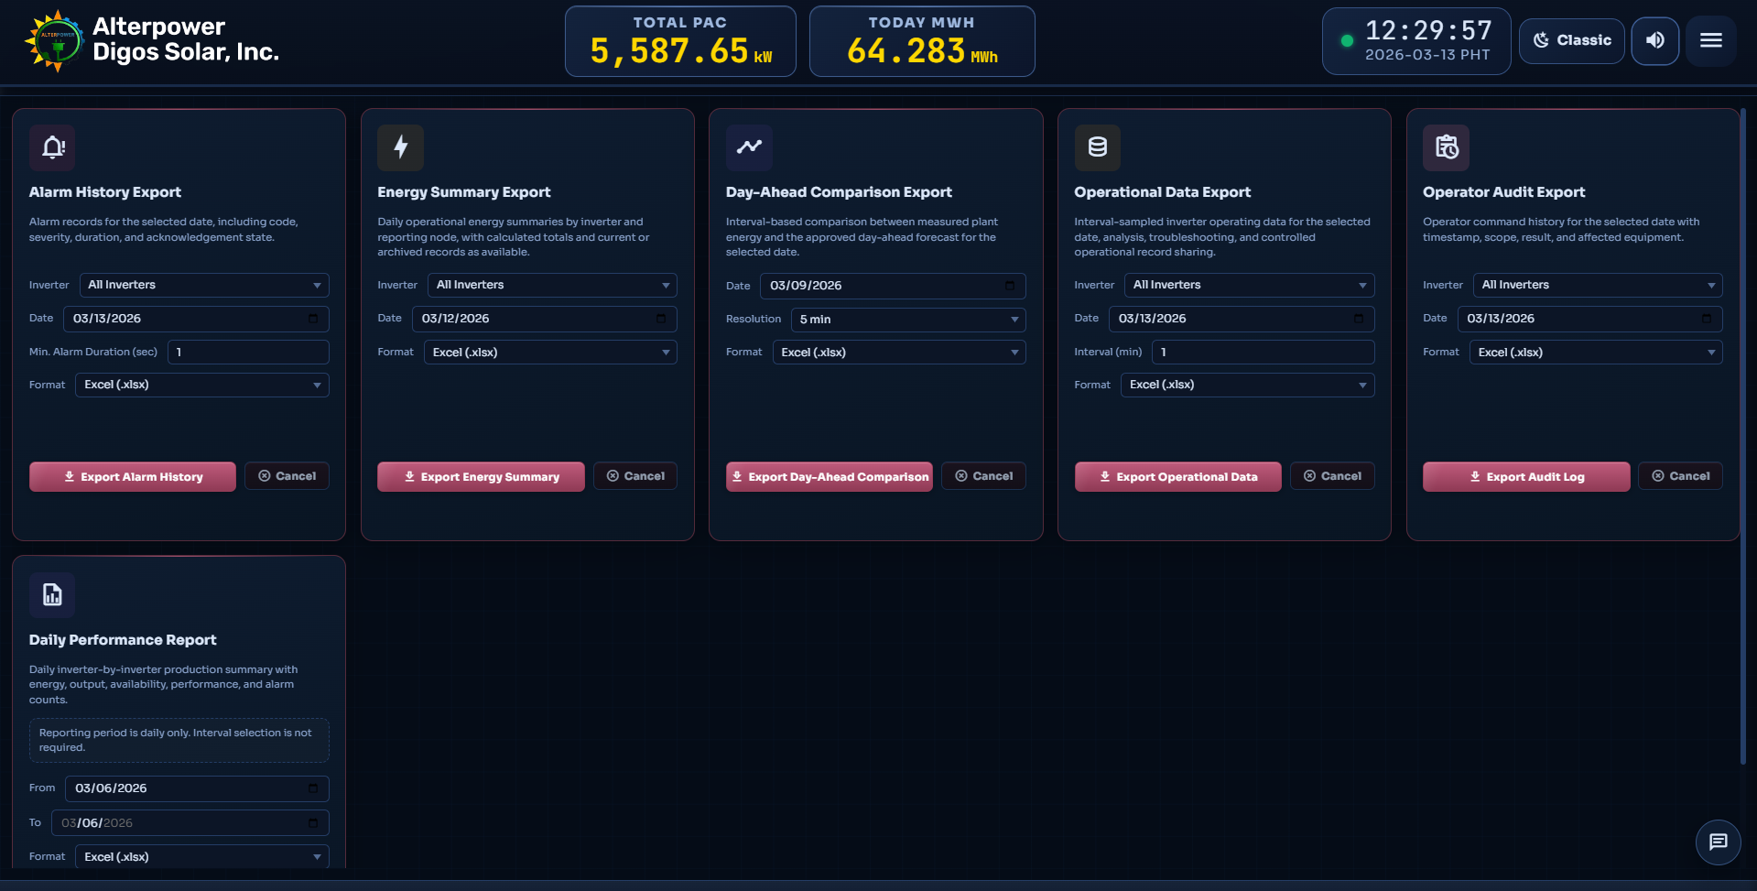
Data Export
Structured Excel and CSV exports for energy summaries, daily reports, trained day-ahead vs actual, Solcast day-ahead vs actual, and Solcast toolkit data. Configurable export paths with separate forecast subfolder routing by source.

Slide 13
Settings Section
Centralized configuration for plant setup, data retention, polling intervals, plant output cap defaults, Solcast toolkit parameters, gateway/remote connectivity, license management, and auto-updates.
Main Highlights:
Cloud Backup (OneDrive / Google Drive)
Gateway-Remote architecture with WebSocket live bridge
Inverter IP Address and Topology Configuration
Solcast Toolkit Settings (Resource ID, Days, Resolution)
App Updates with auto-download installer

Slide 14
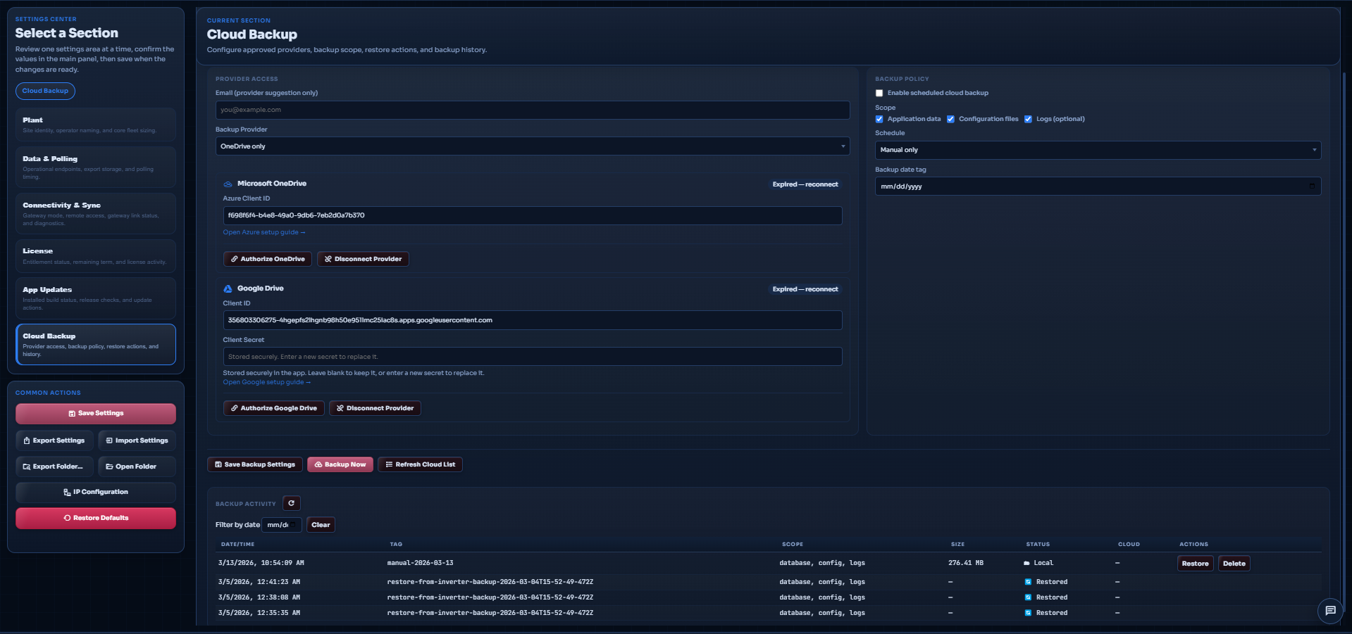
Data Cloud Backup
Scheduled cloud backup to OneDrive or Google Drive with configurable retention. Supports manual backup, restore with settings preservation, and encrypted credential storage.

Slide 15
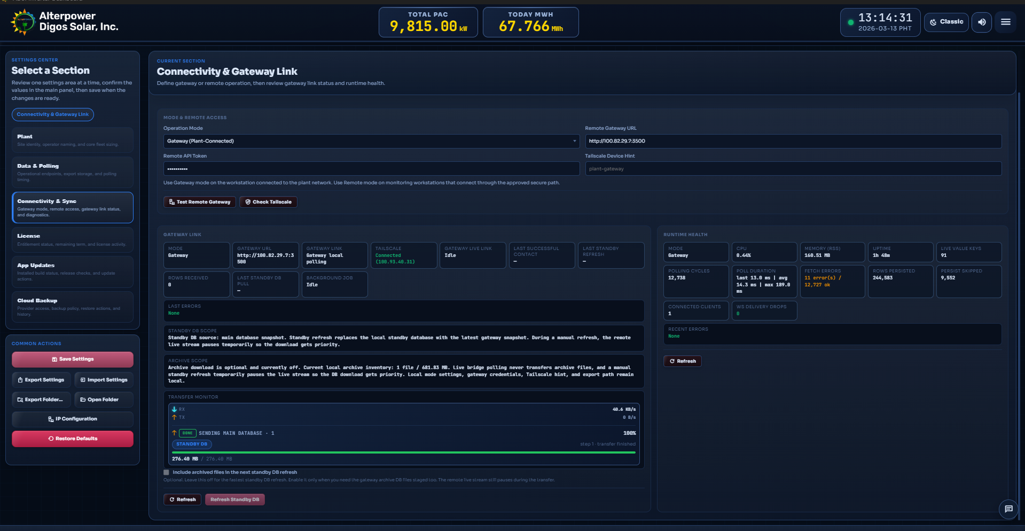
Gateway-Remote Data Synchronization
Gateway-to-remote architecture with incremental cursor-based replication, standby DB refresh (pull), and data push. Remote mode displays live gateway data without local persistence. Operator name is preserved during sync. Manual pull detects local-newer data to prevent accidental overwrites.

Slide 16
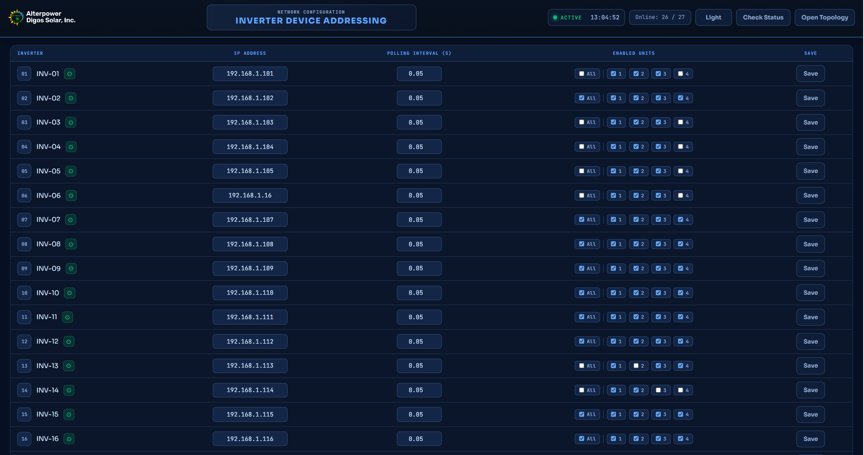
Inverter IP Address Configuration
Configures inverter IP addresses, active node assignments, and polling parameters. Changes apply after confirmation and are protected from accidental remote overwrite during replication.

Slide 17
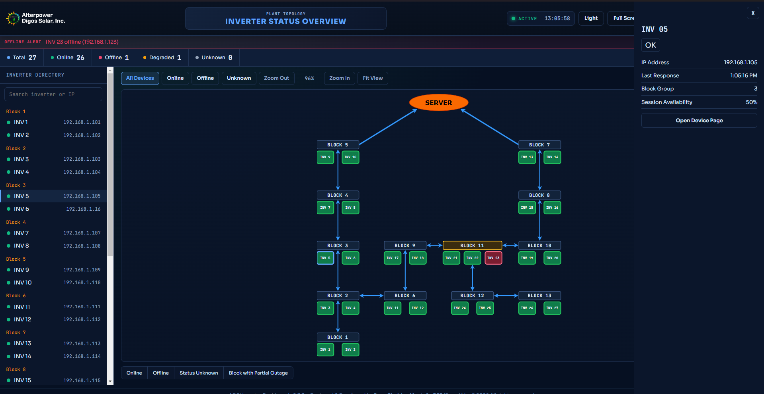
Inverter Network Overview
Visual topology map of inverter connectivity, status, and block structure. Quickly identifies online, offline, and degraded devices across the plant network with time-limited auth gate access.

Slide 18
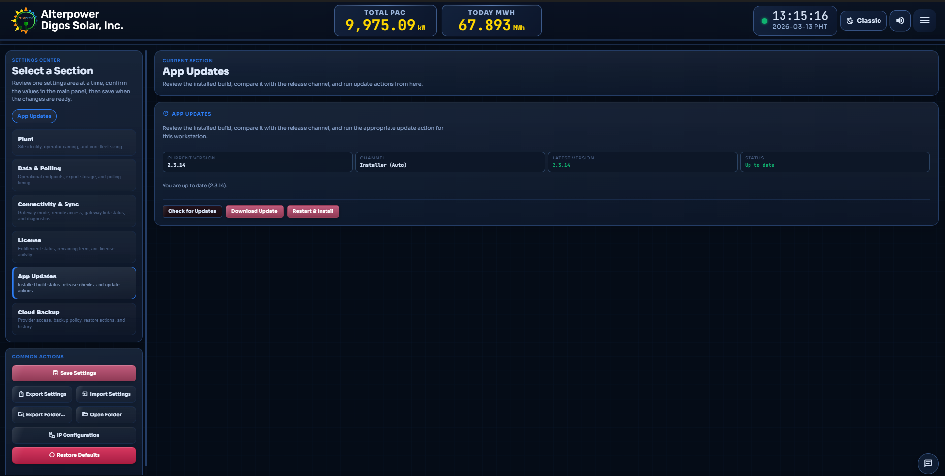
Application Updates and Version Management
Centralized update interface with auto-check, download, and Restart and Install workflow. Uses coordinated shutdown with soft-stop signaling to Python services before installer handoff.

Slide 19
Others
Plant Output Auto Capping – automatically curtails generation during negative market price or grid dispatch orders.
Active Alarm Sound – sustained alarm episodes trigger audible alerts to capture operator attention (5-second threshold).
Built-in ML Forecast Engine – trained day-ahead model with cap-aware reconstruction, intraday adjustment, and error memory.
Solcast Toolkit – free embedded forecast visualization using only a Plant Resource ID. No Solcast API subscription or key required.
Downloadable User Guide – comprehensive in-app HTML guide with PDF download covering all 21 sections.
Operator Messaging – compact gateway-to-remote note channel with read receipts and rate limiting.

