Slide 1

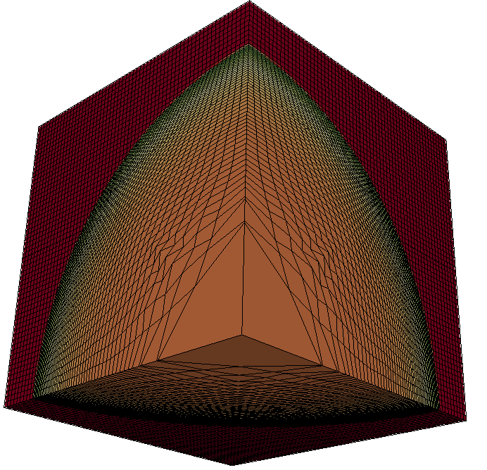
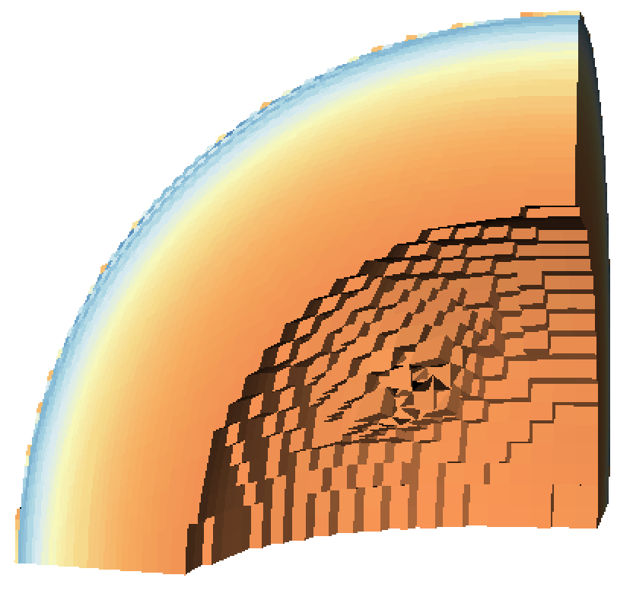

contour
“Pipeline #1”
Simulation
Data
“Pipeline #2”
threshold
clip

