Slide 1
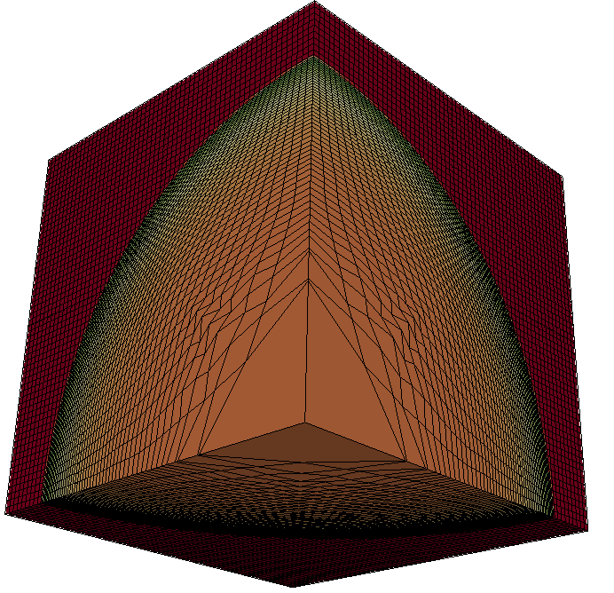
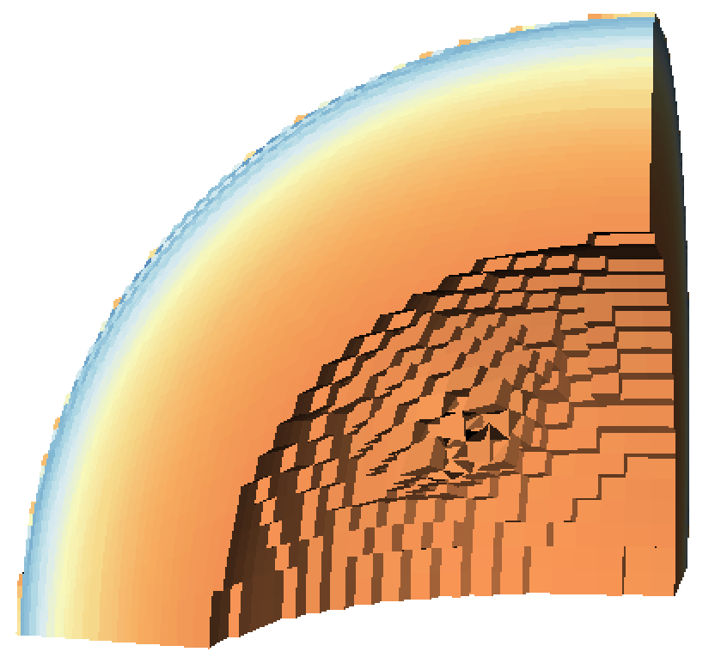

Scene
contour
Pictures
Image
Conduit
Blueprint
Pipeline #1
Extract #1
HDF5
Simulation
Data
Extract #2
ADIOS
threshold
clip
Pipeline #2

