Slide 1

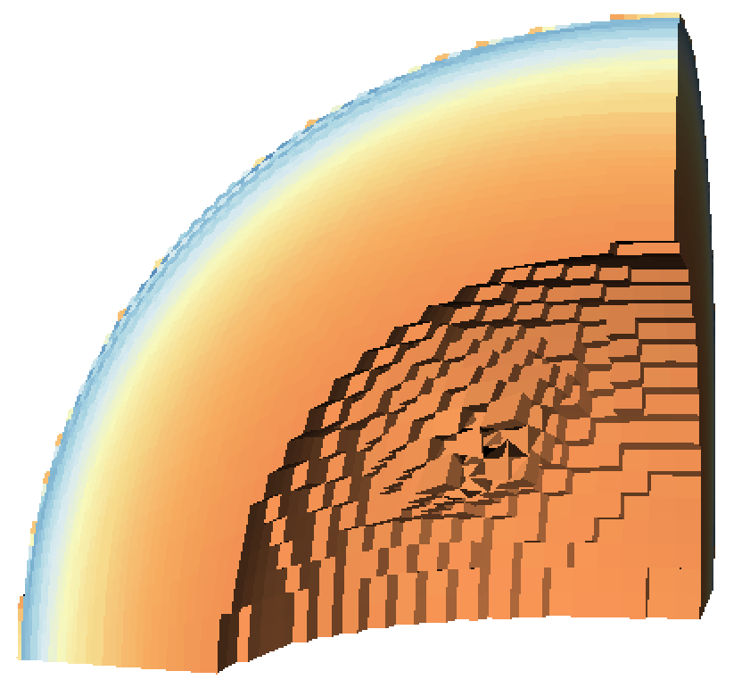

Scene
Pictures
Image
Pipeline
Extract #1
Conduit
Blueprint
HDF5
Simulation
Data
threshold
clip
Extract #2
ADIOS

