Slide 1

Opening a new Restaurant
Mehdi Mashayekhi

Slide 2
To do a great right do a little wrong.”
- William Shakespeare

Slide 3
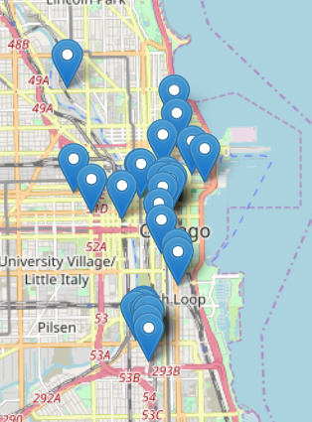
Where should we open a restaurant?

Slide 4
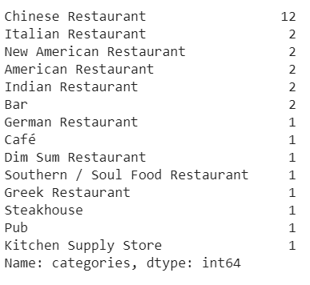
What are the restaurant types in the area?

