Slide 1
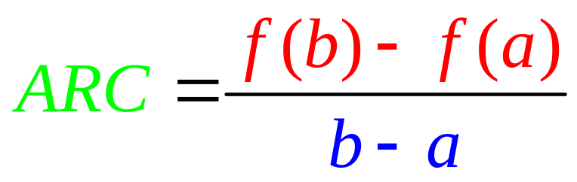
Average rate of change on [a,b]

Slide 2
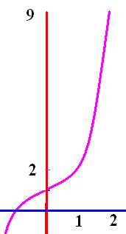
Average rate of change on [a,b]
1. Find the average rate of change of f(x) = x³ + 1 on
A) [1, 2],
B) [-1, 1]

Slide 3
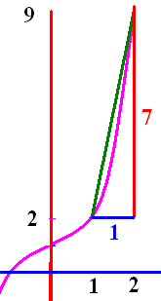
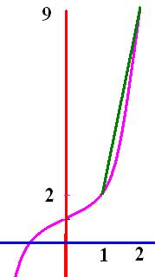
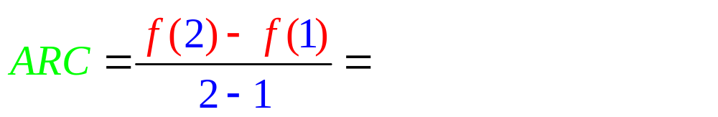

Slide 4
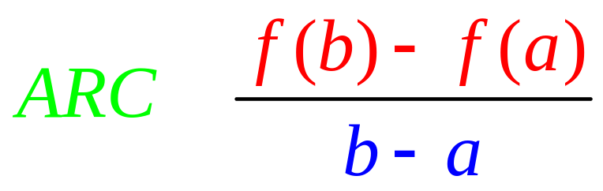
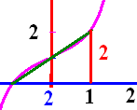
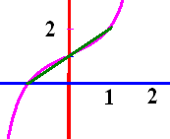
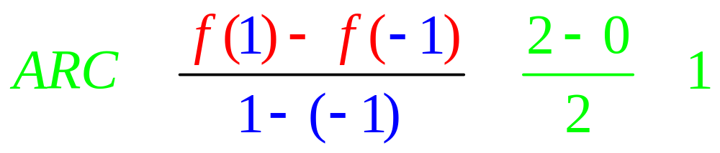
Average rate of change on [a,b]
1. Find the average rate of change of f(x) = x³ + 1 on
B) [-1, 1]

Slide 5
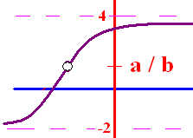
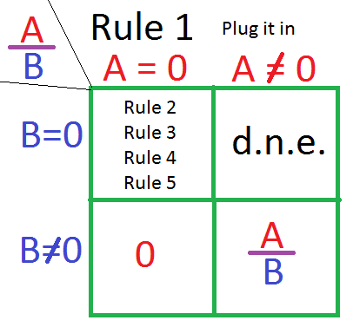
Limit Algebraic Rules
Rule 1 – Plug the x xalue
  into the equation
If you get a/b and
b 0, the answer is a/b
b = 0 and a 0, the answer is d.n.e.
you get 0/0 then go to higher rules

Slide 6
.

Slide 7

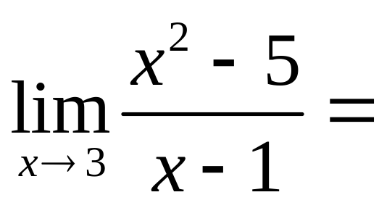
.

Slide 8


.
2.0
0.1

Slide 9
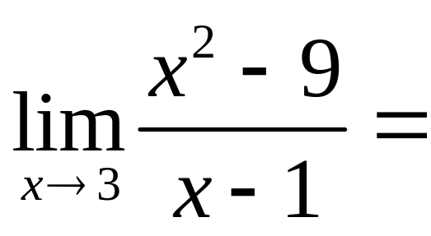
.

Slide 10
.
0.0
0.1

Slide 11
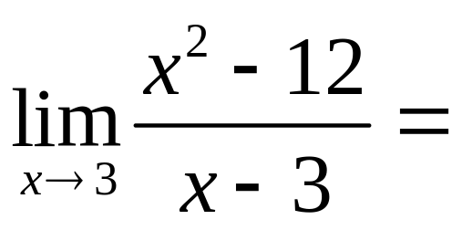
.
-3
0
d.n.e

Slide 12

.
-3
0
d.n.e

Slide 13
Limit Algebraic Rules
Rule 2 – Factor and cancel
  return to Rule 1

Slide 14
Limit Algebraic Rules
Rule 2 – Factor and cancel
  return to Rule 1
Diff of 2 squares (a² - b²) = (a + b)(a – b)

Slide 15
Limit Algebraic Rules
Rule 2 – Factor and cancel
  return to Rule 1
SOAP (a³ + b³) = (a + b)(a² – ab + b²)

Slide 16
Limit Algebraic Rules
Rule 2 – Factor and cancel
  return to Rule 1
a x² + bx + c Find two numbers whose product is ac, but add to b

Slide 17
Limit Algebraic Rules
Rule 2 – Factor and cancel
  return to Rule 1

Slide 18
Limit Algebraic Rules
Rule 2 – Factor and cancel
  return to Rule 1
a x² + bx + c Find two
numbers whose product is ac, but add to b

Slide 19
Limit Algebraic Rules
Rule 2 – Factor and cancel
  return to Rule 1
a x² + bx + c Find two
numbers whose product is ac, but add to b
2 x² + 3x - 9 Find two
numbers whose product is -18, but add to 3

Slide 20
Limit Algebraic Rules
2 x² + 3x - 9 Find two
numbers whose product is
-18, but add to 3
= 2 x² + 6x - 3x - 9
=2x(x + 3) – 3(x + 3)
= (2x – 3)(x + 3)
18 -1
9 -2
6 -3
3 -6
2 -9
1 -18

Slide 21
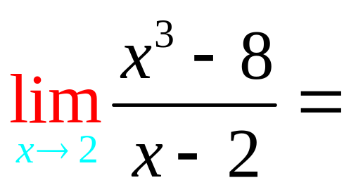
Rule 2 – Factor and cancel
SOAP (a³ + b³) = (a + b)(a² – ab + b²)

Slide 22
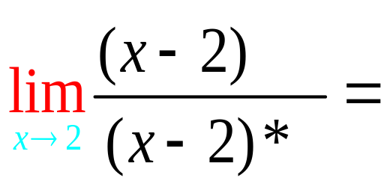
Rule 2 – Factor and cancel
SOAP (a³ + b³) = (a + b)(a² – ab + b²)

Slide 23
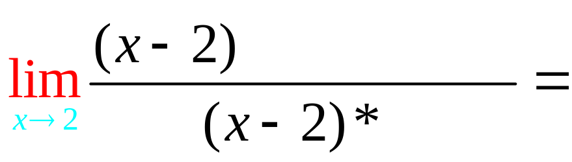
Rule 2 – Factor and cancel
SOAP (a³ + b³) = (a + b)(a² – ab + b²)

Slide 24
Rule 2 – Factor and cancel
SOAP (a³ + b³) = (a + b)(a² – ab + b²)

Slide 25
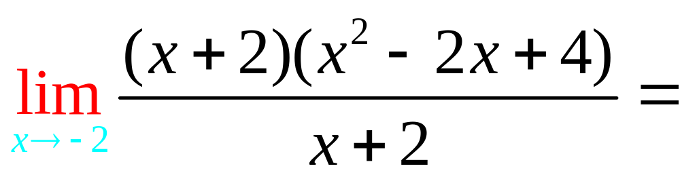
.

Slide 26

.
12.0
0.1

Slide 27
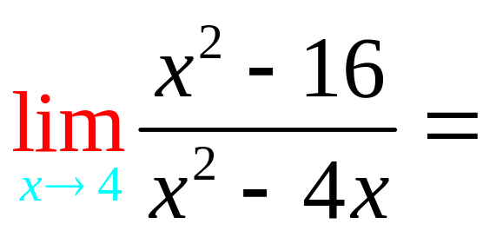
Rule 2 – Factor and cancel
Difference of two squares

Slide 28
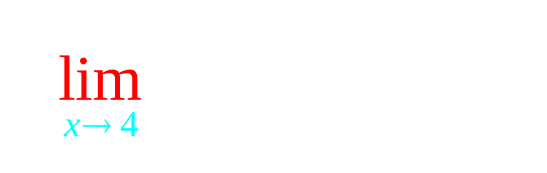
Rule 2 – Factor and cancel
Difference of two squares

Slide 29
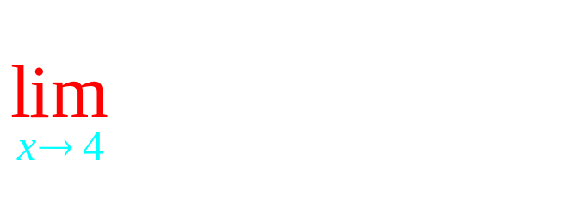

Rule 2 – Factor and cancel
Difference of two squares

Slide 30
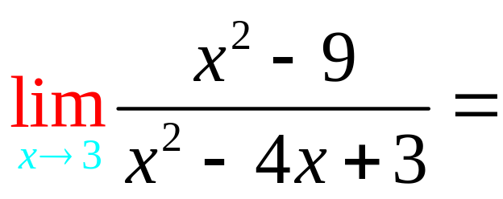
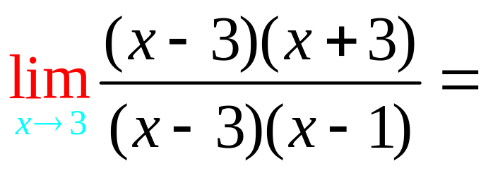
.

Slide 31
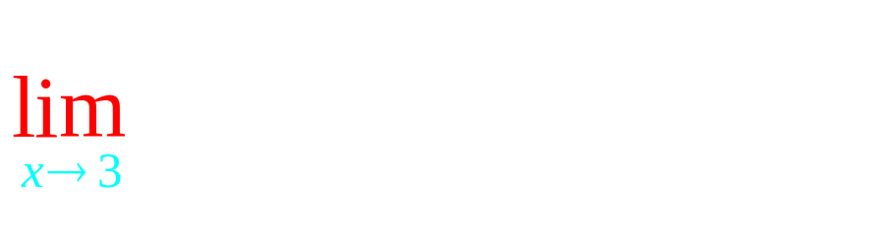
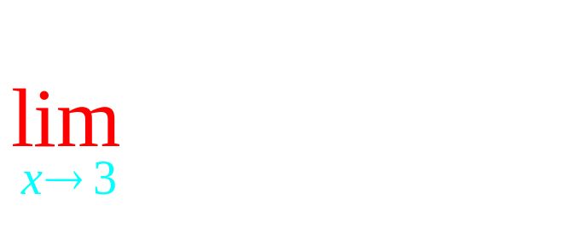
.
3.0
0.1

Slide 32
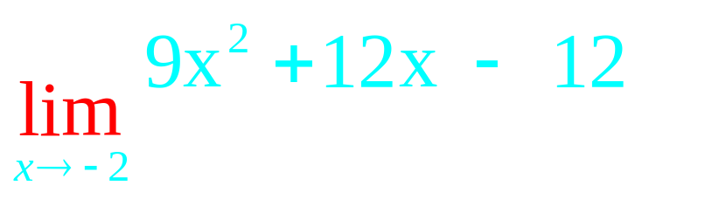
Rule 2 – Factor and cancel
a x² + bx + c Find two numbers whose product is ac, but add to b

Slide 33
Limit Algebraic Rules
9 x² + 12x - 12 Find two
numbers whose product is
-108, but add to 12
= 9 x² + 18x - 6x - 12
= 9x(x + 2) -6(x + 2)
= (9x – 6)(x + 2)
108 -1
54 -2
36 -3
27 -4
18 -6

Slide 34
Rule 2 – Factor and cancel
a x² + bx + c Find two numbers whose product is ac, but add to b

Slide 35
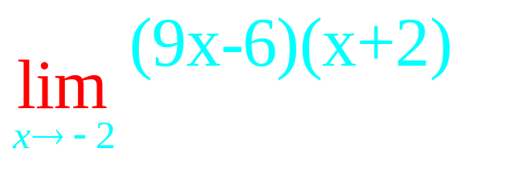
Rule 2 – Factor and cancel
a x² + bx + c Find two numbers whose product is ac, but add to b

Slide 36
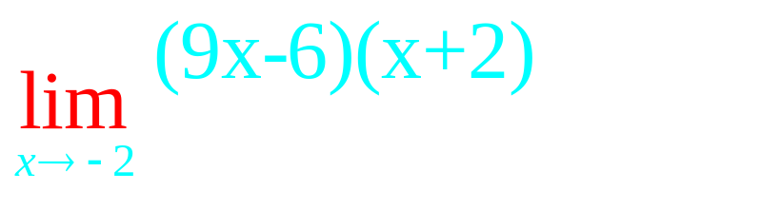
Rule 2 – Factor and cancel
a x² + bx + c Find two numbers whose product is ac, but add to b

Slide 37
Rule 2 – Factor and cancel
a x² + bx + c Find two numbers whose product is ac, but add to b

Slide 38
New problem

Slide 39
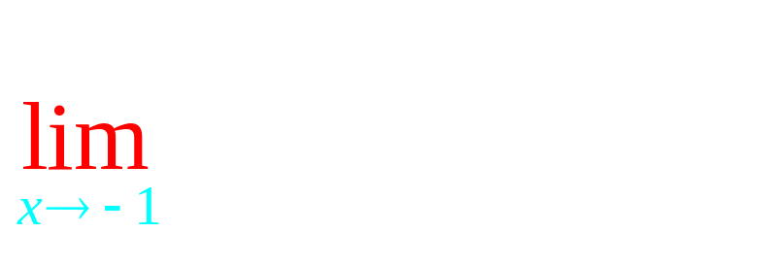
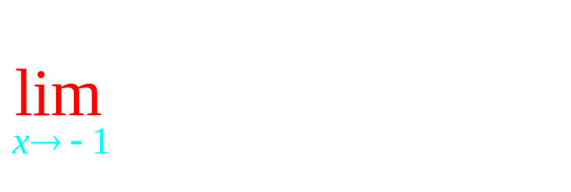
Rule 2 – Factor and cancel
a x² + bx + c Find two numbers whose product is ac, but add to b

Slide 40
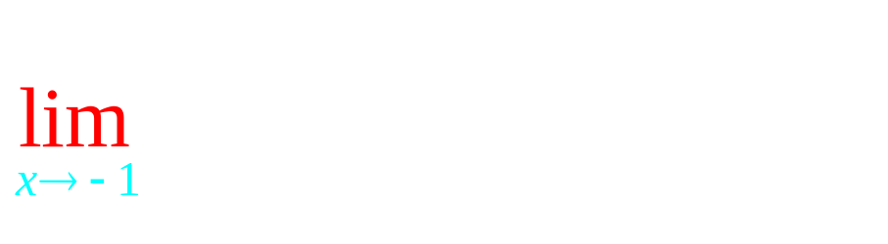
Rule 2 – Factor and cancel
a x² + bx + c Find two numbers whose product is ac, but add to b

Slide 41

Rule 2 – Factor and cancel
a x² + bx + c Find two numbers whose product is ac, but add to b

Slide 42

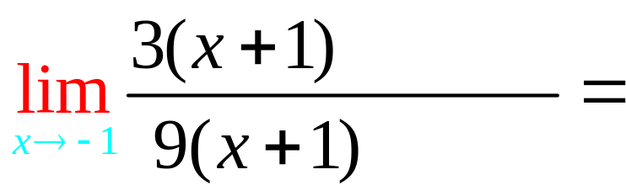
Rule 2 – Factor and cancel
a x² + bx + c Find two numbers whose product is ac, but add to b

Slide 43
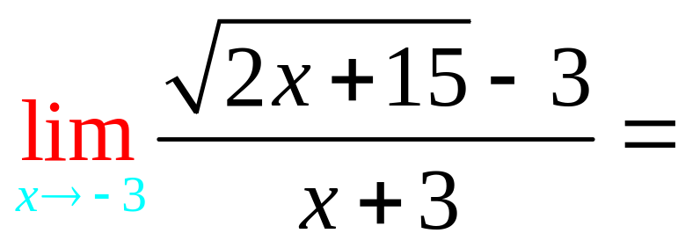
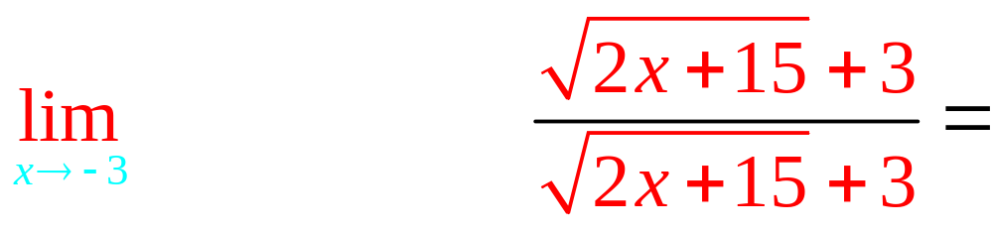
Rule 3 – Conjugate

Slide 44
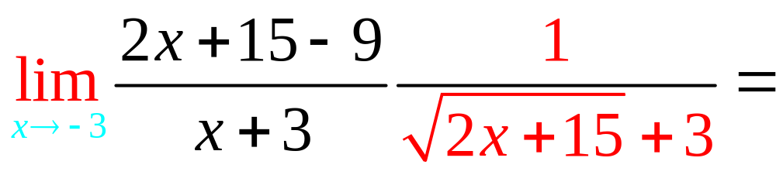
Rule 3 – Conjugate

Slide 45
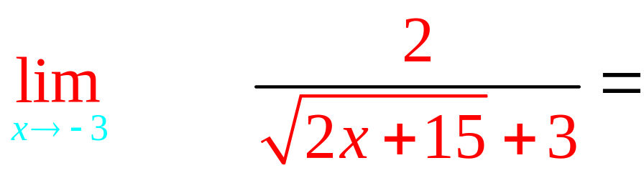
Rule 3 – Conjugate

Slide 46
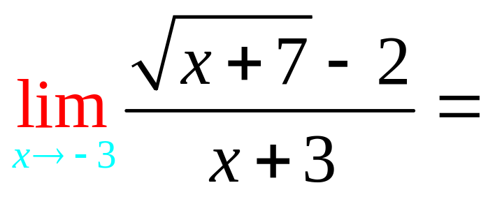
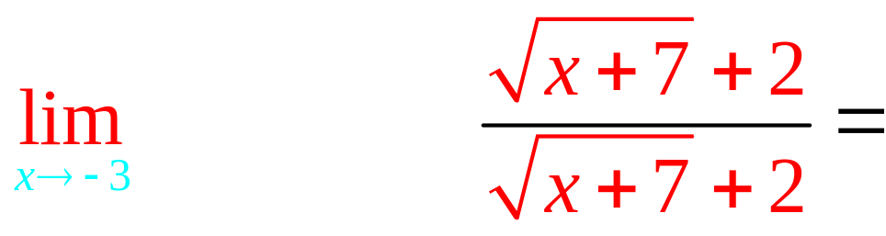
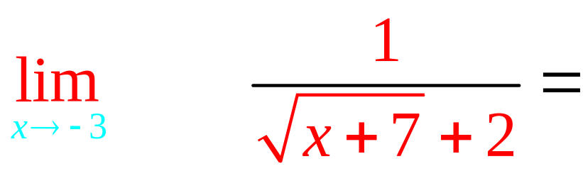
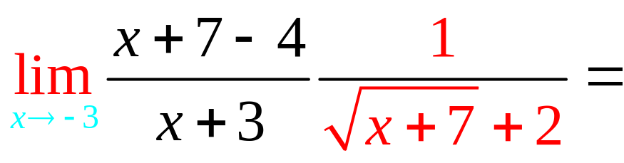
Rule 3 – Conjugate

Slide 47
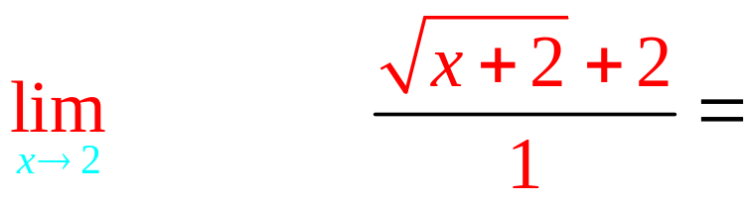
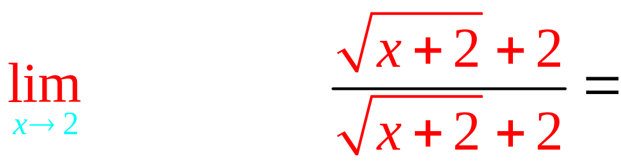
. 4
4.0
0.1

Slide 48
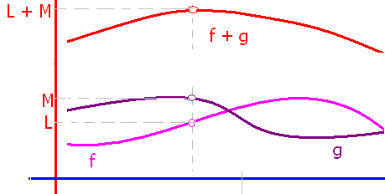
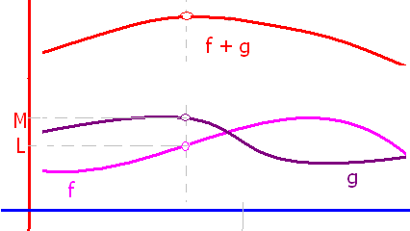
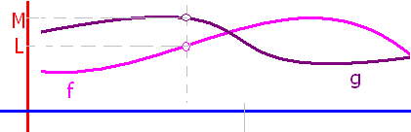
If lim f(x) = L and lim g(x) = M, then
lim(f(x) + g(x)) = L + M
lim(f(x) - g(x)) = L - M
lim(k f(x)) = k L
lim(f(x)g(x)) = L M
lim(f(x) / g(x)) = L / M
lim [f(x)^{n}]= L^{n}
lim

