Slide 1
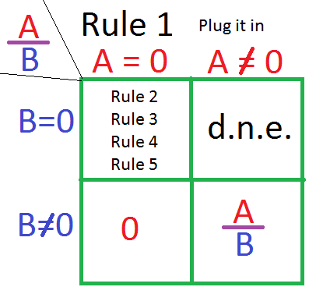

Slide 2
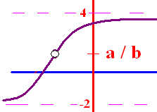
Limit Algebraic Rules
Rule 1 – Plug the x xalue
  into the equation
If you get a/b and
b 0, the answer is a/b
b = 0 and a 0, the answer is d.n.e
you get 0/0 then go to higher rules

Slide 3
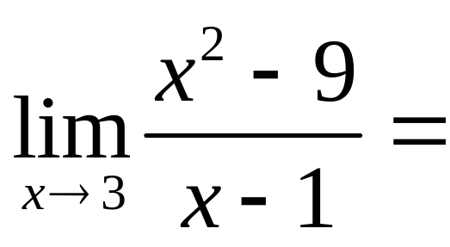
.

Slide 4


.
0.0
0.1

Slide 5
Limit Algebraic Rules
Rule 2 – Factor and cancel
  return to Rule 1
SOAP (a³ + b³) = (a + b)(a² – ab + b²)
Diff of 2 squares (a² - b²) = (a + b)(a – b)
a x² + bx + c Find two numbers whose product is ac, but add to b

Slide 6
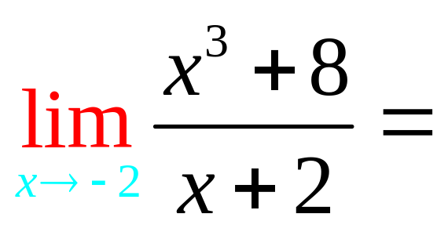
.

Slide 7
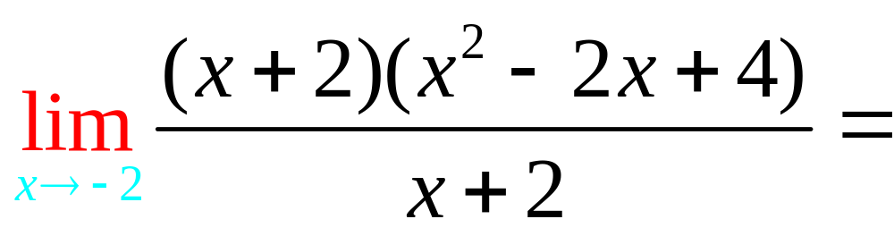
.

Slide 8
.
12.0
0.1

Slide 9
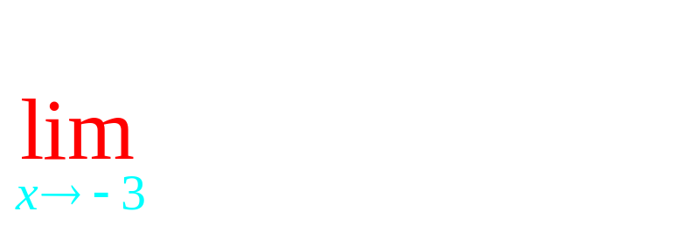
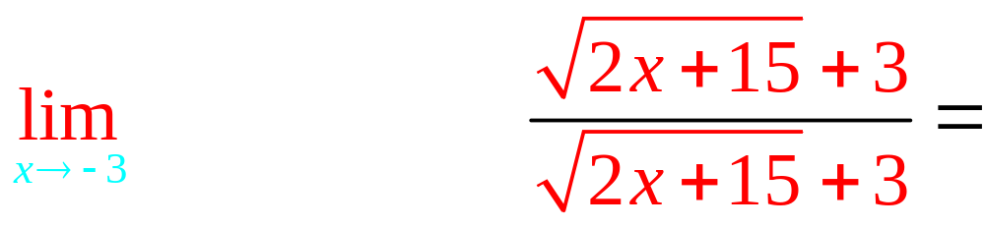
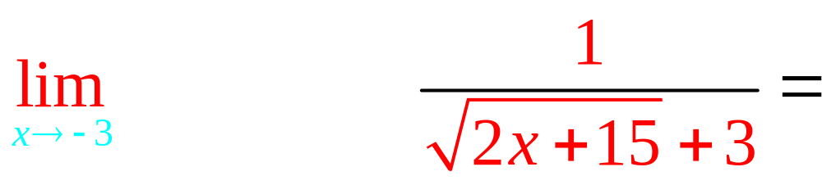
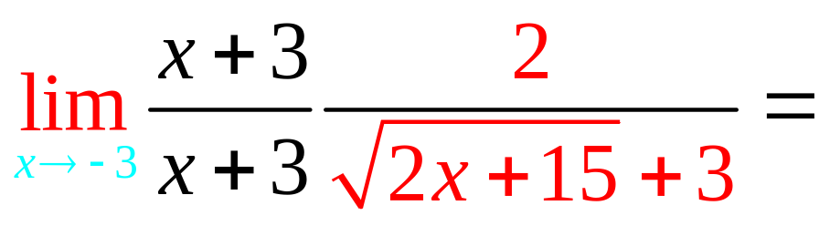
Rule 3 – Conjugate

Slide 10
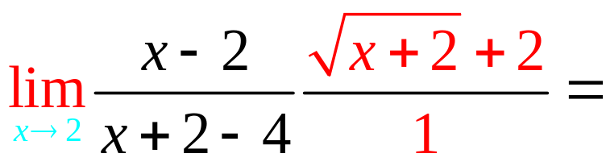
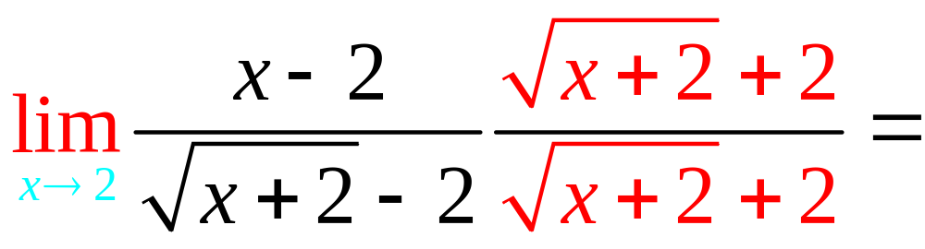
. 4
4.0
0.1

Slide 11
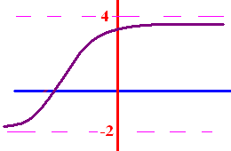
Limits as x goes to
+ or - infinity
What does y get close to
as x goes to + infinity?
What does y get close to
as x goes to - infinity?

Slide 12
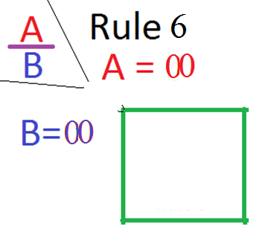

Slide 13
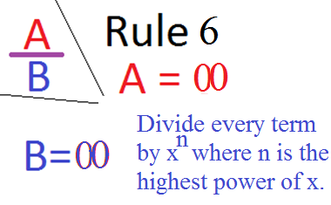

Slide 14
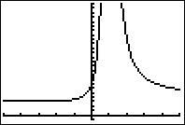

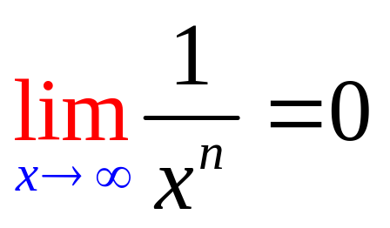
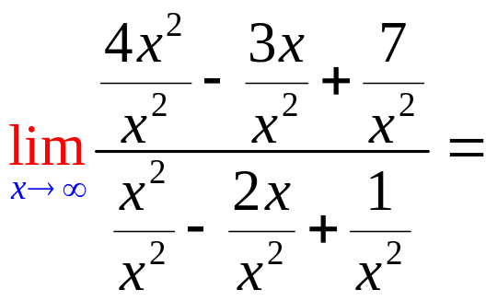
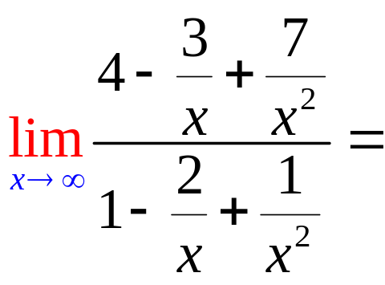
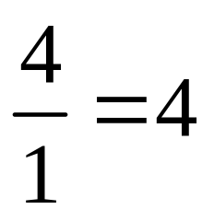
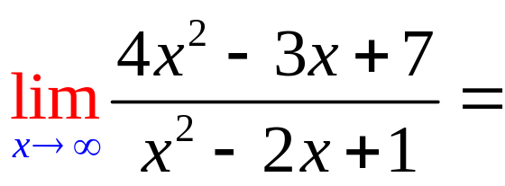
Limits as x goes to
+ or - infinity
To calculate the limit as x
goes to infinity, remember
if n > 0.

Slide 15
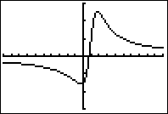
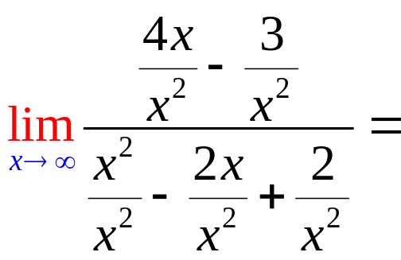
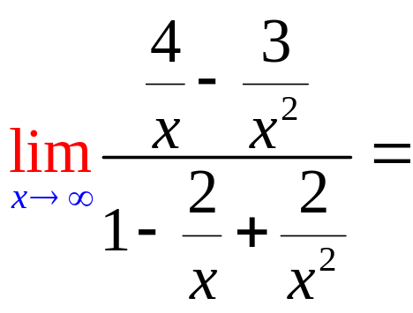
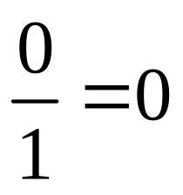
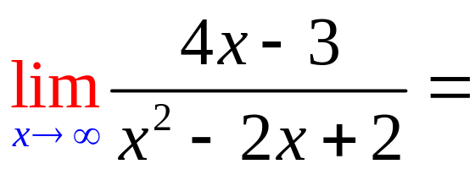
Limits as x goes to
+ or - infinity

Slide 16
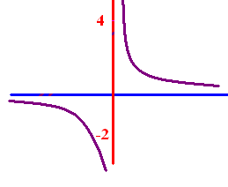

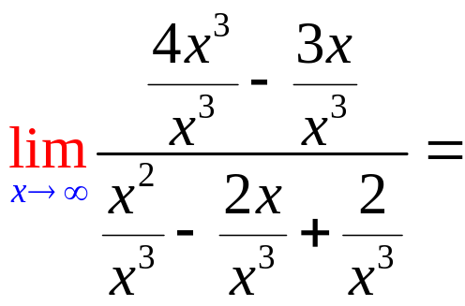
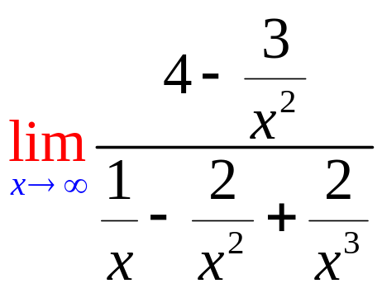
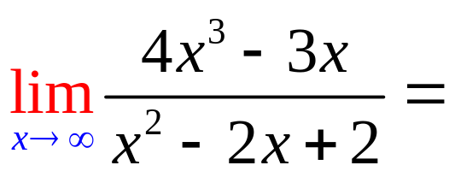
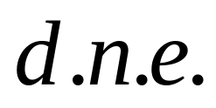
Limits as x goes to
+ or - infinity

Slide 17
N same for numerator and denominator
Numerator has the highest power DNE
Denominator has the highest power 0

Slide 18
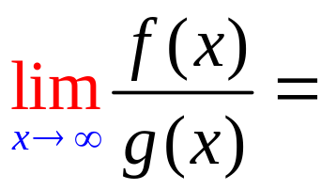
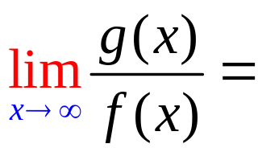
5
f(x)=3x⁵ - 3x³ + 2
g(x) = 2x² - 4x + 2

Slide 19
5
f(x)=3x⁵ - 3x³ + 2
g(x) = 2x⁵ - 4x + 2

Slide 20
5
f(x)=3x⁵ - 3x³ + 2
g(x) = 2x²¹ - 4x + 2

Slide 21
5
f(x)= x⁸ - 3x³ + 2
g(x) = 7x⁸ - 4x + 2

Slide 22
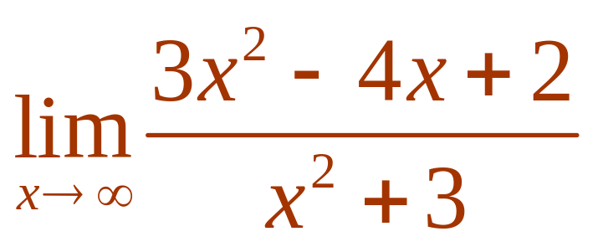

Evaluate .
3
1/3
d.n.e
0

Slide 23
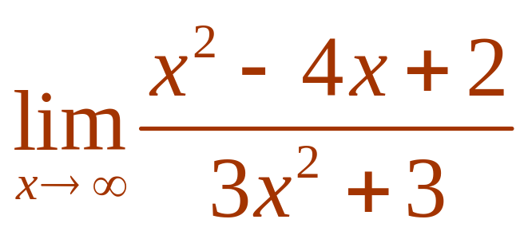
Evaluate .
3
1/3
d.n.e
0

Slide 24
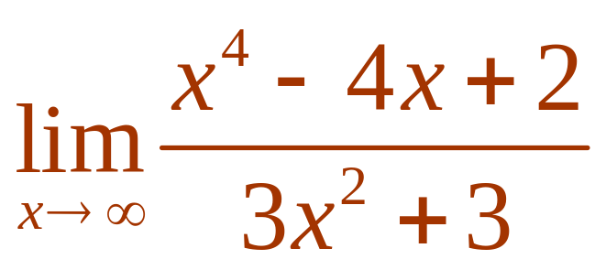
Evaluate .
3
1/3
d.n.e
0

Slide 25
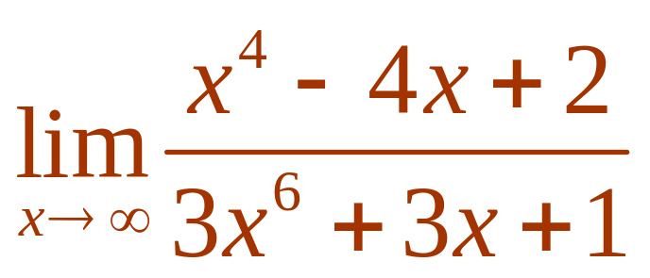
Evaluate .
3
1/3
d.n.e
0

Slide 26
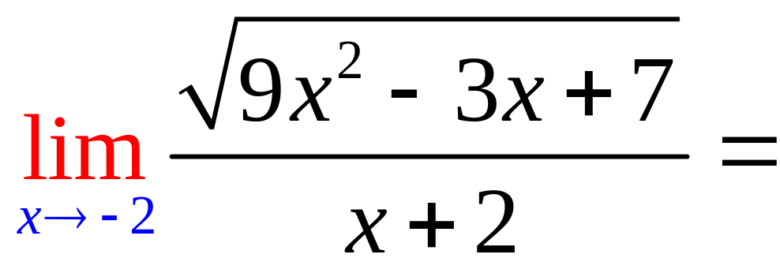
0
d.n.e.
7

Slide 27
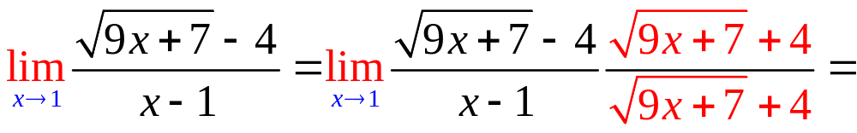
9/8
d.n.e.
0

Slide 28
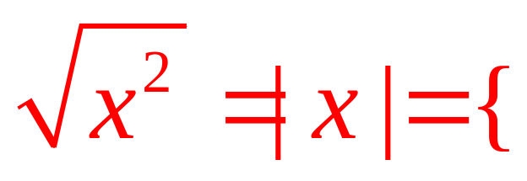
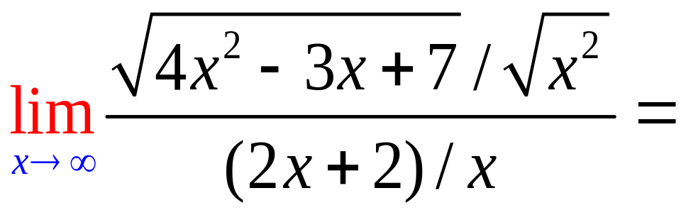
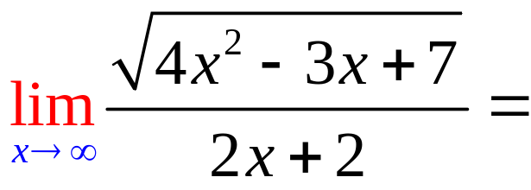
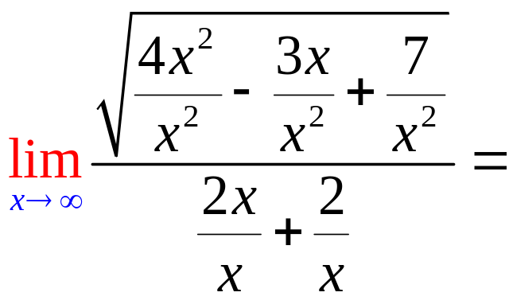
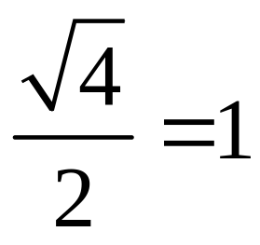
x, if 0 < x
-x, if x < 0

Slide 29
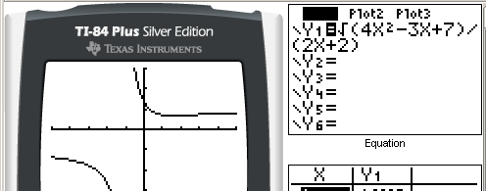
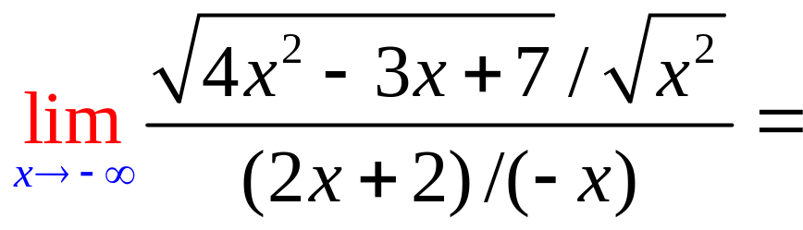
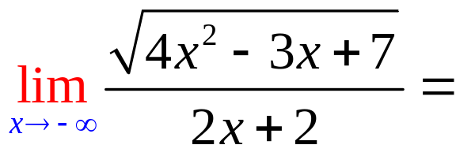
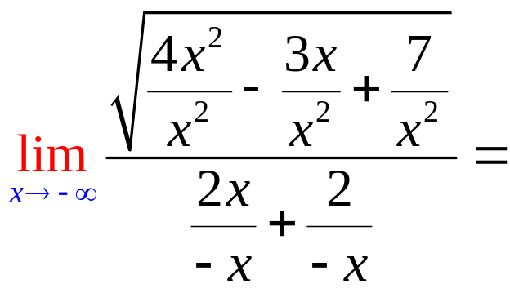
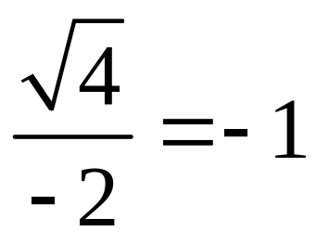
x, if 0 < x
-x, if x < 0

Slide 30
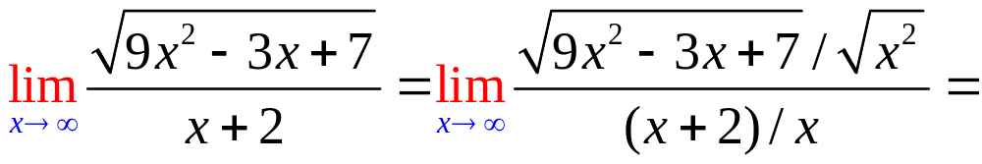
.
3.0
0.1

Slide 31
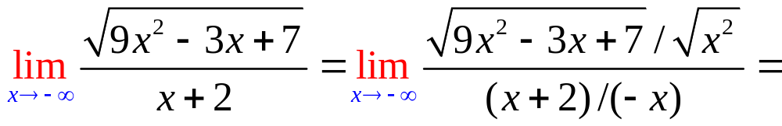
.
-3.0
0.1

