Slide 1
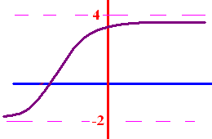
Limits as x goes to
+ or - infinity
What does y get close to
as x goes to + infinity?
What does y get close to
as x goes to - infinity?

Slide 2
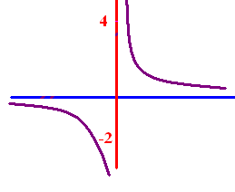

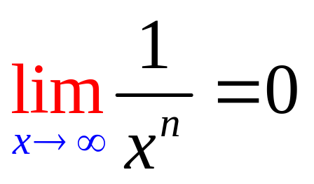
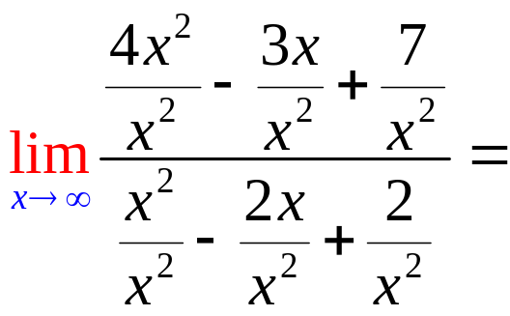
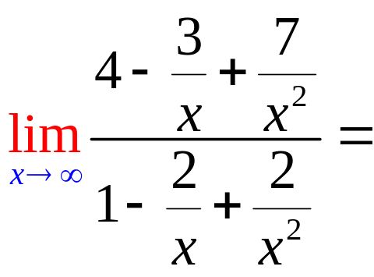
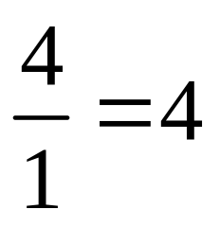
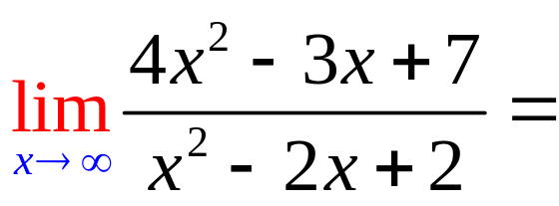
Limits as x goes to
+ or - infinity
To calculate the limit as x
goes to infinity, remember
if n > 0.

Slide 3
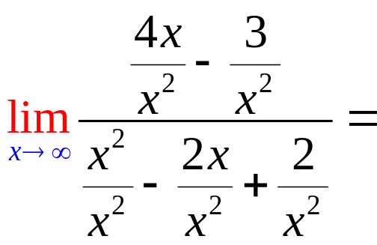
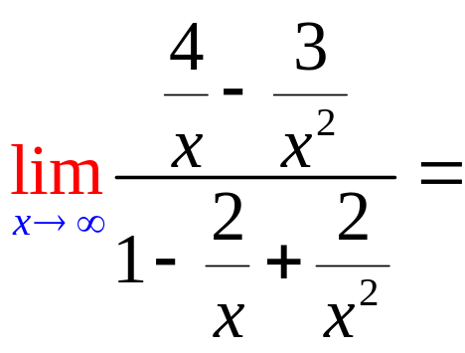
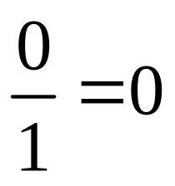
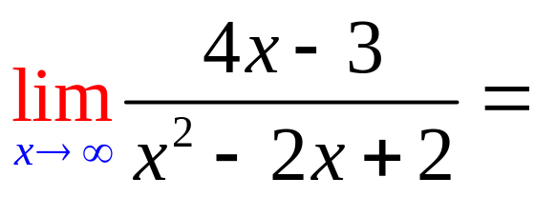
Limits as x goes to
+ or - infinity

Slide 4

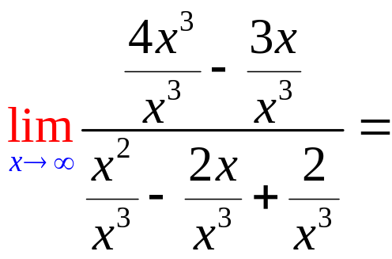
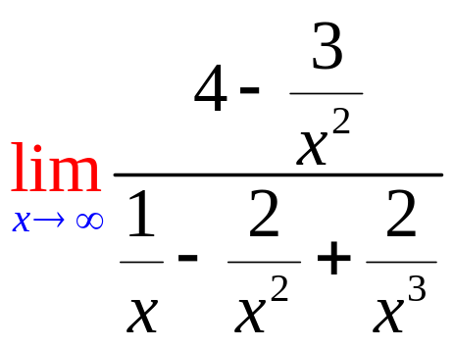
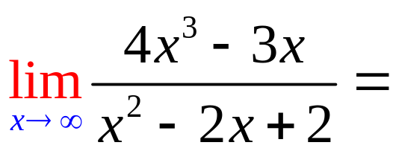
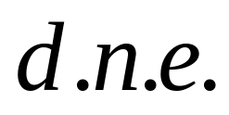
Limits as x goes to
+ or - infinity

Slide 5
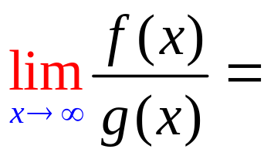
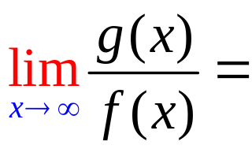
5
f(x)=3x⁵ - 3x³ + 2
g(x) = 2x² - 4x + 2

Slide 6
5
f(x)=3x⁵ - 3x³ + 2
g(x) = 2x⁵ - 4x + 2

Slide 7
5
f(x)=3x⁵ - 3x³ + 2
g(x) = 2x²¹ - 4x + 2

Slide 8
5
f(x)= x⁸ - 3x³ + 2
g(x) = 7x⁸ - 4x + 2

Slide 9
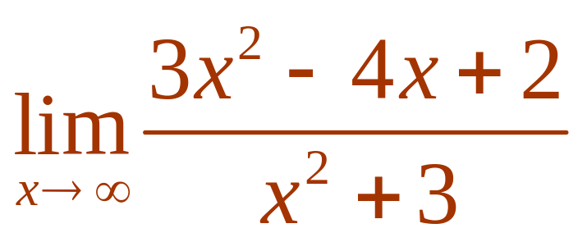


Evaluate .
3
1/3
d.n.e
0

Slide 10
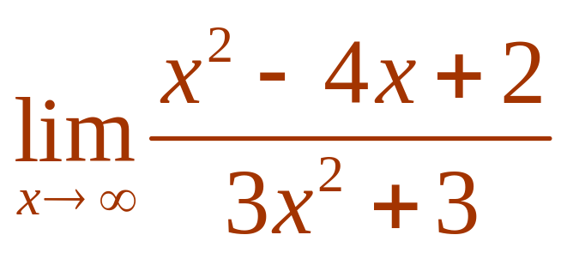
Evaluate .
3
1/3
d.n.e
0

Slide 11
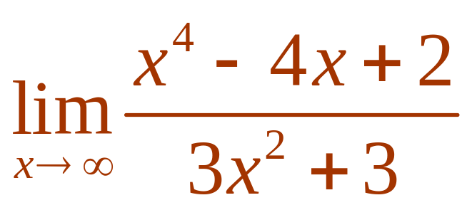
Evaluate .
3
1/3
d.n.e
0

Slide 12
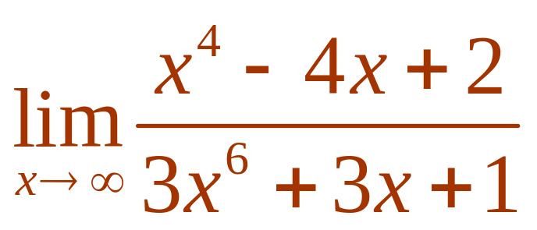
Evaluate .
3
1/3
d.n.e
0

Slide 13
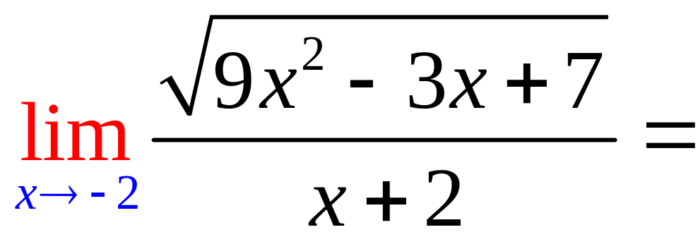
0
d.n.e.
7

Slide 14
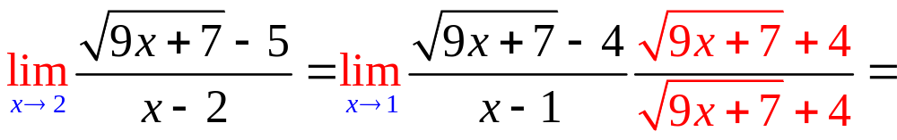
9/8
d.n.e.
0

Slide 15
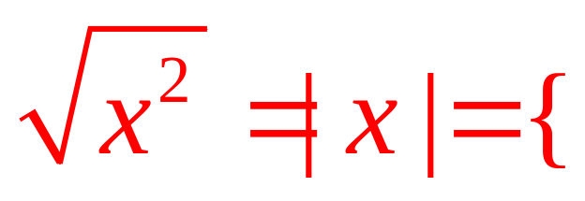
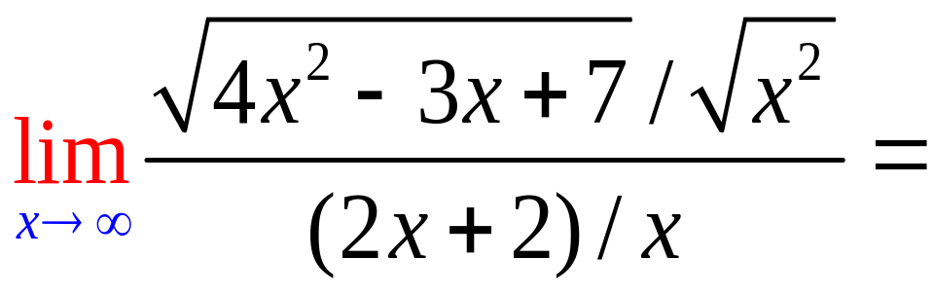
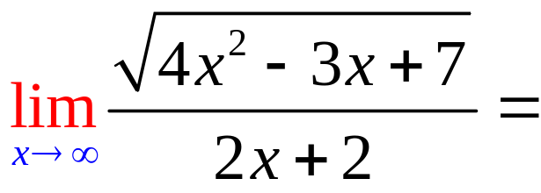
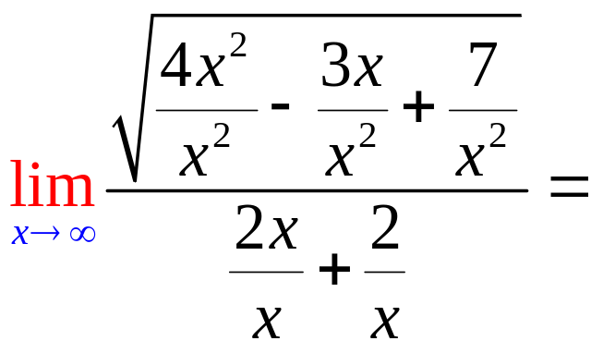
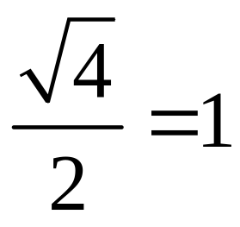
x, if 0 < x
-x, if x < 0

Slide 16
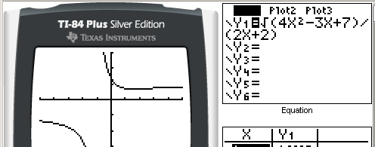
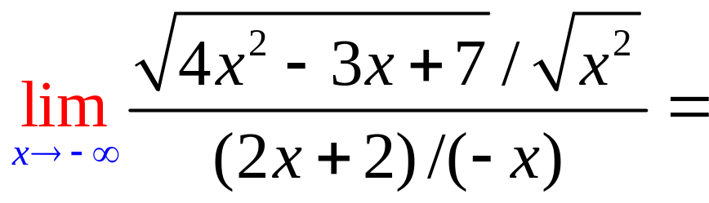
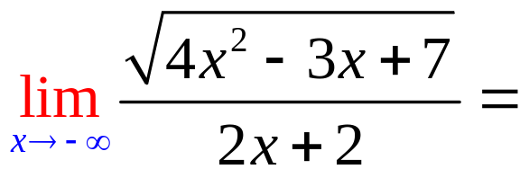
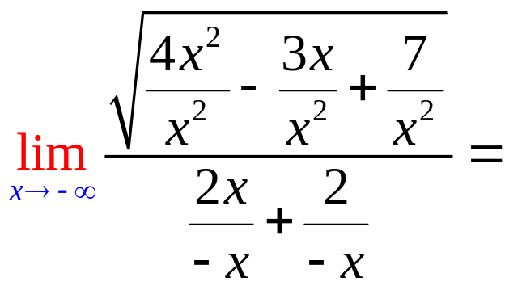
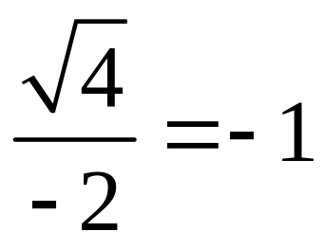
x, if 0 < x
-x, if x < 0

Slide 17
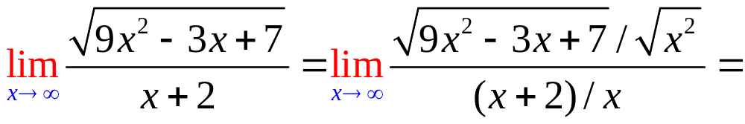

.
3.0
0.1

Slide 18
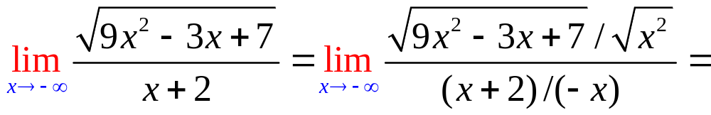
.
-3.0
0.1

