Slide 1
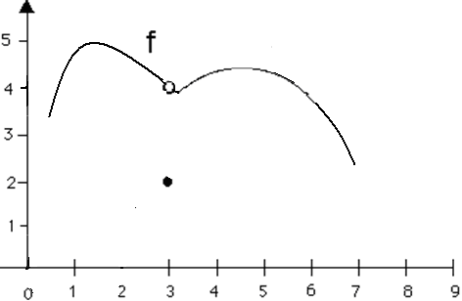
f(3) = .
d.n.e.
2
3
4

Slide 2


f(3) = .
d.n.e.
2
3
4

Slide 3
.
d.n.e.
2
3
4

Slide 4
.
d.n.e.
2
3
4

Slide 5
.
1
2
3
d.n.e.

Slide 6
.
1
2
3
d.n.e.

Slide 7
On [a,b], ARC =
On [1, 16], find ARC for
ARC = =

Slide 8
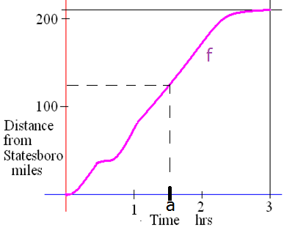
Continuity
This function is continuous on [0,3]
Definition
A function f is continuous at x = a means three things.
1) a is in the domain of f,
2)
3)

Slide 9
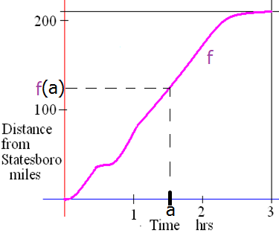
Continuity
This function is continuous on [0,3]
Definition
A function f is continuous at x = a means three things.
1) a is in the domain of f,
2)
3)

Slide 10
Continuity
f is continuous on [0, 3] means that f is
continuous at a for every a in [0, 3].

Slide 11
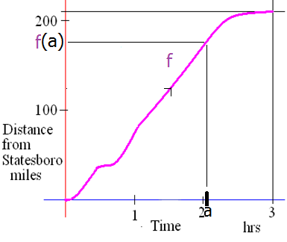
Continuity
f is continuous on [0, 3] means that f is
continuous at a for every a in [0, 3].

Slide 12
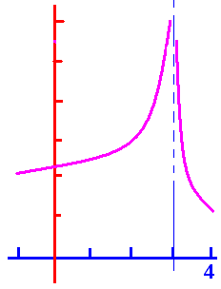
Continuity
f is continuous on [-1, 3) U (3, 4] means that f is continuous at x = a
for every a in [-1, 3) U (3, 4] .

Slide 13
Continuity
1) a is in the domain of f,
2)
3)

Slide 14
Continuity
Why wasn’t f continuous when x = 3?
Must lift your pencil
Not a valid reason

Slide 15
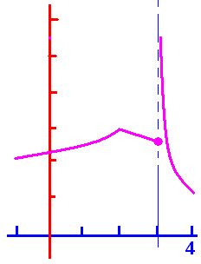
Continuity
1) a is in the domain of f,
2)
3)
Why not at x = 3?

Slide 16
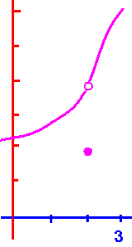
Continuity
1) a is in the domain of f,
2)
3)
Yes on [-.2, 2) U (2, 3.1]
Why not at x = 2?

Slide 17
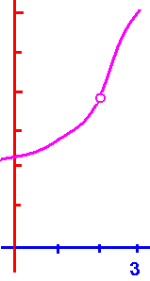
Continuity
1) a is in the domain of f,
2)
3)
Yes on [-.2, 2) U (2, 3.1]
Why not at x = 2?
Hole in the graph
Not a valid reason

Slide 18
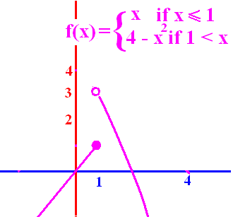
Why is f not continuous at x = 1?
1 is not in the domain of f
.
.
There is a hole in the graph
Must lift your pencil

Slide 19
Why is f not continuous at x = 1?
1 is not in the domain of f
.
.
There is a hole in the graph
Must lift your pencil

Slide 20
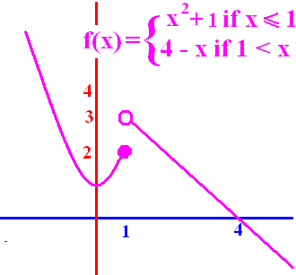
f is continuous at x = 1.
True
False

Slide 21
f is continuous at x = 1.
True
False

Slide 22
f is continuous at x = 4.
True
False

Slide 23
f is continuous at x = 4.
True
False

Slide 24
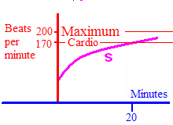
Why is s continuous at 20?
20 is in the domain
.
.
a, b, and c above
none of the above

Slide 25
Why is s continuous at 20?
20 is in the domain
.
.
a, b, and c above
none of the above

Slide 26
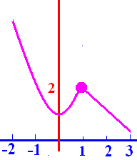
f is continuous on [-2, 3].
Yes
No

Slide 27
f is continuous on [-2, 3].
Yes
No

Slide 28
Why is f not continuous at x=1?
1 is not in the domain
.
.
All of the above

Slide 29
Why is f not continuous at x=1?
1 is not in the domain
.
.
All of the above

Slide 30
Why is f not continuous at x=2?
2 is not in the domain
.
.
All of the above

Slide 31
Why is f not continuous at x=2?
2 is not in the domain
.
.
All of the above

Slide 32

Why is f not continuous at x=2?
2 is not in the domain
.
.
All of the above

Slide 33
Why is f not continuous at x=2?
2 is not in the domain
.
.
All of the above

Slide 34
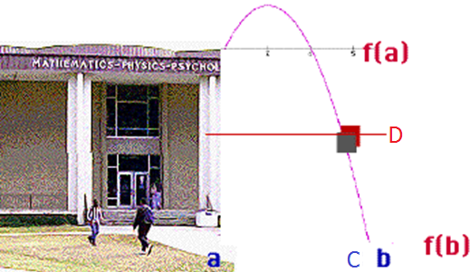
Having thrown a pebble from the roof of MP, will it pass the floor of the 3rd floor?
The domain of this function is [a, b] representing the time it was thrown until the time the pebble struck the ground. The rule of the function, f, is "height of the pebble at time x".

Slide 35
Intermediate Value Theorem
If f is continuous on [a, b] and d is inbetween f(a) and f(b),
then c (a,b) such that f (c) = d.

Slide 36
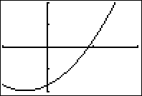
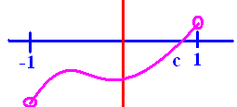
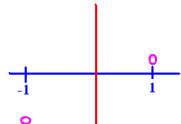
f(x) = x² + x – 1.7
Prove f has a zero on [-1, 1]
f(-1) = -1.7, f(1) = 0.3
f is continuous on [-1, 1]
0 (-1.7, 0.3) so by the IVT
a c (-1, 1) so that f(c)= 0.

Slide 37
f(x) = x² + x – 1.7
Prove f has a zero on [-1, 1]
-1.896424 is not a zero in [-1, 1]

Slide 38
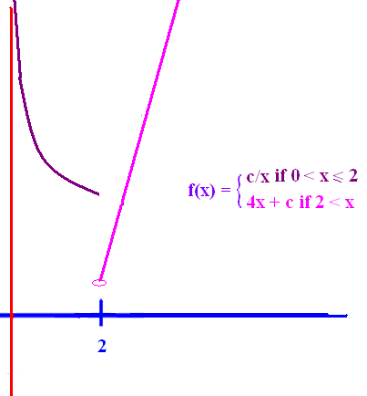
Find c to make f continuous
Part 3 says
or
c/x must equal 4x + c when x = 2

Slide 39
Find c to make f continuous
c/x = 4x + c
when x = 2
c/2 = 8 + c
-8 = c/2
-16 = c
f(2) = -8

Slide 40
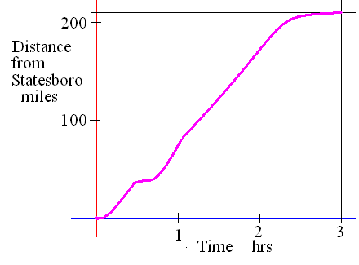
Continuity
This function is continuous on [0,3]
d.n.e.
Similarly,
even though
d.n.e.

