Slide 1


Limit help table
Form | Limit
A/B and B is not 0 | A/B
A/0 and A is not 0 | d.n.e. or oo or -oo
 | 2) Factor and cancel
0/0 | 3) Conjugate
 | 4)
 | 5)
oo/oo | 6) Divide every term by x to the highest power

Slide 2
Evaluate

Slide 3
Write the equation of the horizontal asymptote of
y = 3/8
y = 2/8
y = 2

Slide 4


Write the equation of the horizontal asymptote of
y = 3/8
y = 2/8
y = 2

Slide 5
Write the equation of the vertical asymptote of
x = -2
x = 2
x = 0

Slide 6
Write the equation of the vertical asymptote of
x = -2
x = 2
x = 0

Slide 7
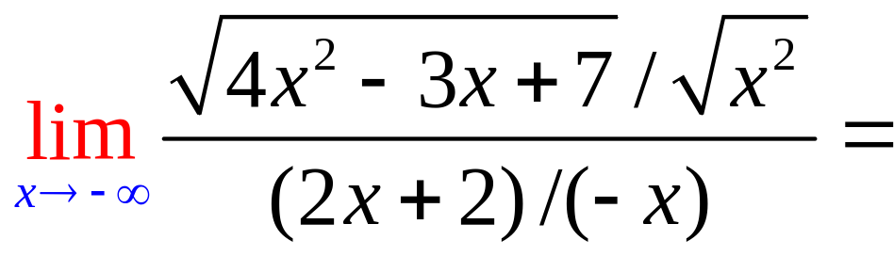
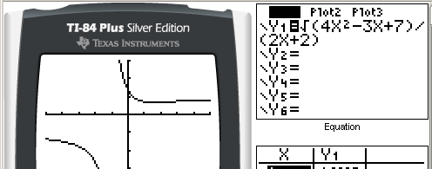
Find

Slide 8


Find
1.0
0.1

Slide 9
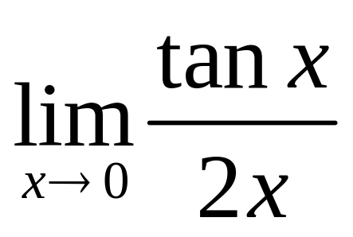
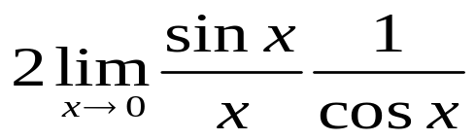
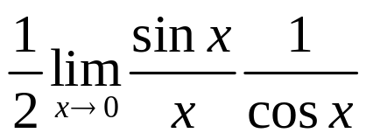
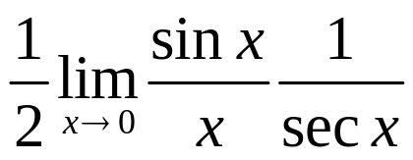
Find . . ….. . .
[Option 1]
[Option 2]
[Option 3]

Slide 10
Find . . ….. . .
[Option 1]
[Option 2]
[Option 3]

Slide 11
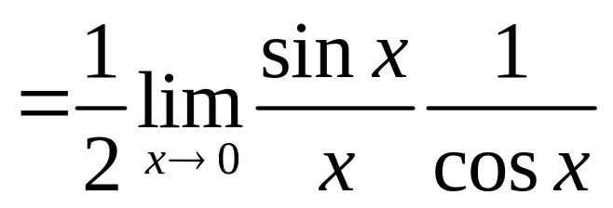



Find . . ….. . .
[Op
[Opt
[O

Slide 12
Find . . ….. . .
[Op
[Opt
[O

Slide 13
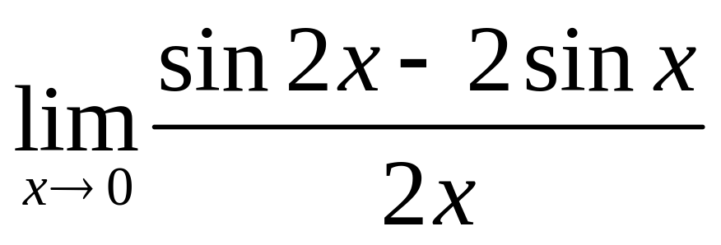
Find . . ….. . .
[Op
[Opt
[O

Slide 14
Find . . ….. . .
[Op
[Opt
[O

Slide 15
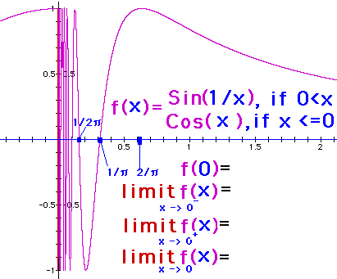
lim f(x) = x→0

Slide 16
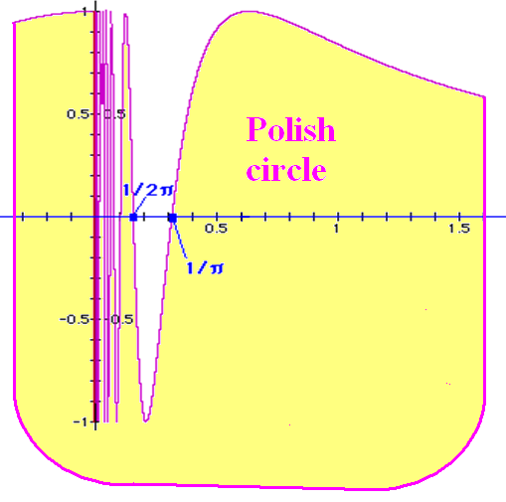

Slide 17
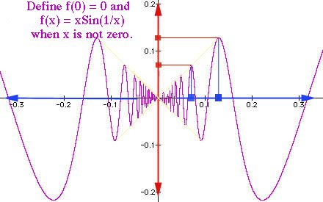
lim f(x) = x→0

Slide 18
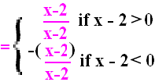
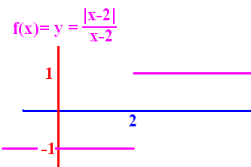
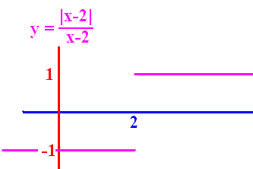
lim f(x) = x→2⁺

Slide 19
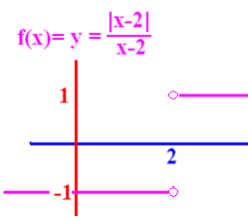
lim f(x) = x→2⁻

Slide 20
lim f(x)= x→2⁻
-1.0
0.1

Slide 21
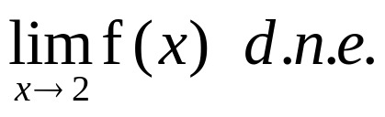
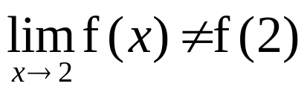
Why is f not continuous at 2?
2 is not in the domain of f
[O
[O
A. and B.

Slide 22
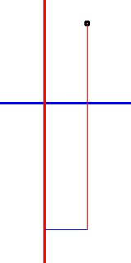
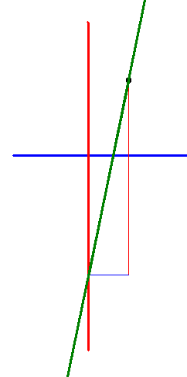
Line passing through (1,2) with a slope of 5.
y = 5(x - 1) - 2
y = 5(x - 2) - 1
y = 5(x - 1) + 2
y = 5(x + 2) - 1

Slide 23
Line passing through (1,2) with a slope of 5.
y = 5(x - 1) - 2
y = 5(x - 2) - 1
y = 5(x - 1) + 2
y = 5(x + 2) - 1

Slide 24
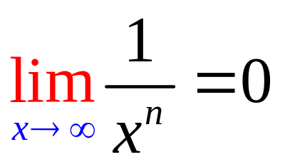
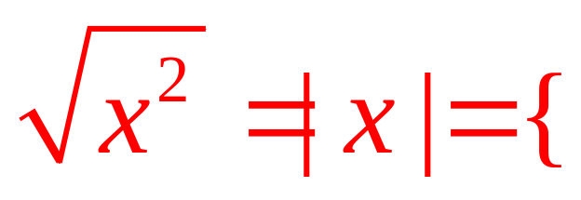
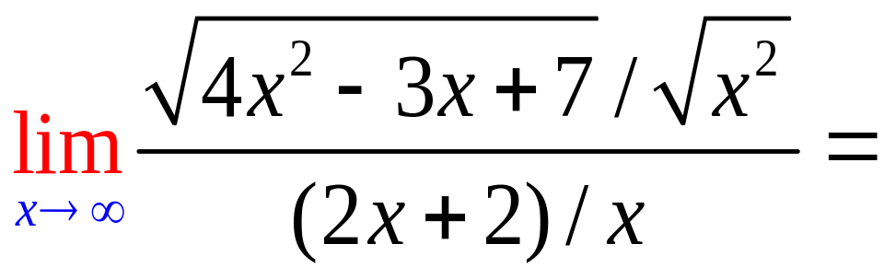
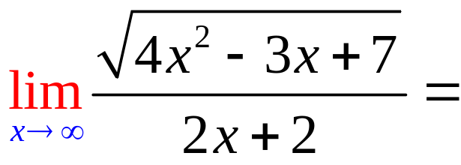
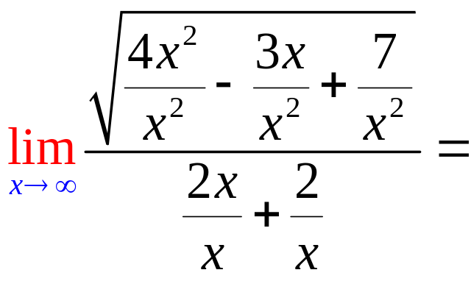
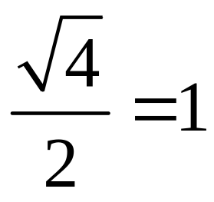
x, if 0 < x
-x, if x < 0

Slide 25
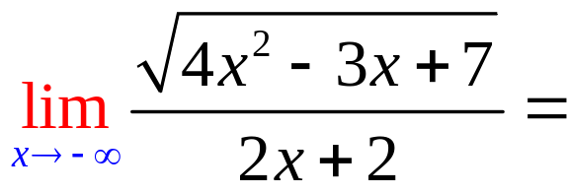
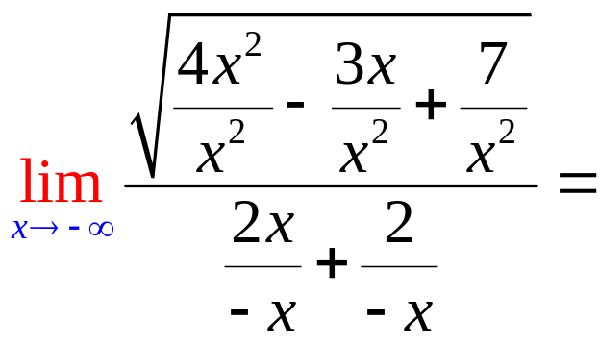
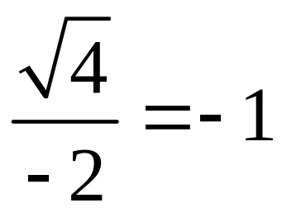
x, if 0 < x
-x, if x < 0

Slide 26
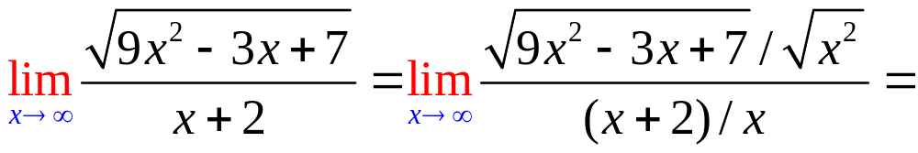
.

Slide 27
.
3.0
0.1

Slide 28
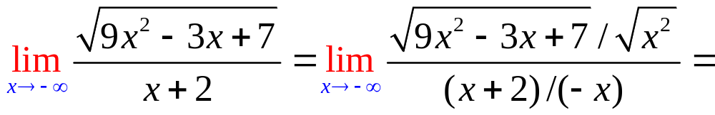
.

Slide 29
.
-3.0
0.1

Slide 30
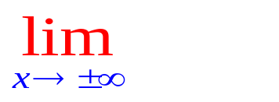
Where are the asymptotes for
?
Set the denominator to zero
Answer is x = answer of 1.
Evaluate
Answer is y = answer to 3.

Slide 31
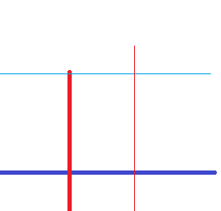
Where are the asymptotes for
Set the denominator to zero. x – 2 = 0
Answer is x = 2.
Evaluate =
Answer is y = answer to 3.

Slide 32
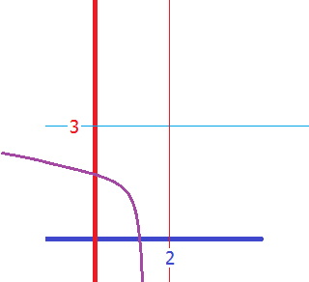
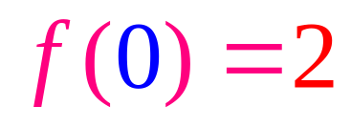
Where are the asymptotes for
Set the denominator to zero. x – 2 = 0
Answer is x = 2.
Evaluate = 3
Answer is y = 3.

Slide 33
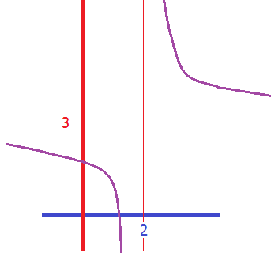
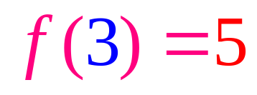
Where are the asymptotes for
Set the denominator to zero. x – 2 = 0
Answer is x = 2.
Evaluate = 3
Answer is y = 3.

