Slide 1

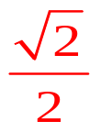
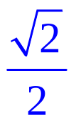

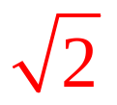

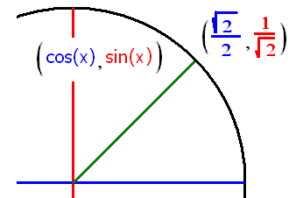

Trigonometry Review
Find sin(π/4) = cos(π/4) = tan(π/4) =
csc(π/4) = sec(π/4) = cot(π/4) =

Slide 2

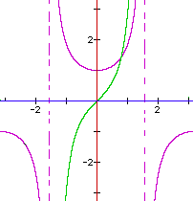

Evaluate tan(π/4)
Root 2
2
Root 2 /2
2 / Root 2
1

Slide 3

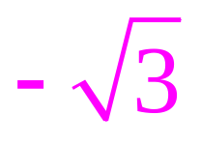


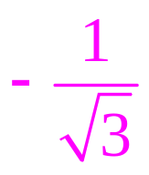


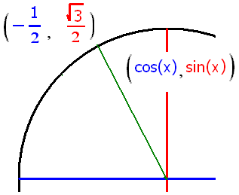
Trigonometry Review
sin(2π/3) = cos(2π/3) = tan(2π/3) =
csc(2π/3) = sec(2π/3) = cot(2π/3) =

Slide 4
Evaluate sec(2π/3)
-1
-2
-3
Root(3)
2 / Root(3)

Slide 5

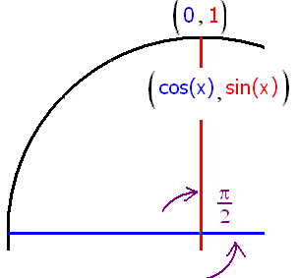
Evaluate cos(π/2)
-1
-.707
1
0.0

Slide 6
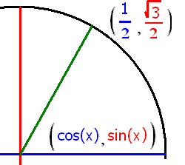
Evaluate sin(π/3)
- 0.5
0.5
0.707
0.866

Slide 7

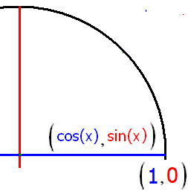


If y = sec(ξ), find y if ξ = 0
1.0
0.1

Slide 8
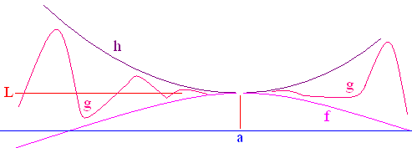
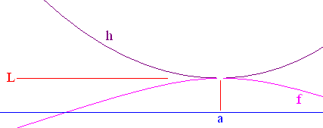
Squeeze Theorem
If f(x) g(x) h(x) on an open interval containing a, and
then

Slide 9
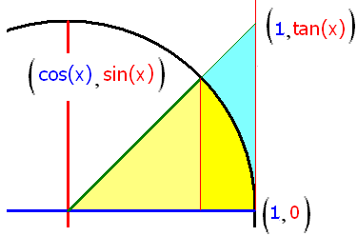
Rule 4 is a Theorem

Slide 10
Theorem -> Sector Area = x/2

Slide 11
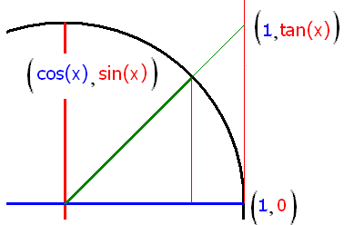
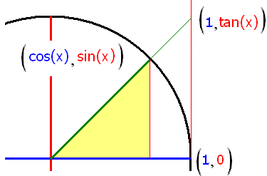
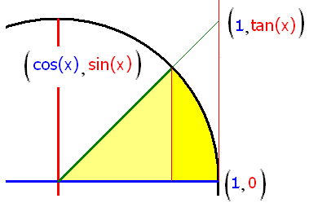
Proof . .
½ sin(x)cos(x) ½ x ½ sin(x)/cos(x)
cos(x) x/sin(x) 1/cos(x)
1
therefore 1

Slide 12
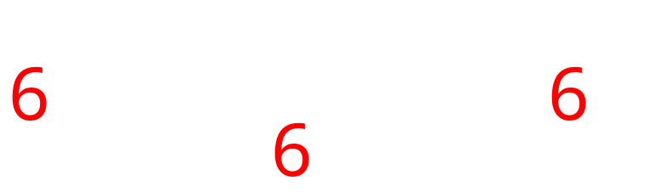

Slide 13
.
5.0
0.1

Slide 14

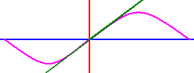
sin(.1)=
sin(.01)=
sin(.001=
sin(.0001)=
sin(.0000001)=

Slide 15
.
0.01
0.005

Slide 16
Rule 5 is a Theorem
= 0
Proof
cos(A+B)=cos(A)cos(B)-sin(A)sin(B)
If A = B = x/2
cos(x)= 1 -

Slide 17
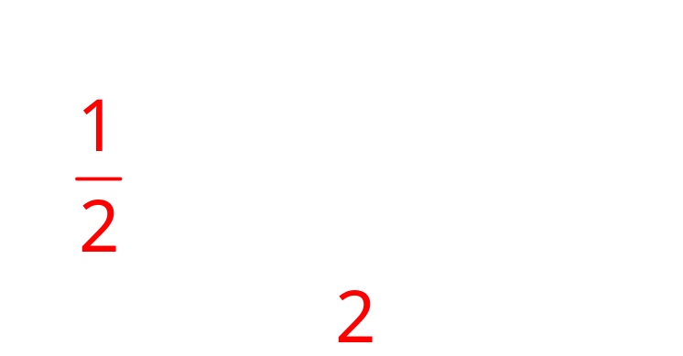
cos(x)=1 -
2sin²(x/2)= 1-cos(x)

Slide 18

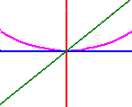


= 0

Slide 19
.
0.0
0.1

Slide 20
.
0.0
0.1

Slide 21

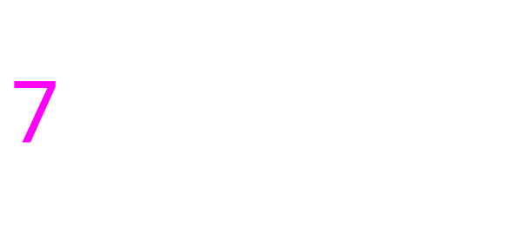
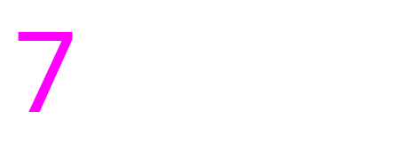

Slide 22

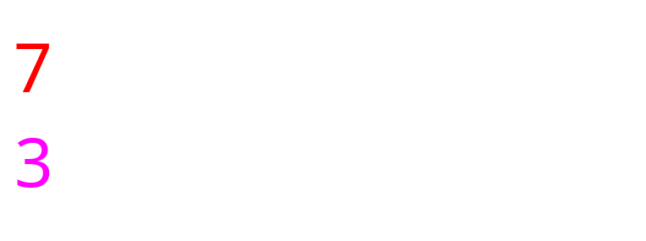
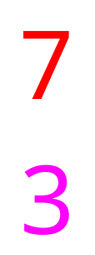

Slide 23
.
0.5
0.1

Slide 24
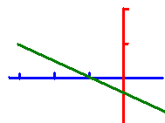
Equation of Lines
Write the equation of a line that passes through (-3, 1) with a slope of – ½ .

Slide 25
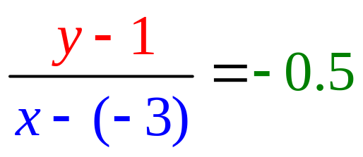

Equation of Lines
Write the equation of a line that passes through (-3, 1) with a slope of – ½ .

Slide 26
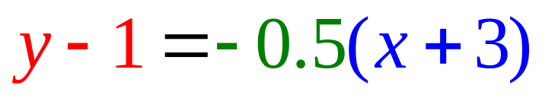
Equation of Lines
Write the equation of a line that passes through (-3, 1) with a slope of – ½ .

Slide 27
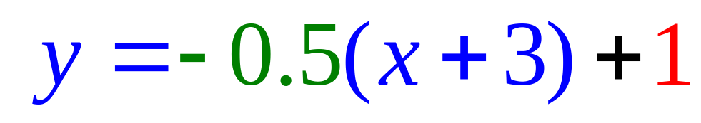
Equation of Lines
Write the equation of a line that passes through (-3, 1) with a slope of – ½ .

Slide 28
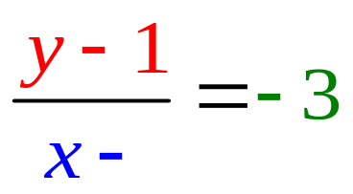
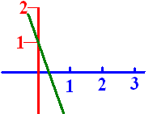
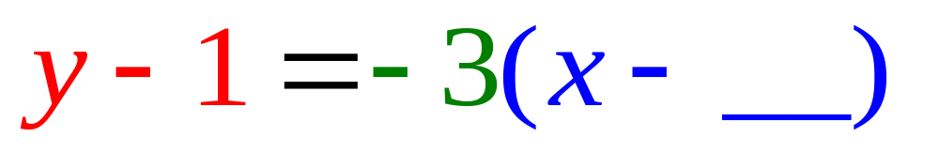
Passes through (0,1) with a slope of -3. What is the missing blue number?

Slide 29
Passes through (0,1) with a slope of -3. What is the missing blue number?

Slide 30
Passes through (0, 1) with a slope of -3. What is the missing blue number?
0.0
0.1

Slide 31
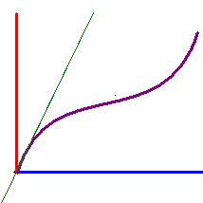
Write the equation of the line tangent to y = x + sin(x) when x = 0 given the slope there is 2.
y = 2x + 1
y = 2x + 0.5
y = 2x

Slide 32
Write the equation of the line tangent to y = x + sin(x) when x = 0 given the slope there is 2.
y = 2x + 1
y = 2x + 0.5
y = 2x

