Slide 1
Tangent Lines
Equation of lines
Equation of secant lines
Equation of tangent lines

Slide 2
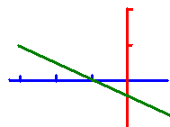
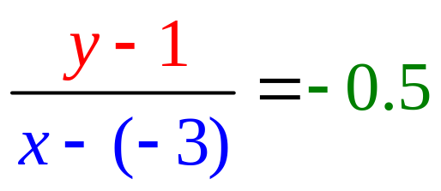
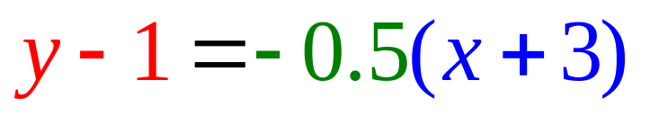
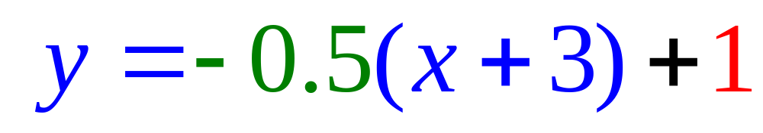
Equation of Lines
Write the equation of a line that passes through (-3, 1) with a slope of – ½ .
or
or

Slide 3
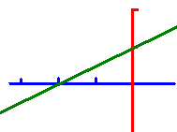
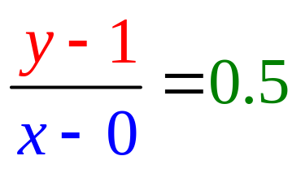
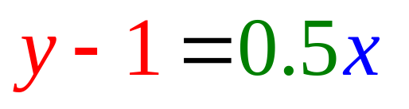
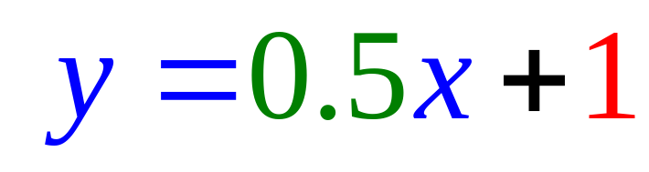
Equation of Lines
Write the equation of a line that passes through (0, 1) with a slope of ½ .
or
or

Slide 4
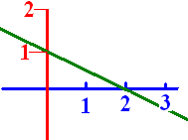
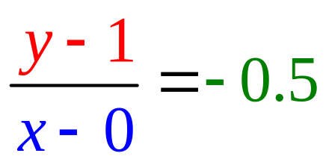
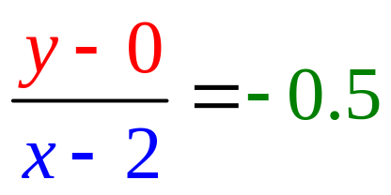
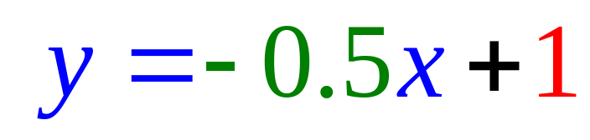
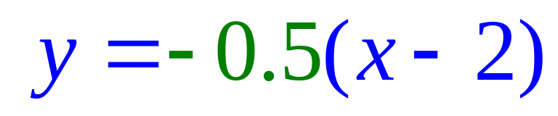
Equation of Lines
Write the equation of the line .
or
or

Slide 5
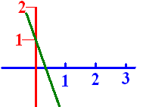
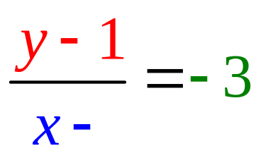
Lines
When writing the equation of a line that passes through (0, 1) with a slope of -3 .
What is the missing blue number?
A -3
B -1
C 0
D 1

Slide 6


Lines
When writing the equation of a line that passes through (0, 1) with a slope of -3 .
What is the missing blue number?
A -3
B -1
C 0
D 1

Slide 7



Passes through (0, 1) with a slope of -3. The missing blue number was zero. . . . . . . . . . . . . . . . . .

Slide 8
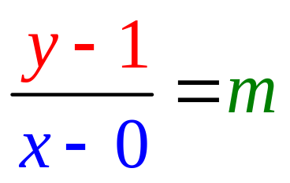

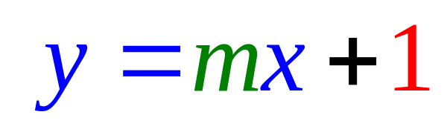
Write the equation of a green line that passes through (0, 1) with a slope of -3 .
What is the missing green number m?
A -3
B -1
C 0
D 1

Slide 9
Write the equation of a green line that passes through (0, 1) with a slope of -3 .
What is the missing green number m?
A -3
B -1
C 0
D 1

Slide 10
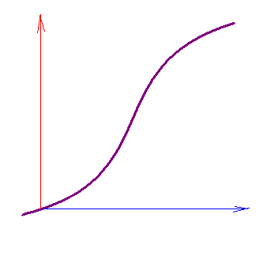
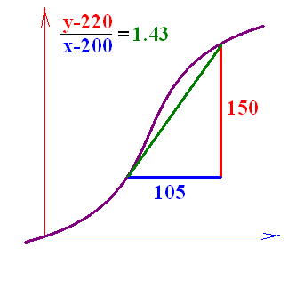
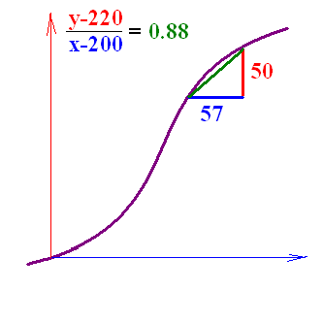
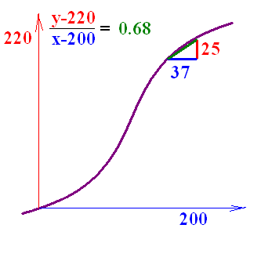
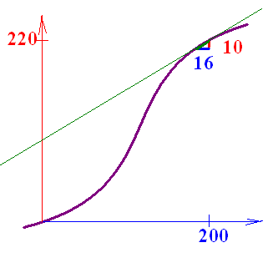
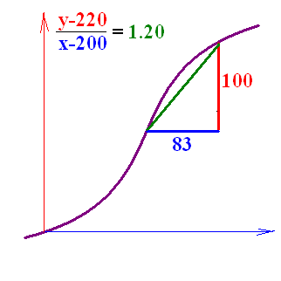
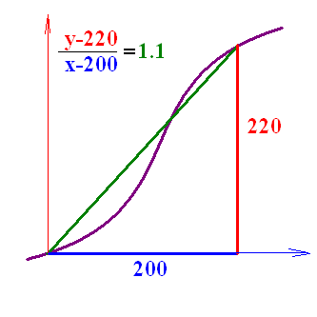






Secant Lines
Write the equation of the secant line that passes through
and (200, 220).

Slide 11
What is the slope of this secant line that passes through (200, 220) and (184, 210) ?

Slide 12
What is the slope of this secant line that passes through (200, 220) and (184, 210) ?
A 5/9
B 5/7
C 5/8
D 10/6
E 10/12

Slide 13
What is the slope of this secant line that passes through (200, 220) and (184, 210) ?
A 5/9
B 5/7
C 5/8
D 10/6
E 10/12

Slide 14
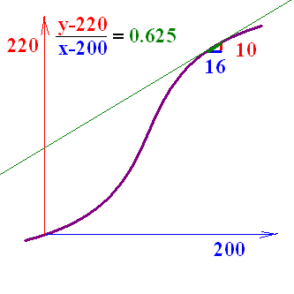
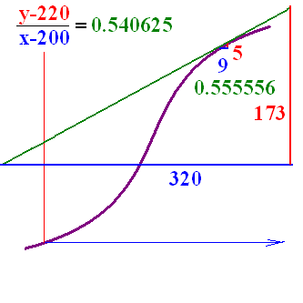
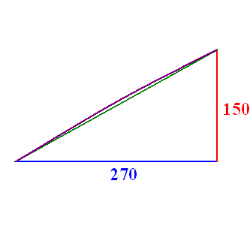
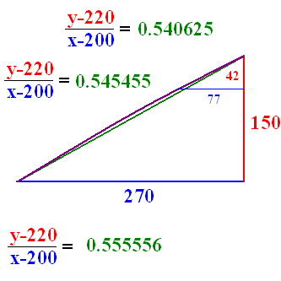
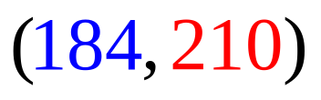
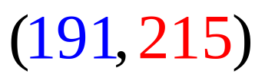
Secant Lines
Write the equation of the secant line that passes through
and (200, 220).

Slide 15
http://math.georgiasouthern.edu/~bmclean/java/p6.html Secant Lines
http://www.youtube.com/watch?v=P9dpTTpjymE Derive

Slide 16
http://www.youtube.com/watch?v=P9dpTTpjymE Derive

Slide 17
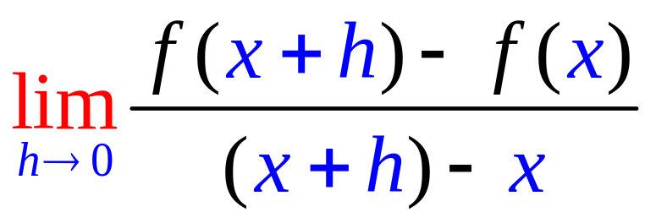
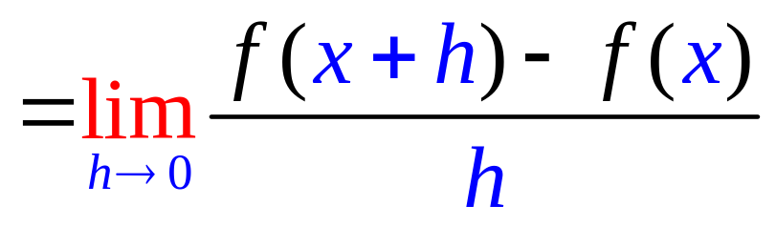
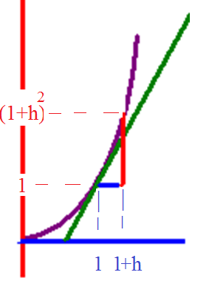
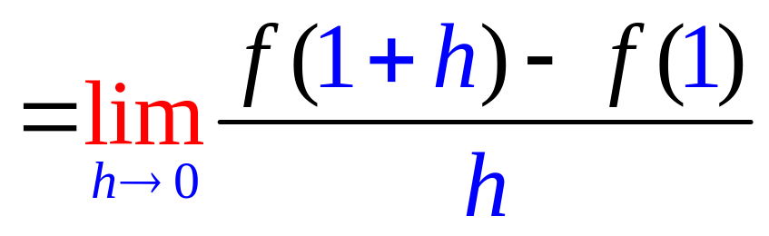
The slope of f(x) =x²
and when x = 1

Slide 18
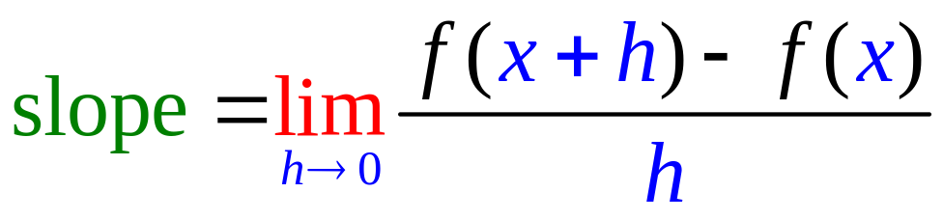
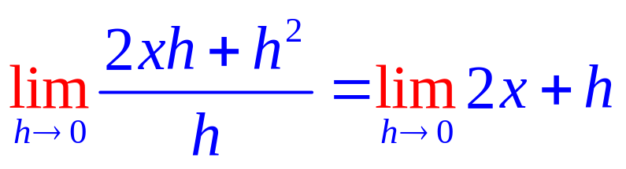
Find the slope of the tangent line of f(x) = x² when x = x.
1. Calculate f(x+h) – f(x)
f(x+h) = x² + 2xh + h²
f(x) = x²
f(x+h) – f(x) = 2xh + h² .
2. Divide by h and get 2x + h
3. Let h go to 0

Slide 19
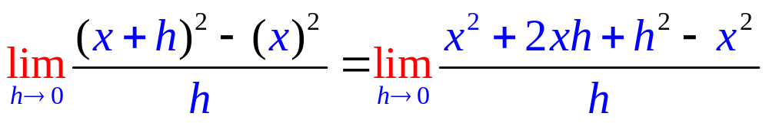
Find the slope of f(x)=x²
2x+h
2x
x²

Slide 20
Find the slope of f(x)=x²
2x+h
2x
x²

Slide 21
Find the slope of the tangent line of f(x) = x² when x = x.
1. Calculate f(x+h) – f(x)
f(x+h) = x² + 2xh + h²
f(x) = x²
f(x+h) – f(x) = 2xh + h² .
2. Divide by h and get 2x + h
3. Let h go to 0 and get 2x

Slide 22
Finding the slope of the tangent line of f(x) = x², f(x+h) - f(x) =
(x+h)² – x²
x² + h² – x²
(x+h)(x – h)

Slide 23
Finding the slope of the tangent line of f(x) = x², f(x+h) - f(x) =
(x+h)² – x²
x² + h² – x²
(x+h)(x – h)

Slide 24
(x+h)² – x² =
x² + 2xh + h²
h²
2xh + h²

Slide 25
(x+h)² – x² =
x² + 2xh + h²
h²
2xh + h²

Slide 26
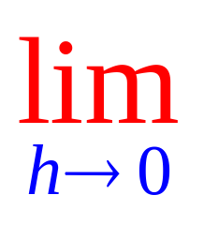
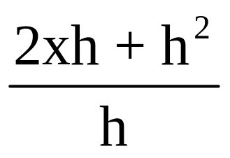
⁼
2x
2x + h²
2xh

Slide 27
⁼
2x
2x + h²
2xh

Slide 28
Find the slope of the tangent line of f(x) = 2x + 3 when x = x.
1. Calculate f(x+h) – f(x)
f(x+h) = 2(x+h) + 3
f(x) = 2x + 3
f(x+h) = 2x + 2h + 3
f(x) = 2x +3
f(x+h)-f(x) = 2h
2. Divide by h and get 2
3. Let h go to 0 and get 2

Slide 29
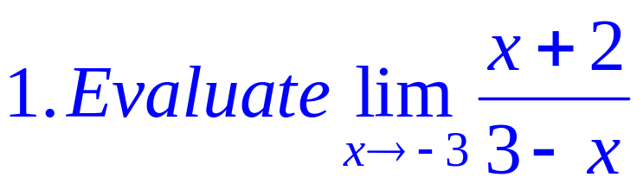
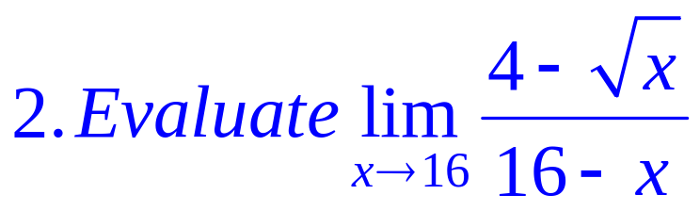
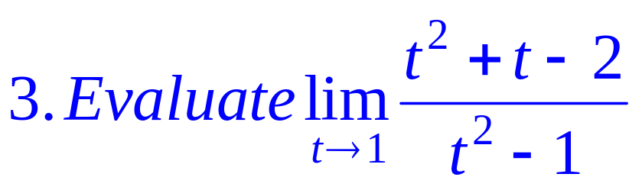

Slide 30
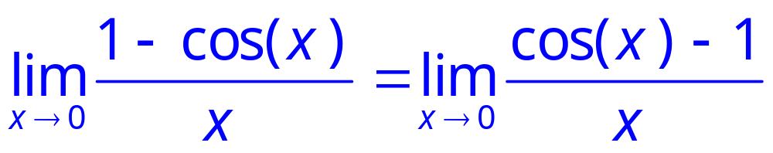
= 0
Rule 5

Slide 31
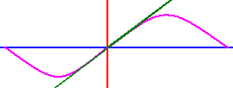
sin(0.0018) =
A 1.8
B 0.18
C 0.018
D 0.0018
E 0.00018

Slide 32
sin(0.0018) =
A 1.8
B 0.18
C 0.018
D 0.0018
E 0.00018

Slide 33
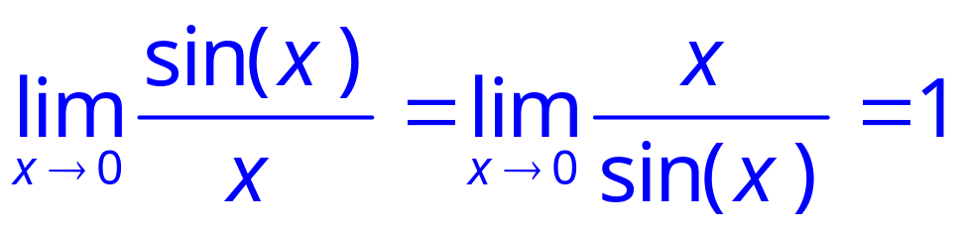
Rule 4

Slide 34

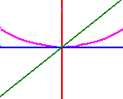


= 0
Rule 5

Slide 35
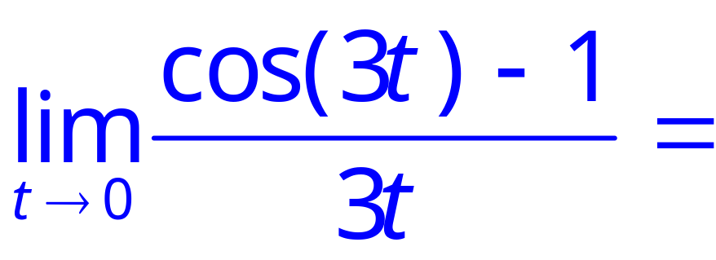
.
A 12
B 6
C 1
D 0
E -1

Slide 36
.
A 12
B 6
C 1
D 0
E -1

Slide 37
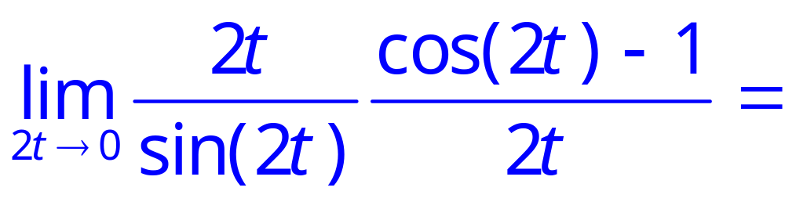
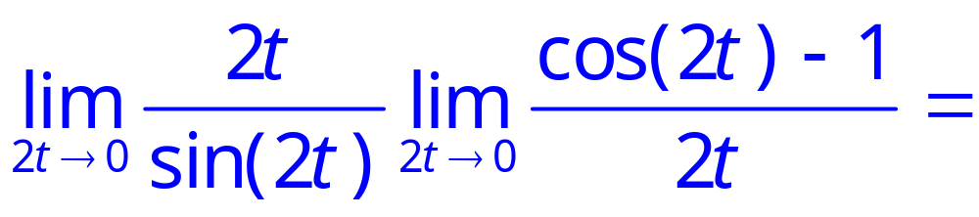
.

Slide 38
.
1 * 0

Slide 39
.
A 12
B 6
C 1
D 0
E -1

Slide 40
.
A 12
B 6
C 1
D 0
E -1

Slide 41
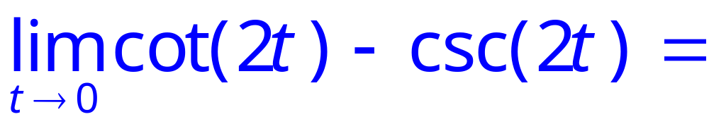

.

Slide 42

.

Slide 43

.

Slide 44

.

Slide 45

.

Slide 46






Slide 47




Slide 48

.
A 0
B ½
C 1
D 4
E 8

Slide 49
.
A 0
B ½
C 1
D 4
E 8

Slide 50

Write the equation of the line tangent to y = x + sin(x) when x = 0 given the slope there is 2.
y = 2x + 1
y = 2x + 0.5
y = 2x

Slide 51
Write the equation of the line tangent to y = x + sin(x) when x = 0 given the slope there is 2.
y = 2x + 1
y = 2x + 0.5
y = 2x

