Slide 1
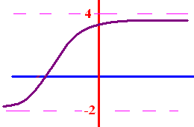
Limits as x goes to
+ or - infinity
What does y get close to
as x goes to + infinity?
What does y get close to
as x goes to - infinity?

Slide 2
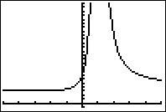

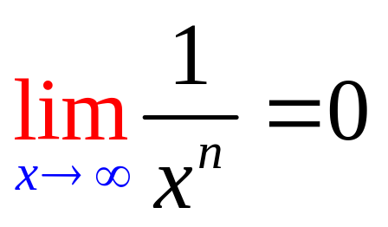
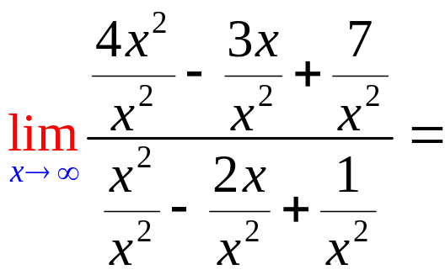
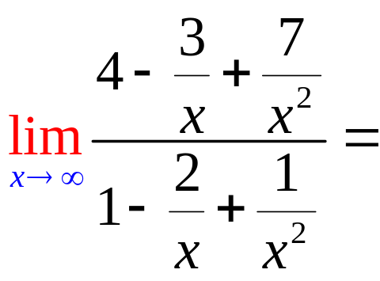
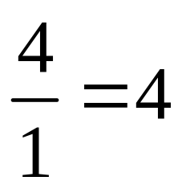
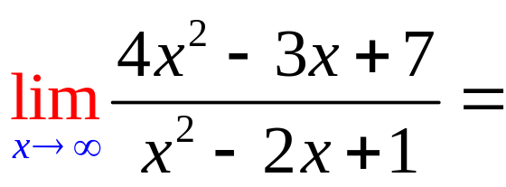
Limits as x goes to
+ or - infinity
To calculate the limit as x
goes to infinity, remember
if n > 0.

Slide 3
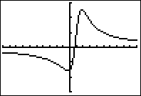
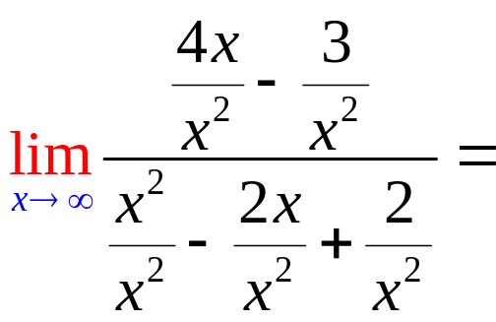
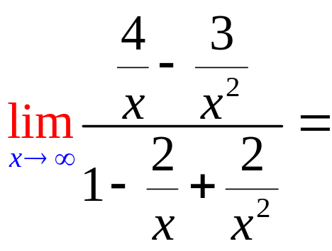
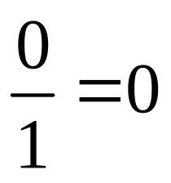
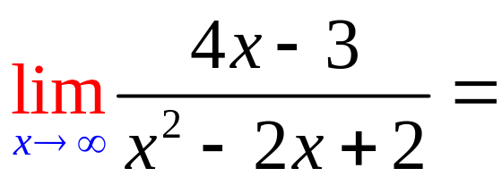
Limits as x goes to
+ or - infinity

Slide 4
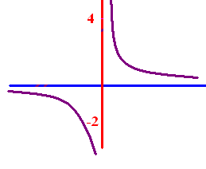
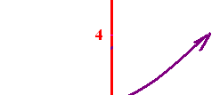
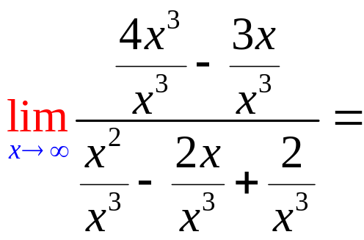
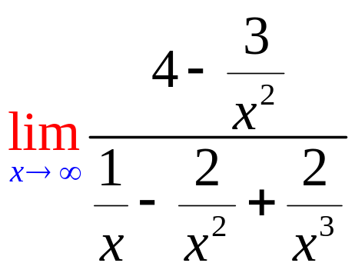
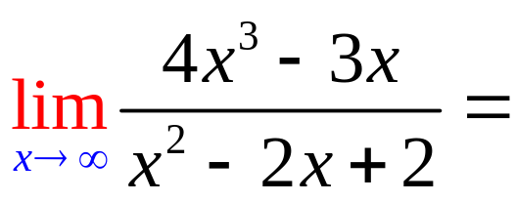
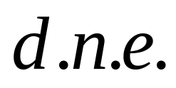
Limits as x goes to
+ or - infinity

Slide 5
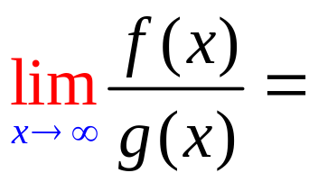
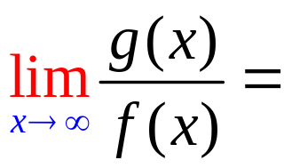
5
f(x)=3x⁵ - 3x³ + 2
g(x) = 2x² - 4x + 2

Slide 6
5
f(x)=3x⁵ - 3x³ + 2
g(x) = 2x⁵ - 4x + 2

Slide 7
5
f(x)=3x⁵ - 3x³ + 2
g(x) = 2x²¹ - 4x + 2

Slide 8
5
f(x)= x⁸ - 3x³ + 2
g(x) = 7x⁸ - 4x + 2

Slide 9
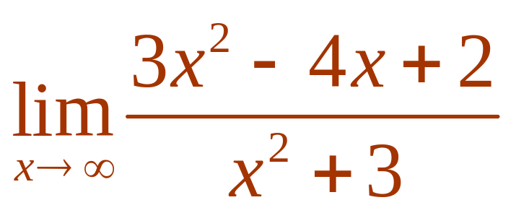

Evaluate .
3
1/3
d.n.e
0

Slide 10


Evaluate .
3
1/3
d.n.e
0

Slide 11
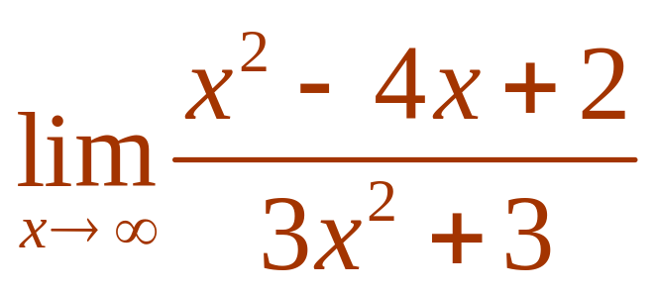
Evaluate .
3
1/3
d.n.e
0

Slide 12
Evaluate .
3
1/3
d.n.e
0

Slide 13
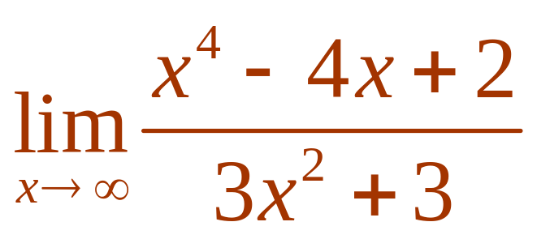
Evaluate .
3
1/3
d.n.e
0

Slide 14
Evaluate .
3
1/3
d.n.e
0

Slide 15
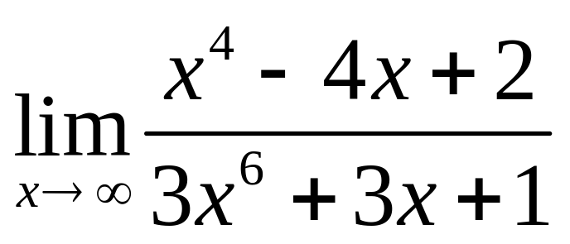
Evaluate
3
1/3
d.n.e
0

Slide 16
Evaluate
3
1/3
d.n.e
0

Slide 17
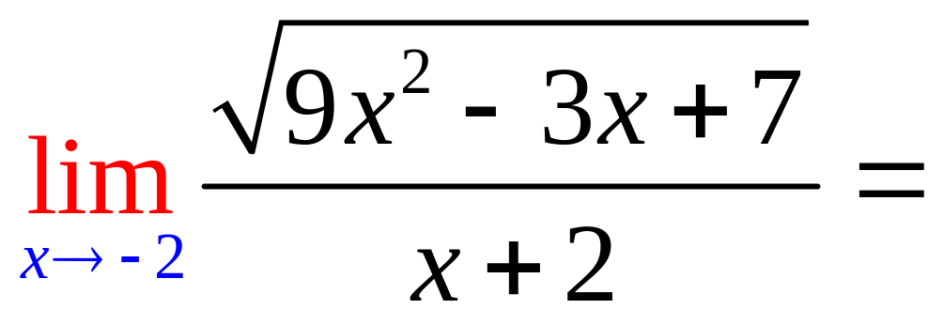
0
d.n.e.
7

Slide 18
0
d.n.e.
7

Slide 19
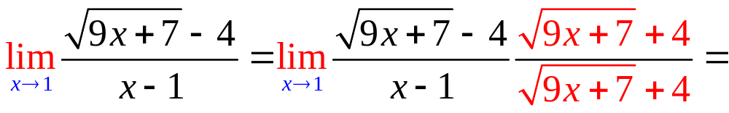
9/8
d.n.e.
0

Slide 20
9/8
d.n.e.
0

Slide 21
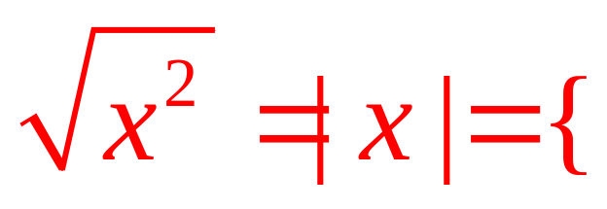
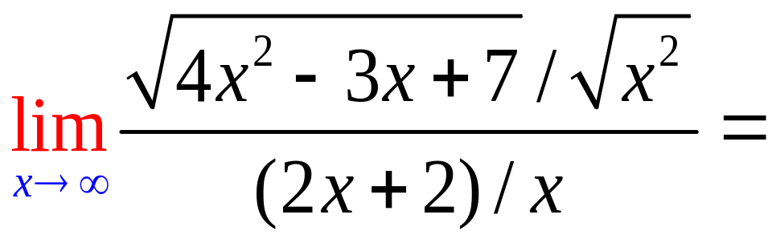
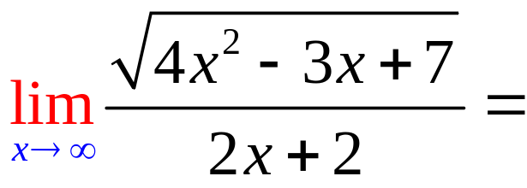
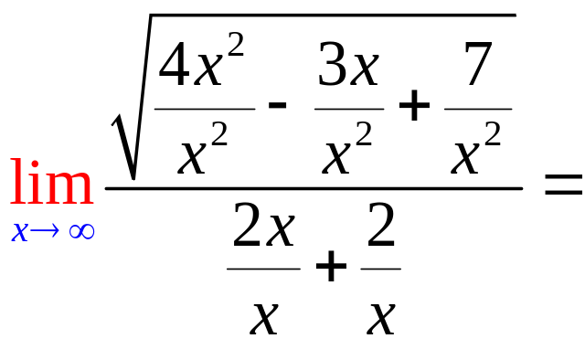
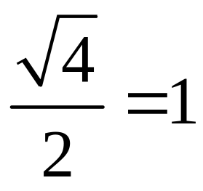
x, if 0 < x
-x, if x < 0

Slide 22
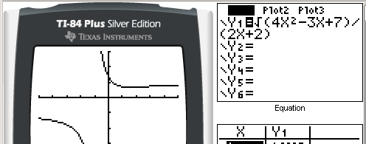
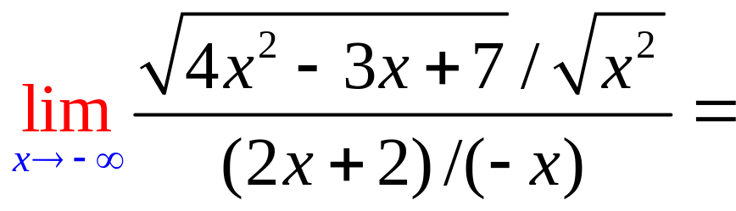
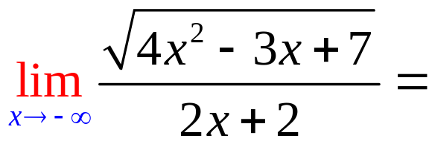
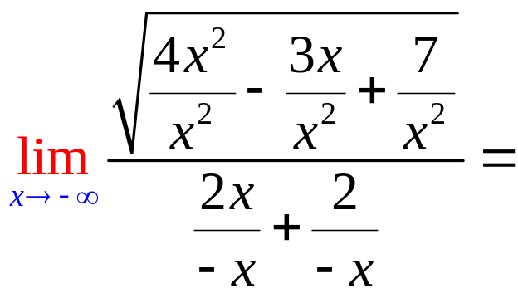
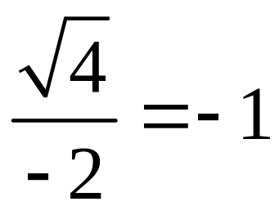
x, if 0 < x
-x, if x < 0

Slide 23
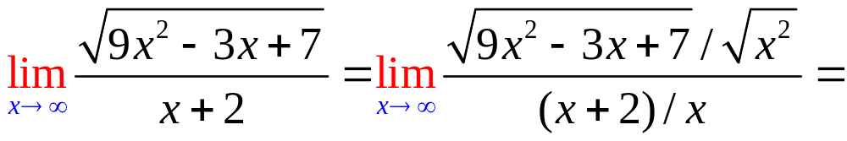
.

Slide 24


.
3.0
0.1

Slide 25
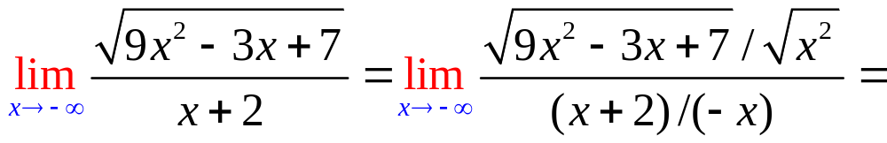
.

Slide 26
.
-3.0
0.1

Slide 27
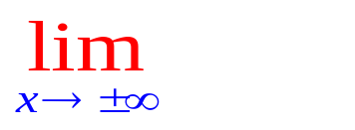
Where are the asymptotes for
?
Set the denominator to zero
Answer is x = answer of 1.
Evaluate
Answer is y = answer to 3.

Slide 28
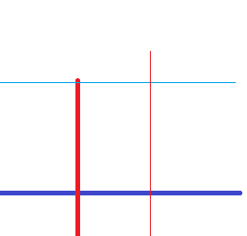
Where are the asymptotes for
Set the denominator to zero. x – 2 = 0
Answer is x = 2.
Evaluate =
Answer is y = answer to 3.

Slide 29
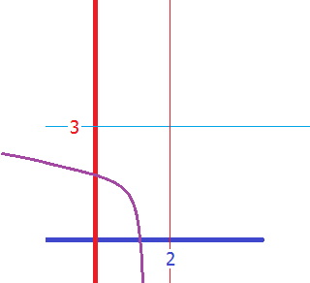
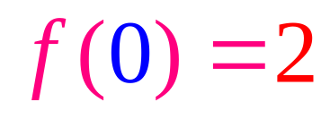
Where are the asymptotes for
Set the denominator to zero. x – 2 = 0
Answer is x = 2.
Evaluate = 3
Answer is y = 3.

Slide 30
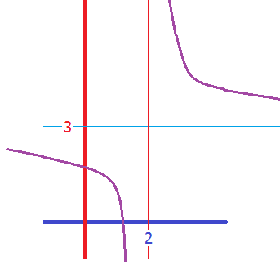
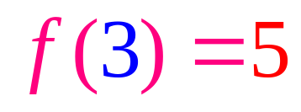
Where are the asymptotes for
Set the denominator to zero. x – 2 = 0
Answer is x = 2.
Evaluate = 3
Answer is y = 3.

