Slide 1

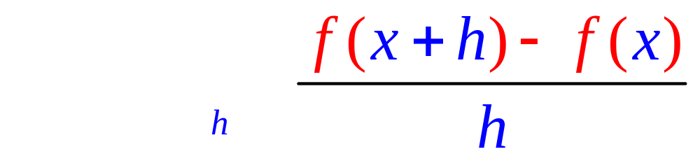
Definition of Derivative
if the limit exists as one real number.

Slide 2

If g(t) = t^{n} then g'(t) = n t ^{(n-1)} If g(t) = t⁴ + 3t + 1, find g’(t)
If f(t) = t^{n} then f ' (t) = n t ^{(n-1)}
4t³ + 4
4t + 3
4t³ + 3
4t + 3 + 1

Slide 3


If g(t) = t^{n} then g'(t) = n t ^{(n-1)} If g(t) = t⁴ + 3t + 1, find g’(t)
4t³ + 4
4t + 3
4t³ + 3
4t + 3 + 1

Slide 4
If g’(t) = 4t³ + 3, find g’’(t)
4t³ + 3
12t² + 3
12t²
4t If f(t) = t^{n} then f ' (t) = n t ^{(n-1)}

Slide 5
If g’(t) = 4t³ + 3, find g’’(t)
4t³ + 3
12t² + 3
12t²
4t If f(t) = t^{n} then f ' (t) = n t ^{(n-1)}

Slide 6
If h(x) = , find h’(x)
If h(x) = x^{n} then h' (x) = n x ^{(n-1)}
h(x) = 4x⁻²

Slide 7
h(x) = =4x⁻² h’(x)=
-8x⁻³ + 30x⁻¹¹
8x⁻³ - 30x⁻¹¹
-8x⁻¹ + 30x⁻⁹
8x⁻¹ - 30x⁻⁹ If h(x) = x^{n} then h' (x) = n x ^{(n-1)}

Slide 8
If h(x) = , find h’(x)
-8x⁻³ + 30x⁻¹¹
8x⁻³ - 30x⁻¹¹
-8x⁻¹ + 30x⁻⁹
8x⁻¹ - 30x⁻⁹ If h(x) = x^{n} then h' (x) = n x ^{(n-1)}

Slide 9
Dist trvl by X-2 racing car t seconds after braking.#59
x(t) = 120 t – 15 t².
Find the velocity for any t.
Find the velocity when brakes applied.
When did it stop?

Slide 10
Dist trvl by X-2 racing car t seconds after braking. 59.
x(t) = 120 t – 15 t².
Find the velocity for any t.
x’(t) = 120 - 30 t

Slide 11
Dist trvl by X-2 racing car t seconds after braking. 59.
x(t) = 120 t – 15 t².
x’(t) = 120 - 30 t
Find the velocity when brakes applied.
x’(0) = 120 ft/sec

Slide 12
Dist trvl by X-2 racing car t seconds after braking. 59.
x(t) = 120 t – 15 t².
x’(t) = 120 - 30 t
Find the velocity when t = 2.
x’(2) = 120 – 30(2) = 60 ft/sec

Slide 13
Dist trvl by X-2 racing car t seconds after braking. 59.
x(t) = 120 t – 15 t².
x’(t) = 120 - 30 t
Find the velocity when t = 2.
x’(2) = 120 – 30(2) = 60 ft/sec
What does positive 60 mean?

Slide 14
Dist trvl by X-2 racing car t seconds after braking. 59.
x(t) = 120 t – 15 t².
x’(t) = 120 - 30 t
Find the velocity when t = 2.
x’(2) = 120 – 30(2) = 60 ft/sec
What does positive 60 mean?
Car is increasing its distance from home.

Slide 15
Dist trvl by X-2 racing car t seconds after braking. 59.
x(t) = 120 t – 15 t².
x’(t) = 120 - 30 t
When did it stop?

Slide 16
Dist trvl by X-2 racing car t seconds after braking. 59.
x(t) = 120 t – 15 t².
x’(t) = 120 - 30 t
When did it stop?
When the velocity is zero.

Slide 17
Dist trvl by X-2 racing car t seconds after braking. 59.
x(t) = 120 t – 15 t².
x’(t) = 120 - 30 t
When did it stop?
x’(t) = 120 - 30 t = 0

Slide 18
Dist trvl by X-2 racing car t seconds after braking. 59.
x(t) = 120 t – 15 t².
x’(t) = 120 - 30 t
When did it stop?
x’(t) = 120 - 30 t = 0
120 = 30 t
4 = t

Slide 19
Dist trvl by X-2 racing car t seconds after braking. 59.
x(t) = 120 t – 15 t².
x’(t) = 120 - 30 t
When did it stop?
x’(t) = 120 - 30 t = 0
120 = 30 t
4 = t
This changes the domain of x to

Slide 20
Dist trvl by X-2 racing car t seconds after braking. 59.
x(t) = 120 t – 15 t².
x’(t) = 120 - 30 t
When did it stop?
x’(t) = 120 - 30 t = 0
120 = 30 t
4 = t
This changes the domain of x to [0,4].

Slide 21
Dist trvl by X-2 racing car t seconds after braking. 59.
x(t) = 120 t – 15 t² defined on [0,4].
x’(t) = 120 - 30 t
How far did it travel after hitting the brakes?

Slide 22
Dist trvl by X-2 racing car t seconds after braking. 59.
x(t) = 120 t – 15 t² defined on [0,4].
x’(t) = 120 - 30 t
How far did it travel after hitting the brakes?
x(4) = 480 – 15*16 = 240 feet

Slide 23
Dist trvl by X-2 racing car t seconds after braking. 59.
x(t) = 120 t – 15 t².
x’(t) = 120 - 30 t
Find the acceleration, x’’(t).

Slide 24
Dist trvl by X-2 racing car t seconds after braking. 59.
x(t) = 120 t – 15 t².
x’(t) = 120 - 30 t
Find the acceleration, x’’(t).
x’’(t) = -30

Slide 25
Dist trvl by X-2 racing car t seconds after braking. 59.
x(t) = 120 t – 15 t².
x’(t) = 120 - 30 t
Acceleration, x’’(t) = -30.
What does the negative sign mean?

Slide 26
Dist trvl by X-2 racing car t seconds after braking. 59.
x(t) = 120 t – 15 t².
x’(t) = 120 - 30 t
Acceleration, x’’(t) = -30.
What does the negative sign mean?
Your foot is on the brakes.

Slide 27
Dist trvl by X-2 racing car t seconds after braking. 59.
x(t) = 120 t – 15 t².
x’(t) = 120 - 30 t
What is the range on [0,4]?

Slide 28
Dist trvl by X-2 racing car t seconds after braking. 59.
x(t) = 120 t – 15 t².
x’(t) = 120 - 30 t
What is the range on [0,4]?
[0, 240]

Slide 29
Definition of Derivative
if the limit exists as one real number.

Slide 30
Theorem 1
The product rule
[f(x) g(x)]’ =
copy diff. copy diff.
f(x) g’(x) + g(x) f ’(x)

Slide 31
The product rule
If k(x) = f(x) g(x) , then
k’(x) = f(x) g’(x) + g(x) f ’(x)
Suppose k(x) = (3x²-2x) (4x⁴+1)
k’(x) = (3x²-2x) (16x³) + (4x⁴+1)(6x-2)

Slide 32
Theorem 1
The product rule
[f(x) g(x)]’ =
f(x) g’(x) + g(x) f ’(x)

Slide 33
The product rule
[f(x) g(x)]’=f(x)g’(x) + g(x)f ’(x)
If y =(x²-3x+1)(1/x+3x) find dy/dx
dy/dx =
(x²-3x+1)(-x⁻²+3) +(1/x+3x) (2x-3)

Slide 34
If f(x) = x^{n} then f ' (x) = n x ^{(n-1)}
If
then

Slide 35
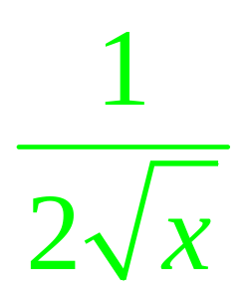
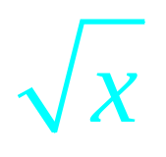
The product rule
[f(x) g(x)]’ = f(x) g’(x) + g(x) f ’(x)
[ (3x-1)]’ = (3) +(3x-1)

Slide 36
If y = (x-1)(3x²+2) find dy/dx or y’
6x
(x-1) 6x + (3x²+2)
(x-1) 6x + (3x²+2)x
3x²+2

Slide 37
If y = (x-1)(3x²+2) find dy/dx or y’
6x
(x-1) 6x + (3x²+2)
(x-1) 6x + (3x²+2)x
3x²+2

Slide 38
If y = (x²-x)(-3x²+2) find dy/dx or y’
(2x-1) (-6x)
(x²-x)(-3x+2) + (-3x²+2)(2x-1)
(x²-x)(-6x) + (-3x²+2)(2x-1)

Slide 39
If y = (x²-x)(-3x²+2) find dy/dx or y’
(2x-1) (-6x)
(x²-x)(-3x+2) + (-3x²+2)(2x-1)
(x²-x)(-6x) + (-3x²+2)(2x-1)

Slide 40
If y = (x²-x)(x³-3x²+2) find dy/dx or y’
(x²-x) (3x² - 6x) + (x³ - 3x²+2) (2x-1)
(x²-x) (2x-1) + (x³ - 3x² ⁺²) (3x² - 6x)
(2x-1) (3x² - 6x)
(x²-x) (3x² - 6x) - (x³ - 3x²+2) (2x-1)

Slide 41
If y = (x²-x)(x³-3x²+2) find dy/dx or y’
(x²-x) (3x² - 6x) + (x³ - 3x²+2) (2x-1)
(x²-x) (2x-1) + (x³ - 3x² ⁺²) (3x² - 6x)
(2x-1) (3x² - 6x)
(x²-x) (3x² - 6x) - (x³ - 3x²+2) (2x-1)

Slide 42
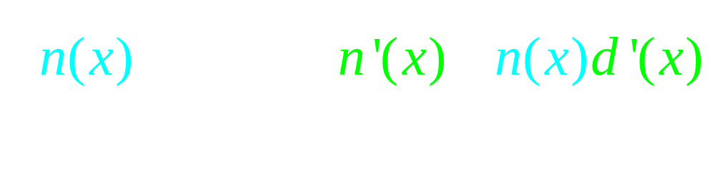
Theorem 2
The quotient rule

Slide 43
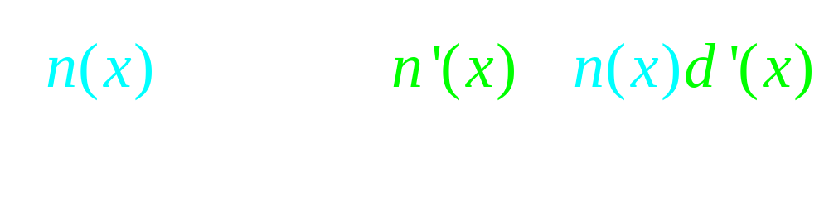
Theorem 2
The quotient rule
Never cancel across the minus sign

Slide 44


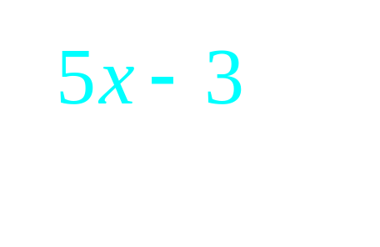

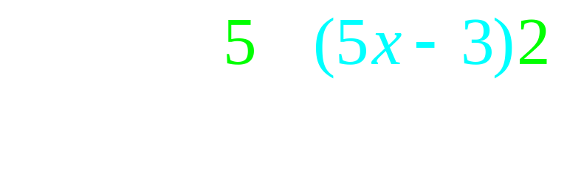
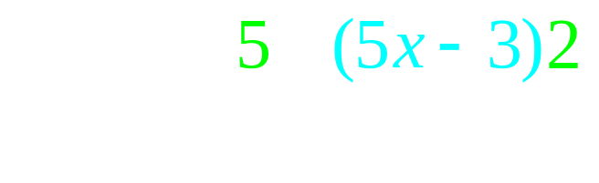
The quotient rule

Slide 45
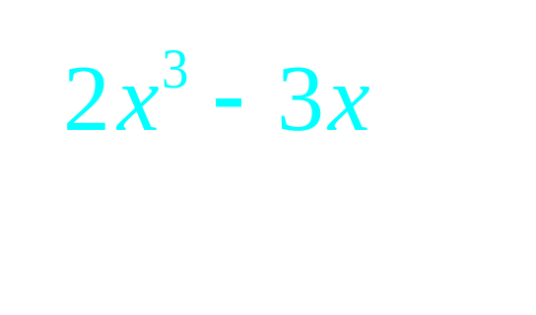
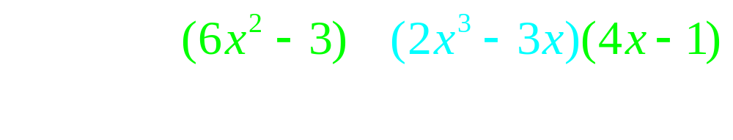

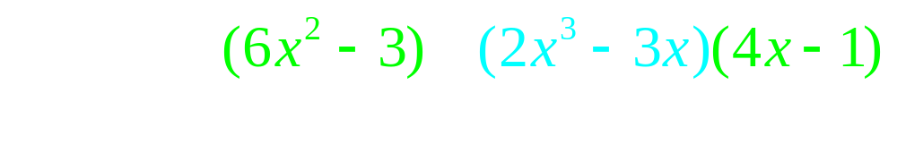
The quotient rule

Slide 46
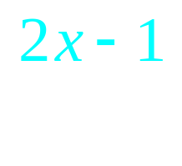
If f(x)= find f ’(x)
[(3x-4)2 – (2x-1)3] /(3x-4)²
(3x-4)2 – (2x -1)(3)
[(2x-1)3 – (3x-4)2] /(3x-4)²

Slide 47
If f(x)= find f ’(x)
[(3x-4)2 – (2x-1)3] /(3x-4)²
(3x-4)2 – (2x -1)(3)
[(2x-1)3 – (3x-4)2] /(3x-4)²

Slide 48
If f(x)= find f ’(1)
-11
-5

Slide 49
If f(x)= find f ’(1)
-11
-5

Slide 50
If f(x)= f ’(1) = -5
Write the equation of the line tangent to f when x = 1.

Slide 51
If f(x)= f ’(1) = -5
Write the equation of the line tangent to f when x = 1.
f(1) =

Slide 52
If f(x)= f ’(1) = -5
Write the equation of the line tangent to f when x = 1.
f(1) = 2/(-1) = -2

Slide 53
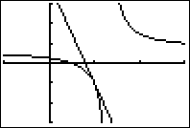
If f(x)= & f ’(1) = -5
Write the eq. of the tan. line
y + 1 = -5(x-1)
y – 1 = -5(x-1)
y = -5(x-1)
y = 5(x-1) - 1
when x = 1.

Slide 54
If f(x)= & f ’(1) = -5
Write the eq. of the tan. line
y + 1 = -5(x-1)
y – 1 = -5(x-1)
y = -5(x-1)
y = 5(x-1) - 1
when x = 1.

Slide 55
If f(x)= where is the horizontal asymptote?
d. n. e.
y = 0
y = 2/3
y = 1

Slide 56
If f(x)= where is the horizontal asymptote?
d. n. e.
y = 0
y = 2/3
y = 1

Slide 57
If f(x)= where is the vertical asymptote?
d. n. e.
x = 1
x = 4/3
x = 3/2

Slide 58
If f(x)= where is the vertical asymptote?
d. n. e.
x = 1
x = 4/3
x = 3/2

Slide 59

Proof of the product rule
k(x) = f(x) g(x)

Slide 60
Proving the product rule

Slide 61
The product rule

Slide 62
The product rule
k’(x) = f(x) g’(x) + g(x) f ’(x)

