Slide 1
Power Rule is a corallary to Chain Rule

Slide 2
Power Rule
If f(x) = x^{n} then f ' (x) = n x ^{(n-1)}
Replacing x by g(x) gives

Slide 3


Power Rule
k(x) = g^{n}(x) = [g(x)]^{n}
k’(x) = n [g (x)] ^{n-1} g’(x)

Slide 4

Power Rule
k(x) = [x² + x ] ³
k’(x) = 3 [x² + x] ² (2x+1)
http://www.youtube.com/watch?v=-8lDYrvTILc

Slide 5
Power Rule
k(x) = 2[3x³ + x ] ⁴
k’(x) = 8 [3x³ + x] ³ (9x²+1)

Slide 6
k(x) = (x³ + 2x)⁴ k’(x)=
4 (x³ + 2x)³ (3x² + 2)
4 (x³ + 2x)³ (3x + 2)
4 (x³ + 2x)³ (3x + 2x)

Slide 7


k(x) = (x³ + 2x)⁴ k’(x)=
4 (x³ + 2x)³ (3x² + 2)
4 (x³ + 2x)³ (3x + 2)
4 (x³ + 2x)³ (3x + 2x)

Slide 8
Power Rule
k(x) = 2[3x³ - x⁻² ]²⁰
k’(x) = 40 [3x³ - x⁻²] ¹⁹ (9x²+2x⁻³)
http://www.youtube.com/watch?v=-8lDYrvTILc

Slide 9
t(x) = (2x⁵ + 3x² + 2)⁴ t’(x)=
4 (2x⁵ + 3x² + 2)³(10x + 6x + 2)
4 (10x⁴ + 6x)³
4 (2x⁵ + 3x² + 2)³ (10x⁴ + 6x)

Slide 10
t(x) = (2x⁵ + 3x² + 2)⁴ t’(x)=
4 (2x⁵ + 3x² + 2)³(10x + 6x + 2)
4 (10x⁴ + 6x)³
4 (2x⁵ + 3x² + 2)³ (10x⁴ + 6x)

Slide 11
s(t)=3(t-2/t)⁷ = 3(t-2t⁻¹)⁷ s’(t) =
21t - 42
21(t - 2/t)⁶ (1 + 2t ⁰)
21(t - 2/t)⁶ (1 - 2t ⁻¹)
21(t - 2/t)⁶ (1 + 2t ⁻²)

Slide 12
s(t)=3(t-2/t)⁷ = 3(t-2t⁻¹)⁷ s’(t) =
21t - 42
21(t - 2/t)⁶ (1 + 2t ⁰)
21(t - 2/t)⁶ (1 - 2t ⁻¹)
21(t - 2/t)⁶ (1 + 2t ⁻²)

Slide 13
Power Rule
=[3x³ - x² ]^{1/2}
k’(x) = ½ [3x³ - x²]^{-1/2} (9x²-2x)
http://www.youtube.com/watch?v=-8lDYrvTILc

Slide 14
rewrite y using algebra .
.
.
.

Slide 15
rewrite y using algebra .
.
.
.

Slide 16
= dy/dx=
.
.
.

Slide 17
= dy/dx=
.
.
.

Slide 18
Power Rule
k(x) = [sin x] ¹³
k’(x) = 13 [sin x] ¹² (cos x)

Slide 19
Power Rule
k(x) = [csc x] ³ = csc³x
k’(x) = 3 [csc x] ² (-csc x cot x)

Slide 20
Power Rule
k(x) = [csc x] ³ = csc³x
k’(x) = 3 [csc x] ² (-csc x cot x)

Slide 21
Power Rule
k(x) = [sin x] ⁻³ = csc³x
k’(x) = -3 [sin x] ⁻⁴ (cos x)
http://www.youtube.com/watch?v=-8lDYrvTILc

Slide 22
t(x) = (tan x)⁴ = tan⁴x t’(x)=
4 (tan x)³
(tan x)³ (sec x)²
4 (tan x)³ (sec x)²

Slide 23
t(x) = (tan x)⁴ = tan⁴x t’(x)=
4 (tan x)³
(tan x)³ (sec x)²
4 (tan x)³ (sec x)²

Slide 24
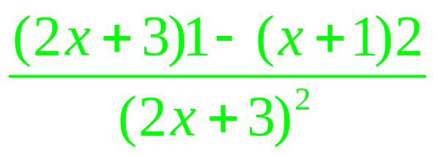

Slide 25
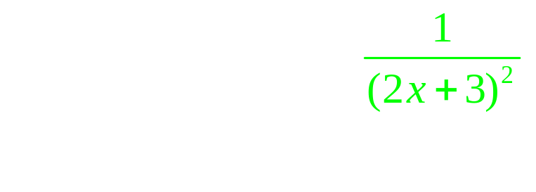
.
.

Slide 26
.
.
.
.

Slide 27
.
.
.
.

Slide 28
k(x) = ( x² + x)³
Evaluate k’(1)
22
24
36
38

Slide 29
t(x) = t’(x)=
.
.

Slide 30
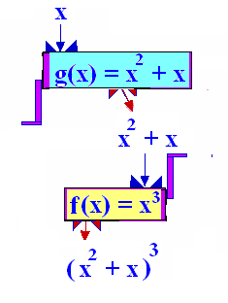
The composition function
k(x) = (f º g)(x) = f (g(x))
g
R--->[-¼,+oo)
f
---->[-1/64 , +oo)

Slide 31
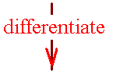
Theorem 1
The chain rule
If k(x) =f (g(x)), then
k’(x) = f ’ ( g(x) ) g’(x)

Slide 32
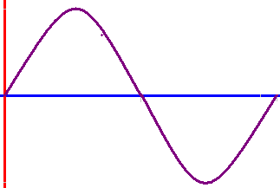
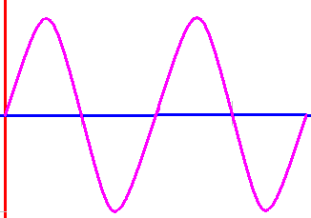
y = sin(x/2)
y = sin (x)

Slide 33
y = sin(x/4)
y = sin (x/2)

Slide 34
y = sin (x) y’ = cos (x)
y = sin (2x)
y’ = cos (2x) 2

Slide 35
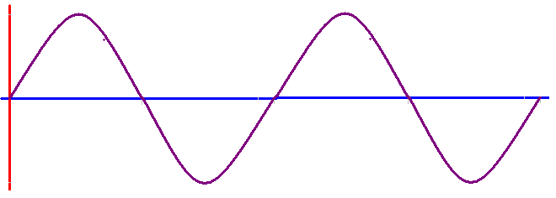
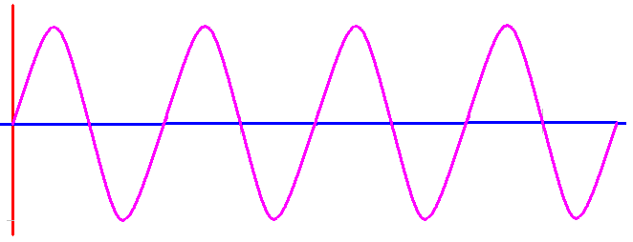
y = sin(2x) y = sin(4x)
y = sin(4x)
y’ = cos(4x) 4

Slide 36
y = tan(4x)
y’ = sec²(4x)
http://www.youtube.com/watch?v=-8lDYrvTILc
y’ = sec²(4x) 4 = 4[sec(4x)] ².

Slide 37
y = [sin(4x)]²¹.
y’ =

Slide 38
y = [sin(4x)]²¹.
y’ = 21[sin(4x)]²⁰

Slide 39
y = [sin(4x)]²¹.
y’ = 21[sin(4x)]²⁰
http://www.youtube.com/watch?v=-8lDYrvTILc

Slide 40
y = [sin(4x)]²¹.
y’ = 21[sin(4x)]²⁰ cos(4x)

Slide 41
y = [sin(4x)]²¹.
y’ = 21[sin(4x)]²⁰ cos(4x)
http://www.youtube.com/watch?v=-8lDYrvTILc
Double doink-doink

Slide 42
y = [sin(4x)]²¹.
y’ = 21[sin(4x)]²⁰ cos(4x)4
= 84 [sin(4x)]²⁰ cos(4x)

Slide 43
y = cot(3πx)
y’ = –csc²(3πx) 3π
y = cos(5πx)
y = -sin(5πx) 5π
y’ = -5π sin(5πx)

Slide 44
If f(x) = sin(10x) , find f’(0)

Slide 45


If f(x) = sin(10x) , find f’(0)
10.0
0.1

Slide 46
If f(x) = cos(12x) , find f’(0)

Slide 47
If f(x) = cos(12x) , find f’(0)
0.0
0.1

Slide 48
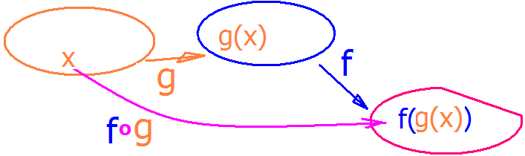
Theorem :
Chain Rule
[f o g ]' (x) = f '[g(x)]g'(x).

Slide 49
Chain Rule
[f o g ]' (x) = f '[g(x)]g'(x)
The derivative of the composite is
the derivative of the outside
evaluated at the inside
times the derivative of the inside
evaluated at x

Slide 50
Theorem :
Chain Rule
[f o g ]' (x) = f '[g(x)]g'(x)
Differentiate f(x),
replacing x by g(x),
differentiate g(x), and
multiply.

Slide 51
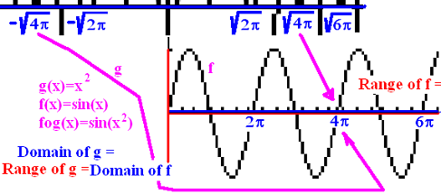
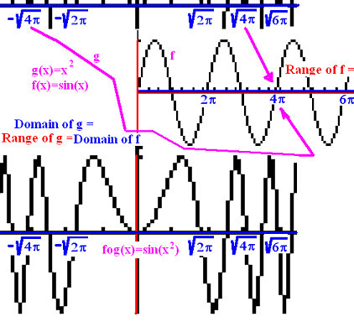
Theorem :
Chain Rule
Thus to find y’
y = sin(x²)
y' = cos(x²) (2x)

Slide 52
y = sin(x²) y’ = cos(x²)2x
y(sqrt(π)/2) = sin(π/4) = sqrt(2)/2
y'(sqrt(π)/2) = cos(π/4) 2 sqrt(π)/2 =
sqrt(2)/2 [2] sqrt(π)/2 = sqrt(2π)/2

Slide 53
Theorem :
Chain Rule
y' = cos(x²) (2x) and when x = sqrt(π)/2,
y'(sqrt(π)/2) = cos(π/4) 2 sqrt(π)/2 =
sqrt(2)/2 [2] sqrt(π)/2 = sqrt(2π)/2
The equation of the tangent line would be
[y - sqrt(2)/2] / [x - sqrt(π)/2] = sqrt(2π)/2

Slide 54
Differentiate f(x), replacing x by g(x),
differentiate g(x), and
multiply the preceeding answers together.

Slide 55
If f(x) = x^{n} then [f(g(x))]’= f ' (g(x))g’(x) = n g(x)^{n-1} g’(x)
y = (csc(x)+x³)⁵ then y’ =
5(csc(x)+x³)⁴

Slide 56
If f(x) = x^{n} then [f(g(x))]’= f ' (g(x))g’(x) = n g(x)^{n-1} g’(x)
y = (csc(x)+x³)⁵ then y’ =
5(csc(x)+x³)⁴ (-csc(x)cot(x)+3x²)
and
y’ (π/2) =

Slide 57
If f(x) = x^{n} then [f(g(x))]’= f ' (g(x))g’(x) = n g(x)^{n-1} g’(x)
y = (csc(x)+x³)⁵ then y’ =
5(csc(x)+x³)⁴ (-csc(x)cot(x)+3x²)
and
y’(π/2) = 5(1 + (π/2)³ )⁴ (0 + 3(π/2)² )

