Slide 1

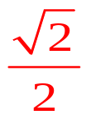
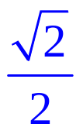

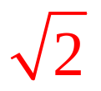

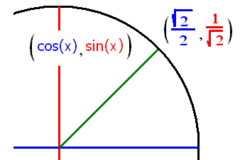

Trigonometry Review
Find sin(π/4) = cos(π/4) = tan(π/4) =
csc(π/4) = sec(π/4) = cot(π/4) =

Slide 2
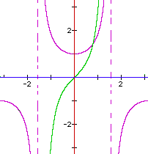
Evaluate tan(π/4)
Root 2
2
Root 2 /2
2 / Root 2
1

Slide 3
Evaluate tan(π/4)
Root 2
2
Root 2 /2
2 / Root 2
1

Slide 4

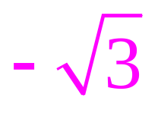


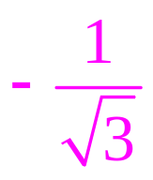


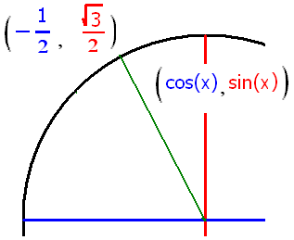
Trigonometry Review
sin(2π/3) = cos(2π/3) = tan(2π/3) =
csc(2π/3) = sec(2π/3) = cot(2π/3) =

Slide 5
Evaluate sec(2π/3)
-1
-2
-3
Root(3)
2 / Root(3)

Slide 6
Trig. Derivatives
sin’(x) = cos(x) cos’(x) = - sin(x)

Slide 7
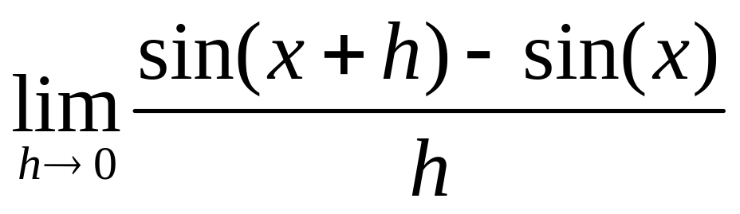
Trig. Derivatives
sin’(x) = cos(x)
sin’(x) =

Slide 8
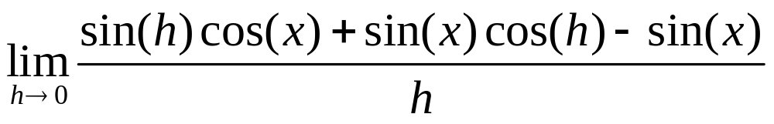
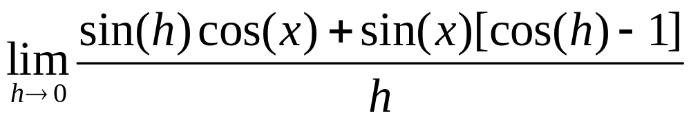
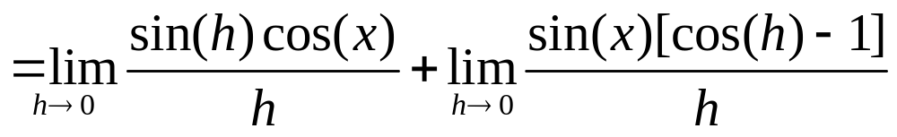
sin’(x) = .
sin’(x) =
sin’(x) =

Slide 9
Rule 4 says .
0
0.5
1
1.5

Slide 10
Rule 5 says .
0
0.5
1
1.5

Slide 11
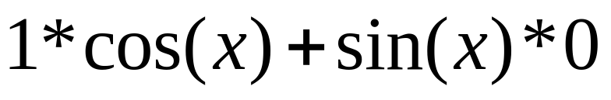
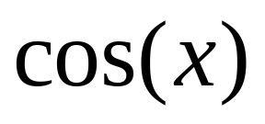
sin’(x) = .
sin’(x) =
sin’(x) =

Slide 12
Trig. Derivatives
sin’(x) = cos(x) cos’(x) = - sin(x)

Slide 13
If y = sin(x) + 2x², find dy/dx
- cos(x) + 4x
cos(x) + 4
cos(x) + 4x

Slide 14
cos’(x) = - sin(x)
cos’(x) =
=

Slide 15
cos’(x) = - sin(x)
cos’(x) =
=

Slide 16



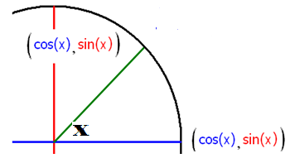
Trig. Derivatives
sin’(x) = cos(x) cos’(x) = - sin(x)
Slope of the sin graph when x = 0
A) sin’(0) = cos(0) =

Slide 17
Trig. Derivatives
sin’(x) = cos(x) cos’(x) = - sin(x)
Slope of the sin graph when x = 0
A) sin’(0) = cos(0) = 1

Slide 18
Trig. Derivatives
sin’(x) = cos(x) cos’(x) = - sin(x)
A) sin’(0) = cos(0) = 1
B) sin’(π/4) = cos(π/4) =

Slide 19
Trig. Derivatives
sin’(x) = cos(x) cos’(x) = - sin(x)
A) sin’(0) = cos(0) = 1
B) sin’(π/4) = cos(π/4) = 0.707

Slide 20
Trig. Derivatives
sin’(x) = cos(x) cos’(x) = - sin(x)
A) sin’(0) = cos(0) = 1
B) sin’(π/4) = cos(π/4) = 0.707
C) sin’(-π/3) = cos(-π/3) =

Slide 21
Trig. Derivatives
sin’(x) = cos(x) cos’(x) = - sin(x)
A) sin’(0) = cos(0) = 1
B) sin’(π/4) = cos(π/4) = 0.707
C) sin’(-π/3) = cos(-π/3) = 0.5

Slide 22

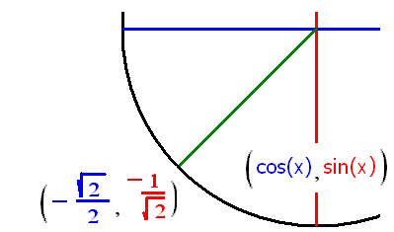
x= 0, 2π/3, - 3π/4
cos’(x) = - sin(x)
A) cos’(0) = - sin (0) = 0
B) cos’(-3π/4) = - sin(5π/4) = 0.707
C) cos’(2π/3) = - sin(2π/3) = - 0.866

Slide 23
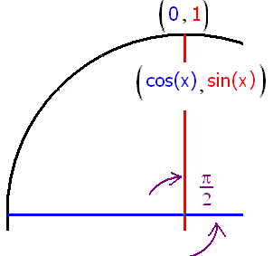
Evaluate cos’(π/2)
-1
-.707
1
0.707

Slide 24
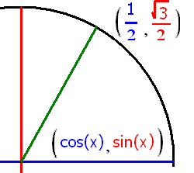
Evaluate sin’(π/3)
- 0.5
0.5
0.707
0.866

Slide 25
Trig. Derivatives
sin’(x) = cos(x) cos’(x) = - sin(x)
tan’(x) = sec²(x) cot’(x) = - csc²(x)
sec’(x) = sec(x)tan(x) csc’(x) = -csc(x)cot(x)

Slide 26
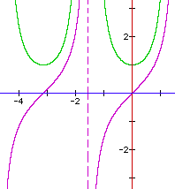
Trig. Derivatives
Theorem tan’(x) = sec²(x)
Proof : tan’(x) = [sin(x)/cos(x)]’

Slide 27
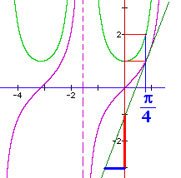
Trig. Derivatives
Theorem tan’(x) = sec²(x)
tan’(π/4) =

Slide 28
Trig. Derivatives
Theorem tan’(x) = sec²(x)
tan’(π/4) = sec²(π/4) = 2 while tan(π/4) =
1

Slide 29
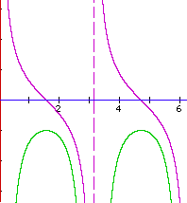
Trig. Derivatives
Theorem cot’(x) = - csc²(x)
Proof : cot’(x) = [cos(x)/sin(x)]’

Slide 30
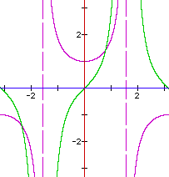
Trig. Derivatives
Theorem sec’(x) = sec(x)tan(x)
Proof : sec’(x) = [1/cos(x)]’

Slide 31
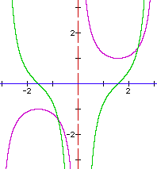
Trig. Derivatives
Theorem csc’(x) = - csc(x)cot(x)
Proof : csc’(x) = [1/sin(x)]’

Slide 32
Trig. Derivatives
sin’(x) = cos(x) cos’(x) = - sin(x)
tan’(x) = sec²(x) cot’(x) = - csc²(x)
sec’(x) = sec(x)tan(x) csc’(x) = - csc(x)cot(x)

Slide 33
If y = tan(x) sec(x) find the velocity and y’(π/3)
sec’(x) = sec(x)tan(x) tan’(x) = sec²(x)
y ’ = tan(x)sec(x)tan(x) + sec(x)sec²(x)
y’=sec(x)[sec² (x)-1] + sec³(x)=2sec³(x)-sec(x)
y’(π/3) = 2sec³(π/3)-sec(π/3) =
sin²x+cos²x=1 dividing by cos²⁽x)
tan² (x)+1=sec² (x)

Slide 34
If y = tan(x) cos(x) find the acceleration and y’’(π/3)
y’ = cos(x)
y’’ = -sin(x) y’’(π/3)=

Slide 35
If y = tan(x) + cos(x) find the initial acceleration, y’’(0)
tan’(x) = sec²(x) sec’(x) = sec(x)tan(x)
y’ = sec(x)sec(x) - sin(x) y’’ =
sec(x) sec(x)tan(x) + sec(x) sec(x)tan(x) - cos(x)
= 2 sec²(x) tan(x) – cos(x)
y’’(0) = 2 * 1 * 0 - . . . . . .

Slide 36


y” = 2 sec²(x) tan(x) – cos(x) y”(0) = -1
-1.0
0.1

Slide 37

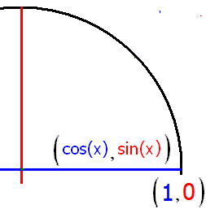
If y = sec(x), find the acceleration, y’’(0) using the product rule on sec’(x).
1.0
0.1

Slide 38
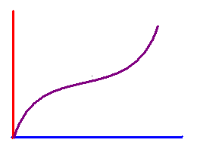
Find the slope of the tangent line to y = x + sin(x) when x = 0
2.0
0.1

Slide 39


Write the equation of the line tangent to y = x + sin(x) when x = 0
y = 2x + 1
y = 2x + 0.5
y = 2x

Slide 40
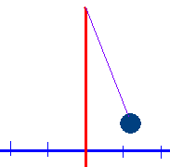
Displacement x(t) = 2 cos(t) find x(0) .
x(0) = 2 cos(t)
x(0) = -2
x(0) = 2

Slide 41
Displacement x(t) = 2 cos(t) find x(0) .
x(0) = 2 cos(t)
x(0) = -2
x(0) = 2

Slide 42
Displacement x(t) = 2 cos(t) find x(π/2).
x(π/2) = 1
x(π/2) = 0
x(π/2) =

Slide 43
Displacement x(t) = 2 cos(t) find x(π/2).
x(π/2) = 1
x(π/2) = 0
x(π/2) =

Slide 44
Displacement x(t) = 2 cos(t) find x’’(t) = a(t)
a(t) = 2 sin(t)
a(t) = 2 cos(t)
a(t) = -2 cos(t)

Slide 45
If f(x) = x^{n} then f ' (x) = n x ^{(n-1)}
Proof, when n is a natural number.
n = 1
Proof : Lim [f(x+h)-f(x)]/h =
Lim (x + h - x)/h = Lim h/h = 1
What is the derivative of x grandson?
One grandpa, one.

Slide 46
If f(x) = x^{n} then f ' (x) = n x ^{(n-1)}
Assume true when n = k
Assume that k is fixed and k >= 1 and
f(x) = x^{k} and that f '(x) = k x ^{(k-1)}

Slide 47
If f(x) = x^{n} then f ' (x) = n x ^{(n-1)}
Prove true when n = k + 1
Proof : Suppose f(x) = x^{k+1} = x x ^{k}
f ’(x) = x [x ^{k}]’ + [x ^{k}] 1
= x [kx ^{k-1}] + x ^{k}
= k x ^{k} + x ^{k} = (k+1) x ^{k}

