Slide 1
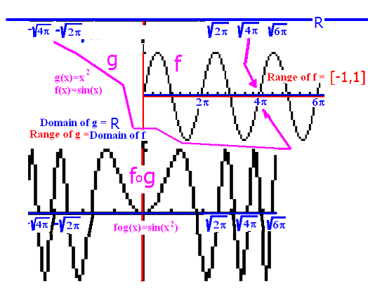
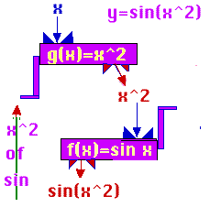
The composition function
k(x) = (f º g)(x) = f (g(x))
g f
R->[0,+oo)->[-1, 1]

Slide 2
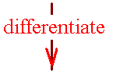


Theorem 1
The chain rule
g f
R-->[0,+oo)-->[-1, 1]
If k(x) =f (g(x)), then
k’(x) = f ’ ( g(x) ) g’(x)

Slide 3
If k(x) =f (g(x)), then k’(x) = f ’ ( g(x) ) g’(x)
k(x) = sin( x² )
k’(x) = cos ( x² ) 2x

Slide 4
If y=sin(3πt), find y’
3π cos(3πt)
cos(t)
3πt[cos(3πt)]

Slide 5


If y=sin(3πt), find y’
3π cos(3πt)
cos(t)
3πt[cos(3πt)]

Slide 6
Corallary
k(x) = g^{n}(x) = [g(x)]^{n}
k’(x) = n [g (x)] ^{n-1} g’(x)

Slide 7
If y=(2x+1)⁴, find y’
4(2)³
4(2x+1)³
8(2x+1)
8(2x+1)³

Slide 8
If y=tan(sin(x)), find y’
-sec²[sin(x)]cos(x)
sec²[sin(x)]cos(x)
sec²[cos(x)]
-csc²[sin(x)]cos(x)

Slide 9
If y=tan(sin(x)), find y’
-sec²[sin(x)]cos(x)
sec²[sin(x)]cos(x)
sec²[cos(x)]
-csc²[sin(x)]cos(x)

Slide 10
If y=x cos(x²), find dy/dx
-x sin(x²) + cos(x²)
-2x sin(x²) + cos(x²)
-2x² sin(x²) + cos(x²)
2x² sin(x²) + cos(x²)

Slide 11
If y=x cos(x²), find dy/dx
-x sin(x²) + cos(x²)
-2x sin(x²) + cos(x²)
-2x² sin(x²) + cos(x²)
2x² sin(x²) + cos(x²)

Slide 12
The chain rule
If y is a function of u and u is a function of x then dy/dx = dy/du du/dx

Slide 13
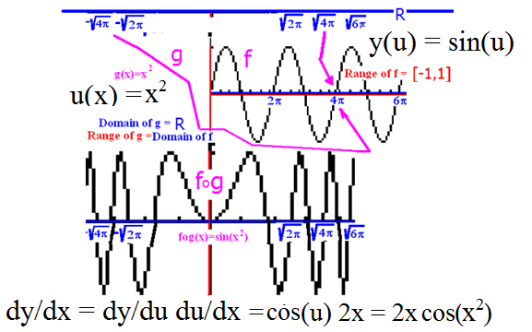
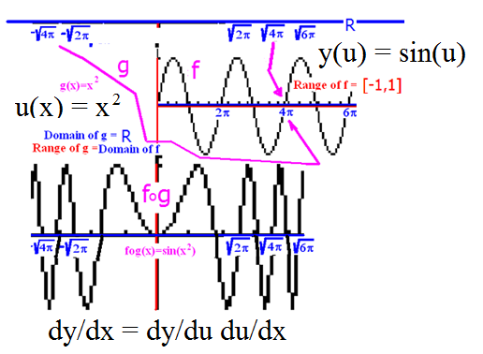
The chain rule
If y is a function of u and u is a function of x then dy/dx = dy/du du/dx

Slide 14
The chain rule
If y = sin(u) and u(x) = x²
then dy/dx = dy/du du/dx
dy/du = cos(u) du/dx = 2x
dy/dx = cos(u) 2x
= cos(x²) 2x

Slide 15
The chain rule
If y = cos(u) and u(x) = x² + 3x
then dy/dx = dy/du du/dx
dy/du = -sin(u) du/dx = 2x + 3
dy/dx = -sin(u) (2x+3)
= -sin(x²+3x) (2x+3)

Slide 16
y=tan(u) u = 10x – 5 find dy/dx
-10 csc²(10x-5)
sec²(10)
-csc²(10x-5)
10 sec²(10x-5)

Slide 17
y=tan(u) u = 10x – 5 find dy/dx
-10 csc²(10x-5)
sec²(10)
-csc²(10x-5)
10 sec²(10x-5)

Slide 18
Corallary
k(x) = [3x³ - x⁻² ]²⁰
k’(x) = 20 [3x³ - x⁻²] ¹⁹ (9x²+2x⁻³)

Slide 19
If y = (sec(x))²=sec²(x) find dy/dx
2 sec(x) tan(x)
2 sec²(x) tan(x)
2 sec(x) tan²(x)
sec²(x) tan (x)

Slide 20
If y = (sec(x))²=sec²(x) find dy/dx
2 sec(x) tan(x)
2 sec²(x) tan(x)
2 sec(x) tan²(x)
sec²(x) tan (x)

Slide 21
Corallary
=[3x³ - x² ]^{1/2}
k’(x) = ½ [3x³ - x²]^{-1/2} (9x²-2x)

Slide 22
Corallary
k’(x) =

Slide 23

Corallary
k’(x) =

Slide 24
If y = find dy/dx
.
.
.

Slide 25
If y = find dy/dx
.
.
.

Slide 26
Corallary
= [sin(2x) ]^{1/2}
k’(x) = ½ [sin(2x)]^{-1/2} (cos(2x) 2)

Slide 27
k(x) = sec(sin(2x))
k’(x) =
sec(sin(2x))tan(sin(2x))(cos(2x) 2)

Slide 28
y = sec( u ) u(x) = sin(2x)
=

Slide 29
y = sec( u ) u(x) = sin(2x)
= sec(u) tan(u)

Slide 30
y = sec( u ) u(x) = sin(2x)
= sec(u)tan(u)cos(2x)

Slide 31
y = sec( u ) u(x) = sin(2x)
= sec(u)tan(u)cos(2x) 2
Remove u from answer for dy/dx.

Slide 32
y = sec( u ) u(x) = sin(2x)
= sec(u)tan(u)cos(2x) 2
= sec(sin(2x))

Slide 33
y = sec( u ) u(x) = sin(2x)
= sec(u)tan(u)cos(2x) 2
=2sec(sin(2x)) tan(sin(2x))cos(2x)

Slide 34
quizz
1.Write the equation of the line tangent to the graph of
y = x – cos(x) when x=0.
2. Diff. g(x)=cot x[sin x – cos x].
3. Find the x’s where the lines tangent to y= are horizontal.

