Slide 1
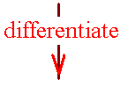


If k(x) =f (g(x)), then k’(x) = f ’ ( g(x) ) g’(x)
k(x) = sin( x² )
k’(x) = cos ( x² ) 2x

Slide 2


If y=sin(3πt), find y’
3π cos(3πt)
cos(t)
3πt[cos(3πt)]

Slide 3
Corallary
k(x) = g^{n}(x) = [g(x)]^{n}
k’(x) = n [g (x)] ^{n-1} g’(x)

Slide 4
If y=(2x+1)⁴, find y’
4(2)³
4(2x+1)³
8(2x+1)
8(2x+1)³

Slide 5
If y=tan(sin(x)), find y’
-sec²[sin(x)]cos(x)
sec²[sin(x)]cos(x)
sec²[cos(x)]
-csc²[sin(x)]cos(x)

Slide 6
If y=x cos(x²), find dy/dx
-x sin(x²) + cos(x²)
-2x sin(x²) + cos(x²)
-2x² sin(x²) + cos(x²)
2x² sin(x²) + cos(x²)

Slide 7
The chain rule
If y = sin(u) and u(x) = x²
then dy/dx = dy/du du/dx
dy/du = cos(u) du/dx = 2x
dy/dx = cos(u) 2x
= cos(x²) 2x

Slide 8
The chain rule
If y = cos(u) and u(x) = x² + 3x
then dy/dx = dy/du du/dx
dy/du = -sin(u) du/dx = 2x + 3
dy/dx = -sin(u) (2x+3)
= -sin(x²+3x) (2x+3)

Slide 9
y=tan(u) u = 10x – 5 find dy/dx
-10 csc²(10x-5)
sec²(10)
-csc²(10x-5)
10 sec²(10x-5)

Slide 10
Corallary
k(x) = [3x³ - x⁻² ]²⁰
k’(x) = 20 [3x³ - x⁻²] ¹⁹ (9x²+2x⁻³)

Slide 11
If y = (sec(x))²=sec²(x) find dy/dx
2 sec(x) tan(x)
2 sec²(x) tan(x)
2 sec(x) tan²(x)
sec²(x) tan (x)

Slide 12
Corallary
=[3x³ - x² ]^{1/2}
k’(x) = ½ [3x³ - x²]^{-1/2} (9x²-2x)

Slide 13
Corallary
k’(x) =

Slide 14

Corallary
k’(x) =

Slide 15
If y = find dy/dx
.
.
.

Slide 16
Corallary
= [sin(2x) ]^{1/2}
k’(x) = ½ [sin(2x)]^{-1/2} (cos(2x) 2)

Slide 17
k(x) = sec(sin(2x))
k’(x) =
sec(sin(2x))tan(sin(2x))(cos(2x) 2)

Slide 18
quizz
1.Write the equation of the line tangent to the graph of
y = x – cos(x) when x=0.
2. Diff. g(x)=cot x[sin x – cos x].
3. Find the x’s where the lines tangent to y= are horizontal.

Slide 19
Parametric Equations
Instead of y = f(x), it is sometimes easier to express x and y as a function of a third variable, say time.

Slide 20

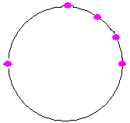
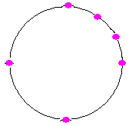
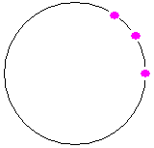
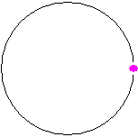
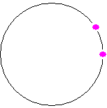
Parametric Equations . .
Graph {(4 cos t, 4 sin t) | }
t x = 4 cos t y = 4 sin t
0 4 0
π/6 2(1.732) 2
π/3 2 2(1.732)
π/2 0 4
π -4 0
3π/2 0 -4
2π 4 0

Slide 21
Where is (4 cos t, 4 sin t) when t = π?
(0, 4)
(4, 0)
(-4, 0)
(0, -4)

Slide 22

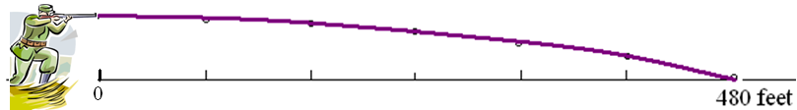

Parametric Equations . .
Graph {(800 t, 6 – 16t²) | }
t x = 800 t y = 6 – 16t²
0 0 6
0.1 80 5.84
0.2 160 5.36
0.3 240 4.56
0.4 320 3.44
0.5 400 2.00
0.6 480 0.24

Slide 23
Where is (800 t, 6 – 16t²) when t = 0.5?
(400, 1)
(400, 2)
(400, 3)
(400, 4)

Slide 24
x=4 cos t y = 4 sin t
Graph {(4 cos t, 4 sin t) | }
Remember x² + y² = 16 cos² t + 16 sin² t = 16

Slide 25
Parametric Equations . .
Graph {(800 t, 6 – 16t²) | }
x = 800 t y = 6 – 16t²
x/800 = t y = 6 – 16 [x/800] ².
y = 6 – x²/40000

Slide 26
y = 6 – x²/40000
If x = 400 ft., find y
1
2
3
4

Slide 27
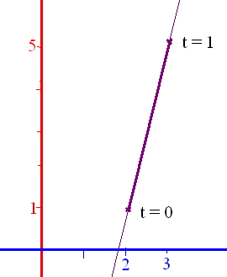
Paramatize a line
Connecting (2,1) and (3,5)
x = 2 + at y = 1 + bt
x=2+a = 3 when y=1+b = 5
a = 1 b = 4
x = 2 + t y = 1 + 4t

Slide 28
x = 2 + t y = 1 + 4t when t = 10 the point is
(12, 41)
(12, 12)
(41, 41)
(-12, -41)

Slide 29
The curve x = f(t) & y = g(t) is differentiable at t if x and y are
and dy/dt = dy/dx dx/dt by the chain rule
If dx/dt is not zero, .

Slide 30
If x=2t-4 & y=t²+1, find dy/dx
= (2t) / 2= t = x/2 + 2
t=(x+4)/2 and y = (x²+8x+16)/4 + 1
y’ = (2x+8)/4 = x/2 + 2

Slide 31
If x=2t-4 & y=t³+t+1, find dy/dx
3/2
(3t+1)/2
(3t²+1)/2
3t²/2

Slide 32
=d(y’(x) )/dx=
x = 2t and y = t + t³
= = 0.5 + 1.5 t²
d²y/dx² = 3t/2 = 1.5 t

Slide 33
If x=cos(2t) & y=sin(t), find d²y/dx²
=
=-0.25 csc t
y’’ = 0.25 csc t cot t /[-4 sin t cos t]
= -1/16 csc³ t

Slide 34
If x=cos(2t) & y=sin(t), find dy/dx
=
=y’(t)
=-0.25 csc t
y’(π/4) = -0.25

Slide 35
If x=cos(2t) & y=sin(t), find d²y/dx²
=
=y’(t) =-0.25 csc t
: d²y/dx² =

Slide 36
If x=2t-4 & y=t³+t+1, find d²y/dx² :dy/dx=1.5t² + 0.5
3/2
3t/2
(3t²+1)/2
3t²/2

Slide 37
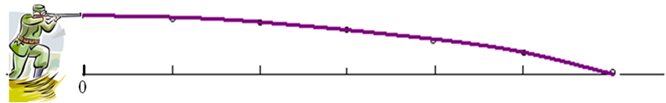
Parametric Equations . .
If there is a public swimming pool 200 yards from the shooter, are the swimmers in danger?
x = 1000 t y = 6 – 16t²
The bullet hits the ground when y=0 or t =
At that time, x = 1000 = 612.3724 feet

Slide 38
Find x and y when t = -1 if x = 2t²+3 and y = t⁴
(5, -1)
(1, -1)
(5, 1)
(1, 1)

Slide 39
Write eq. of tangent line when t = -1 if x = 2t²+3 and y = t⁴
y = x - 4
y = x - 6
y = -4(x-5)
y = - x + 5

Slide 40
=d(y’)/dx=
x = 2t and y = t + t³
= = 0.5 + 1.5 t²
d²y/dx² = d( )/dt divided by dx/dt
d²y/dx² = 3t/2 = 1.5 t

Slide 41
if x = 2t²+3 and y = t⁴, find d²y/dx² [recall dy/dx = t²]
y’’ = 2t
y’’ = 2t - 2
y’’ = 2t + 1
y’’ = 0.5 t

Slide 42
Quizz
If f(x) = tan (sin (πx)), find f’(x).
If g(x) = (2x + 1)⁴ (x ² - 3x + 6)⁻⁴ . find g’(x).
If h(x) = csc³(t)=[csc (t)]³, find h’(x).

