Slide 1
Implicit Differentiation
is another chain rule.

Slide 2
Implicit Differentiation
is another chain rule.
Nothing new today except we don’t know what y is.

Slide 3
If h(x) = [g(x)]^{n} then h’(x) = n [g(x)]^{n-1}g’(x)
We review the power rule.

Slide 4
If y = 4(2x + 2)⁵ then y’ =
20 (2x + 2)⁴ 2 = 40 (2x + 2)⁴
20 (2x + 2)⁵ 2 = 40 (2x + 2)⁵
20(2)⁴ = 20 (16) = 320
20 (2x + 2)⁴ = 20 (2x + 2)⁴

Slide 5


If y = 4(2x + 2)⁵ then y’ =
20 (2x + 2)⁴ 2 = 40 (2x + 2)⁴
20 (2x + 2)⁵ 2 = 40 (2x + 2)⁵
20(2)⁴ = 20 (16) = 320
20 (2x + 2)⁴ = 20 (2x + 2)⁴

Slide 6
If h(x) = [3x + cos(x)]⁷
^{h’(x) =}
21 x + 7 cos(x)
7 [3x + cos(x)] ⁶[3 + sin(x)]
7 [3x + cos(x)] ⁶[3 - sin(x)]
7 [3 - sin(x)]⁶

Slide 7
If h(x) = [3x + cos(x)]⁷
^{h’(x) =}
21 x + 7 cos(x)
7 [3x + cos(x)] ⁶[3 + sin(x)]
7 [3x + cos(x)] ⁶[3 - sin(x)]
7 [3 - sin(x)]⁶

Slide 8
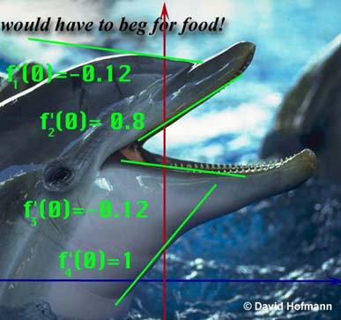
Replace g(x) with y.
Instead of ([g(x)]^{n} )’ = n [g(x)]^{n-1}g’(x)
We get (y ^{n} )’ = n [ y ]^{n-1} y’

Slide 9
Replace g(x) with y.
We get (y ^{n} )’ = n [ y ]^{n-1} y’

Slide 10
Guidelines for Finding the Derivative Implicitly
Let y stand for one of any number of functions.
In this case, 4 different functions.

Slide 11
Number of heart beats per minute, t seconds
after the beginning of a race is given by
Find R’(t).
R’(t) =

Slide 12
Number of heart beats per minute, t seconds
after the beginning of a race is given by
Find R’(t).
R’(t)

Slide 13
Number of heart beats per minute, t seconds
after the beginning of a race is given by
Find R’(t).

Slide 14
Recall [(x+1)(x²-3)]’
= (x+1)(2x)+ (x²-3)
So [(x+1)y]’ = (x+1)y’ + y
[3 y³ ]’ = 9 y² y’

Slide 15
So [(2x+1)y]’ = ?
2Y’
(2x+1) y’ + 2y
(2x+1) y’ + 2y’
(2x+1) y’

Slide 16
Find [2y⁶ + tan(2x)]’
12y⁵ y’ – sec²(2x) 2
12y⁵ y’ + sec²(2x) 2
12y⁵ y’ + csc²(2x) 2
12y⁵ + sec²(2x) 2

Slide 17
Guidelines for Finding the Derivative Implicitly
Let y stand for one of any number of functions.
Differentiate both sides of the equation, using chain rule, power rule, product rule, quotient rule.

Slide 18
If x² + y² = 36 find y’.
What is the derivative of x² ?
2x
What is the derivative of y² ?
2yy’
What is the derivative of 36 ?

Slide 19
What is the derivative of 36?
36x
36
0

Slide 20
What is the derivative of 36?
36x
36
0

Slide 21
Differentiate both sides x² + y² = 36
2x + 2yy’ = 0
2x + 2yy’ = 36
2x + 2y = 0

Slide 22
Differentiate both sides x² + y² = 36
2x + 2yy’ = 0
2x + 2yy’ = 36
2x + 2y = 0

Slide 23
Guidelines for Finding the Derivative Implicitly
Let Y stand for one of any number of functions.
Differentiate both sides of the equation, using chain rule, power rule, product rule, quotient rule.
Place all of the terms containing Y' on one side and the other terms on the other.

Slide 24
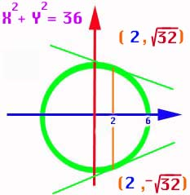
If x² + y² = 36 find y’.
2x + 2yy’ = 0
2yy’ = -2x

Slide 25
Guidelines for Finding the Derivative Implicitly
Differentiate both sides of the equation, using chain rule, power rule, product rule, quotient rule.
Place all of the terms containing Y' on one side and the other terms on the other.
Factor the Y' out if necessary and solve for Y‘.

Slide 26
If x² + y² = 36 find y’.
2yy’ = -2x
yy’ = -x
y’ =

Slide 27
Guidelines for Finding the Derivative Implicitly
Place all of the terms containing Y' on one side and the other terms on the other.
Factor the Y ' out if necessary and solve for Y '.
Replace x and y by the values given.

Slide 28
y’ = x² + y² = 36
Top point only!
Find the slope when x = 2.
When x = 2, y = or
Y =
Thus y’ =

Slide 29
y’ =
Y’ = for top point
Y’ = bottom point

Slide 30
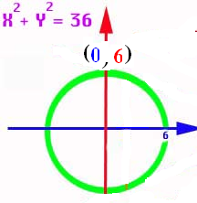
If y’ = find the slope at (-3 , 3)

Slide 31
If y’ = find the slope at (-3 , 3)
3/2
-3/2
.

Slide 32
If y’ = find the slope at (-3 , 3)
3/2
-3/2
+

Slide 33
Thus if the dolphins forehead could be approximated by a circle,
we could calculate
the slope there if
we knew the x and
y coordinates.
y’ =

Slide 34
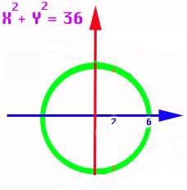
And if the dolphins throat could be approximated by a circle,
we could calculate
the slope there if
we knew the x and
y coordinates.
y’ =

Slide 35
Guidelines for Finding the Derivative Implicitly
Let Y stand for one of any number of functions.
Differentiate both sides of the equation, using
chain rule, power rule, product rule, quotient rule.
Place all of the terms containing Y' on one side and the other terms on the other.
Factor the Y' out if necessary and solve for Y‘.
Replace x and y by the values given.

Slide 36
Let Y stand for one of 5 functions.
If 3x² + xy⁵ = 16x find y’.
What is the derivative of 3x² ?
6x
What is the derivative of xy⁵ ?
x5y⁴y’+y⁵
What is the derivative of 16x ?

Slide 37
Differentiate xy⁵ using the product rule and power rule
x5y⁴y’ + y⁵

Slide 38
3x² + xy⁵ = 16x
Differentiate both sides
6x + 5y⁴ y’= 16
6x +5xy⁴ y’= 16
6x +5xy⁴ y’+y⁵ = 16
6 + 6x +5xy⁴ y’+y⁵ = 0

Slide 39
3x² + xy⁵ = 16x
Differentiate both sides
6x + 5y⁴ y’= 16
6x +5xy⁴ y’= 16
6x +5xy⁴ y’+y⁵ = 16
6 + 6x +5xy⁴ y’+y⁵ = 0

Slide 40
Guidelines for Finding the Derivative Implicitly
Let y stand for one of 5 functions.
Differentiate both sides of the equation, using chain rule, power rule, product rule, quotient rule.

Slide 41
If 3xy + x + 5y² = 16 find y’.
3xy’ + 3y + 1 + 10yy’ = 0
Place all (y’)’s on the left and factor
3xy’ + 10yy’ = -1 - 3y
(3x+10y)y’= -1 - 3y
y’ =

Slide 42
If 3xy + x + 5y² = 16 find y’’.
3xy’ + 3y + 1 + 10yy’ = 0
3xy’’ + 3y’ + 3y’ + 10yy’’ + 10(y’)² = 0
Place all (y’’)’s on the left and factor
(3x+10y)y’’= -6y’ - 10(y’)²

Slide 43
If x² + 5y² = 6 find y’.
2x + 10yy’ = 0
y’ = -2x/10y

Slide 44
y’ = -2x/10y
Find y’ when x = y = 1

Slide 45
y’ = -2x/10y
Find y’ when x = y = 1
0
-0.1
-0.2
-0.3

Slide 46
y’ = -2x/10y
Find y’ when x = y = 1
0
-0.1
-0.2
-0.3

Slide 47
If x² + 5y² = 1 find y’’.
2x + 10yy’ = 0
2 + 10yy’’+ y’10y’ = 0
Place all (y’’)’s on the left and solve
y’’ = (-10(y’)² – 2)/10y

Slide 48
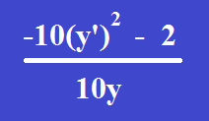
Find y’’ when x = y = 1 and y’ = -0.2 y’’ =

Slide 49
Find y’’ when x = y = 1 and y’ = -0.2 y’’ =
0
-0.14
-0.24
-0.34

Slide 50
Find y’’ when x = y = 1 and y’ = -0.2 y’’ =
0
-0.14
-0.24
-0.34

Slide 51
If 3xy + x + 5y² = 16 find y’’.
Place all (y’’)’s on the left and factor
(3x+10y)y’’=-6y’+10(y’)²
Solve for y’’
y’’ = =
=

Slide 52
If 3xy + x + 5y² = 16 find y’’.
y’’=
=
=

Slide 53
Find dy/dx
1. x² y + y² x = 6
6. (3xy + y)³ = 6y
11. x + tan(xy) = π + 1 at (π, ¼ )

Slide 54
Find the equation of the tangent and the normal
29. x² + xy - y² = 1 at (2, 3)
31. x² y² = 9 at (1, 3)
35. 2xy + π sin(y) = 2 π at (1, π /2)

Slide 55
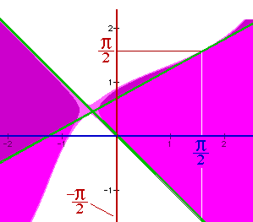
Find the slope of
y² - sin( x + y ) = x² at the points (π/2, π/2) and (π/2, -π/2).
In other words, find the slopes of the two green lines.

Slide 56
y² - sin( x + y ) = x²
Let y stand for the two functions f1 and f2. Differentiating,
2yy' - cos(x + y)[1+y'] = 2x
2yy’ – cos(x+y) – cos(x+y) y’ = 2x
[2y - cos(x+y)]y' = 2x + cos(x+y), or
y' = [2x + cos(x+y)] / [2y - cos(x+y)]

Slide 57
y² - sin( x + y ) = x²
[2y - cos(x+y)]y' = 2x + cos(x+y), or
y' = [2x + cos(x+y)] / [2y - cos(x+y)]
At (π/2, π/2)
y’ =[π + cos(π)]/[π - cos(π)]
= (π - 1 ) / (π + 1)

Slide 58
y² - sin( x + y ) = x²
[2y - cos(x+y)]y' = 2x + cos(x+y), or
y' = [2x + cos(x+y)] / [2y - cos(x+y)]
At (π/2, −π/2)
y’ =[π + cos(0)]/[- π - cos(0)]
= (π + 1 ) / (- π - 1)
= -1

Slide 59
y² - sin( x + y ) = x² y’ =
[2x + cos(x+y)] / [2y - cos(x+y)]
Now substitute (π/2, π/2) and
(π/2, -π/2).
f1 has a slope of [π-1]/[π+1]
and the slope of f2 is [π+1] / [-π-1] =
-1

Slide 60


y’=[2x+cos(x+y)] / [2y-cos(x+y)]
Find y’ at (-π/2,-π/2) to one decimal.
1.933884414
0.1

Slide 61
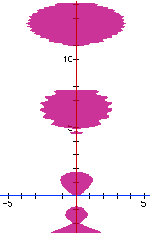
sin(y²) = x² - y cos(y)
Find y’ at the point (0, 0)
cos(y²)2yy’ = 2x – [-y sin(y) y’ + cos(y) y’]
[cos(y²)2y - y sin(y) + cos(y)]y’=2x
(0 + 0 + 1) y’ = 0 so y’ = 0

Slide 62
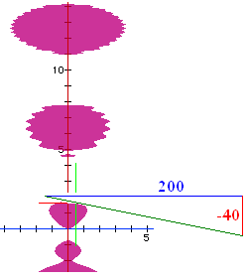
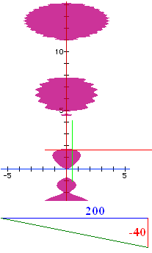
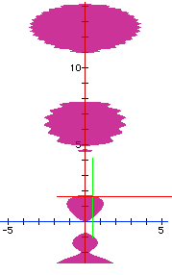
sin(y²) = x² - y cos(y)
Find y’ at the point (.5, 1.65555)
cos(y²)2yy’ = 2x – [-y sin(y) y’ + cos(y) y’]
[cos(y²)2y - y sin(y) + cos(y)]y’=2x
(-3.04876 - 1.64961 -0.08465) y’ = 1
so y’ = -0.2091

Slide 63
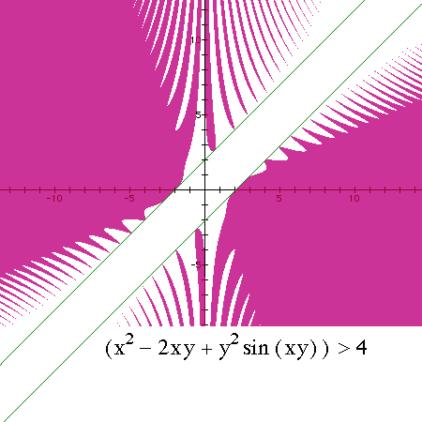
x² – 2xy + y²sin(xy) > 4
Find y’ at the point (-2, 0)
2x -2xy’-2y+y2cos(xy)[xy’+y]+2sin(xy)yy’=0

Slide 64
x² – 2xy + y²sin(xy) = 4 implicitly 2x-2xy’-2y + . .
y²cos(xy)+sin(xy)2yy’=0
y²cos(xy)[xy’]+sin(xy)2yy’=0
y²cos(xy)[xy’+y]+sin(xy)yy’=0
y²cos(xy)[xy’+y]+sin(xy)2yy’=0

Slide 65
x² – 2xy + y²sin(xy) = 4
Find y’ at the point (-2, 0)
2x -2xy’-2y+y²cos(xy)[xy’+y]+2sin(xy)yy’=0
Next question is ‘Find y’ at the point (-2,0).’

Slide 66
2x -2xy’-2y+y²cos(xy)[xy’+y]+2sin(xy)yy’=0
^{Find y’ at (-2,0)}
0
1
2
-1

Slide 67
Theorem – If n is an integer, [x^{n}]’ =nx^{n-1}
Use mathematical induction for positive n
Use mathematical induction for nonnegative n
n=0 ; 1’ = 0
Assume [x^{k}]’ =kx^{k-1} for k<0 but fixed
Prove [x^{k-1}]’ =(k-1)x^{k-2}

Slide 68
Theorem – If q is rational, [x^{q}]’ =qx^{q-1}
Since q is rational, there exist integers, m and n such that q = m/n and n is not 0.
Then y = x^{q} = x^{m/n} and y^{n} = x^{m} thus
ny^{n-1} y’ = m x^{m-1}
y’ = qx^{q-1}

Slide 69
Implicit Differentiation
Related Rates
x’ = dx/dx = 1
x’ = dx/dt

Slide 70
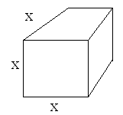
If the edge of a cube is decreasing at 2’/sec when x = 10’,
find the rate the volume is changing at that instant.

Slide 71
If the edge of a cube is decreasing at 2’/sec when x = 10’, find v’.
v = x³
v’ = 3x²

Slide 72
If the edge of a cube is decreasing at 2’/sec when x = 10’, find v’.
v = x³
v’ = 3x² x’

Slide 73
If the edge of a cube is decreasing at 2’/sec when x = 10’, find v’.
v = x³
v’ = 3x² x’
v’ = 3(100)(-2) = -600 cubic ft / sec

Slide 74
Related Rates
Read the problem, drawing a picture
No non-constants on the picture
Write an equation
Differentiate implicitly
Enter non-constants and solve

Slide 75
If the edge of a cube is decreasing at 2’/sec when x = 10’,
find the rate the volume is changing at that instant.
10 does not appear on the drawing
x=10 after v’ = 3x² x’

Slide 76
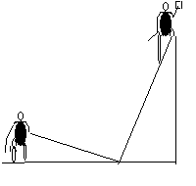
Related Rates
Suppose a painter is standing on a 13 foot ladder and Joe ties a rope to the bottom of the ladder and walks away at the rate of 2 feet per second.

Slide 77
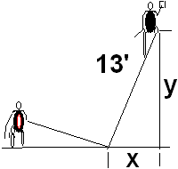
Related Rates
Suppose a painter is standing on a 13 foot ladder and Joe ties a rope to the bottom of the ladder and walks away at the rate of 2 feet per second.
How fast is the painter
falling when x = 5 feet?

Slide 78
Related Rates
13 is a constant and appears
the rate of 2 feet per second [x’ = 2]
How fast is the painter
falling when x = 5 feet?

Slide 79
Related Rates
13 is a constant and appears
the rate of 2 feet per second [x’ = 2]
How fast is the painter
falling when x = 5 feet?
NOT ON THE DRAWING

Slide 80
What does the Pythagorean Theorem say about
x² + y² = 13
2x² + y² = 169
x² + 2y² =13
x² + y² = 169

Slide 81
What does the Pythagorean Theorem say about
x² + y² = 13
2x² + y² = 169
x² + 2y² =13
x² + y² = 169

Slide 82
Related Rates
Write an equation
Differentiate the equation
implicitly
2x x’ + 2y y’ = 0 or xx’ + yy’ = 0
If Joe pulls at 2 ft./sec., find the speed
of the painter when x = 5.

Slide 83
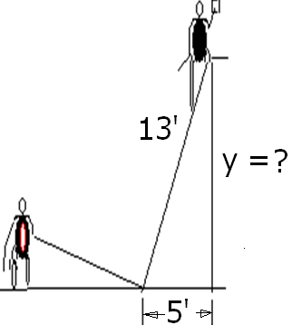
Find y when x = 5
5
8
12
13

Slide 84
Find y when x = 5
5
8
12
13

Slide 85
Related Rates
Use algebra to find y.
x² + y² = 169
5² + y² = 169
y² = 169 – 25 = 144
y = 12

Slide 86
2x x’ + 2y y’ = 0 or xx’ + yy’ = 0
Back to the calculus with y = 12,
x = 5, and x’ = 2 ft/sec
xx’ + yy’ =0
5(2) + 12(y’) = 0
y’ = -10/12 = -5/6 ft./sec.

Slide 87
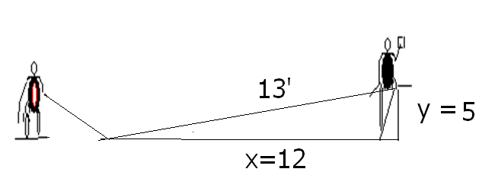
Related Rates
Summary
Even though Joe is walking 2 ft/sec,
the painter is only falling -5/6 ft/sec.
If the x and y values were reversed,

Slide 88
xx’ + yy’ =0 Find y’ if x’=2, y=5, and x = 12
-24/5
5/24
-5/24
-5

Slide 89
xx’ + yy’ =0 Find y’ if x’=2, y=5, and x = 12
-24/5
5/24
-5/24
-5

Slide 90
Related Rates
Summary

Slide 91
Mo pulls in her small boat from a dock, 50’ high
If she pulls at 2 ft per sec, how fast is the boat approaching the dock when it is 120 ft away?

Slide 92
E = I R
If the voltage is decreasing at 4 v per second and R is a constant 5 ohms, find I’ ?
If instead R is increasing at 6 ohms per sec, find I’ when E = 22, R = 5.

Slide 93


Related Rates
Suppose air is entering a balloon at the rate of 25 cubic feet per minute. How fast is the radius changing when r = 30 feet?

Slide 94
Related Rates
r’ = 0.00221
ft per min

Slide 95
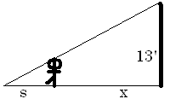
Related Rates
Suppose a 6 ft tall person walks away from a 13 ft lamp post at a speed of 5 ft per sec. How fast is the tip of his shadow moving when 12 ft from the post?

Slide 96
Related Rates
Suppose a 6 ft tall person walks away from a 13 ft lamp post at a speed of 5 ft per sec. How fast is the tip of his shadow moving when 12 ft from the post?

Slide 97
Find ?
s
x
s + x
3

Slide 98
Find ?
s
x
s + x
3

Slide 99
Related Rates
The tip of the shadow has a speed of
(s+x)’, not s’. What is s’ ?
s’ is the growth of the shadow and includes getting shorter on the right.

Slide 100
Related Rates
Cross multiplying
Since x’ = 5

Slide 101
Related Rates
Thus s’ is
and
Note that the tip is moving almost
twice as fast as the walker, and more than twice as fast as the shadow regardless of x.

Slide 102
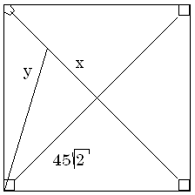

Related Rates
Suppose a radar gun on first base catches a baseball 30 feet away from the pitcher and registers 50 feet per second. How fast is the ball really traveling?

Slide 103
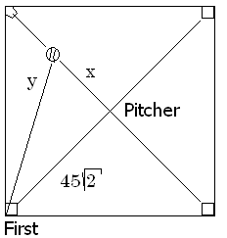
a baseball 30 feet away from the pitcher and registers 50
. feet per second.
x=30 y’=50
x=30 y =50
x’=30 y’=50
x’=30 y=50

Slide 104
Related Rates
The calculus.
x = 30 y’ = 50 y = ?
The algebra.

Slide 105
Differentiate implicitly
2x = 2y y’
2x = y y’
2x x’ = y y’
2x x’ = 2y y’

Slide 106
Differentiate implicitly
2x = 2y y’
2x = y y’
2x x’ = y y’
2x x’ = 2y y’

Slide 107
Related Rates
x = 30 y’ = 50 y = ?
Back to the calculus.

Slide 108
Related Rates
Back to the calculus.
x = 30 y’ = 50 y = ?

Slide 109
Related Rates
Back to the calculus.
x = 30 y’ = 50 y = ?

Slide 110
a baseball 30 feet away from the pitcher and registers 50
. feet per second.
x’ = 0.6 root(4950)
x’ = 50 root(4950)
x’ = 30 root(4950)
x’ = 5/3 root(4950)

Slide 111
a baseball 30 feet away from the pitcher and registers 50
. feet per second.
x’ = 0.6 root(4950)
x’ = 50 root(4950)
x’ = 30 root(4950)
x’ = 5/3 root(4950)

Slide 112

Related Rates
x’ = 117.260 feet/sec.
X = 30 y’ = 50 y = ?

Slide 113
Related Rates
Read the problem, drawing a picture
No non-constants on the picture
Write an equation
Differentiate implicitly
Enter non-constants and solve

