Slide 1
Implicit Differentiation

Slide 2
If 3x² +16x-y-17 = xy⁵ find y’ @ (1,-1)
6x +
16 -
y’ =

Slide 3


[xy⁵ ]’ =
5xy⁴
5xy⁴ y’
x5y⁴ y’+y⁵
x5y⁴ y’+y⁵ y’

Slide 4
If 3x² +16x-y-17 = xy⁵ find y’ @ (1,1)
6x + 16 – y’ = x5y⁴ y’+y⁵

Slide 5
6x + 16 – y’ = x5y⁴ y’+y⁵
6x + 16 - y⁵ = y’ + 5 x y⁴ y’
6x + 16 - y⁵ = - y’ - 5 x y⁴ y’
6x + 16 + y⁵ = - y’ + 5 x y⁴ y’

Slide 6
6x + 16 - y⁵ = y’ + 5 x y⁴ y’
6x + 16 - y⁵ = y’ (1 + 5 x y⁴ )
6x + 16 - y⁵ = y’ (y’ + 5 x y⁴ )
6x + 16 + y⁵ = y’ ( 5 x y⁴ )

Slide 7
6x + 16 - y⁵ = y’ (1 + 5 x y⁴ ) y’ =
(6x + 16 - y⁵) / (1 + 5 x y⁴ )
6x + 16 - y⁵ = /(-1 – 5 x y⁴ )

Slide 8
y’=(6x+16-y⁵) /(1+5xy⁴)
@ (1,-1)
-23/6
23/6
21/6
-21/6

Slide 9
s = 4 π r ²
Relate ds/dt to dr/dt.

Slide 10
s = 4 π r ² ds/dt = 8 π r dr/dt
True
False

Slide 11
ds/dt = 8 π r dr/dt If r=1
& ds/dt = 8 then dr/dt = π
True
False

Slide 12
V = I R
V’ = I R’ + I’ R
#5 Enter answer on next slide.
d) Find the rate of dR/dt when V is increasing at 1 volt per second and I is decreasing at 1/3 amp per second, V = 12 and I = 2.

Slide 13


[Enter question here]
1.5
0.1

Slide 14
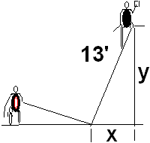
If x’=1 when x=5 find y’
-0.417
0.05

Slide 15
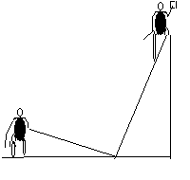
Related Rates
Back to the calculus with y = 12,
x = 5, and x’ = 1 ft/sec
xx’ + yy’ =0
5(1) + 12(y’) = 0
y’ = -5/12 ft./sec.

Slide 16
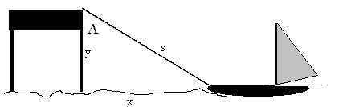
22. The rope is hauled in
At 2 feet/sec and y=6’
is constant.
How fast is the boat approaching the dock when 10’ of rope is out?

Slide 17
rope is hauled in at 2 feet/sec and y=6’ is constant.
How fast is the boat approaching the dock when 10’ of rope is out?
-2.5
0.05

Slide 18
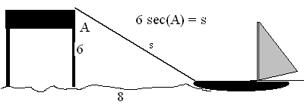
What rate is the angle A changing then? s’=-2
-5.4
0.05

Slide 19

Related Rates
Suppose air is entering a balloon at the rate of 25 cubic feet per minute. How fast is the radius changing when r = 30 feet?

Slide 20
[r’ = ? When v’ = 25]
0.00221
0.0005

Slide 21

Related Rates

Slide 22
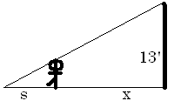
Find ?
s
x
s + x
3

Slide 23
Related Rates
The tip of the shadow has a speed of
(s+x)’, not s’. What is s’?
s’ is the growth of the shadow and includes getting shorter on the right.

Slide 24
Related Rates
Cross multiplying
Since x’ = 5

Slide 25
Related Rates
Thus s’ is
and
Note that the tip is moving almost
twice as fast as the walker, and more than twice as fast as the shadow regardless of x.

Slide 26
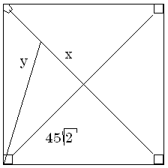

Related Rates
Suppose a radar gun on first base catches a baseball 30 feet away from the pitcher and registers 50 feet per second. How fast is the ball really traveling?

Slide 27
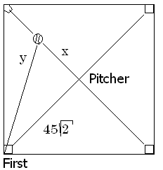
a baseball 30 feet away from the pitcher and registers 50
. feet per second.
x=30 y’=50
x=30 y =50
x’=30 y’=50
x’=30 y=50

Slide 28
Related Rates
The calculus.
x = 30 y’ = 50 y = ?
The algebra.

Slide 29
Differentiate implicitly
2x = 2y y’
2x = y y’
2x x’ = y y’
2x x’ = 2y y’

Slide 30
Related Rates
x = 30 y’ = 50 y = ?
Back to the calculus.

Slide 31
a baseball 30 feet away from the pitcher and registers 50
. feet per second.
x’ = 0.6 root(4950)
x’ = 50 root(4950)
x’ = 30 root(4950)
x’ = 5/3 root(4950)

Slide 32
Related Rates
Back to the calculus.
x = 30 y’ = 50 y = ?

Slide 33
Related Rates
Back to the calculus.
x = 30 y’ = 50 y = ?

Slide 34
Related Rates
x’ = 117.260 feet/sec.
X = 30 y’ = 50 y = ?

Slide 35
Related Rates
Read the problem, drawing a picture
No non-constants on the picture
Write an equation
Differentiate implicitly
Enter non-constants and solve

