Slide 1

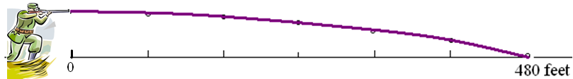

Parametric Equations . .
Graph {(800 t, 6 – 16t²) | }
x = 800 t y = 6 – 16t²
x/800 = t y = 6 – 16 [x/800] ².
y = 6 – x²/40000

Slide 2


y = 6 – x²/40000
If x = 400 ft., find y
1
2
3
4

Slide 3
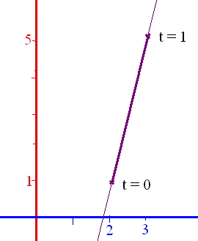
Paramatize a line
Connecting (2,1) and (3,5)
x = 2 + at y = 1 + bt
x=2+a = 3 when y=1+b = 5
a = 1 b = 4
x = 2 + t y = 1 + 4t

Slide 4
x = 2 + t y = 1 + 4t when t = 10 the point is
(12, 41)
(12, 12)
(41, 41)
(-12, -41)

Slide 5
The curve x = f(t) & y = g(t) is differentiable at t if x and y are
and dy/dt = dy/dx dx/dt by the chain rule
If dx/dt is not zero, .

Slide 6
x=2t-4 & y=t²+1
t = (x+4)/2
y = [x/2 + 2]² + 1
y = x²/4 + 2x + 5
dy/dx = x/2 + 2

Slide 7
If x=2t-4 & y=t²+1, find dy/dx
= (2t) / 2= t = x/2 + 2
t=(x+4)/2 and y = (x²+8x+16)/4 + 1
y’ = (2x+8)/4 = x/2 + 2

Slide 8
If x=2t-4 & y=t³+t+1, find dy/dx
3/2
(3t+1)/2
(3t²+1)/2
3t²/2

Slide 9
x=2t-4 & y=t²+1
t = (x+4)/2
y = [x/2 + 2]² + 1
y = x²/4 + 2x + 5
dy/dx = x/2 + 2
y’’ = ½

Slide 10
=d(y’(x) )/dx=
x = 2t-4 and y = 1 + t²
= = t
d²y/dx² = = ½

Slide 11
=d(y’(x) )/dx=
x = 2t and y = t + t³
= = 0.5 + 1.5 t²
d²y/dx² = 3t/2 = 1.5 t

Slide 12
If x=cos(2t) & y=sin(t), find d²y/dx²
=
=-0.25 csc t
y’’ = 0.25 csc t cot t /[-4 sin t cos t]
= -1/16 csc³ t

Slide 13
If x=2t-4 & y=t³+t+1, find d²y/dx² :dy/dx=1.5t² + 0.5
3/2
3t/2
(3t²+1)/2
3t²/2

Slide 14
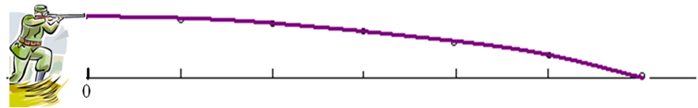
Parametric Equations . .
If there is a public swimming pool 200 yards from the shooter, are the swimmers in danger?
x = 1000 t y = 6 – 16t²
The bullet hits the ground when y=0 or t =
At that time, x = 1000 = 612.3724 feet

Slide 15
Find x and y when t = -1 if x = 2t²+3 and y = t⁴
(5, -1)
(1, -1)
(5, 1)
(1, 1)

Slide 16
=d(y’(x) )/dx=
x = 2t and y = t + t³
= = 0.5 + 1.5 t²
d²y/dx² = = 3t/2 = 1.5 t
When t = 2, x = 4, y = 10, and y’ = 6.5
(y – 10)/(x – 4) = 6.5

Slide 17
Write eq. of tangent line when t = -1 if x = 2t²+3 and y = t⁴
y = x - 4
y = x - 6
y = -4(x-5)
y = - x + 5

Slide 18
=d(y’)/dx=
x = 2t and y = t + t³
= = 0.5 + 1.5 t²
d²y/dx² = d( )/dt divided by dx/dt
d²y/dx² = 3t/2 = 1.5 t

Slide 19
if x = 2t²+3 and y = t⁴, find d²y/dx² [recall dy/dx = t²]
y’’ = 2t
y’’ = 2t - 2
y’’ = 2t + 1
y’’ = 0.5 t

Slide 20
Quizz
If f(x) = tan (sin (πx)), find f’(x).
If g(x) = (2x + 1)⁴ (x ² - 3x + 6)⁻⁴ . find g’(x).
If h(x) = csc³(t)=[csc (t)]³, find h’(x).

Slide 21
Implicit Differentiation

Slide 22
If h(x) = [g(x)]^{n} then h’(x) = n [g(x)]^{n-1}g’(x)
We review the power rule.

Slide 23
If y = 4(2x + 2)⁵ then y’ =
20 (2x + 2)⁴ 2 = 40 (2x + 2)⁴
20 (2x + 2)⁵ 2 = 40 (2x + 2)⁵
20(2)⁴ = 20 (16) = 320
20 (2x + 2)⁴ = 20 (2x + 2)⁴

Slide 24
If h(x) = [3x + cos(x)]⁷
^{h’(x) =}
21 x + 7 cos(x)
7 [3x + cos(x)] ⁶[3 + sin(x)]
7 [3x + cos(x)] ⁶[3 - sin(x)]
7 [3 - sin(x)]⁶

Slide 25
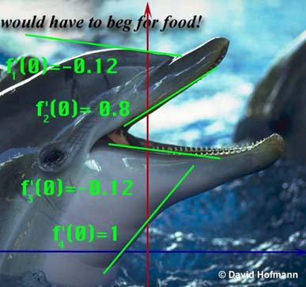
Replace g(x) with y.
Instead of ([g(x)]^{n} )’ = n [g(x)]^{n-1}g’(x)
We get (y ^{n} )’ = n [ y ]^{n-1} y’

Slide 26
Replace g(x) with y.
We get (y ^{n} )’ = n [ y ]^{n-1} y’

Slide 27
Guidelines for Finding the Derivative Implicitly
Let Y stand for one of any number of functions.
In this case, 4 different functions.

Slide 28
Recall [(x+1)(x²-3)]’
= (x+1)(2x)+ (x²-3)
So [(x+1)y]’ = (x+1)y’ + y
[3 y³ ]’ = 9 y² y’

Slide 29
So [(2x+1)y]’ = ?
2Y’
(2x+1) y’ + 2y
(2x+1) y’ + 2y’
(2x+1) y’

Slide 30
Find [2y⁶ + tan(2x)]’
12y⁵ y’ – sec²(2x) 2
12y⁵ y’ + sec²(2x) 2
12y⁵ y’ + csc²(2x) 2
12y⁵ + sec²(2x) 2

Slide 31
Guidelines for Finding the Derivative Implicitly
Let Y stand for one of any number of functions.
Differentiate both sides of the equation, using chain rule, power rule, product rule, quotient rule.

Slide 32
If x² + y² = 36 find y’.
What is the derivative of x² ?
2x
What is the derivative of y² ?
2yy’
What is the derivative of 36 ?

Slide 33


What is the derivative of 36?
0.0
0.1

Slide 34
Differentiate both sides x² + y² = 36
2x + 2yy’ = 0
2x + 2yy’ = 36
2x + 2y = 0

Slide 35
Guidelines for Finding the Derivative Implicitly
Let Y stand for one of any number of functions.
Differentiate both sides of the equation, using chain rule, power rule, product rule, quotient rule.
Place all of the terms containing Y' on one side and the other terms on the other.

Slide 36
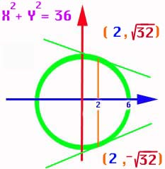
If x² + y² = 36 find y’.
2x + 2yy’ = 0
2yy’ = -2x

Slide 37
Guidelines for Finding the Derivative Implicitly
Differentiate both sides of the equation, using chain rule, power rule, product rule, quotient rule.
Place all of the terms containing Y' on one side and the other terms on the other.
Factor the Y' out if necessary and solve for Y‘.

Slide 38
If x² + y² = 36 find y’.
2yy’ = -2x
yy’ = -x
y’ =

Slide 39
Guidelines for Finding the Derivative Implicitly
Place all of the terms containing Y' on one side and the other terms on the other.
Factor the Y ' out if necessary and solve for Y '.
Replace x and y by the values given.

Slide 40
y’ = x² + y² = 36
Top point only!
Find the slope when x = 2.
When x = 2, y = or
Y =
Thus y’ =

Slide 41
y’ =
Y’ = for top point
Y’ = bottom point

Slide 42
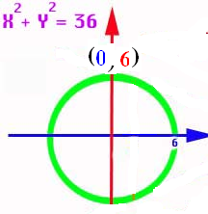
If y’ = find the slope at (-3 , 3)
1.732
0.1

Slide 43
Thus if the dolphins forehead could be approximated by a circle,
we could calculate
the slope there if
we knew the x and
y coordinates.
y’ =

Slide 44
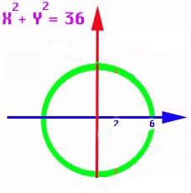
And if the dolphins throat could be approximated by a circle,
we could calculate
the slope there if
we knew the x and
y coordinates.
y’ =

Slide 45
Guidelines for Finding the Derivative Implicitly
Let Y stand for one of any number of functions.
Differentiate both sides of the equation, using
chain rule, power rule, product rule, quotient rule.
Place all of the terms containing Y' on one side and the other terms on the other.
Factor the Y' out if necessary and solve for Y‘.
Replace x and y by the values given.

Slide 46
Let Y stand for one of 5 functions.
If 3x² + xy⁵ = 16x find y’.
What is the derivative of 3x² ?
6x
What is the derivative of xy⁵ ?
x5y⁴y’+y⁵
What is the derivative of 16x ?

Slide 47
Differentiate xy⁵ using the product rule and power rule
x5y⁴y’ + y⁵

Slide 48
3x² + xy⁵ = 16x
Differentiate both sides
6x + 5y⁴ y’= 16
6x +5xy⁴ y’= 16
6x +5xy⁴ y’+y⁵ = 16
6 + 6x +5xy⁴ y’+y⁵ = 0

Slide 49
Guidelines for Finding the Derivative Implicitly
Let Y stand for one of 5 functions.
Differentiate both sides of the equation, using chain rule, power rule, product rule, quotient rule.

Slide 50
If 3x² + xy⁵ = 16x find y’.
6x + x 5y⁴y’ + y⁵ = 16

Slide 51
If 3x² + xy⁵ = 16x find y’.
6x + x 5y⁴y’ + y⁵ = 16
Place all y’s on the left
5xy⁴y’ = 16 – 6x – y⁵

Slide 52
If 3x² + xy⁵ = 16x find y’.
6x + x 5y⁴y’ + y⁵ = 16
Place all y’s on the left
5xy⁴y’ = 16 – 6x – y⁵
solve
Y’ =

Slide 53
If 3xy + x + 5y² = 16 find y’.
3xy’ + 3y + 1 + 10yy’ = 0
Place all (y’)’s on the left and factor
3xy’ + 10yy’ = (3x+10y)y’= -1 - 3y
Y’ =

Slide 54
If 3xy + x + 5y² = 16 find y’’.
3xy’ + 3y + 1 + 10yy’ = 0
3xy’’ + 3y’ + 3y’ + 10yy’’ + 10(y’)² = 0
Place all (y’’)’s on the left and factor
(3x+10y)y’’= -6y’ - 10(y’)²

Slide 55
If 3xy + x + 5y² = 16 find y’’.
Place all (y’’)’s on the left and factor
(3x+10y)y’’=-6y’+10(y’)²
Solve for y’’
y’’ = =
=

Slide 56
If 3xy + x + 5y² = 16 find y’’.
y’’=
=
=

Slide 57
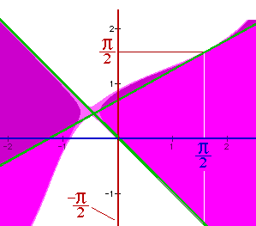
Find the slope of
y² - sin( x + y ) = x² at the points (π/2, π/2) and (π/2, -π/2).
In other words, find the slopes of the two green lines.

Slide 58
y² - sin( x + y ) = x²
Let y stand for the two functions f1 and f2. Differentiating,
2yy' - cos(x + y)[1+y'] = 2x
2yy’ – cos(x+y) – cos(x+y) y’ = 2x
[2y - cos(x+y)]y' = 2x + cos(x+y), or
y' = [2x + cos(x+y)] / [2y - cos(x+y)]

Slide 59
y² - sin( x + y ) = x² y’ =
[2x + cos(x+y)] / [2y - cos(x+y)]
Now substitute (π/2, π/2) and
(π/2, -π/2).
f1 has a slope of [π-1]/[π+1]
and the slope of f2 is [π+1] / [-π-1] =
-1

Slide 60
y’=[2x+cos(x+y)] / [2y-cos(x+y)]
Find y’ at (-π/2,-π/2) to one decimal.
1.933884414
0.1

Slide 61
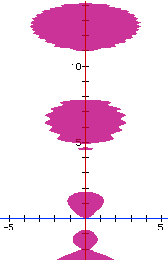
sin(y²) = x² - y cos(y)
Find y’ at the point (0, 0)
cos(y²)2yy’ = 2x – [-y sin(y) y’ + cos(y) y’]
[cos(y²)2y - y sin(y) + cos(y)]y’=2x
(0 + 0 + 1) y’ = 0 so y’ = 0

Slide 62
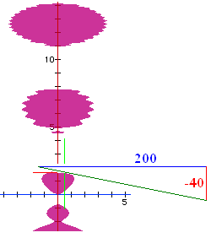
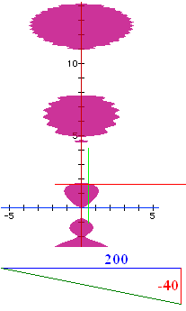
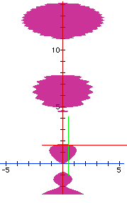
sin(y²) = x² - y cos(y)
Find y’ at the point (.5, 1.65555)
cos(y²)2yy’ = 2x – [-y sin(y) y’ + cos(y) y’]
[cos(y²)2y - y sin(y) + cos(y)]y’=2x
(-3.04876 - 1.64961 -0.08465) y’ = 1
so y’ = -0.2091

Slide 63
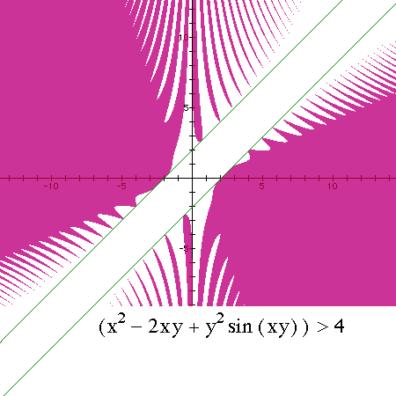
x² – 2xy + y²sin(xy) > 4
Find y’ at the point (-2, 0)
2x -2xy’-2y+y2cos(xy)[xy’+y]+2sin(xy)yy’=0

Slide 64
x² – 2xy + y²sin(xy) = 4 implicitly 2x-2xy’-2y
+y²cos(xy)+sin(xy)2yy’=0
+y²cos(xy)[xy’]+sin(xy)2yy’=0
+y²cos(xy)[xy’+y]+sin(xy)yy’=0
+y²cos(xy)[xy’+y]+sin(xy)2yy’=0

Slide 65
x² – 2xy + y²sin(xy) = 4
Find y’ at the point (-2, 0)
2x -2xy’-2y+y²cos(xy)[xy’+y]+2sin(xy)yy’=0
Next question is ‘Find y’ at the point (-2,0).’

Slide 66
x² – 2xy + y²sin(xy) = 4
^{Find y’ at (-2,0)}
0
1
2
-1

Slide 67
Theorem – If q is rational, [x^{q}]’ =qx^{q-1}
Since q is rational, there exist integers, m and n such that q = m/n and n is not 0.
Then y = x^{q} = x^{m/n} and y^{n} = x^{m} thus
ny^{n-1} y’ = m x^{m-1}
y’ = mx^{m-1}/[ny^{n-1}] = q x^{m-1}/x^{m/n(n-1)}
y’ = qx^{m-1-m+q} = qx^{q-1}

Slide 68
Implicit Differentiation
Related Rates

Slide 69
Related Rates
Read the problem, drawing a picture
No non-constants on the picture
Write an equation
Differentiate implicitly
Enter non-constants and solve

Slide 70
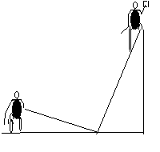
Related Rates
Suppose a painter is standing on a 13 foot ladder and Joe ties a rope to the bottom of the ladder and walks away at the rate of 2 feet per second.

Slide 71
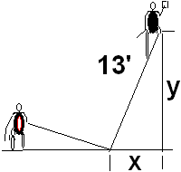
Related Rates
Suppose a painter is standing on a 13 foot ladder and Joe ties a rope to the bottom of the ladder and walks away at the rate of 2 feet per second.
How fast is the painter
falling when x = 5 feet?

Slide 72
What does the Pythagorean Theorem say about
x² + y² = 13
2x² + y² = 169
x² + 2y² =13
x² + y² = 169

Slide 73
Related Rates
Write an equation
Differentiate the equation
implicitly
2x x’ + 2y y’ = 0 or xx’ + yy’ = 0
If Joe pulls at 2 ft./sec., find the speed
of the painter when x = 5.

Slide 74
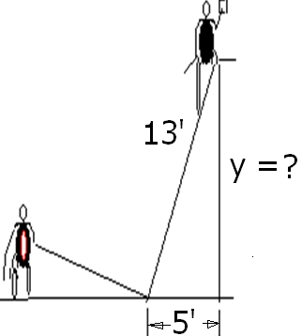
Find y when x = 5
5
8
12
13

Slide 75
Related Rates
Use algebra to find y.
x² + y² = 169
5² + y² = 169
y² = 169 – 25 = 144
y = 12

Slide 76
Related Rates
Back to the calculus with y = 12,
x = 5, and x’ = 2 ft/sec
xx’ + yy’ =0
5(2) + 12(y’) = 0
y’ = -10/12 = -5/6 ft./sec.

Slide 77
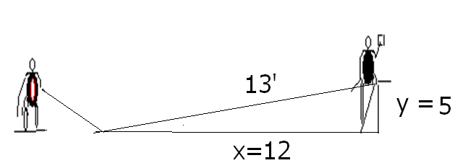
Related Rates
Summary
Even though Joe is walking 2 ft/sec,
the painter is only falling -5/6 ft/sec.
If the x and y values were reversed,

Slide 78
xx’ + yy’ =0 Find y’ if x’=2, y=5, and x = 12
-24/5
5/24
-5/24
-5

Slide 79
Related Rates
Summary

Slide 80


Related Rates
Suppose air is entering a balloon at the rate of 25 cubic feet per minute. How fast is the radius changing when r = 30 feet?

Slide 81
Related Rates
r’ = 0.00221
ft per min

Slide 82
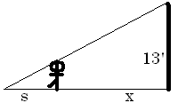
Related Rates
Suppose a 6 ft tall person walks away from a 13 ft lamp post at a speed of 5 ft per sec. How fast is the tip of his shadow moving when 12 ft from the post?

Slide 83
Related Rates
Suppose a 6 ft tall person walks away from a 13 ft lamp post at a speed of 5 ft per sec. How fast is the tip of his shadow moving when 12 ft from the post?

Slide 84
Find ?
s
x
s + x
3

Slide 85
Related Rates
The tip of the shadow has a speed of
(s+x)’, not s’. What is s’?
s’ is the growth of the shadow and includes getting shorter on the right.

Slide 86
Related Rates
Cross multiplying
Since x’ = 5

Slide 87
Related Rates
Thus s’ is
and
Note that the tip is moving almost
twice as fast as the walker, and more than twice as fast as the shadow regardless of x.

Slide 88
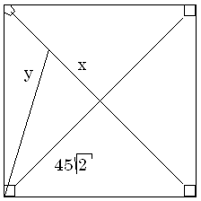
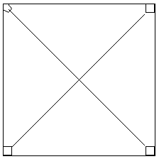
Related Rates
Suppose a radar gun on first base catches a baseball 30 feet away from the pitcher and registers 50 feet per second. How fast is the ball really traveling?

Slide 89
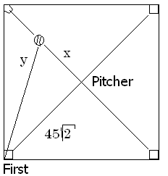
a baseball 30 feet away from the pitcher and registers 50
. feet per second.
x=30 y’=50
x=30 y =50
x’=30 y’=50
x’=30 y=50

Slide 90
Related Rates
The calculus.
x = 30 y’ = 50 y = ?
The algebra.

Slide 91
Differentiate implicitly
2x = 2y y’
2x = y y’
2x x’ = y y’
2x x’ = 2y y’

Slide 92
Related Rates
x = 30 y’ = 50 y = ?
Back to the calculus.

Slide 93
Related Rates
Back to the calculus.
x = 30 y’ = 50 y = ?

Slide 94
Related Rates
Back to the calculus.
x = 30 y’ = 50 y = ?

Slide 95
a baseball 30 feet away from the pitcher and registers 50
. feet per second.
x’ = 0.6 root(4950)
x’ = 50 root(4950)
x’ = 30 root(4950)
x’ = 5/3 root(4950)

Slide 96

Related Rates
x’ = 117.260 feet/sec.
X = 30 y’ = 50 y = ?

Slide 97
Related Rates
Read the problem, drawing a picture
No non-constants on the picture
Write an equation
Differentiate implicitly
Enter non-constants and solve

