Slide 1
Antiderivative

Slide 2
Buttons on your calculator have a second button
Square root of 100 is 10 because
10 square is 100
Arcsin( ½ ) = π/6 because
Sin( π/6 ) = ½
Reciprocal of 20 is 0.05 because
Reciprocal of 0.05 is 20

Slide 3

Definition:
F is an antiderivative of f on D if f is the derivative of F on D or F ' = f on D.

Slide 4
Definition:
F is an antiderivative of f on D if f is the derivative of F on D or F ' = f on D.
Instead of asking
What is the derivative of F? f
We ask
What is the antiderivative of f? F

Slide 5
Definition:
Name an antiderivative of f(x) = cos(x).
F(x) = sin(x) because the derivative of
sin(x) is cos(x) or F’(x) = f(x).

Slide 6
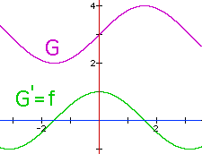
G = F + 3 is also an antiderivative of f
because G' = (F + 3)' = f + 0 = f.
sin(x) and the sin(x) + 3 are both antiderivatives of the Cos(x) on R because when you differentiate either one you get cos(x).

Slide 7
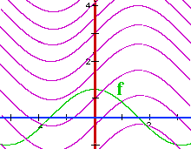
G = F + k is also an antiderivative of f
How many antiderivatives of Cos(x) are there?
If you said infinite, you are correct.
G(x) = sin(x) + k is one for every real number k.

Slide 8
Which of the following is an antiderivative of y = cos(x)?
F(x) = 1 – sin(x)
F(x) = - sin(x)
F(x) = sin(x) + 73
F(x) = cos(x)

Slide 9


Which of the following is an antiderivative of y = cos(x)?
F(x) = 1 – sin(x)
F(x) = - sin(x)
F(x) = sin(x) + 73
F(x) = cos(x)

Slide 10
Buttons on your calculator have a second button
A square root of 100 is -10 because
(-10) square is 100
arcsin( ½ ) = 5π/6 because
Sin( 5π/6 ) = ½
Recipicol of 20 is 0.05 because
Recipicol of 0.05 is 20

Slide 11
Theorem:
If F and G are antiderivatives of f on an interval I, then F(x) - G(x) = k where k is a real number.

Slide 12
Proof:
Let F and G be antiderivatives of f on I and define H(x) = F(x) - G(x) on I.

Slide 13
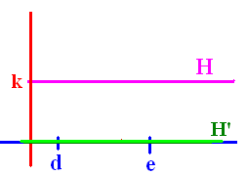
Proof:
Let F and G be antiderivatives of f on I and define H(x) = F(x) - G(x) on I.
H’(x) = F’(x) – G’(x) = f(x) – f(x) = 0 for every x in I.
What if H(d) is different than H(e)?

Slide 14
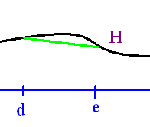
H(x) = F(x) - G(x) = k
If the conclusion of the theorem were false, there would be numbers d < e in I for which H(d) H(e).

Slide 15
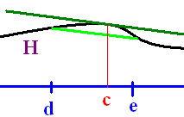
H(x) = F(x) - G(x) = k
Since H is differentiable and continuous on [d, e], the Mean Value Theorem guarantees a c, between d and e, for which H'(c) =
(H(e) - H(d))/(e - d) which can’t be 0.

Slide 16
H(x) = F(x) - G(x) = k
H’(x) = 0 for all x in I
H’(c) = (H(e) - H(d))/(e - d)
This contradicts the fact that H’( c) must be zero.
q.e.d.

Slide 17
Which of the following are antiderivatives of y = 4?
4x
4x + 2
4x - 7
All of the above

Slide 18
Which of the following are antiderivatives of y = 4?
4x
4x + 2
4x - 7
All of the above

Slide 19
Since antiderivatives differ by a constant on intervals, we will use the notation f(x)dx to represent the family of all antiderivatives of f. When written this way, we call this family the indefinite integral of f.

Slide 20
Using our new notation, evaluate

Slide 21
Using our new notation, evaluate

Slide 22
=
True
False

Slide 23
=
True
False

Slide 24
Theorems
because [x + c]’ = 1
What is the integral of dx?
x grandma, x

Slide 25
.
c
3x + c
x² + c
x + c

Slide 26
.
c
3x + c
x² + c
x + c

Slide 27

Theorems
If F is an antiderivative of f => F’=f
and
kF is an antiderivative of kf
because [kF]’ = k[F]’ = k f
and

Slide 28
Theorems

Slide 29
.
12 x + c
0
- 24 x + c
24 x + c

Slide 30
.
12 x + c
0
- 24 x + c
24 x + c

Slide 31
Theorem
Proof:
F(x)
F’(x) =

Slide 32
Examples

Slide 33
.
3 x² + c
9 x² + c
x³ + c
3 x³ + c

Slide 34
.
3 x² + c
9 x² + c
x³ + c
3 x³ + c

Slide 35
Examples

Slide 36
.
4/x + c
-4/x + c
4/x³ + c
-4/x³ + c

Slide 37
.
4/x + c
-4/x + c
4/x³ + c
-4/x³ + c

Slide 38
Theorem
If h(x) = 2cos(x) + 3x² – 4,
evaluate

Slide 41
Trigonometry Theorems

Slide 42
.
2 sin(x) – 1/x + c
2 sin(x) – 1/x³ + c
- 2 sin(x) – 1/x + c

Slide 43
.
2 sin(x) – 1/x + c
2 sin(x) – 1/x³ + c
- 2 sin(x) – 1/x + c

Slide 44
Trigonometry Theorems

Slide 45
.
sin(x) – 1/x + c
4 sin(x) – 1/x + c
-2 sin(x) – 1/x + c

Slide 46
.
sin(x) – 1/x + c
4 sin(x) – 1/x + c
-2 sin(x) – 1/x + c

