Slide 1
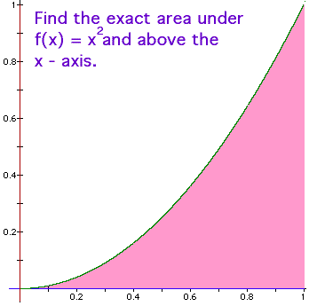
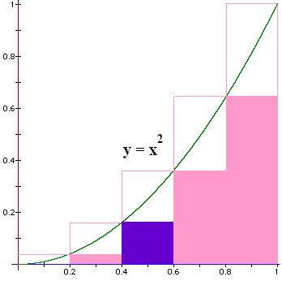
Blue area?
A = L * H
How do we find
the height?
Plug the left end point into the function
f(x) = x².

Slide 2
Blue area?
A = L * H
L = 0.6 – 0.4 = 0.2
H = 0.4² = 0.16
Blue Area = 0.032

Slide 3

Find all 5 bottom areas
BA = 0 * 0.2 +
0.04 * 0.2 +
0.16 * 0.2 +
0.36 * 0.2 +
0.64 * 0.2 = .2 * 1.2 = 0.24 < A
This is a lower sum.

Slide 4
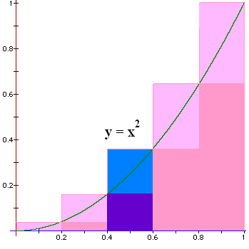
Next we find an upper sum
Plug in the
right pt to
calculate
the height

Slide 5
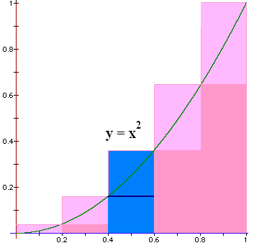


What is the blue area?
0.072
0.001

Slide 6
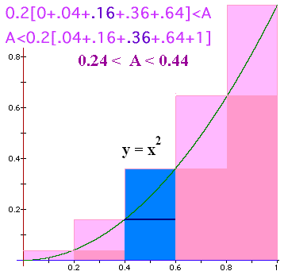
Find all 5 upper areas
UA = 0.04 * 0.2 +
0.16 * 0.2 +
0.36 * 0.2 +
0.64 * 0.2 +
1.00 * 0.2 = 0.2 * 2.2 = 0.44 > A
This is an upper sum.

Slide 7
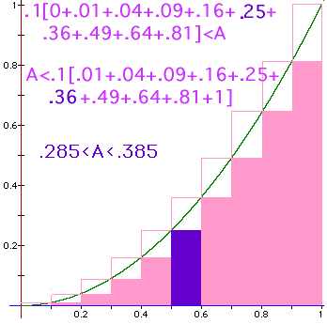
Blue area?
Lower sum for
n = 10
BA = 0.025

Slide 8
Lower sum
Lower sum for
n = 10
LS = .285

Slide 9
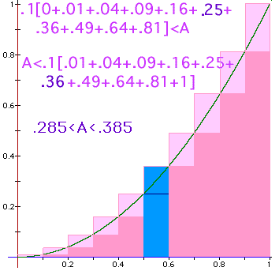
Find the total blue area
0.036
0.1

Slide 10
Find the total upper sum
0.385
0.1

Slide 11
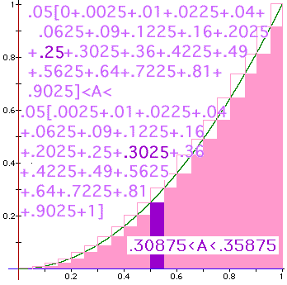

Slide 12
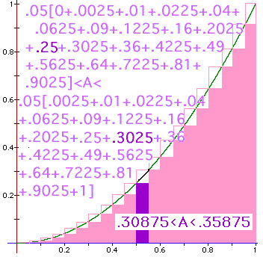
Find the blue area
0.0125
0.01

Slide 13
Find the upper and lower sum for n rectangles
N=5 => width = 0.2
N=10 => width = 0.1
N=20 => width = 0.05
N=n => width = 1/n

Slide 14
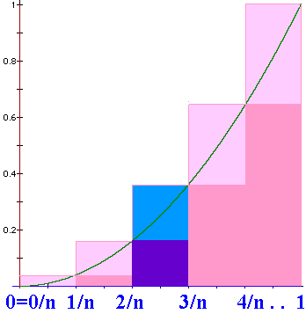
Upper sum
N = n
N=n => width = 1/n
US = 1/n [(1/n)² +(2/n)². .+(i/n)² +. . +1²]
US =

Slide 15
Sigma notation
1/2+1/3+1/4+1/5=77/60
1+4+9+16=30
3+3+3+3+3=15
2*0²+2*1²+2*2² = 0+2+8=10

Slide 16


Evaluate
3*1+2+3 = 8
3*1+3*2+3*3 = 18
1+3*2+3*3 = 16

Slide 17
Upper sum
N = n
N=n => width = 1/n
US = 1/n [(1/n)² +(2/n)². .+(i/n)² +. . +1²]
US =

Slide 18
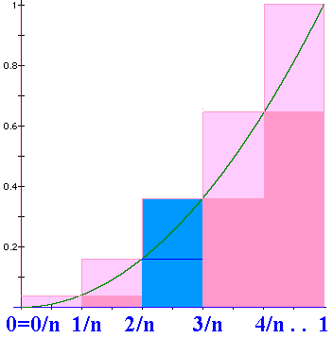
Upper sum
N = n
N=n => width = 1/n
US = 1/n [(1/n)² +(2/n)². .+(i/n)² +. . +1²]
US = =1/n³[1+4+9+….+n²]

Slide 19
2 nice theorems
1+4+9+16+25+36+49 =
7*4*5 = 140

Slide 20
1+8+3³+4³+5³+6³+7³= n=7
441.0
1.1

Slide 21
N=n => width = 1/n
US = =1/n³[1+4+9+….+n²]
US =

