Slide 1
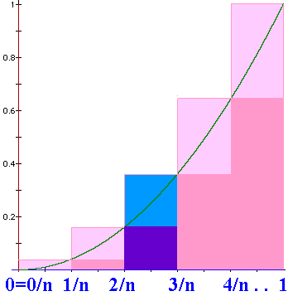
.
N=n => width = 1/n
US = =1/n³[1+4+9+….+n²]
US =

Slide 2
=

Slide 3

Definite
Integral
We will define
to be the limit as n
approaches oo of
where Δx_{i} = (b-a)/n
and is any point in the ith interval.

Slide 4
where Δx_{i} = (b-a)/n
and is any point in the i^{th} interval, [x_{i-1},x_{i}].

Slide 5
> 0 when f(x) > 0, but it is negative when f(x)<0.
We will define
to be the limit as n
approaches oo of
and is any point in the i^{th} interval, [x_{i-1},x_{i}].

Slide 6
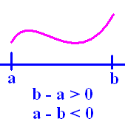
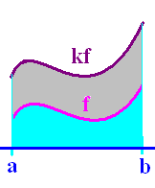
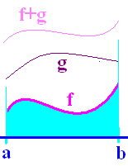
Definition
Theorems
1.
2.
3.
4.

Slide 7
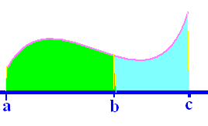
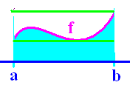
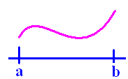
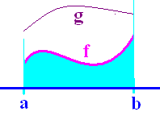
Definition
Theorems
5.
6.
7.
8.

Slide 9
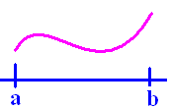
If f(x) >= 0 on [a,b]
then is the area under f(x) and
over the x-axis between a and b.

Slide 10
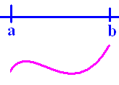
If f(x) <= 0 on [a,b]
then is the negative of the area
over f(x) and under the x-axis between
a and b.

Slide 11
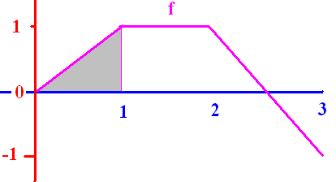
[

Slide 12


[
0.50
0.1

Slide 13
[

Slide 14
[
2.0
0.1

Slide 15
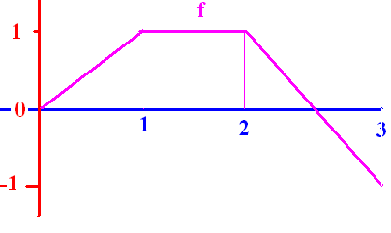
]

Slide 16
]
0.0
0.1

Slide 17
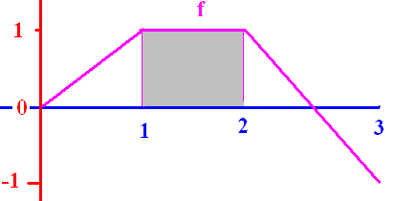
[

Slide 18
[

Slide 19
[
1.0
0.1

Slide 20
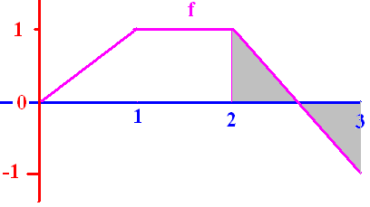

Slide 22
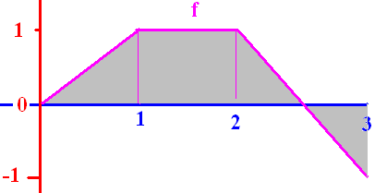
[

Slide 23
[
1.5
0.1

Slide 24
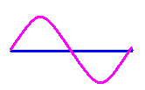

Slide 25
0

Slide 26
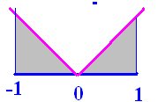
]

Slide 27
]
1.0
0.1

Slide 28
where Δx_{i} = (b-a)/n
and is any point in the i^{th} interval, [x_{i-1},x_{i}].
If the interval is [-4, 4] evaluate
8π

Slide 29
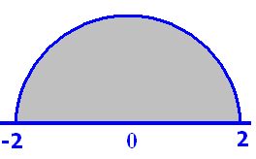
Pi = 3.14

Slide 30
Pi = 3.14
6.28
0.1

Slide 31
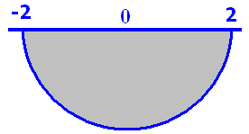
Pi = 3.14

Slide 32
Pi = 3.14
-6.28
0.1

