Slide 1
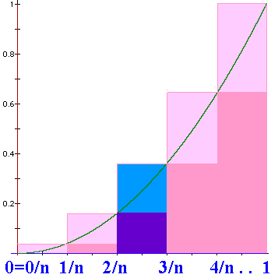
N=n => width = 1/n
US = =1/n³[1+4+9+….+n²]
US =

Slide 2
=

Slide 3

Definite
Integral
We will define
to be the limit as n
approaches +oo of
where Δx_{i} = (b-a)/n
and is any point in the ith interval.

Slide 4
where Δx_{i} = (b-a)/n
and is any point in the i^{th} interval, [x_{i-1},x_{i}].

Slide 5
> 0 when f(x) > 0, but it is negative when f(x)<0.
We will define
to be the limit as n
approaches +oo of
and is any point in the i^{th} interval, [x_{i-1},x_{i}].

Slide 6
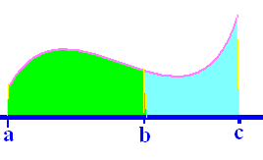
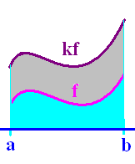
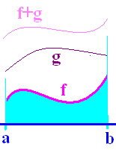
Definition
Theorems
1.
2.
3.
4.

Slide 7
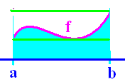
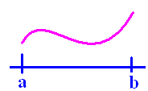
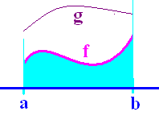
Definition
Theorems
5.
6.
7.
8.

Slide 8
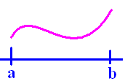
If f(x) >= 0 on [a,b]
then is the area under f(x) and
over the x-axis between a and b.

Slide 9
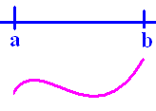
If f(x) <= 0 on [a,b]
then is the negative of the area
over f(x) and under the x-axis between
a and b.

Slide 10
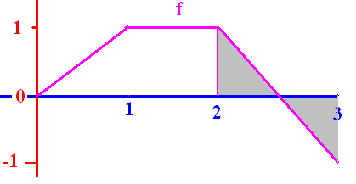
.
½ + (-½) = 0
The definite integral of f from 2 to 3 is 0

Slide 11
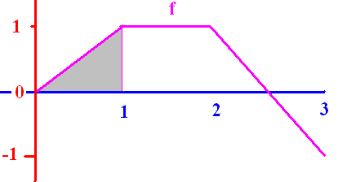
[

Slide 12


[
0.50
0.1

Slide 13
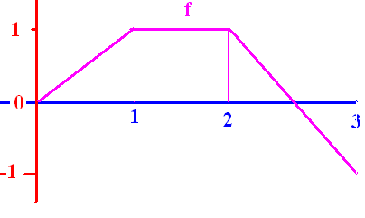
]

Slide 14
]
0.0
0.1

Slide 15
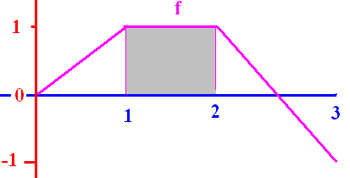
[

Slide 16
[
1.0
0.1

Slide 17
Definite
Integral
We will define
to be the limit as n
approaches +oo of
where Δx_{i} = (b-a)/n
and is any point in the ith interval.

Slide 18
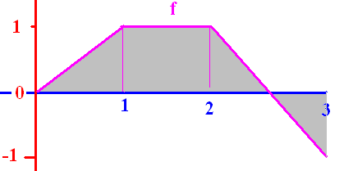
[

Slide 19
[
1.5
0.1

Slide 20
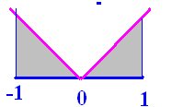
]

Slide 21
]
1.0
0.1

Slide 22
Fundamental Theorem of Calculus
If f is continuous on [a, b] and F is any antiderivative of f, then

Slide 23
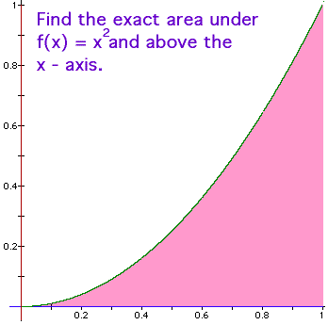
Fundamental Theorem of Calculus
f(x) = x² is continuous on [0, 1] and
F(x) = x³/3 is an antiderivative of f(x), so

Slide 24
Traditional Notation

Slide 25
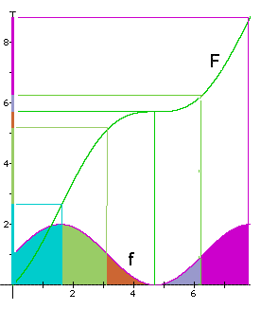
Example
Let f be continuous on
[0,8] and let F be any
antiderivative of f.

Slide 26
What is the green area?
By the F.T.C.,
sq. in.
1.6 3.1

Slide 27
What is the total area?
By the F.T.C.,
sq. in.
0 8

Slide 28
Fundamental Theorem of Calculus
If f is continuous on [a, b] and F is any antiderivative of f, then

Slide 29
Fundamental Theorem of Calculus
If fx) = x² is continuous on [0, 1] and
F(x) = x³/3 is an antiderivative of f(x), so

Slide 30
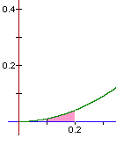
Fundamental Theorem of Calculus
If f(x) = x² is continuous on [0.1, 0.2] and
F(x) = x³/3 is an antiderivative of f(x), so
=

Slide 31
Fundamental Theorem of Calculus
If fx) = x² is continuous on [0.1, 0.2] and
F(x) = x³/3 is an antiderivative of f(x), so
= (0.008 – 0.001)/3 = 0.007/3 = 0.00233..

Slide 32
Using the traditional notation
= (0.008 – 0.001)/3 = 0.007/3 =
0.0023333333….

Slide 33

Find the area under y=-x(x-3) on [0, 3]

Slide 34
Find the area under y=-x(x-3) on [0, 3]
= [-54 + 81]/6 = 27/6
= 9/2 = 4.5 sq. in.

Slide 35
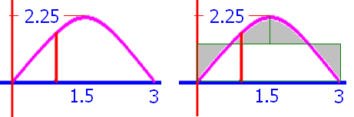
Find the average height y=-x(x-3) on [0, 3]
AH =
4.5 sq. in. / 3 in = 1.5 in

Slide 36
Evaluate

Slide 37
Evaluate
1.5
0.1

Slide 39
Evaluate

Slide 40
Evaluate
4.5
0.1

Slide 42
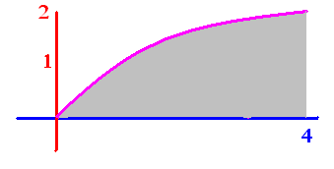
Evaluate

Slide 43
Evaluate
5.33
0.1

Slide 44
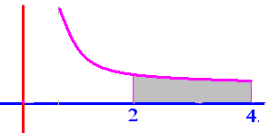
Evaluate

Slide 45
Evaluate
.25
0.1

Slide 46
Get from
Rewriting 1 over x squared as x to the negative two we get

Slide 47
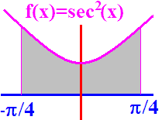
Find an antiderivative of f.
F(X) = sec(x)
F(X) = sec(x)tan(x)
F(x) = tan(x)
F(x) = tan² x)

Slide 48


Find an antiderivative of f.
F(X) = sec(x)
F(X) = sec(x)tan(x)
F(x) = tan(x)
F(x) = tan² x)

Slide 49
F(x) = tan(x) is an antiderivative of sec²(x).
Area =
F(-π/4) + F(π/4)
F(-π/4) - F(π/4)
F(π/4) + F(-π/4)
F(π/4) - F(-π/4)

Slide 50
F(x) = tan(x) is an antiderivative of sec²(x).
Area =
F(-π/4) + F(π/4)
F(-π/4) - F(π/4)
F(π/4) + F(-π/4)
F(π/4) - F(-π/4)

Slide 51
F(x) = tan(x)
F(π/4) - F(-π/4) =
0
1
1.5
2

Slide 52
F(x) = tan(x)
F(π/4) - F(-π/4) =
0
1
1.5
2

Slide 53

Evaluate

Slide 54
Evaluate
2.0
0.1

Slide 55

Evaluate

Slide 56
Evaluate
2.0
0.1

Slide 58
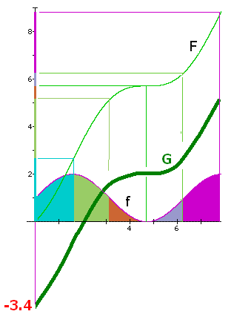
Draw a different
antiderivative G
Evaluate
5.2 – 0 = 5.2
1.8 – (-3.4) = 5.2 square inches

Slide 59
Draw a different
antiderivative G
Evaluate
1.8 – (-3.4) = 5.2 square inches

Slide 60
Evaluate
F(6.28) – F(3.14) =
6.3 - 5.2 = 1.1
The orange and grey
area is 1.1 square
inches.

Slide 61
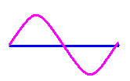

Slide 62
0

Slide 65
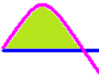

Slide 66
]
1.0
0.1

Slide 67
Fundamental Theorem of Calculus
If f is continuous on [a, b] and F is any antiderivative of f, then

Slide 68
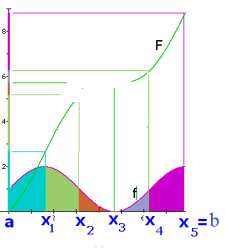
.
Find a Riemann sum on [a,b]
using left endpoints and n = 5

Slide 69
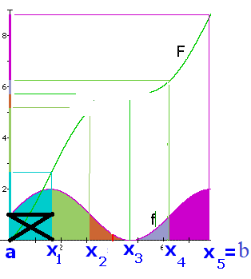
.
Find a Riemann sum on [a,b]
using left endpoints and n = 5

Slide 70
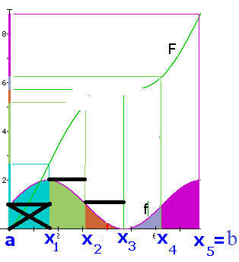
.
Find a Riemann sum on [a,b]
using left endpoints and n = 5

Slide 71
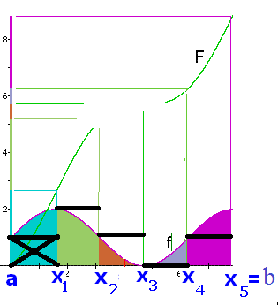
.
Find a Riemann sum on [a,b]
using left endpoints and n = 5

Slide 72
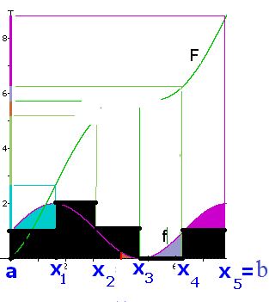
.
Find a Riemann sum on [a,b]
using left endpoints and n = 5
LS = π/2[

Slide 73
.
Find a Riemann sum on [a,b]
using left endpoints and n = 5
LS = π/2[1 + 2 +

Slide 74
.
Find a Riemann sum on [a,b]
using left endpoints and n = 5
LS = π/2[1 + 2 + 1 + 0 + 1]

Slide 75
.
Find a Riemann sum on [a,b]
using left endpoints and n = 5
LS = π/2[1 + 2 + 1 + 0 + 1] = 5π/2

Slide 76
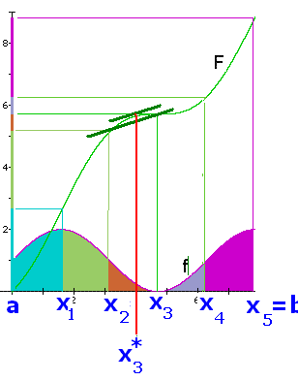
.
Let F be an antiderivative of f
For each i choose x_{i}* so that
F’(x_{i}*) = [F(x_{i})-F(x_{i-1})]/[x_{i}-x_{i-1}]

Slide 77
.
F’(x_{i}*) = [F(x_{i})-F(x_{i-1})]/[x_{i}-x_{i-1}]

Slide 78
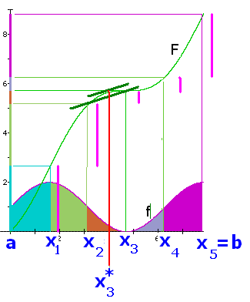
.
. . . . . . . . . . . . . . . . .
= F(b) – F(a)

Slide 79
Fundamental Theorem of Calculus
f(x) = x² is continuous on [0, 1] and
F(x) = x³/3 is an antiderivative of f(x), so

Slide 80
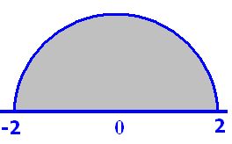
Pi = 3.14

Slide 81
Pi = 3.14
6.28
0.1

Slide 82
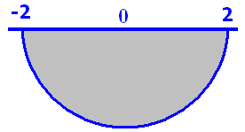
Pi = 3.14

Slide 83
Pi = 3.14
-6.28
0.1

