Slide 1
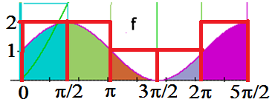
Upper Sum with n=5

Slide 2

Upper Sum with n=5
(2+2+1+1+2) π/2

Slide 3

Upper Sum with n=5
12.56
1.0

Slide 4
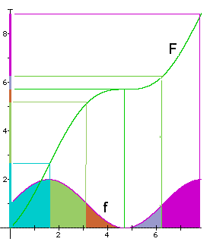
.

Slide 5
.

Slide 6
.

Slide 7
.

Slide 9
8.85
0.4

Slide 10
Fundamental Theorem of Calculus
If f is continuous on [a, b] and F is any antiderivative of f, then

Slide 11

Maximize
=-x(x-3) = 0 when

Slide 12
Maximize
=-x(x-3) = 0 when x = 0 or x = 3
f(1) = 2 > 0 => F(x) is increasing

Slide 13
Maximize

Slide 14
Maximize

Slide 15
Maximize
= [-54 + 81]/6 = 27/6

Slide 16
Maximize
= [-54 + 81]/6 = 27/6
= 9/2 = 4.5 sq. in.

Slide 17
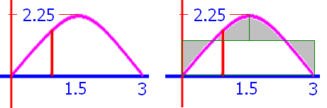
Find the average height y=-x(x-3) on [0, 3]
AH =
4.5 sq. in. / 3 in = 1.5 in

Slide 18
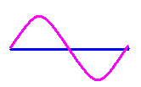

Slide 19
-cos x |

Slide 20
-cos x | =-cos(2π)-(-cos(0))

Slide 21
-cos x | =-0-(-0)

Slide 22
-cos x | =-1 - (-1)=0

Slide 23
0

Slide 24
F(x) = + 12
f(x) = F’(x) =

Slide 25
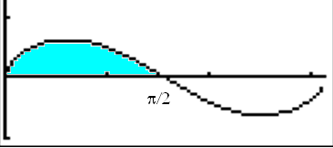
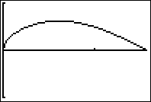
y = [sin x] ^{½} cosx

Slide 26
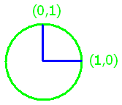
Evaluate

Slide 27
Evaluate
0.6667
0.01

