Slide 1
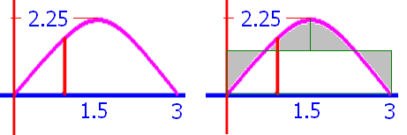
Average height
AH =

Slide 2
Average height
AH = Find the height of a rectangle
with the same ‘area’.

Slide 3
Find the average height y=-x(x-3) on [0, 3]
AH = /3

Slide 4
Find the average height y=-x(x-3) on [0, 3]
AH = / 3
4.5 sq. in. / 3 in = 1.5 in

Slide 5
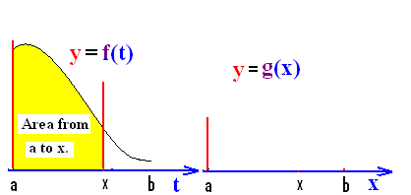
FTC I
Suppose f : [a, b] => R is a positive continuous function. Define g : [a, b] => R by
g(x) = = area under f from a to x.

Slide 6
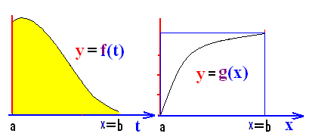
In other words, g(x) is the area over [a, x] and under f(t).

Slide 7
.
1
2
0

Slide 8


.
1
2
0

Slide 9
FTC I
g(x) = = area under f from a to x.
What is g(a)?

Slide 10
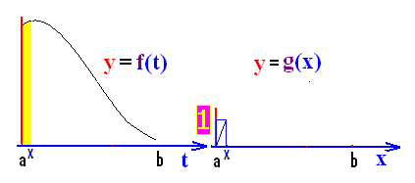
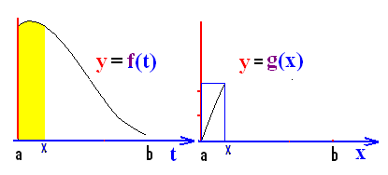
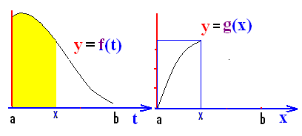
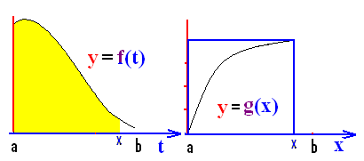
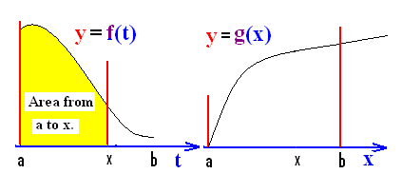
FTC I
g(x) = = area under f from a to x.

Slide 11
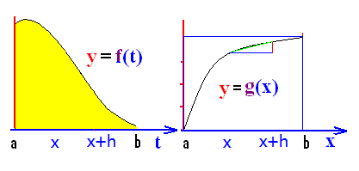
In other words, g(x) is the area over [a, x] and under f(t).
Note that the derivative of g(x) is
defined to be g’(x) =

Slide 12
The definition of g’(x) is
.
.
.

Slide 13
The definition of g’(x) is
.
.
.

Slide 14
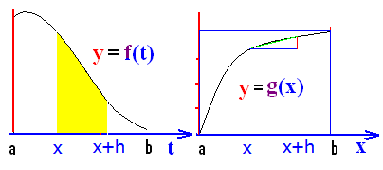
.
.
.
.

Slide 15
.
.
.
.

Slide 16
.
.
.
.

Slide 17
.
.
.
.

Slide 18
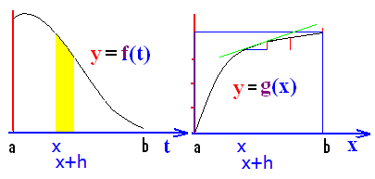
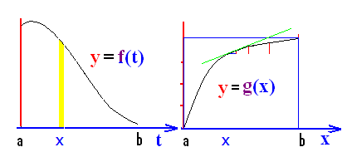
g(x)=
The definition of g’(x) is

Slide 19

g’(x) =

Slide 20
Fundamental theorem of calculus I
If f : [a, b] => R is a continuous function
and g : [a, b] => R is defined by
g(x) = then g’(x) = f(x).

Slide 21

FTC I
If g(x) = then g’(x) = f(x).
If g(x) = find g’(x).
g’(x) = cos(2x)

Slide 22
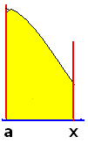
FTC I
If g(x) = then g’(x) = f(x).
If g(x) = find g’(x).
g’(x) = 1/csc⁴x = sin⁴(x)

Slide 23
If then g’(x) =
tan²x
tan x
sec³x

Slide 24
If then g’(x) =
tan²x
tan x
sec³x

Slide 25
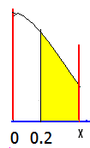
FTC I
If g(x) = then g’(x) = f(x).
If g(x) = find g’(x).
g’(x) = cos(2x)

Slide 26
FTC I
If g(x) = then g’(x) = f(x).
If g(x) = find g’(x).
g’(x) =

Slide 27
FTC I
If g(x) =
then g(x) = find g’(x).
g’(x) = - 3x sin x

Slide 28
If then g’(x) =
- sec³x
tan³x
sec³x

Slide 29
If then g’(x) =
- sec³x
tan³x
sec³x

Slide 30
If y = g(x) = .
Let u = x² and recall
dy/dx =

Slide 31
dy/dx =
dy/dx = 3u sin u du/dx
dy/dx =

Slide 32
If then g’(x) =
-sec³ u
- sec³(x³ + x)*(3x² +1)
tan³u

Slide 33
If then g’(x) =
-sec³ u
- sec³(x³ + x)*(3x² +1)
tan³u

