Slide 1
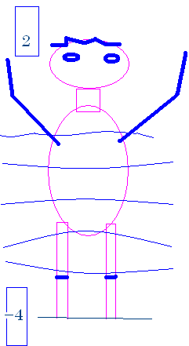
How tall am I?
My head is 232 feet above sea level.
My feet are 226 feet above sea level.
My head is 2 feet above sea level.
My feet are (-4) feet ‘above’ sea level.

Slide 2
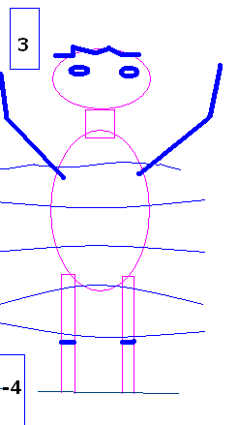
How many feet tall am I?

Slide 3


How many feet tall am I?
7.0
0.1

Slide 4
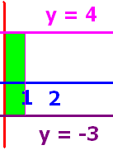
What is the area of the green rectangle?

Slide 5
What is the area of the green rectangle?

Slide 6
What is the area of the green rectangle?
7.0
0.1

Slide 7
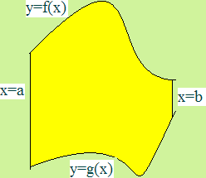
What is the area
below f(x), above g(x) and
between x=a and x=b ?

Slide 8
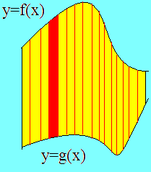
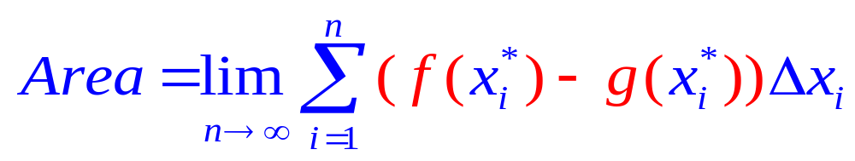
Set up n rectangles of width Δx
And height is top – bottom or f(x) – g(x)

Slide 9
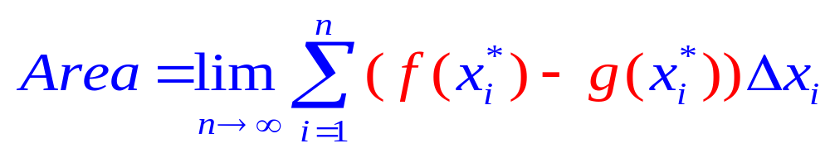
The area of one rectangle is height times width

Slide 10
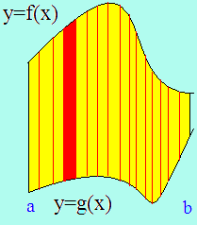
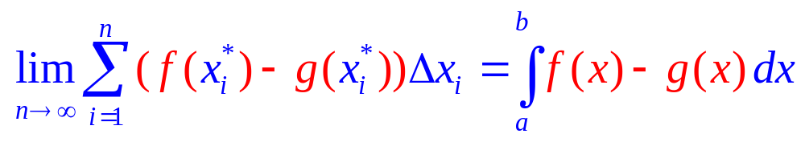
By the definition of the definite integral
Area =

Slide 11
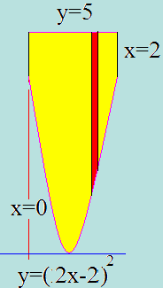
Example 1
Find the area over y=(2x-2)² and under y=5
Between x=0 and x=2
Just add up all of the red rectangles
As they slide from x=0 to x=2
The top function is . . .
Y=5
And the bottom function is . . .
Y=(2x-2)²

Slide 12
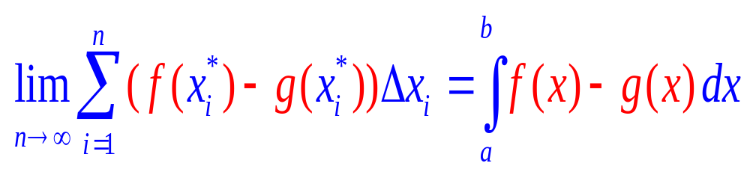
By the definition of the definite integral
Area =

Slide 13
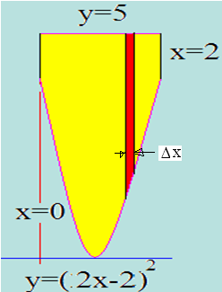
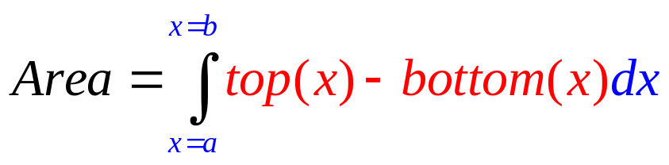
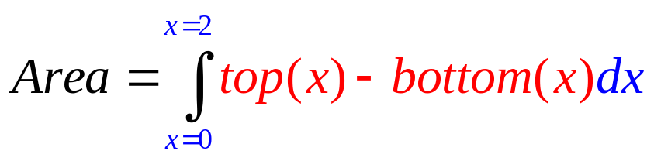
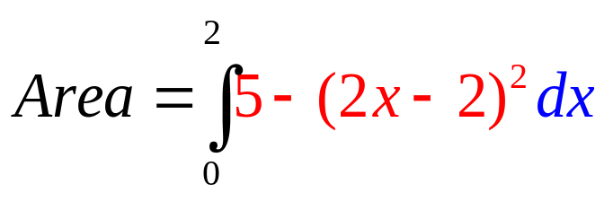
Example 1
Find the area over y=(2x-2)² and under y=5
Between x=0 and x=2

Slide 14
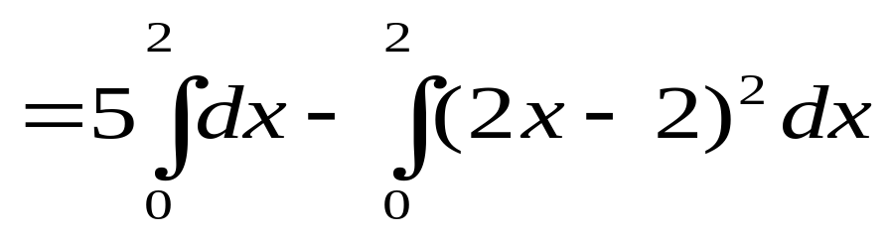
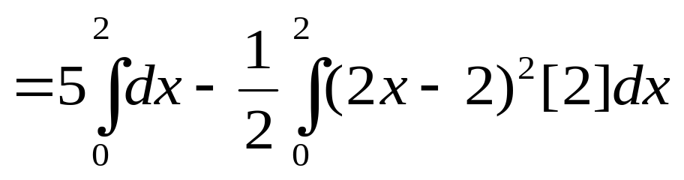

Example 1
Find the area over y=(2x-2)² and under y=5
Between x=0 and x=2
=5x-1/2 (2x-2)³/3
=10 - 0.5 8/3-[0 - 0.5 (-8/3)]
=10 - 4/3 - 4/3 = 10 – 8/3 = 22/3 square feet

Slide 15
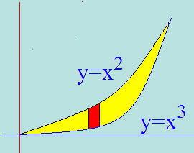
Example 2
Set the two functons equal to each other
Solve for x x² = x³ or 0 = x³ - x²
By factoring 0 = x² ( x – 1 )
so x² =0 or x–1=0
Next we add up all of the red rectangles
From 0 to 1
Area =

Slide 16
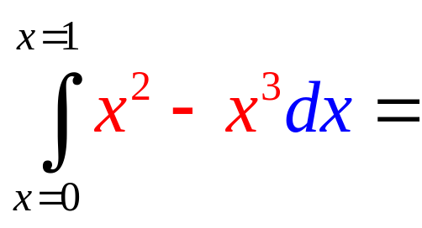
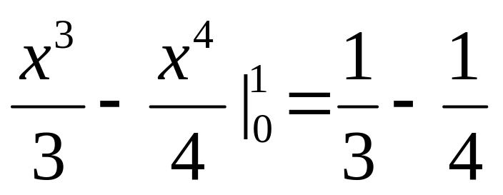
Area =
= 1/12 square feet

Slide 17
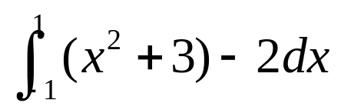
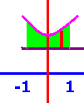
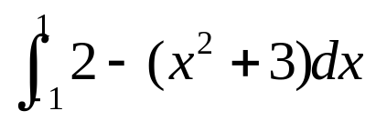
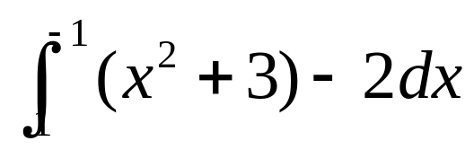
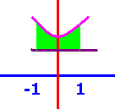
The area over y=2 and under y=x²+3 between x=-1 and x=1
[
[
[

Slide 18

The area over y=2 and under y=x²+3 between x=-1 and x=1
[
[
[

Slide 19
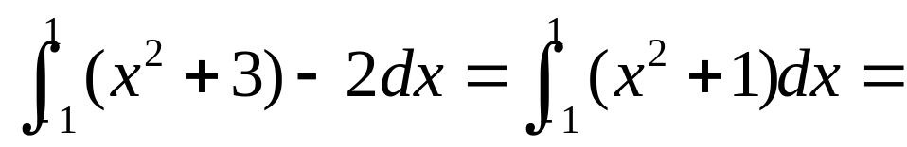
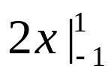
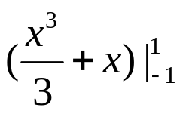
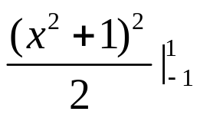
.
[
[
[

Slide 20
.
[
[
[

Slide 21
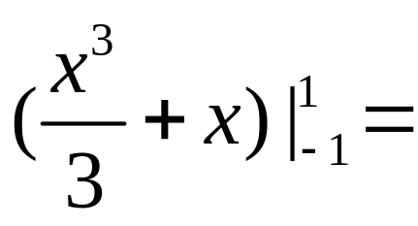
]

Slide 22
]
2.667
0.1

Slide 23
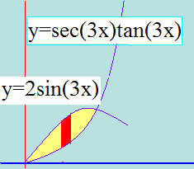

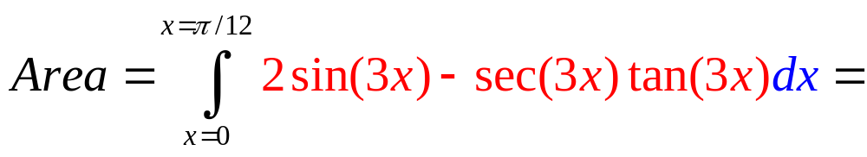
Area =

Slide 24
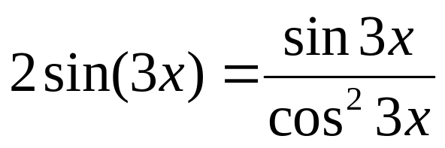
.
Set the two functons equal to each other

Slide 25
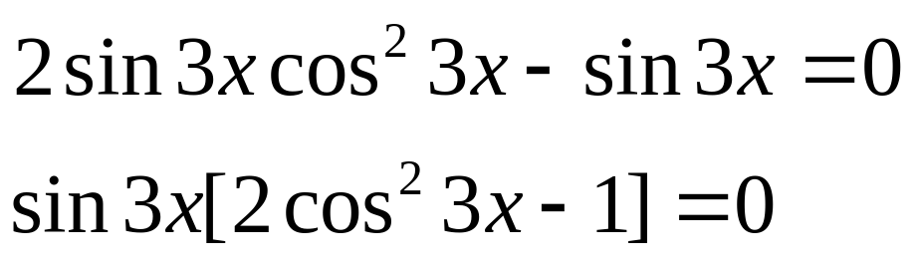
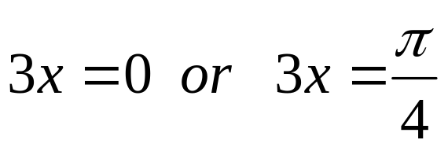
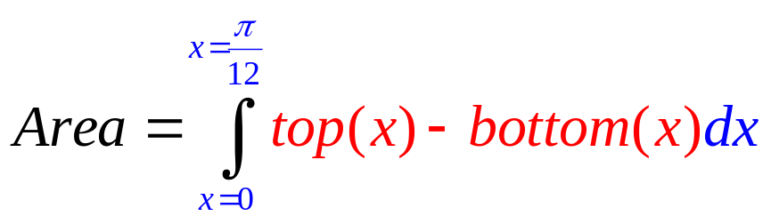
.

Slide 26
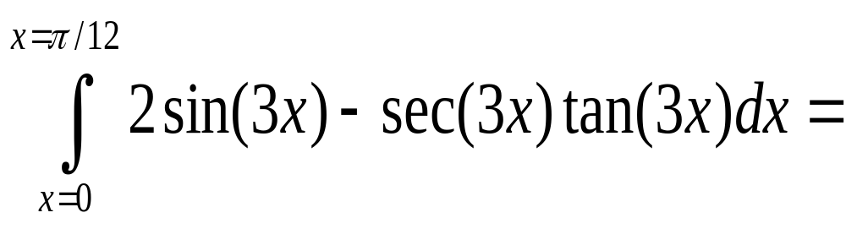
Area =
True
False

Slide 27
Area =
True
False

Slide 28
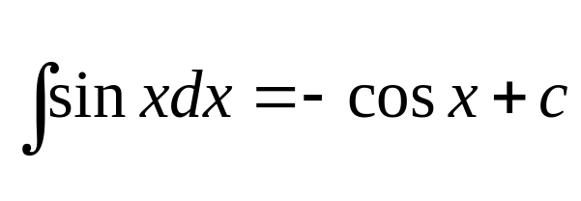
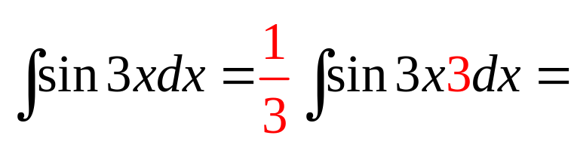
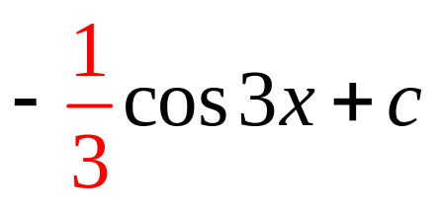
Review

Slide 29
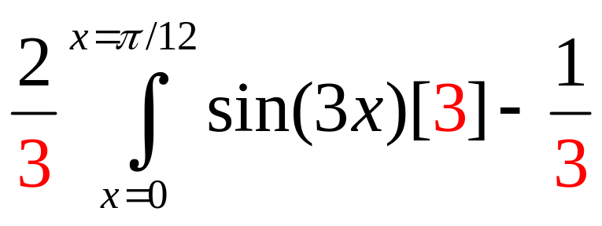
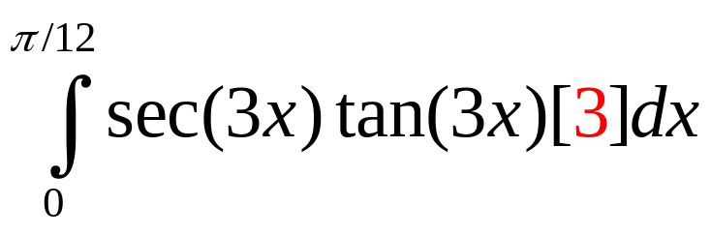
.

Slide 30
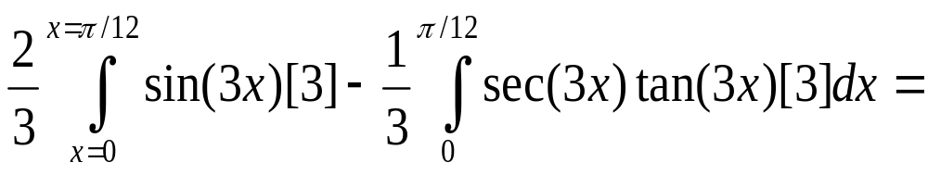
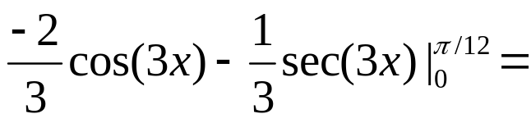
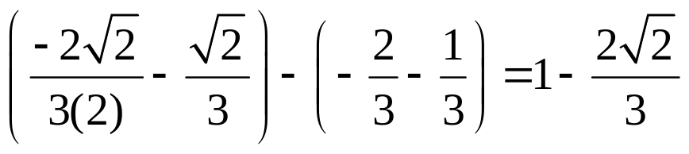

Slide 31
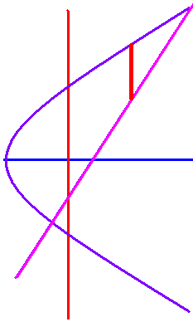
Example 4
Find the area bounded by y² = 2x + 6 and y = x – 1.
2x = y² – 6 = 2y + 2

Slide 32
y² - 6 = 2y + 2
Solve for y.
y = -2 or y = -4
y = - 2 or y = 4

Slide 33
y² - 6 = 2y + 2
Solve for y.
y = -2 or y = -4
y = - 2 or y = 4

Slide 34
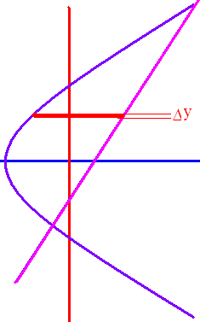
x = 0.5y² - 3
x = y + 1
y² – 6 = 2y + 2
y² - 2y – 8 = (y – 4)(y + 2 ) = 0
y = 4 or y = -2

Slide 35
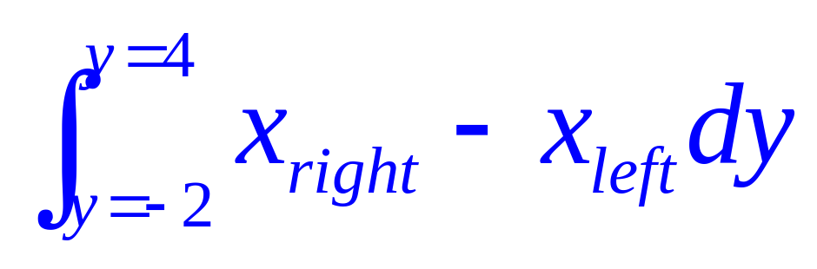

Slide 36
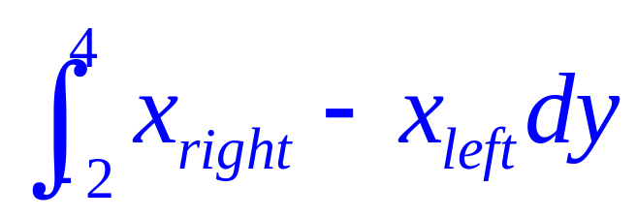
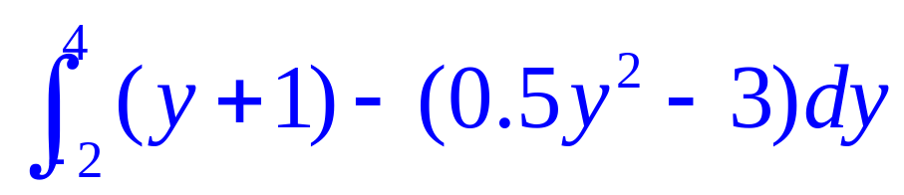













x = y + 1.
x = 0.5 y² – 3 .

Slide 37

First two places y=cosx and y=2 sinx cosx cross?
]
x= π/3, π
x=π/3, π/2
x=π/6, π/2

Slide 38
First two places y=cosx and y=2 sinx cosx cross?
]
x= π/3, π
x=π/3, π/2
x=π/6, π/2

Slide 39




What is the area between them?
.
.
.

Slide 40
What is the area between them?
.
.
.

Slide 41
What is the area between them?
.
.
.

Slide 42




]
]
]
]

Slide 43
]
]
]
]

Slide 44




]
]
]
]

Slide 45
]
]
]
]

Slide 46

]

Slide 47
]
0.25
0.1

