Slide 1
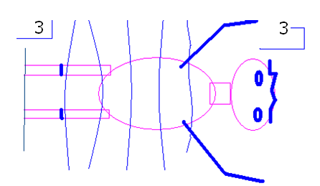
Right minus left

Slide 2
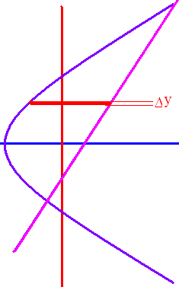
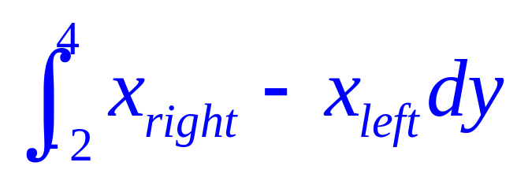
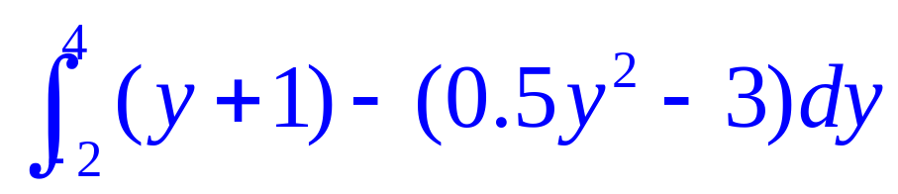
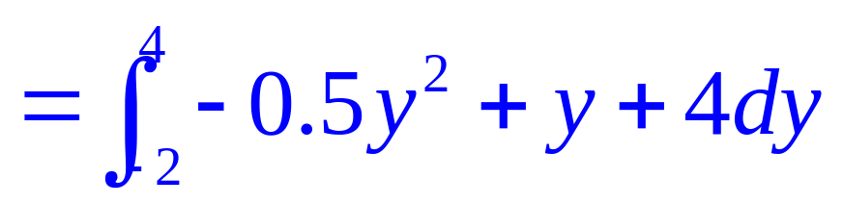
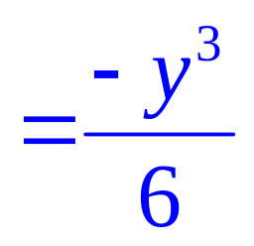
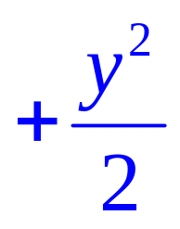
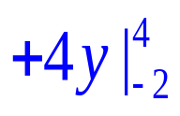
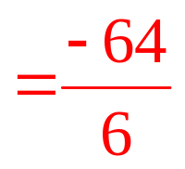



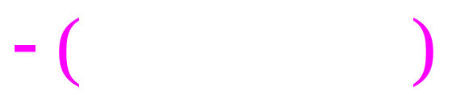


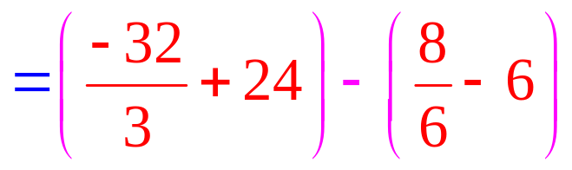
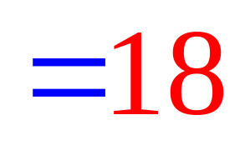
y + 1 = 0.5 y² – 3 0 = 0.5 y² – y – 4
0 = y² – 2y – 8 =(y – 4)(y + 2)

Slide 3
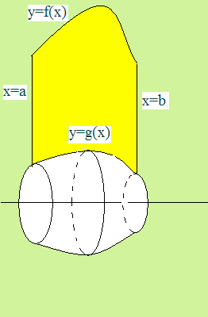
What is the volume if the yellow area is rotated about the x-axis?

Slide 4
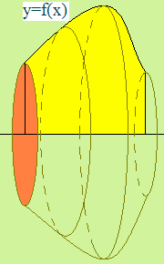
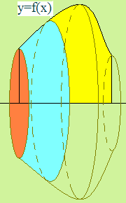
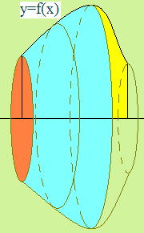
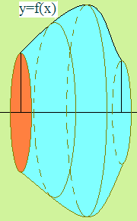
An easier question would be an easier graph of f(x).

Slide 5
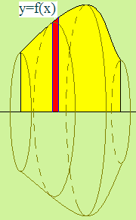
Start like we did for area. Take a narrow red strip and then rotate it about the x-axis.

Slide 6
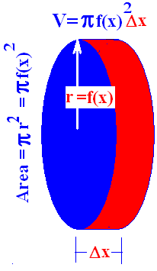
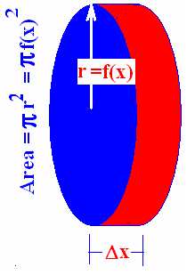
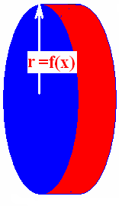
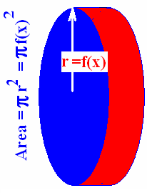
The volume of a nickel is π r² times the width.

Slide 7
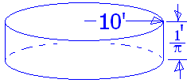
Find the volume of a stool with radius 10 ft. and height 1/π ft.
10/π cubic feet
100 π cubic feet
10 cubic feet
100 cubic feet

Slide 8


Find the volume of a stool with radius 10 ft. and height 1/π ft.
10/π cubic feet
100 π cubic feet
10 cubic feet
100 cubic feet

Slide 9
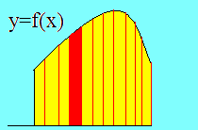
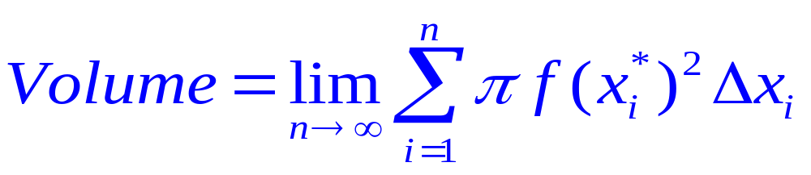
Set up n rectangles of width Δx
And the height
of each is f(x) so . . .

Slide 10
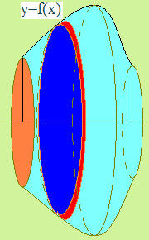
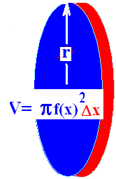
What is the volume if the area between f(x) and y=0 is revolved about the x-axis?

Slide 11
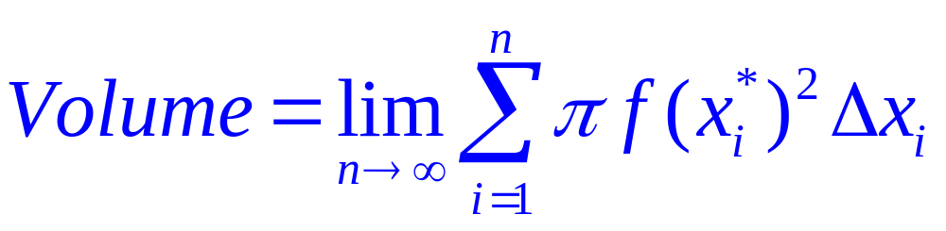
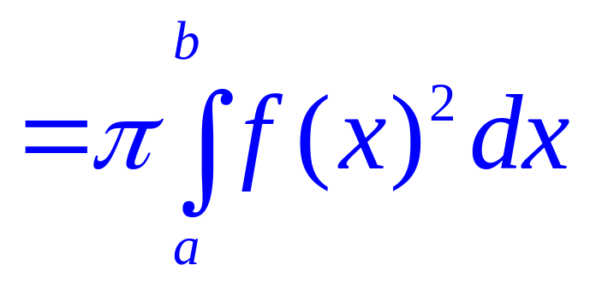

Slide 12

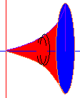
Example 1
Find the volume when the area under y = x² and over the x-axis is revolved about the x-axis.
Between x=0 and x=2
Just add up all of the red nickels
As they slide from x=0 to x=2
The top function is . . .
Y= x²

Slide 13
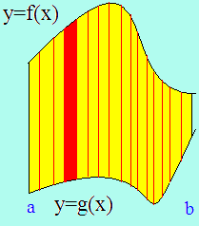
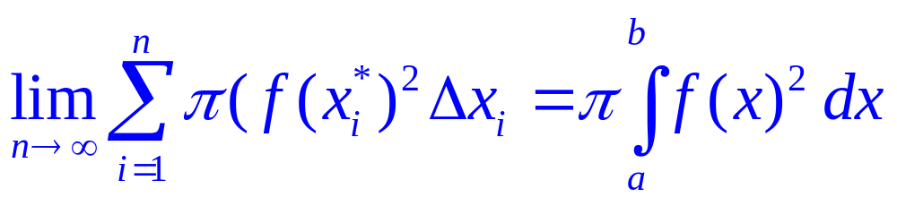
By the definition of the definite integral
Volume =

Slide 14
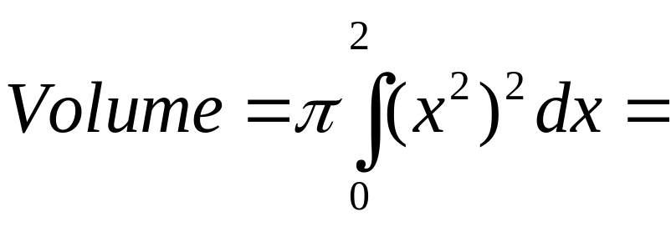

Example 1
Find the volume when the area under y=x²
Between x=0 and x=2
Is revolved about the x-axis
= π x⁵/5
= π 32/5

Slide 15

Example 2
Find the volume when the area under y=the square root of x is revolved about the x-axis between x=0 and x=4.
Volume =

Slide 16
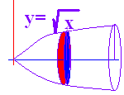
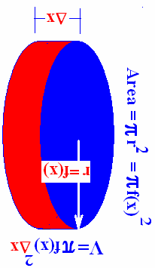
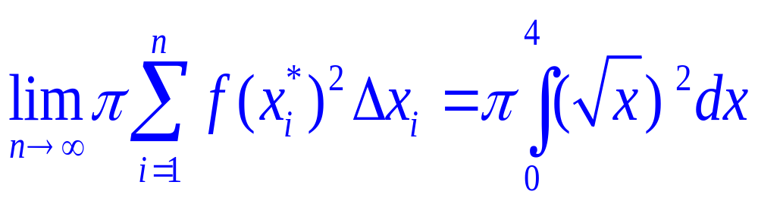
Volume =

Slide 17
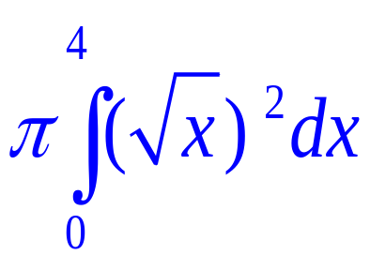
Volume = =
2π
4π
6π
8π

Slide 18
Volume = =
2π
4π
6π
8π

Slide 19
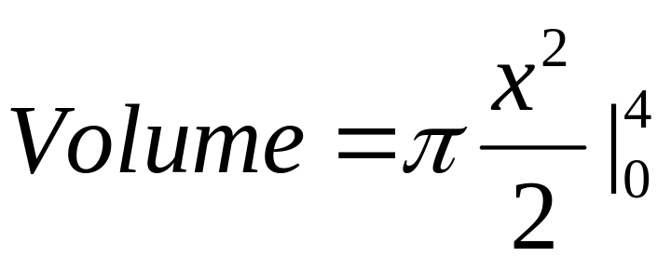
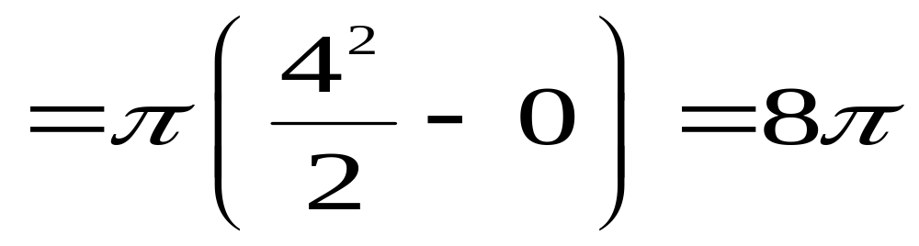
Volume =

Slide 20
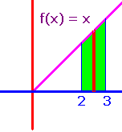
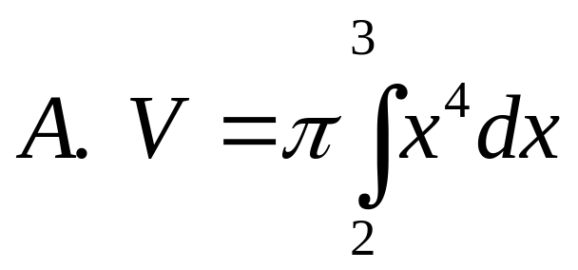
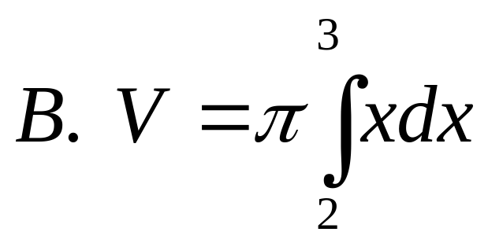
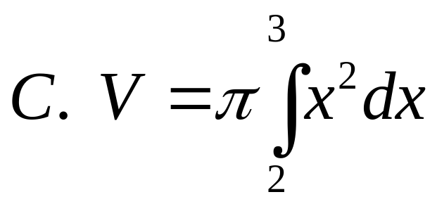
Revolve the shown area about the x-axis.
]
]
]

Slide 21
Revolve the shown area about the x-axis.
]
]
]

Slide 22
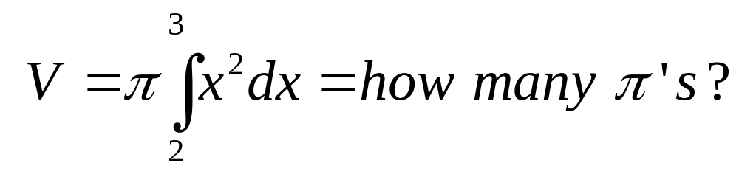
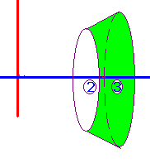
[

Slide 23

[
6.333
0.1

Slide 24
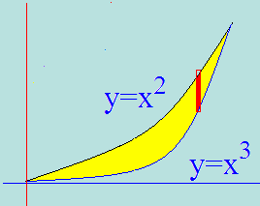
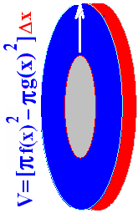
Example 3
Washer Method
Spin the shown region about the x-axis
Show red strip perpendicular to the axis of revolution

Slide 25
Example 3
Washer Method
Use the disc method for the top function
Use it again for the bottom one
Subtract the two answers

Slide 26
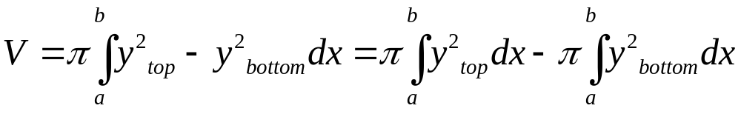
Example 3
Washer Method
.

Slide 27
Speaker
Washer Method
Set the two functons equal to each other
Solve for x x² = x³ or 0 = x³ - x²
By factoring 0 = x² ( x – 1 )
so x² =0 or x–1=0
Next we add up all of the red washers
From 0 to 1
Volume =

Slide 28
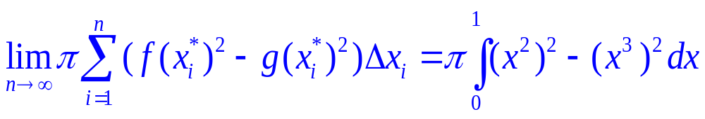
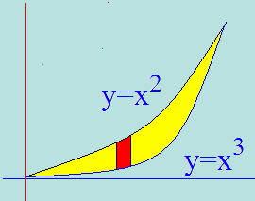

Volume =
= π[(7-5)/35] = 2π /35

Slide 29




Find the volume
[]
[]
[]

Slide 30
Find the volume
[]
[]
[]

Slide 31




.
[]
[]
[]

Slide 32
.
[]
[]
[]

Slide 33




.
[]
[]
[]

Slide 34
.
[]
[]
[]

Slide 35

]

Slide 36
]
9.83
0.2

Slide 37





Slide 38





Example 4
Take the area bounded by x = y² and y = x/2.
Revolve that area about the y-axis
Red strip is perpendicular to axis of rev.

Slide 39

x = y² and y = x/2
Solve for x and set them equal
y² = 2y

Slide 40
x = y² and y = x/2
Solve for x and set them equal
y² = 2y
y² - 2y = 0
y(y – 2) = 0 so y = 0 or y = 2

Slide 41

x = y² and y = x/2
Solve for x and set them equal
y² = 2y
y² - 2y = 0
y(y – 2) = 0 so y = 0 or y = 2

Slide 42




Slide 43


What is the volume if the grey area is revolved about the x-axis?
What are the limits of integration.

Slide 44


What is the volume if the yellow area is revolved about the y-axis?
Red strip must be perpendicular to the axis of revolution.

Slide 45

What is the volume if the yellow area is revolved about the y-axis?
Red strip must be perpendicular to the axis of revolution.

Slide 46

What is the volume if the yellow area is revolved about the y-axis?
Red strip must be perpendicular to the axis of revolution.

Slide 47







=-π/3[0-1]

Slide 48





Slide 49
.

Slide 50
.
0.5
0.1

Slide 51


Region bounded by y=x²+1 and y=x+3 is revolved about the x-axis.

Slide 52
Region bounded by y=x²+1 and y=x+3 is revolved about the x-axis.
23.4
0.2

Slide 53
cos(A+B)=cosAcosB-sinAsinB
cos(x+x) = cosx cos x – sinx sinx
=cos²x-sin²x=2 cos²x -1
Thus cos²x = (1+cos(2x))/2
Similarly sin²x = (1-cos(2x))/2
sin(x+x) = sin x cos x + cos x sin x
sin(2x) = 2 sin x cos x

Slide 54

First two places y=cosx and y=2sinxcosx cross?
]
x= π/3, π
x=π/3, π/2
x=π/6, π/2

Slide 55




What is the area between them?
.
.
.

Slide 56




]
]
]
]

Slide 57

]
0.25
0.1

