Slide 1
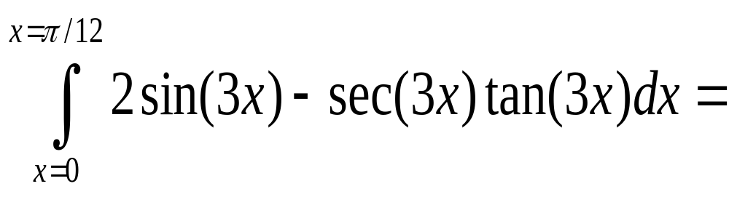
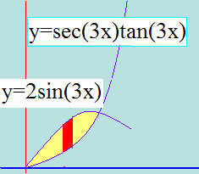
Area =
True
False

Slide 2


Area =
True
False

Slide 3
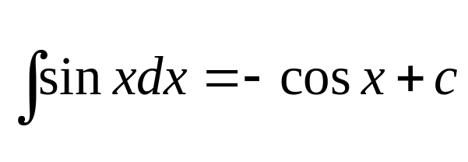
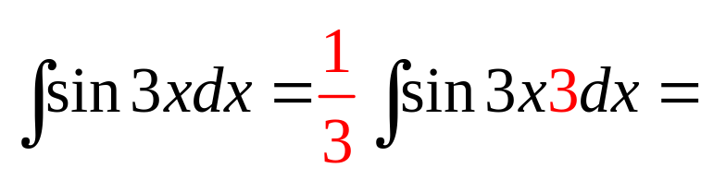
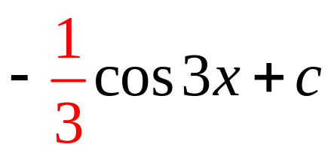
Review

Slide 4
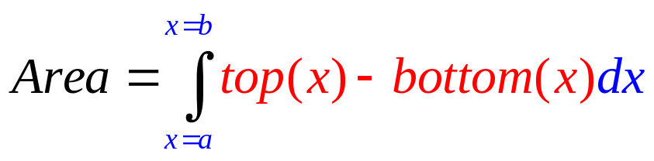
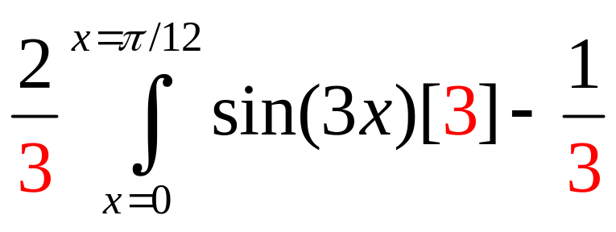
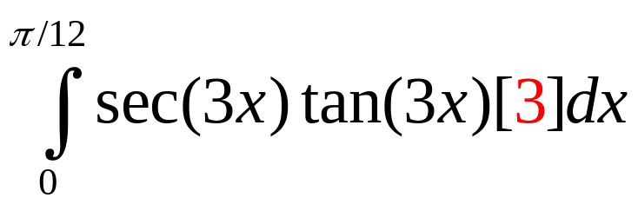
.

Slide 5
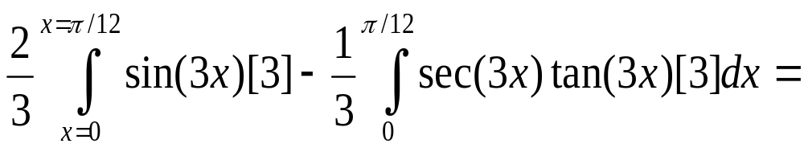
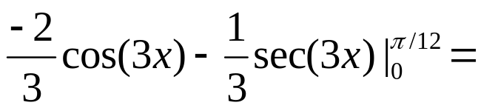
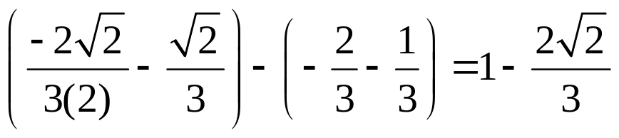

Slide 6
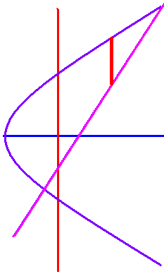
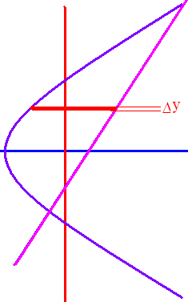
x = 0.5y² - 3
x = y + 1
y² – 6 = 2y + 2
y² - 2y – 8 = (y – 4)(y + 2 ) = 0
y = 4 or y = -2

Slide 7
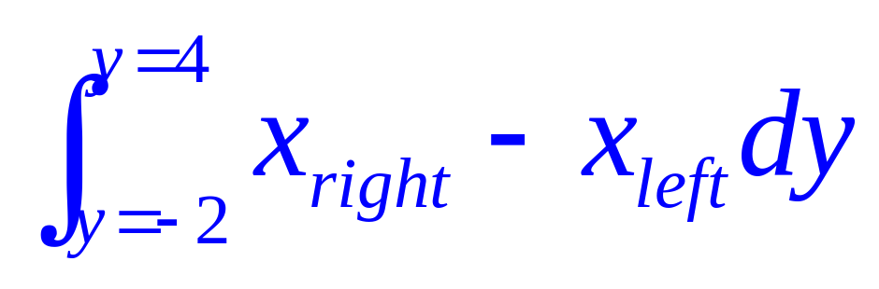

Slide 8
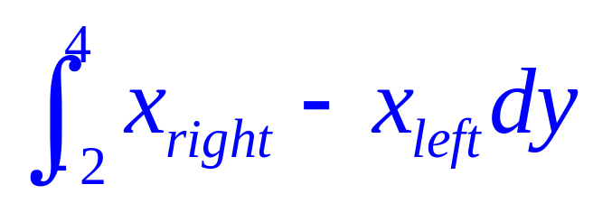
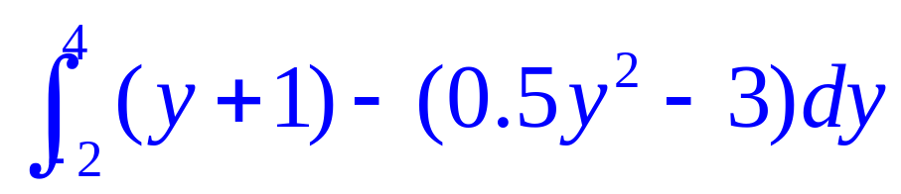
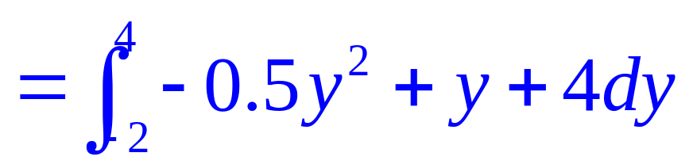
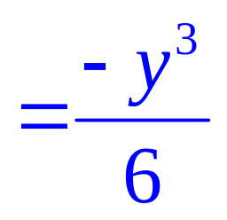
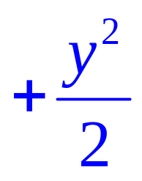
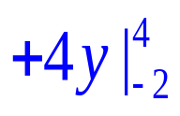
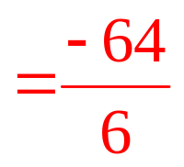



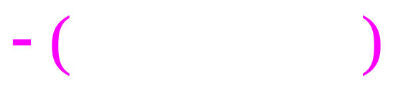


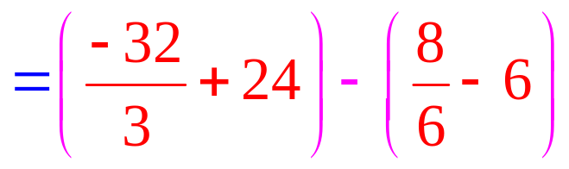
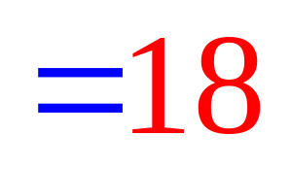
x = y + 1.
x = 0.5 y² – 3 .

Slide 9
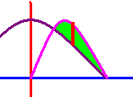
First two places y=cosx and y=2 sinx cosx cross?
]
x= π/3, π
x=π/3, π/2
x=π/6, π/2

Slide 10
First two places y=cosx and y=2 sinx cosx cross?
]
x= π/3, π
x=π/3, π/2
x=π/6, π/2

Slide 11
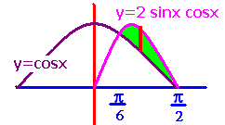
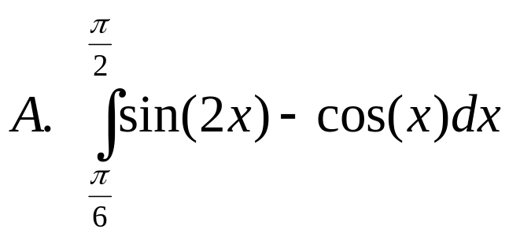
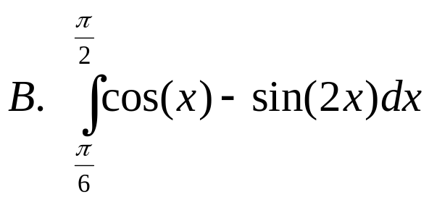
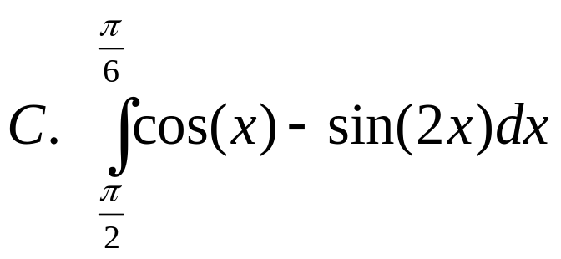
What is the area between them?
.
.
.

Slide 12
What is the area between them?
.
.
.

Slide 13
What is the area between them?
.
.
.

Slide 14
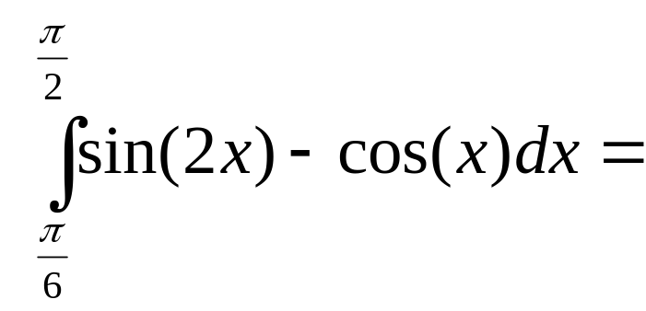
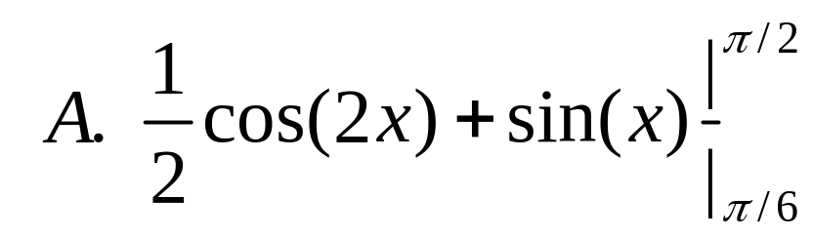
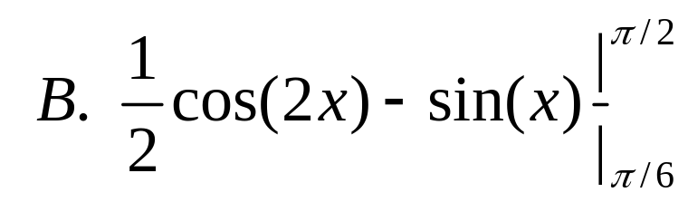
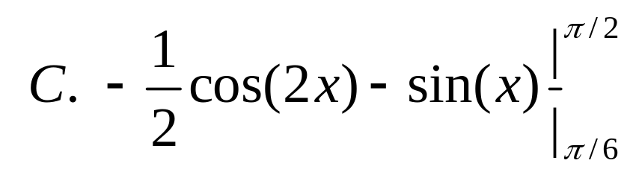
]
]
]
]

Slide 15
]
]
]
]

Slide 16
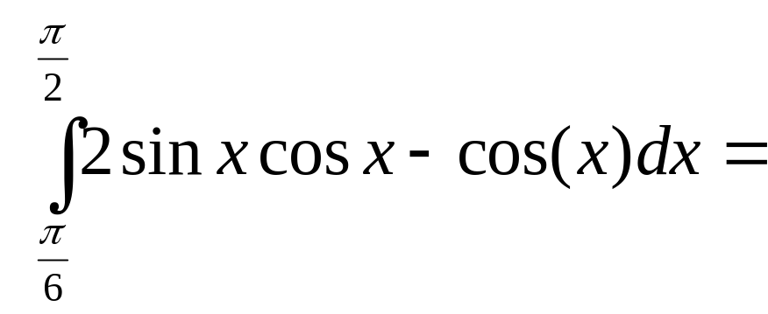
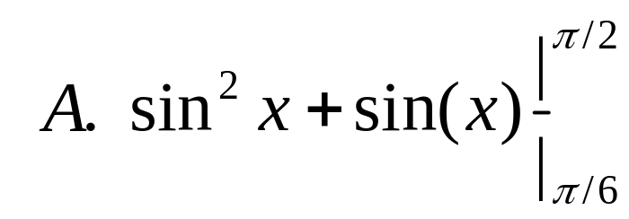
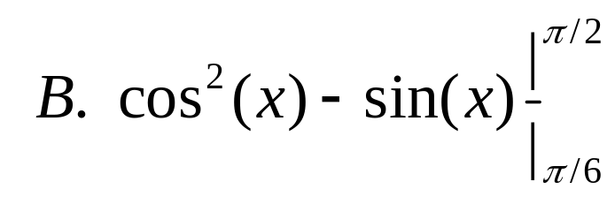
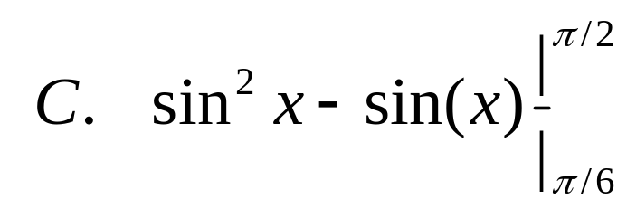
]
]
]
]

Slide 17
]
]
]
]

Slide 18
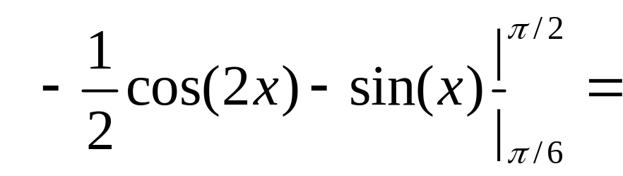
]

Slide 19

]
0.25
0.1

Slide 20
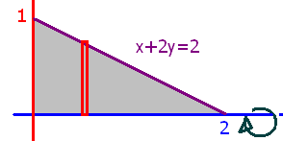
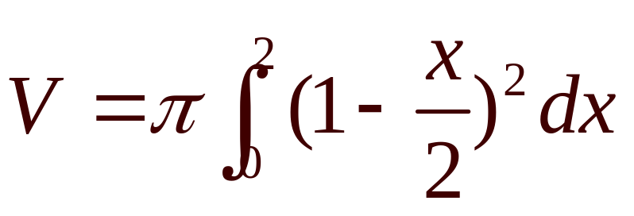
What is the volume if the grey area is revolved about the x-axis?
What are the limits of integration.

Slide 21
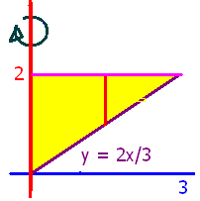
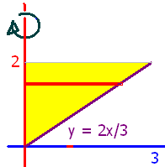
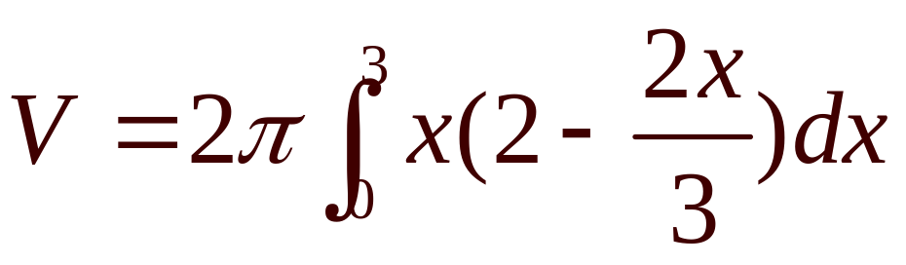
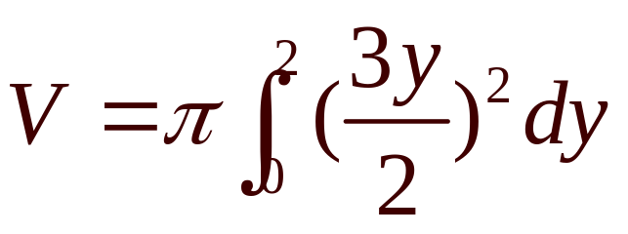
What is the volume if the yellow area is revolved about the y-axis?

Slide 22
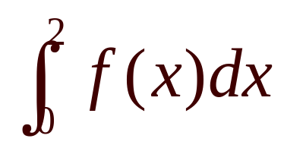
When finding the area, use
True
False

Slide 23
When finding the area, use
True
False

Slide 24
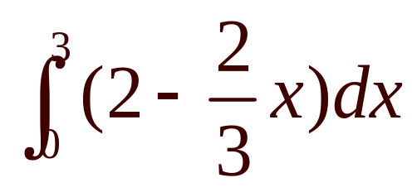
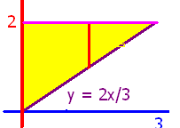
When finding the area, use
True
False

Slide 25
When finding the area, use
True
False

Slide 26
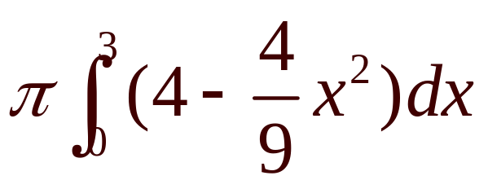
Revolve about the x-axis
V =
True
False

Slide 27
Revolve about the x-axis
V =
True
False

Slide 28
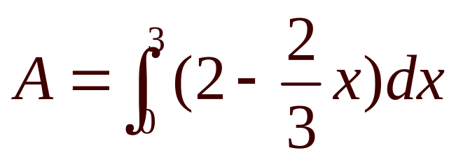
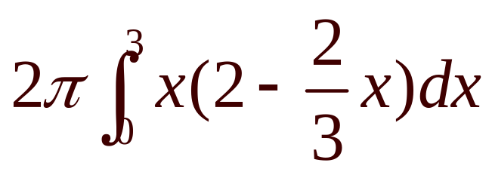
Revolve about the y-axis
V =
True
False

Slide 29
Revolve about the y-axis
Find V if V =
18.84
0.2

Slide 30
y=x²+1 crosses y=4-2x at x=1 and x=-3
True
False

Slide 31
y=x²+1 crosses y=4-2x at x=1 and x=-3
True
False

Slide 32

y=x²+1 crosses y=4-2x at x=1 and x=-3. The area is
True
False

Slide 33
y=x²+1 crosses y=4-2x at x=1 and x=-3. The area is
True
False

Slide 34







=-π/3[0-1]

Slide 35





Slide 36
.

Slide 37
.
0.5
0.1

Slide 38


Region bounded by y=x²+1 and y=x+3 is revolved about the x-axis.

Slide 39
Region bounded by y=x²+1 and y=x+3 is revolved about the x-axis.
23.4
0.2

