Slide 1
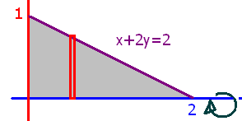
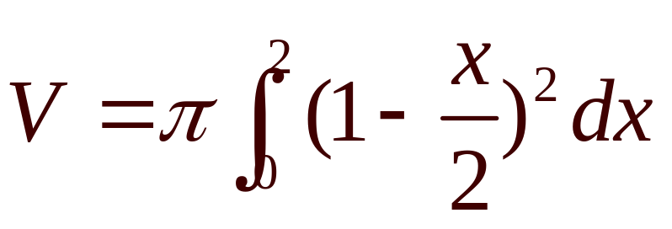
What is the volume if the grey area is revolved about the x-axis?
What are the limits of integration.

Slide 2
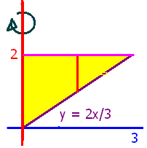
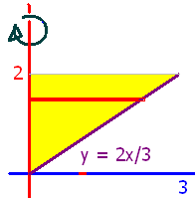
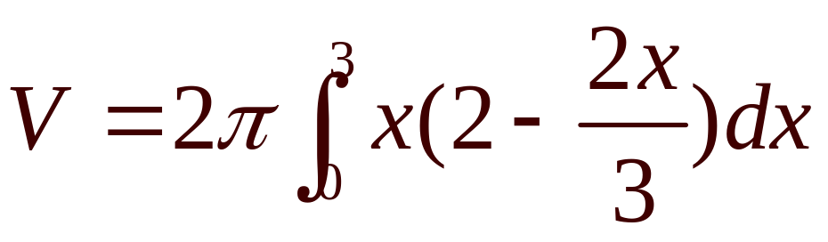
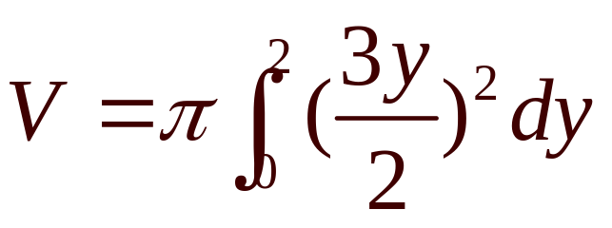
What is the volume if the yellow area is revolved about the y-axis?

Slide 3
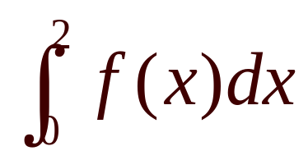


When finding the area, use
True
False

Slide 4
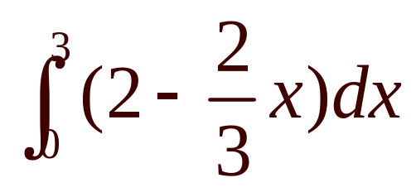
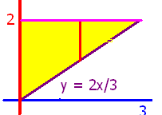
When finding the area, use
True
False

Slide 5
When finding the area, use
True
False

Slide 6
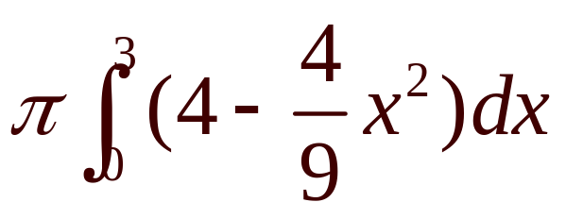
Revolve about the x-axis
V =
True
False

Slide 7
Revolve about the x-axis
V =
True
False

Slide 8
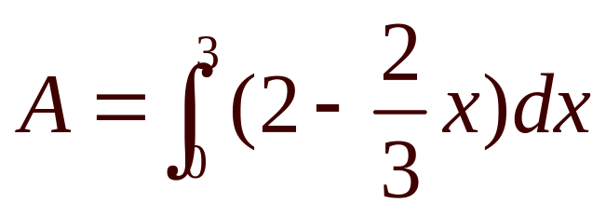
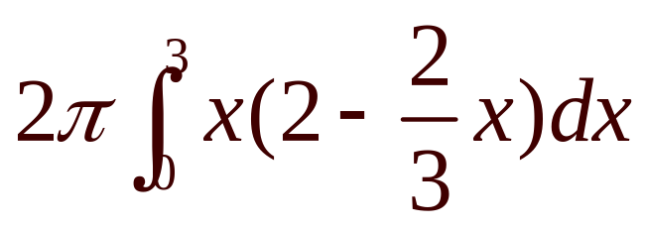
Revolve about the y-axis
V =
True
False

Slide 9

Revolve about the y-axis
Find V if V =
18.84
0.2

Slide 10
y=x²+1 crosses y=4-2x at x=1 and x=-3
True
False

Slide 11
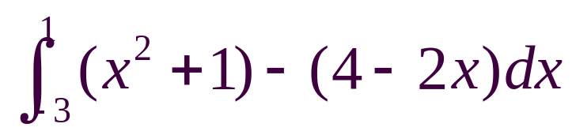
y=x²+1 crosses y=4-2x at x=1 and x=-3. The area is
True
False

Slide 12
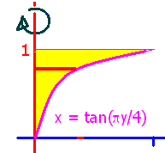
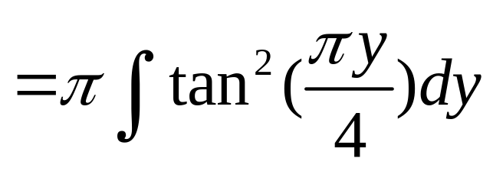
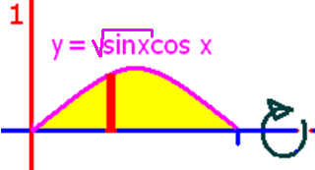
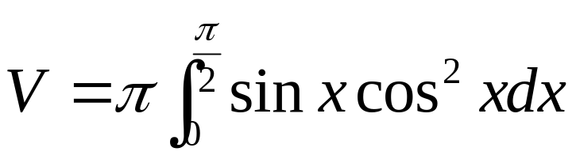
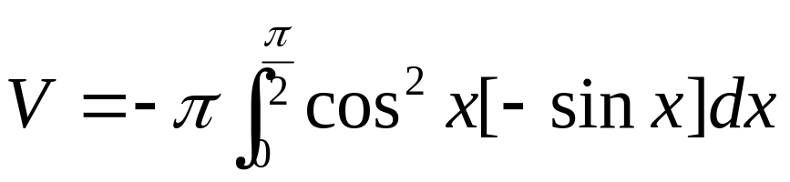
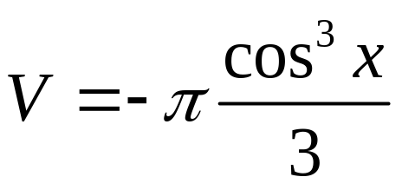
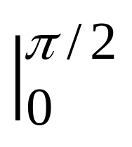
=-π/3[0-1]

Slide 13
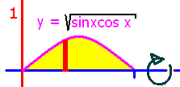
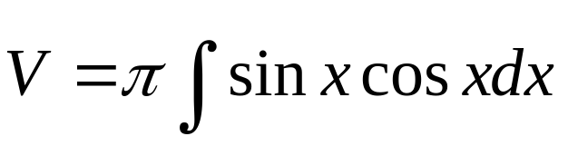
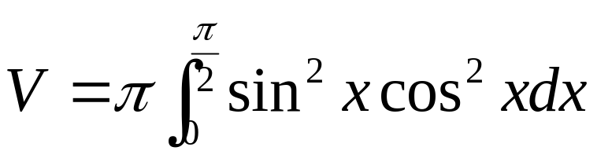
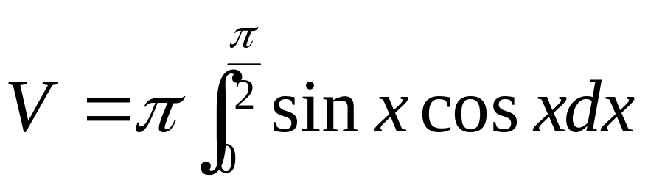

Slide 14
.

Slide 15
.
0.5
0.1

Slide 16
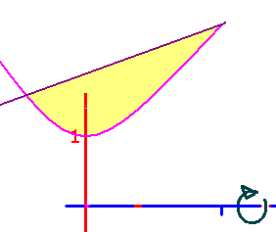
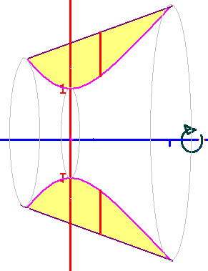
Region bounded by y=x²+1 and y=x+3 is revolved about the x-axis.
23.4
0.2

