Slide 1
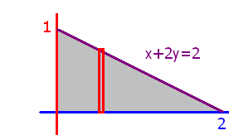
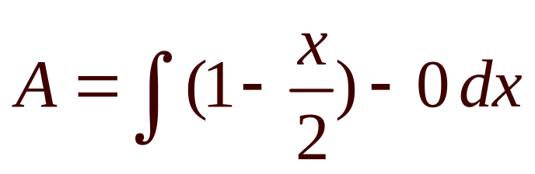
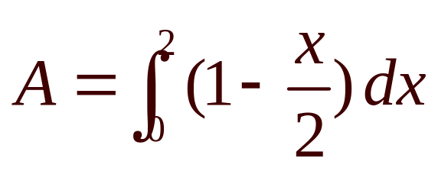
What is the grey area ?
Take strip perpendicular to x-axis
What are the limits of integration.

Slide 2
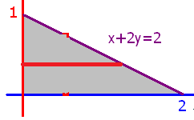
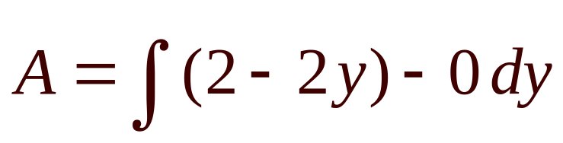
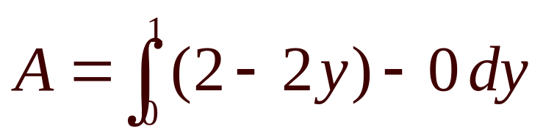
What is the grey area ?
Take strip parallel to x-axis
What are the limits of integration.

Slide 3
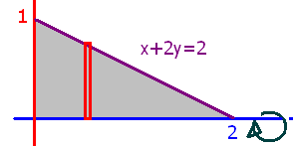
What is the volume if the grey area is revolved about the x-axis?
What are the limits of integration.

Slide 4
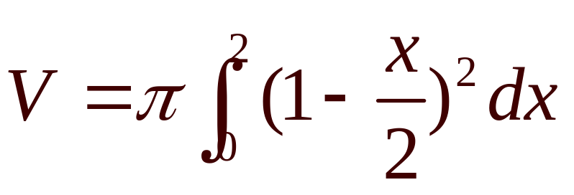
What is the volume if the grey area is revolved about the x-axis?
What are the limits of integration.

Slide 5
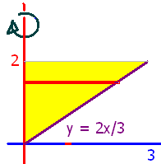
What is the volume if the yellow area is revolved about the y-axis?

Slide 6
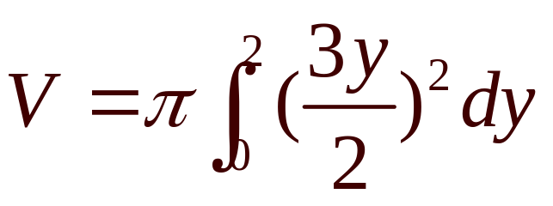
What is the volume if the yellow area is revolved about the y-axis?

Slide 7
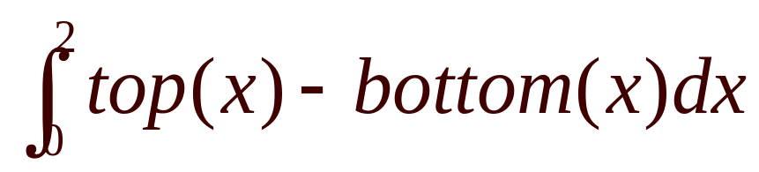
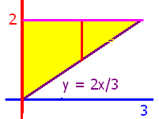
When finding the area, use
True
False

Slide 8


When finding the area, use
True
False

Slide 9
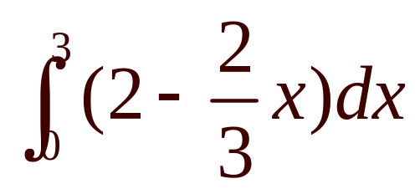
When finding the area, use
True
False

Slide 10
When finding the area, use
True
False

Slide 11
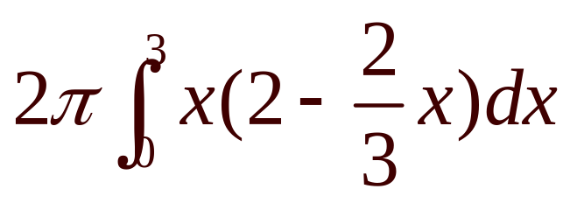
Revolve about the y-axis
V =
True
False

Slide 12
Revolve about the y-axis
V =
True
False

Slide 13
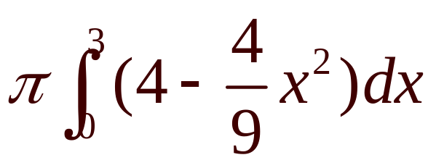
Revolve about the x-axis
V =
True
False

Slide 14
Revolve about the x-axis
V =
True
False

Slide 15
What is the volume if the grey area is revolved about the x-axis?
Red strip perpendicular to axis
Solve for y and square

Slide 16
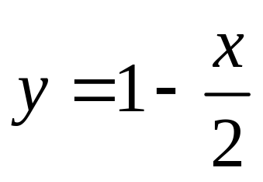
What is the volume if the grey area is revolved about the x-axis?
Red strip perpendicular to axis
Solve for y
and square

Slide 17
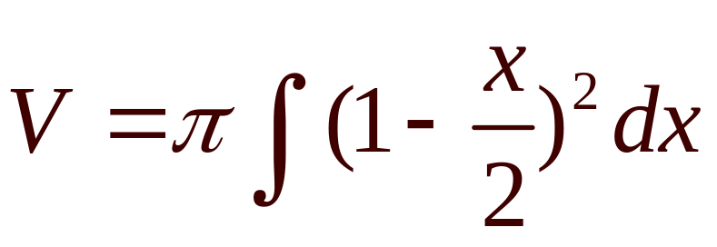
What is the volume if the grey area is revolved about the x-axis?
What are the limits of integration.

Slide 18
What is the volume if the grey area is revolved about the x-axis?
What are the limits of integration.

Slide 19
What is the volume if the yellow area is revolved about the y-axis?
Solve for x, square, integrate, times pi

Slide 20
What is the volume if the yellow area is revolved about the y-axis?
Solve for x, square, integrate, times pi

Slide 21
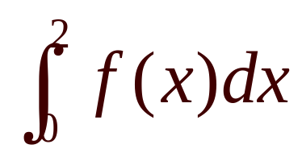
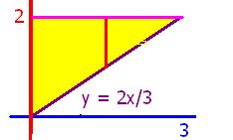
When finding the area, use
True
False

Slide 22
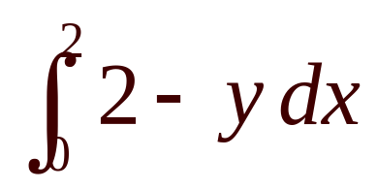
When finding the area, use
True
False

Slide 23
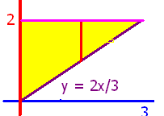
When finding the area, use
True
False

Slide 24
When finding the area, use
True
False

Slide 25
Revolve about the x-axis
V =
True
False

Slide 26
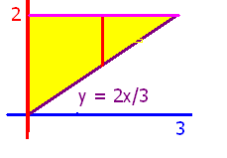
Revolve about the x-axis
V =
True
False

Slide 27
What is the volume if the grey area is revolved about the x-axis?

Slide 28
What is the volume if the yellow area is revolved about the y-axis?
Red strip perpendicular to axis
Solve for x and square.

Slide 29
What is the volume if the yellow area is revolved about the y-axis?

Slide 30

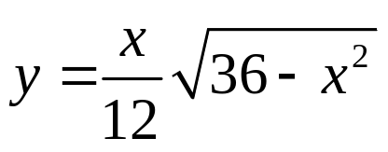
#56 Plumb bob design
Revolve the shown region about the x-axis

Slide 31
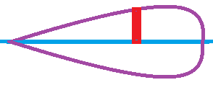
#56 Plumb bob design
Revolve the shown region about the x-axis
Must weigh in the neighborhood of 190 g.
Specify a brass that weighs 8.5 g/cm³.

Slide 32
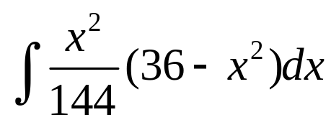
#56 Plumb bob design
V =
Must weigh in the neighborhood of 190 g.
Specify a brass that weighs 8.5 g/cm³.

Slide 33
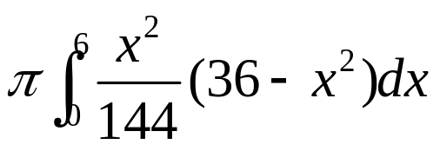
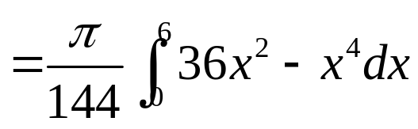
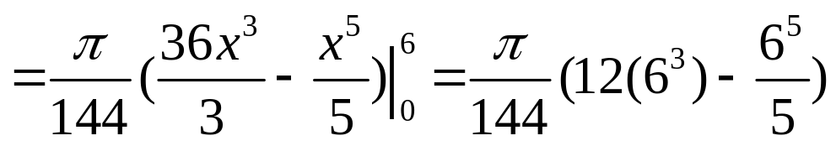
#56 Plumb bob design
V =
=22.62
cm³
times 8.5 g/cm³.
=192.27 g.

Slide 34
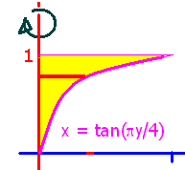
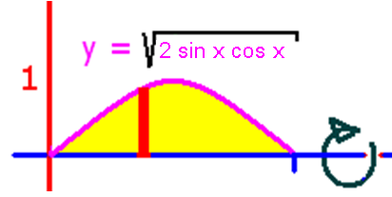
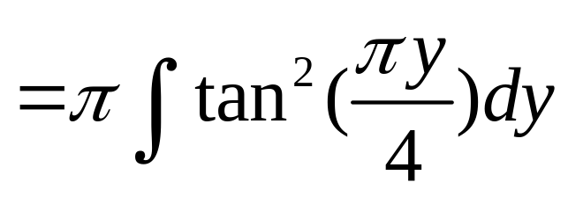
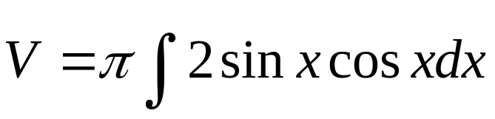
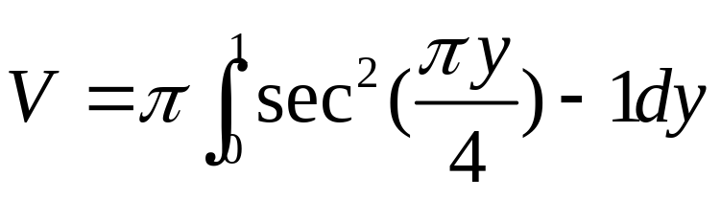
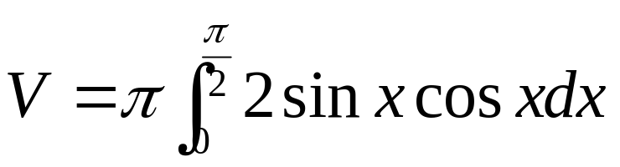

Slide 35
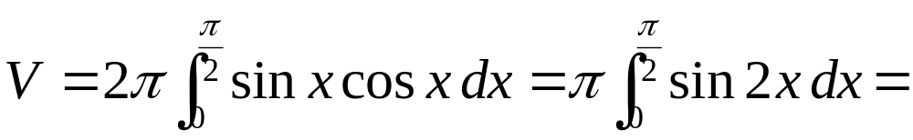
.

Slide 36
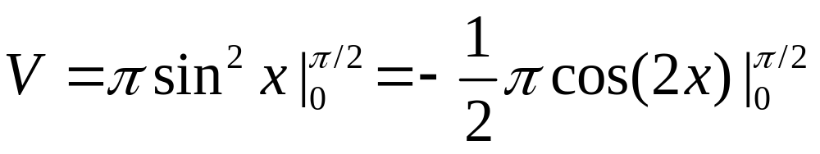
.

Slide 37
.

Slide 38

.
3.14159
0.1

Slide 39
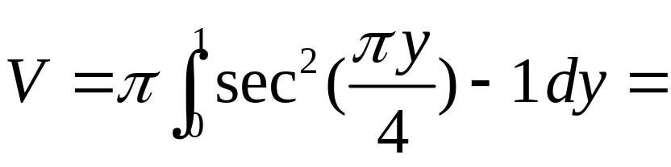
.

Slide 40
.
0.8584
0.1

Slide 41
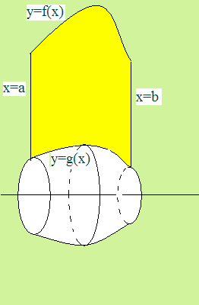

What is the volume if the yellow area is rotated about the y-axis?
Last time we went about the x as shown.

Slide 42
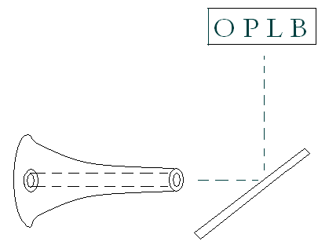
Dr. Jack Tenzel has a
Project-o-Chart in his office
The light reflects off of a mirror and ends up on a wall in front of the patient.

Slide 43
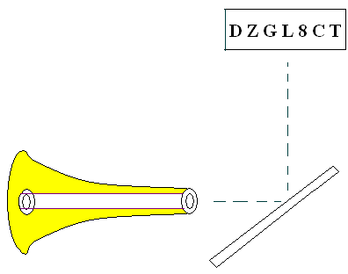
Given the center light source, calculate the volume around it
First write the equation of the surface.

Slide 44
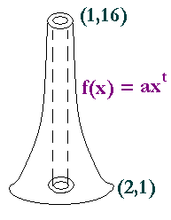

y = 16 = f(1) = a(1)^{t} = a y = 1 = f(2) = 16 2^{t}
The model is f(x) = a x^{t}
When x = 1, y = 16, so a = 16
So f(x) = 16 x^{t}
When x = 2, y = 1, so 1 = 16 2^{t}

Slide 45

y = 16 x^{t}
When x = 2, y = 1, so 1 = 16 2^{t}
Divide both sides by 16 = 2⁴
1/2⁴ = 2^{t}
2⁻⁴ = 2^{t}
t = - 4

Slide 46
y = 16 x⁻⁴
We will come
back to this later.

Slide 47
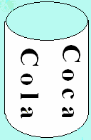
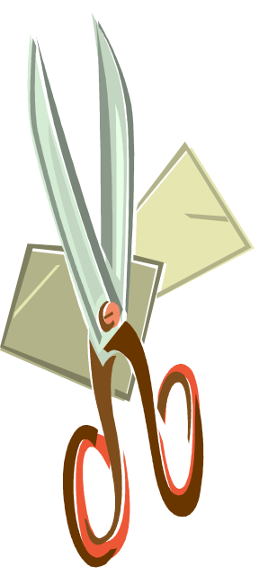
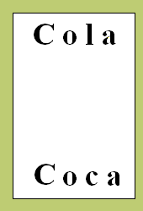

What is the volume of a coke can?
Just the aluminum
Top - Bottom

Slide 48
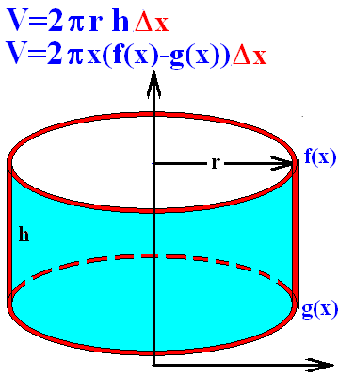
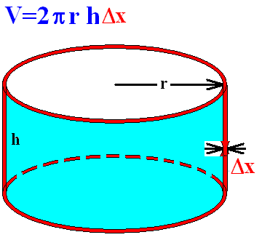
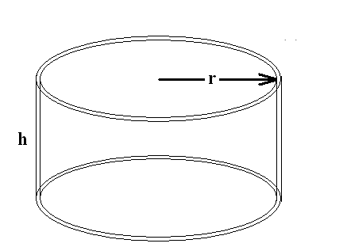
The volume of a can is 2π r times the height times the Δx.

Slide 49
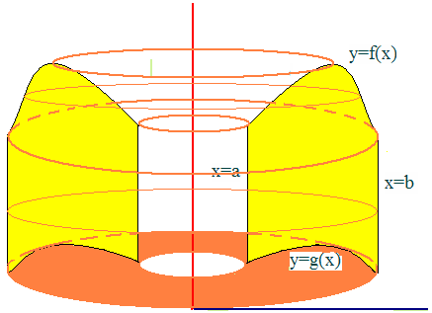
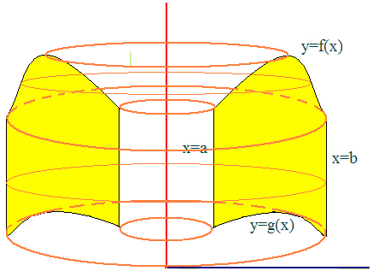
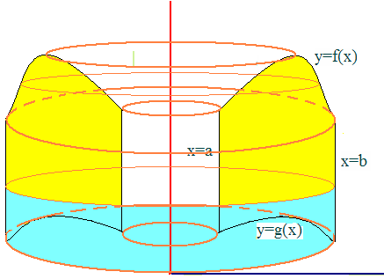






Slide 50

Start like we did for area. Take a narrow Δx red strip and then rotate it about the y-axis.
This makes a red coke can.
The volume of one can is…
2πx(f(x)-g(x))Δx so the desired volume is

Slide 51

Set up n rectangles of width Δx
Revolve about the y-axis
That produces n cylinders

Slide 52



Take a narrow Δx red strip and then rotate it about the y-axis.
This makes a coke can.
The volume of one can with radius x is…
2πx(f(x)-g(x))Δx so the desired volume is

Slide 53



By the definition
Volume =

Slide 54


Example 1
Find the volume when the area under y = x² and over the x-axis is revolved about the y-axis.
Between x=0 and x=2
Just add up all of the red coke cans
As they slide from x=0 to x=2
Top function is y= x²
Bottom function is y = 0

Slide 55


Example 1
Find the volume when the area under y=x²
Between x=0 and x=2
Is revolved about the y-axis
= 2πx⁴/4
= 2π2⁴/4 = 8π

Slide 56




.
Back to the problem
x is the radius times top - bottom

Slide 57


.

Slide 58

[
2π[−(−2−2) − (−8−0.5)]
2π[(−2−2) + (−8−0.5)]
2π[(−2−2) − (−8−0.5)]

Slide 59
[
2π[−(−2−2) − (−8−0.5)]
2π[(−2−2) + (−8−0.5)]
2π[(−2−2) − (−8−0.5)]

Slide 60
2π[(−2−2)−(−8−0.5)]=
2π[ - 4 + 8.5]
2π[ - 4 - 8.5]
2π[ - 4 + 7.5 ]

Slide 61
2π[(−2−2)−(−8−0.5)]=
2π[ - 4 + 8.5]
2π[ - 4 - 8.5]
2π[ - 4 + 7.5 ]

Slide 62


Example 3
Revolve the area between x² and x³ about the y-axis
Find the volume generated.
0 = x² ( x – 1 )
so x² =0 or x–1=0
Next we add up all of the red cylinders
From 0 to 1
Volume =

Slide 63



Revolve about the y-axis
[
[
[

Slide 64
Revolve about the y-axis
[
[
[

Slide 65




.
.
.
.

Slide 66
.
.
.
.

Slide 67


Volume =
= 2 π[(5-4)/20] = 2 π /20 = π /10

Slide 68


Example 2
Consider the first region in the first quadrant bounded by y=sin(x²) and y=1/root(2)
Set the two functions equal
Solve for x² and then for x
Spin about the y-axis or radius of x
Add the volumes of the n cylinders

Slide 69


Example 2
sin(x²) = root(2)/2 when x²=π/4 or 3π/4

Slide 70



Example 2

Slide 71





Example 2

Slide 72


y = x + 3 .……. y = x² + 1 . …1
2 pi radius ( top – bottom) thick.

Slide 73



.
.
.
.

Slide 74
.
.
.
.

Slide 75
Region of y=x²+1 and y=x+3 is revolved about the line x = -1.

Slide 76
Region of y=x²+1 and y=x+3 is revolved about the line x = -1.
45.95
0.2

Slide 77



Region bounded by y=x²+1 and y=x+3 is revolved about the x-axis.

Slide 78
Region bounded by y=x²+1 and y=x+3 is revolved about the x-axis.
73.51
0.2

