Slide 1
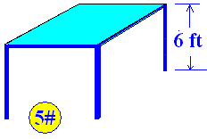
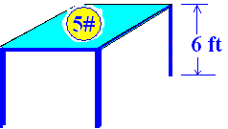
Work = Force * Distance
Work = 5 * 6 = 30 Foot Pounds

Slide 2
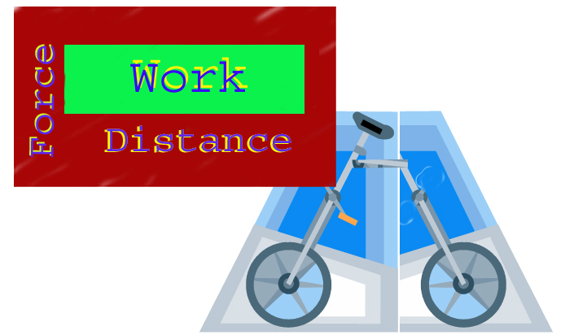
Work = Force * Distance

Slide 3

Work = Force * Distance

Slide 4
Work = Force * Distance

Slide 5
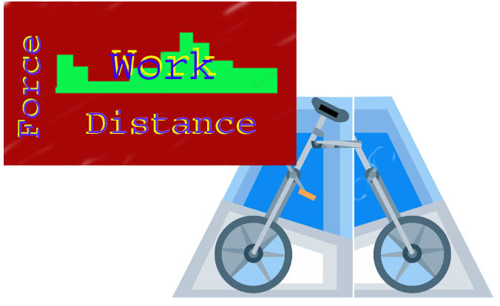
Work = Force * Distance

Slide 6
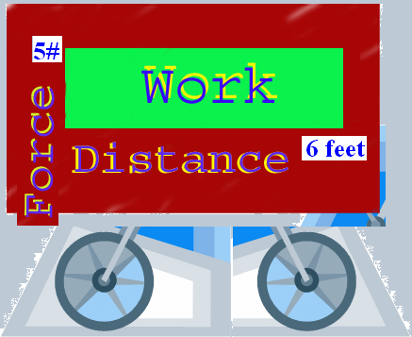
Work = Force * Distance

Slide 7
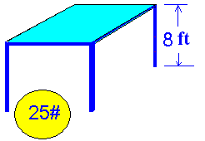
How much work in ft-pounds is done lifting a 25 pound ball 8 feet?

Slide 8


How much work in ft-pounds is done lifting a 25 pound ball 8 feet?
200.0
0.1

Slide 9
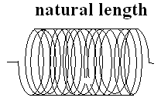
A spring of natural length
Hooke’s Law F(x) = kx

Slide 10
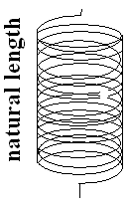
Tom McLean hung his 54# back pack on the scale at the Appalachin Trail and the spring stretched ¾ of an inch.
F(x) = kx
54 = 0.75k
216/3 = k #/in
F(x) = 72 x

Slide 11
It takes Bruce McLean a force of 40 pounds to compress his garage door spring ¼ inch.
F(x) = kx
40 = 0.25 k
160 = k #/in
F(x) = 160x

Slide 12

If it takes 3 # to hold the spring two feet beyond its natural length
F(x) = kx
F(2) = k2 = 3
K = 3/2 thus F(x) = 3/2 x
The spring constant is 1.5.

Slide 13
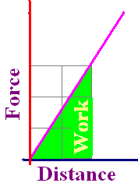
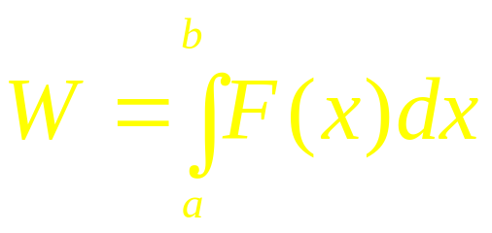
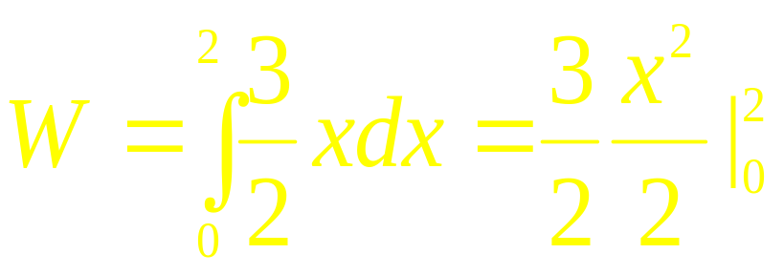
How much work was done in pulling the last spring two feet beyond its natural length?
Work is the area of the green region.

Slide 14
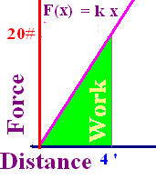
F=20 # keeps a spring 4 feet beyond its natural length. Find k if F(x) = kx

Slide 15
F=20 # keeps a spring 4 feet beyond its natural length. Find k if F(x) = kx
5.0
0.1

Slide 16
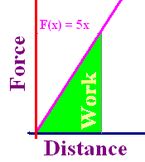
With k=5, how much work if stretched from natural length to 6 feet beyond natural length?
30 ft-lbs
60 ft-lbs
90 ft-lbs

Slide 17

With k=5, how much work if stretched from natural length to 6 feet beyond natural length?
30 ft-lbs
60 ft-lbs
90 ft-lbs

Slide 18
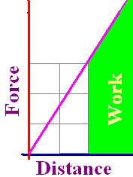

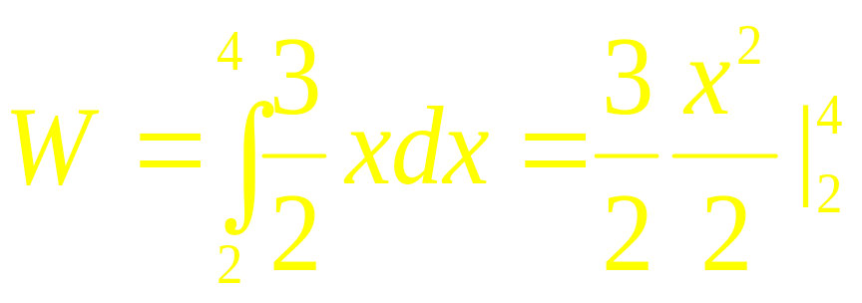
How much work is done in pulling the first spring two additional feet?
Work is the green area.

Slide 19
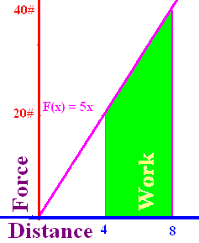
20# needed to stretch 4 ft. How much work to pull it another 4 ft?

Slide 20
20# needed to stretch 4 ft. How much work to pull it another 4 ft?
120.0
0.1

Slide 21
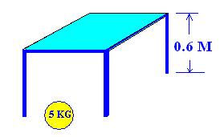
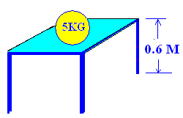
Work = Force * Distance
Force = 9.8 * 5 = 49 Newtons
Work = 9.8 * 5 * 0.6 = 29.4 Newton-Meters (Joules)

Slide 22
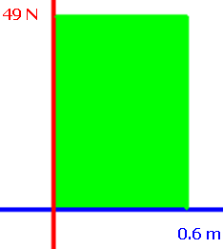
Work = Force * Distance
How much work is done if a force of 49 N is lifted 0.6 meters?
W = 49 * 0.6 = 29.4 Joules

Slide 23

If it takes 3 N to hold the spring 1.8 meters beyond its natural length
F(x) = kx
F(1.8) = 1.8k = 3
K = 5/3 thus F(x) = 5/3 x
The spring constant is 5/3.

Slide 24
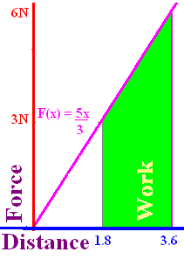

How much work is done in pulling that spring 1.8 additional meters?
Work is the area that is green.

Slide 25
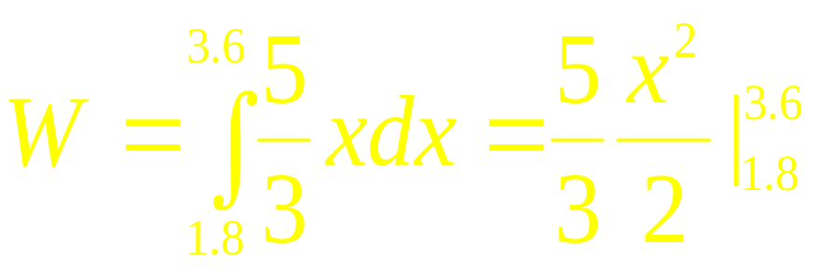
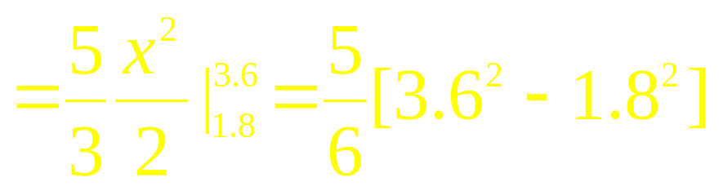

How much work is done in pulling that spring 1.8 additional meters?

Slide 26
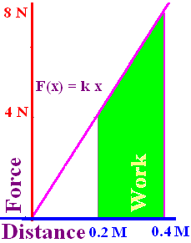
4 N holds a spring 0.2 meters beyond its natural length. Find k in F = kx.
0.1

Slide 27
4 N holds a spring 0.2 meters beyond its natural length. Find k in F = kx.
20.0
0.1

Slide 28

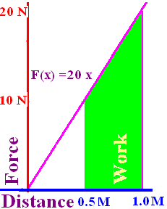
Find the work in stretching that same spring from ½ meter to 1 meter.
0.1

Slide 29
Find the work in stretching that same spring from ½ meter to 1 meter.
7.5
0.1

Slide 30
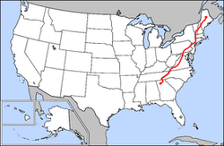
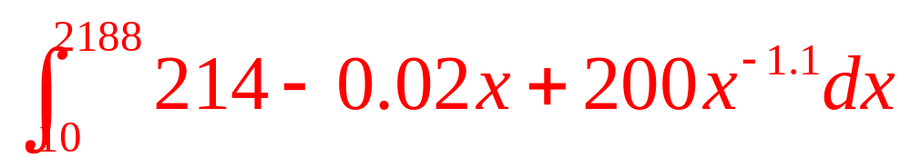
If Tom’s pack weighed 54 – 0.01x and Tom weighed 160 – 0.01x + 200/x^{1.1}, how much work did he do in walking the 2178 miles?
Trip starts at x=10 and finishes when x = 2188 miles.

Slide 31
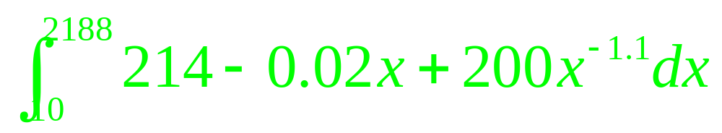
Mile Pounds

Slide 32
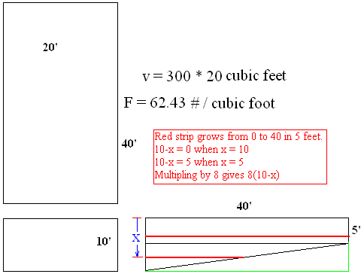
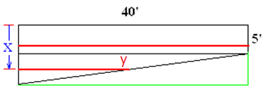
Find the work in emptying a swimming pool filled with water.
Thin slabs of water
must be lifted x feet.
Each slab weighs
62.43*20*40Δx for 5’
62.43*20* y Δx for 5’

Slide 33
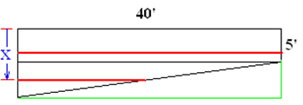
The weight of one cubic foot of water is 7.48052 gallons per cubic foot times 8.3453 pounds per gallon, which equals 62.42718356 pounds of water per cubic foot.

Slide 34
Find the work in emptying a swimming pool filled with water.
Thin slabs of water
must be lifted x feet.
Each slab weighs
62.43*20*40 Δx for 5’
62.43*20* y Δx for 5’

Slide 35
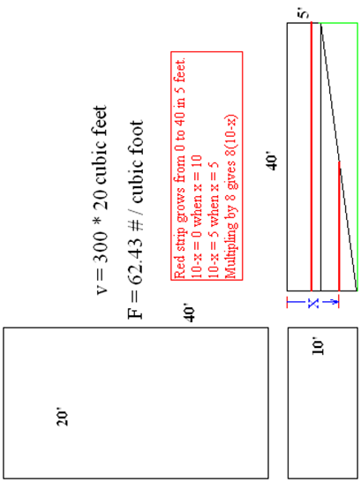
Write the equation of the line
(y-10)/(x+8) = 0
(x-0)/(y-0) = -8
(y-0)/(x-0) = 8
(y-0)/(x-10) = -8

Slide 36
Write the equation of the line
(y-10)/(x+8) = 0
(x-0)/(y-0) = -8
(y-0)/(x-0) = 8
(y-0)/(x-10) = -8

Slide 37
Find the work in emptying a swimming pool filled with water.
Thin slabs of water
must be lifted x feet.
Each slab weighs
62.43*20*40 Δx for 5’
62.43*20*8*(10-x) Δx
( y-0)/(x-10)= 40/-5

Slide 38
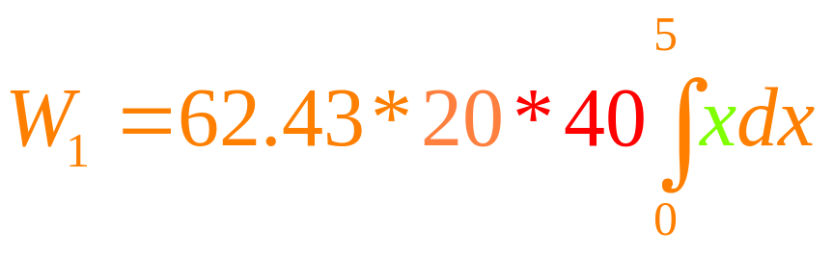
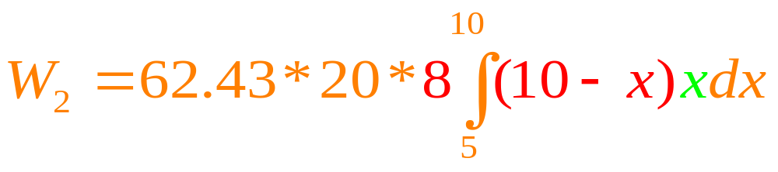
Find the work in emptying a swimming pool filled with water.
Thin slabs of water
must be lifted x feet
Each slab weighs
62.43*20*40 Δx for 5’
62.43*20*y Δx for next 5’
62.43*20* 8*(10-x) Δx

Slide 39
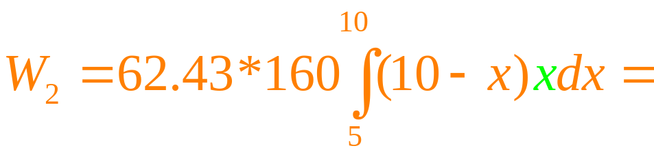
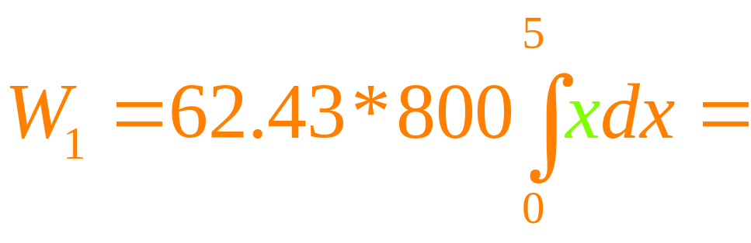
Find the work in emptying a swimming pool filled with water.

