Slide 1
.
3 x² + c
9 x² + c
x³ + c
3 x³ + c

Slide 2


.
3 x² + c
9 x² + c
x³ + c
3 x³ + c

Slide 3
Examples

Slide 4
.
4/x + c
-4/x + c
4/x³ + c
-4/x³ + c

Slide 5
.
4/x + c
-4/x + c
4/x³ + c
-4/x³ + c

Slide 6
Theorem
If k(x) = 2cos(x) + 3x² – 4,
evaluate

Slide 9
Trigonometry Theorems

Slide 10
.
2 sin(x) – 1/x + c
2 sin(x) – 1/x³ + c
- 2 sin(x) – 1/x + c

Slide 11
.
2 sin(x) – 1/x + c
2 sin(x) – 1/x³ + c
- 2 sin(x) – 1/x + c

Slide 12
a(t) = v’(t) = s’’(t) v(t) = s’(t)
a(t) = dv/dt = d²s/dt²
v(t) =
s(t) =

Slide 13
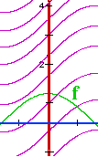
Initial value problems
.

Slide 14
Current circulation is 3000 per month. Growth rate is C’(t)= . Find C(t).
C(t) =
C(0) = c = 3000 C(t) =

Slide 15
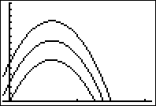
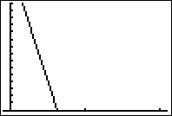
Suppose s’(t) = -32t + 20
Find all s(t)’s or
-16 t² + 20 t + C
-32 t² + 20 t + C
-32

Slide 16
s(t) = -16 t² + 20 t + C
Find C so that s(1) = 10
2
6
0
s

Slide 17
s(t) = -16 t² + 20 t + C
Find C so that s(1) = 10
2
6
0
s

Slide 18
Suppose s’(t) = -32t + 20
Find s(t) so that s(1) = 10
s(t) = -16 t² + 20 t + C
s(t) = -16 t² + 20 t + 6
s(t) = -32

Slide 19
Suppose s’(t) = -32t + 20
Find s(t) so that s(1) = 10
s(t) = -16 t² + 20 t + C
s(t) = -16 t² + 20 t + 6
s(t) = -32

Slide 20
a(t) = v’(t) v(t) = s’(t)
a(t) = dv/dt = d²s/dt²
v(t) =
s(t) =

Slide 21
David Scott drops a hammer and a feather from 4 ft. on the moon.
a(t) = d²s/dt² = dv/dt = - 5.2 ft/sec².
v(t) =
= -5.2t + C

Slide 22
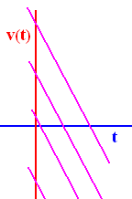
ds/dt = v(t) = - 5.2 t + C
v(t) = -5.2t + C and
v(t) = 0 when t = 0 so C =

Slide 23
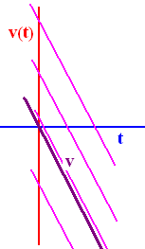
v(t) = -5.2t + C
v(t) = 0 when t = 0 so C =
0 and v(t) = -5.2t
v(t) = -5.2t and

Slide 24
.
s(t) =
-2.6t² + K but at t = 0,

Slide 25
.
s(t) =
-2.6t² + K but at t = 0,
s(0) = 4 ft.
s(t) = - 2.6t² + 4

Slide 26
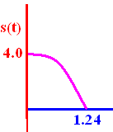

s(t) = - 2.6t² + 4 = 0 means hammer hits ground
4 = 2.6t² when 4/2.6 = t² or
t = 1.24 seconds

Slide 27
s(t) = - 2.6t² + 4 = 0
How fast when it hits?
4 = 2.6t² when 4/2.6 = t² or
t = 1.24 seconds
v(t) = -5.2 t
v(1.24) = -5.2(1.24)

Slide 28
s(t)
s’(t) = v(t)
s’’(t) = v’(t) = a(t)
a(t)
v(t)
s(t)

Slide 29
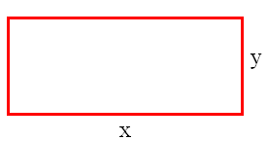
Perimeter of a rectangle is 100 miles.
P = 2x + 2y
P = (2x)(2y)
P = x y

Slide 30
Perimeter of a rectangle is 100 miles.
P = 2x + 2y
P = (2x)(2y)
P = x y

Slide 31
If a rectangle is x by y, what is the area of the rectangle?
A = 2x + 2y
A = (2x)(2y)
A = x y

Slide 32
If a rectangle is x by y, what is the area of the rectangle?
A = 2x + 2y
A = (2x)(2y)
A = x y

Slide 33
100=2x+2y ; y=100-2x
A = x y = x(100-2x)
x = 20
x = 25
x = 30

Slide 34
100=2x+2y ; y=100-2x
A = x y = x(100-2x)
x = 20
x = 25
x = 30

Slide 35
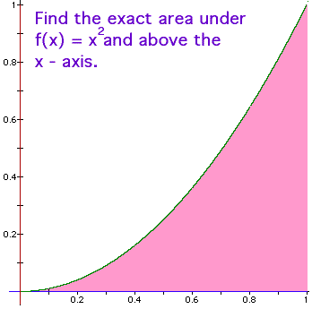
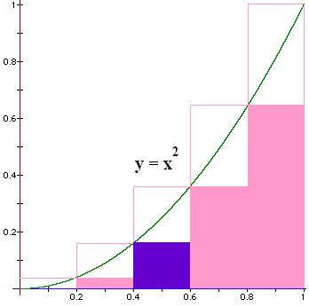
Blue area?
A = L * H
How do we find
the height?
Plug the left end point into the function
f(x) = x².

Slide 36
Blue area?
A = L * H
L = 0.6 – 0.4 = 0.2
H = 0.4² = 0.16
Blue Area = 0.032

Slide 37

Find all 5 bottom areas
BA = 0 * 0.2 +
0.04 * 0.2 +
0.16 * 0.2 +
0.36 * 0.2 +
0.64 * 0.2 = .2 * 1.2 = 0.24 < A
This is a lower sum.

Slide 38
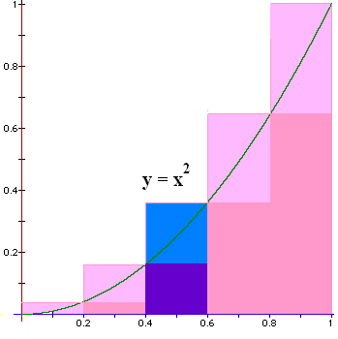
Next we find an upper sum
Plug in the
right pt to
calculate
the height

Slide 39


When x = 0.6 blue area = ?
0.072
0.001

Slide 40
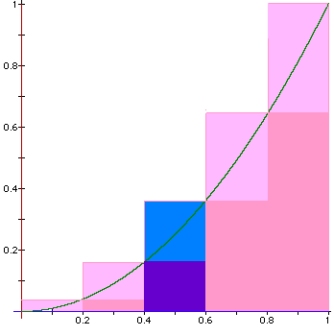
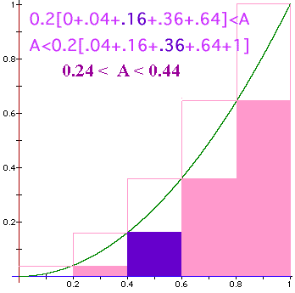
Find all 5 upper areas
UA = 0.04 * 0.2 +
0.16 * 0.2 +
0.36 * 0.2 +
0.64 * 0.2 +
1.00 * 0.2 = 0.2 * 2.2 = 0.44 > A
This is an upper sum.

Slide 41
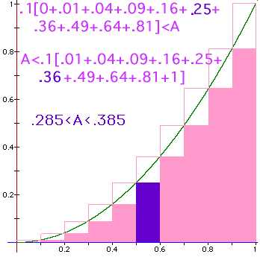
Blue area?
Lower sum for
n = 10
BA = 0.025

Slide 42
Lower sum
Lower sum for
n = 10
LS = .285

Slide 43
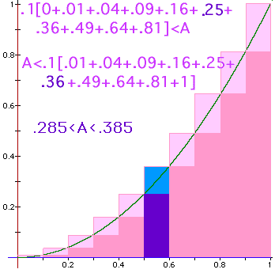
Total blue area when x = 0.6 is
0.036
0.1

Slide 44
Find the total upper sum
0.385
0.1

Slide 45
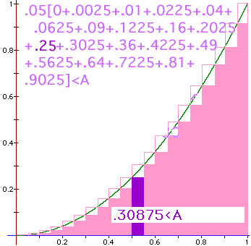
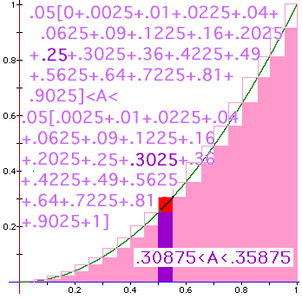

Slide 46
Find the blue area
A 0.0125
B 0.125
C 0.008
D 0.018

Slide 47
Find the blue area
A 0.0125
B 0.125
C 0.008
D 0.018
0.8

Slide 48
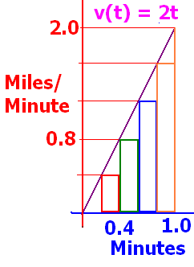
Car is stopped 1 mile in front of the starting line
t min v(t) miles per minute
0 0
0.2 0.4
0.4 0.8
0.6 1.2
0.8 1.6
1.0 2.0

Slide 49
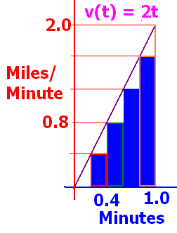
Find the lower sum. 0.2[v(.2)+v(.4)+v(.6)+v(.8)]
A 0.7
B 0.8
C 0.9
D 1.0

Slide 50
Find the lower sum. 0.2[v(.2)+v(.4)+v(.6)+v(.8)]
0.8
0.1

Slide 51
Find upper and lower sum for N rectangles
N=5 => width = 0.2
N=10 => width = 0.1
N=20 => width = 0.05
N=n => width = 1/n

Slide 52
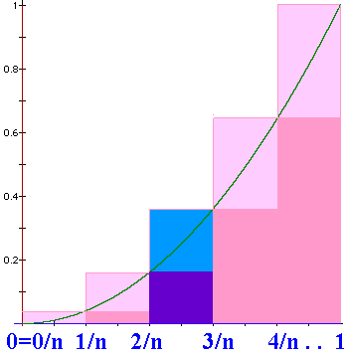
Upper sum
N = n
N=n => width = 1/n
US = 1/n [(1/n)² +(2/n)². .+(i/n)² +. . +1²]
US =

Slide 53
Sigma notation
1/2+1/3+1/4+1/5=77/60
1+4+9+16=30
3+3+3+3+3=15
2*0²+2*1²+2*2² = 0+2+8=10

Slide 54
Evaluate
3*1+2+3 = 8
3*1+3*2+3*3 = 18
1+3*2+3*3 = 16

Slide 55
Upper sum
N = n
N=n => width = 1/n
US = 1/n [(1/n)² +(2/n)². .+(i/n)² +. . +1²]
US =

Slide 56
Upper sum
N = n
N=n => width = 1/n
US = 1/n [(1/n)² +(2/n)². .+(i/n)² +. . +1²]
US = =1/n³[1+4+9+….+n²]

Slide 57
2 nice theorems
1+4+9+16+25+36+49 =
7*4*5 = 140

Slide 58
1+8+27+64+125+216= n=6
441.0
1.1

Slide 59
.
N=n => width = 1/n
US = =1/n³[1+4+9+….+n²]
US =

Slide 60
.

