Slide 1
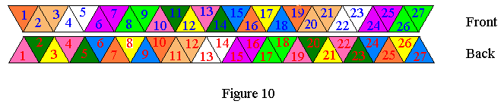
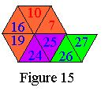
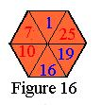
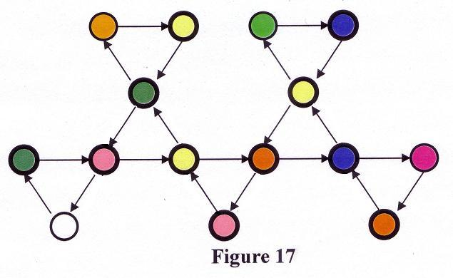
Flexagons: computer vs. theory
How many mathematical faces does the shown flexagon with 9 physical faces have?
by
Bruce McLean
Thomas Anderson : Chemistry major
Chasen Smith : High school senior
Homeira Pajoohesh
Notes:
SEE me afterwards for demonstrations.
Thomas Anderson and Chasen Smith joined us in this project. Thomas is a Chemistry major at Georgia Southern and Chase is a high school senior at Washington County that will be returning to Southern in the Fall as a freshman.

Slide 2
Three operations on a mathematical face
60 degree CW Rotation
Pinch flex
V-flex
Notes:
Need a larger flexagon to use the V-flex.

Slide 3



It's called a mobius loop and it is recognized around the world.
Each arrow stands for the 3 main components of the recycling system:
http://www.green-networld.com/tips/whyrecyl.htm
http://www.paperrecycles.org/
Thanks to Ivars Peterson
Notes:
At the Rock Eagle Conference for the Georgia NCTM meeting, Ivars Peterson stated that the correct recycling symbol is the one on the right, a Mobius Band with one half twist. They are both single sided surfaces, but the one with 3 half twists could be stepped on and turned into a tri hexa flexagon.

Slide 4
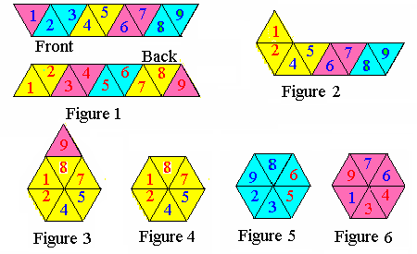
Arthur Stone’s Trihexaflexagon 1939 http://math.georgiasouthern.edu/math/tourny/2007photos/
A regular flexagon has 3k physical faces, is constructed from 9k triangles and has 3(3k-2) half-twists in the construction.
We will only consider k = 1, 2, 3
.
Notes:
The construction and one application for the trihexaflexagon
Regular flexagons were discovered by Arthur Stone after trimming american paper to fit his english note book binder. Colen Singleton states that Stone followed Erdos from the UK to Princeton causing this miracle to happen.

Slide 5
Outline
Pats
Physical faces of order 3, 6, & 9
3 operations on mathematical faces
Computer count for the 6 & 9
Student theory count for the 9
Notes:
Outline
Pats
Faces
3 operations on the mathematical faces
Computer count for 6, 9 faced flexagons
Student theory count for 9 faces

Slide 6
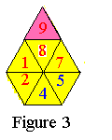

Definitions & notation
1 - 2,3 – 4 - 5,6 – 7 - 8,9
Pat - One of the six triangular regions that make up a flexagon
Degree – number of triangles in a pat
Singleton – pat with degree one
Notes:
A pat is one of the 6 triangular regions
The notation across the top shows the 6 pats with the left most number on top.
The , is called a thumb hole and tells you where you can insert your thumb to separate the pat into two components.
Degree of a pat is the number of triangles in the pat
Singleton is a pat of degree 1 Example 1, 4, 7

Slide 7
Definitions
Each natural number is a pat.
p = 1 p = 2 p = 3
If p is a pat, then ~p is p turned upside down.
p = 2,3 => ~p = 3,2
Notes:
Inductive definition of a pat
~p is p upside down
P= 2,3 => ~p = 3,2

Slide 8
Definitions
A pat of degree 3m + 1 is odd and one of degree 3m + 2 is even.
If a and b are pats, both even or both odd and a U b can be rearranged to be consecutive, then ~a U ~b is a pat and denoted by ~a,~b.
Notes:
Odd
Even
Regular flexagons do not have pats of degree 3m
a, b are pats => ~a,~b is a pat

Slide 9
Pat examples
Degree Examples Eq. Class
1 1 2 3 4 5 6 7 1
2 1,2 2,3 3,4 4,5 6,7 1
4 21,43 43,65 76,98 1
5 3412,5 5,8967 2
7 52143,76 43,76985 4
8 3412,7856 2,5896734 9
Notes:
Skip to Degree 5

Slide 10
Thomas Anderson
Pat Sequence
http://math.georgiasouthern.edu/~bmclean/flex/
Notes:
The sequence certainly was known back in 1939, but Thomas Anderson just knows more terms than most. The above address shows his speadsheet.

Slide 11
Faces
A mathematical face is an ordered set of 6 distinct pats that alternate even and odd degree and the sum of the 6 degrees is the number of triangles and adjacent pats must be consecutive

Slide 12
Three operations on a mathematical face
CW Rotation
Pinch flex
V-flex
Notes:
Need a larger flexagon to use the V-flex.

Slide 13
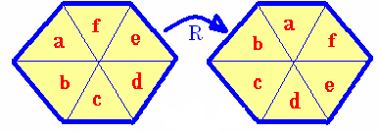
CW Rotation
R(a – b – c – d – e – f) =
(b – c – d – e – f – a)
We are not counting rotations as being different.

Slide 14
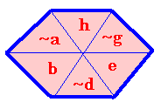
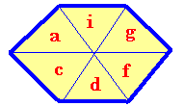


Pinch flex
P
(a,b - c - d,e - f - g,h - i) =
(~a - b,~c - ~d - e,~f - ~g - h,~i)
P

Slide 15
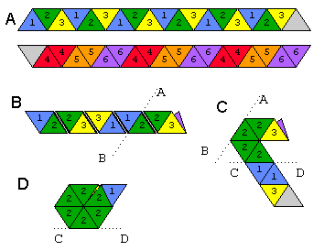
Arthur Stone’s Hexahexaflexagon
Figure 8 (Kapauan, 1996)
Kapauan, Alejandro. Hexaflexagons. Updated 14 Jan. 1996. Accessed 26 Dec. 2001.
<http://home.xnet.com/~aak/hexahexa.html>.
Notes:
The next morning, Stone discovered the 6 face one and we have applied another function on this one and larger ones, the V-flex that was formalized in 1965.

Slide 16
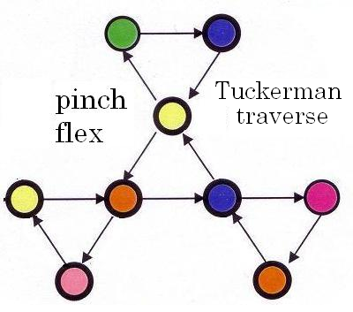
Hexahexaflexagon pinch produces 9 mathematical
Notes:
This is the pinch flex and the Tuckerman traverse for seeing all 6 faces. You must rotate the flexagon 60 degrees whenever there is a 60 degree angle on the traverse.

Slide 17
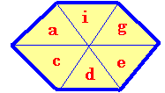
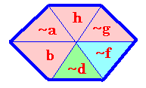
V - flex
V
(a,b - c - d - e,f - g,h - i) =
(~a - b,~c - ~d,e - ~f - ~g - h,~i)
V
Notes:
The first two and the last 2 are the same as the pinch flex.
Note the the yellow pats obey a different rule.

Slide 18
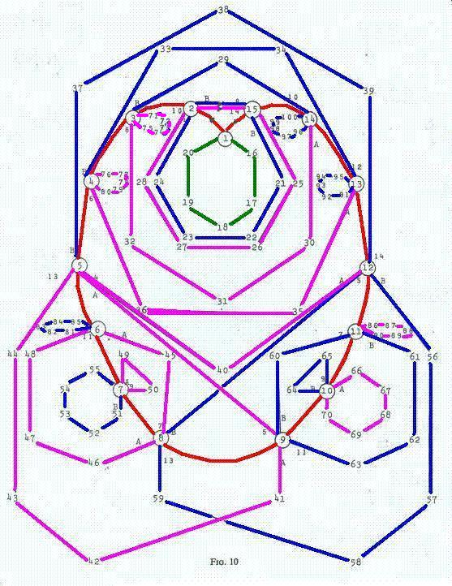
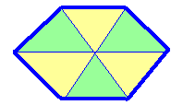
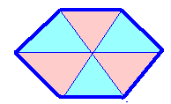
Hexahexaflexagon V-flex
100 mathematical faces
92 more with the
Pinch flex
Including
Translations
3420 faces
Notes:
100 faces shown on the V-flex traverse.
Another 92 that can be reached by pinch flexing from these 100.
The little triangle leaving from face 7 produces a translation of 9 which causes the colors to alternate after you return to face 1.
Desire to have the same picture when 3k = 9.

Slide 19
Nonahexaflexagon
Tuckerman traverse
http://math.georgiasouthern.edu/~bmclean/flex/
has 15 mathematical faces using only the pinch flex
Notes:
Time to count the faces for 3k = 9.

Slide 20
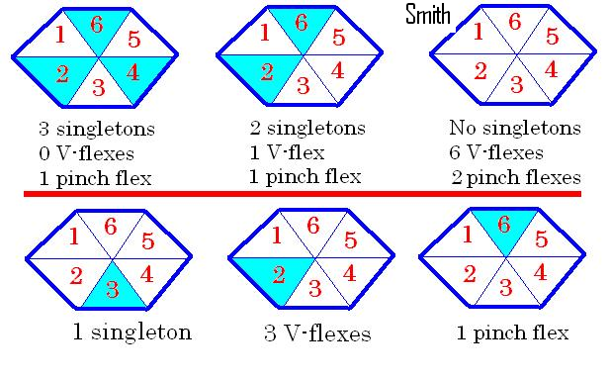
How many operations are possible?
Notes:
Upper right only. Each vertex in the graph could come from as many as 8 vertices and at most 8 edges could leave each vertex.

Slide 21
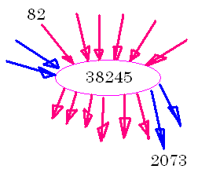
Directed graph of degree 16
Notes:
Should I have said degree 8?
6 v-flexes
2 pinch flexes
Coming and going

Slide 22
Two counters
Initialization
X = the current location in the table that we are flexing
n = the number of mathematical faces already in the table and the position of the next face to be added
Initialize a 4 - 4,1 - 4 - 4,1- 4 - 4,1
into the table at X = 0 and say n = 1.

Slide 23
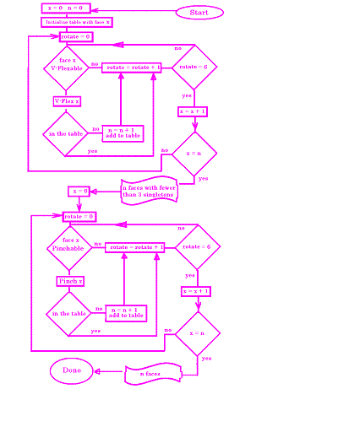
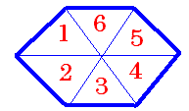
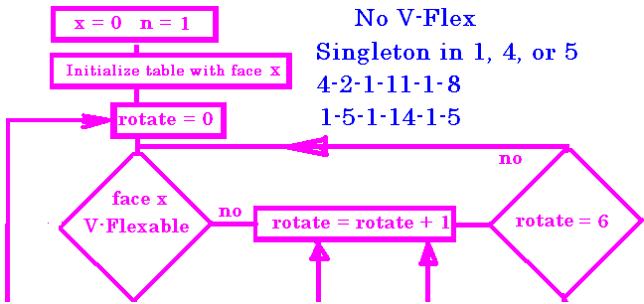
Flow
Chart
Notes:
If you cant V-flex rotate.
Try all 6 positions.

Slide 24
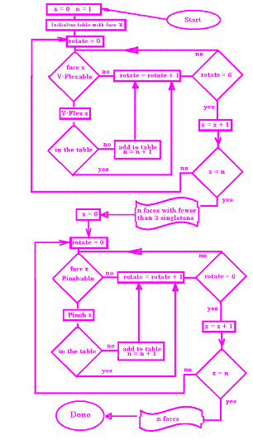
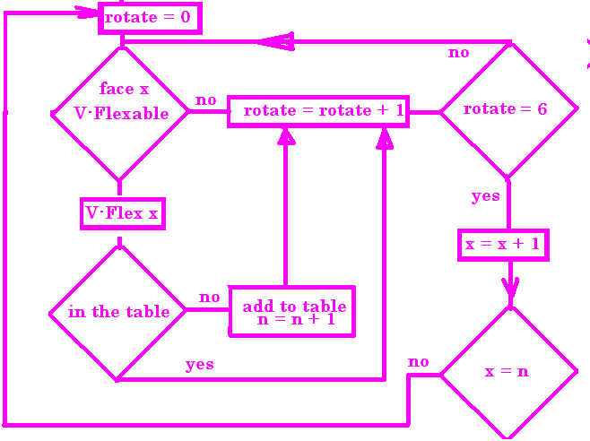
n faces in the table
V-Flex X 6 times
Notes:
If Vflexable see if the new face is in the table.
If yes rotate else add to the table and increment n

Slide 25
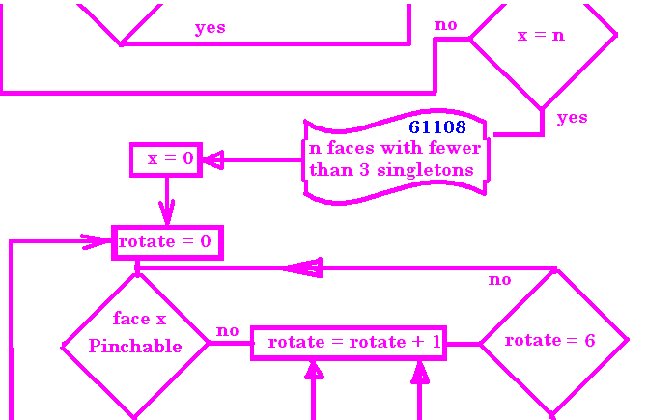
until X = n reset X = 0 but not n
2
Notes:
Repeat until X = n

Slide 26
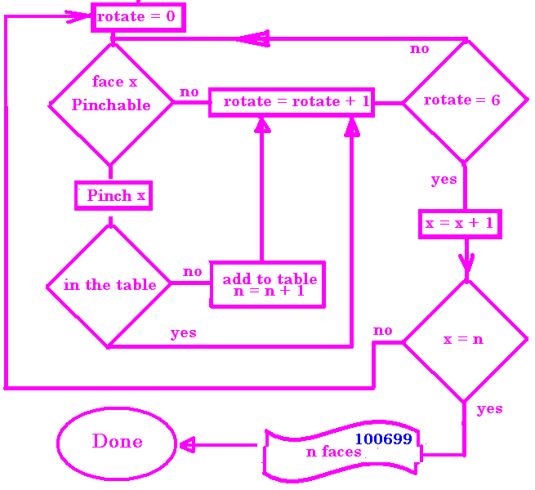
Pinch X 2 times not 6
2
61108
Notes:
I originally just duplicated the flo chart and changed V-flex to pinch flex
Since pinch is symmetric modulo 2, I need to change the program
From 3k=6 experiences, I should have quit when x = the number of V-faces were counted.
My n finished at 100,699.

Slide 27

Computer count summary
100699 * 27 2.7 million when 3k=9
192 * 18 3420 when 3k = 6
3 when 3k = 3
Notes:
These approximately equals are different.
In the first line some faces are perfectly symmetrical like 4 – 5 – 4 – 5 – 4 – 5
And all of the 5’s are wound 4-1 or all 1-4. In these cases I can only multiply by 9, not 27. I have not finished checking symmetries.
In the second line, symmetries have been identified and the count is exactly 3430 so it is the 18 that is approximate. The computer count was exacly 192 and agrees with theory.

Slide 28
Anderson/Smith answer
arh hardy har har
100698 mathematical faces
2718576 includes translations
I think one of these two answers is correct.
Notes:
The first line was the subject heading that I received from Thomas. He was convinced he had considered all cases and his count is one less than the computers. There are so many cases that I have not checked his work. He hasn’t checked my program. When X cought up with n, that means that X was 100699. There is a face in zero, but there is no face in 100699.

