Slide 1
Introduction
Dr. Bruce McLean
Tallest, fattest, oldest, smartest
2 children your age - 2 your parents’ age
Percussion & Racquetball
University of Kentucky (1971)
Topologist – Abstract geometer
Bowling Green State University (1965)
Ohio Northern University (1963)

Slide 2
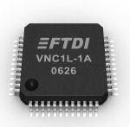

Vinculum
Vinculum - Binding USB Technologies
Vinculum is the brand name for the new family of USB Host Controller ICs devices from FTDI.
The Vinculum family of devices allow the implementation of USB host controller functionality within products, thus saving development time and costs by using FTDI's tried and tested firmware programmed into internal, easily upgradeable Flash memory.
FTDI VNC1L
USB Host Controller IC_x000b_

Slide 3
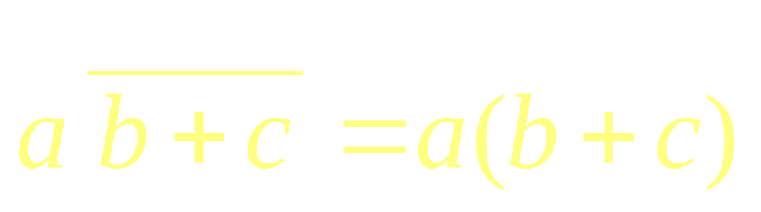
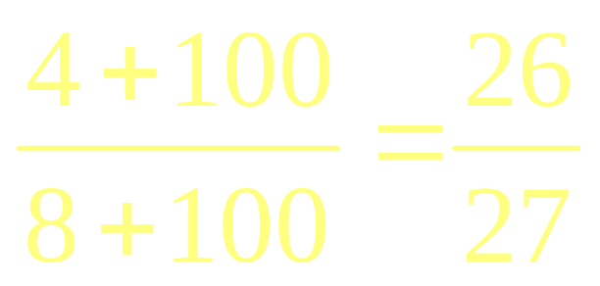
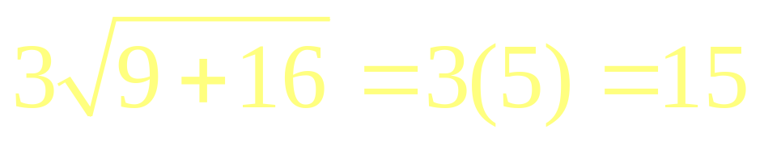
Add First
vin·cu·lum vɪŋkyələm – [ving-kyuh-luhm]
–noun, plural -la -lə -
1.a bond signifying union or unity; tie.
2.Mathematics. a stroke or brace drawn “over” a quantity consisting of several members or terms, as , in order to show that they are to be considered together. [Origin: 1655–65; < L: fetter, equiv. to vinc(īre) to bind + -ulum -ule]

Slide 4
vinculum=add first
n. pl. vin·cu·lums or vin·cu·la (-lə)
Mathematics A bar drawn over two or more algebraic terms to indicate that they are to be treated as a single term.
Anatomy A ligament that limits the movement of an organ or part.
A bond or tie.
[Latin, bond, tie, from vincīre, to tie.]
vin·cu·lum (vngky-lm)
n. pl. vin·cu·lums or vin·cu·la (-l)
A uniting band or bandlike structure, such as a frenum or ligament.
The American Heritage® Stedman's Medical Dictionary
Copyright © 2002, 2001, 1995 by Houghton Mifflin Company. Published by Houghton Mifflin Company.

Slide 5
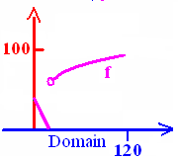
Domain = Home
All x’s or t’s that can be considered in a
function f.
Domain = [0, 120]
The set of all x such that

Slide 6
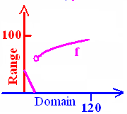
Range of f
All f(x)’s or f(t)’s that can
be realized in a function,
called f.
Range = [0, 38] U (62, 100]
=

Slide 7
Range of f
All f(x)’s or f(t)’s that can
be realized in a function,
called f.
OR
Range = [0, 38] U (62, 100]
=
OR

Slide 8

Domain = Home
When working out to obtain cardio benefit, a student must increase their heart rate to 85% of their maximum heart rate.

Slide 9
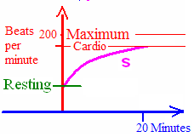
What must this student increase their heart rate to in order to obtain a cardio benefit?
A) 200
B) 185
C) 170
D) 160
E) 85

Slide 10
If a student had a resting heart rate of 65 beats per minute, and works out for 20 minutes, what is the domain of s?
A) [0, 40]
B) [0, 20]
C) [0, 65]
D) [65, 200]
E) [65, 170]

Slide 11
If this student has a resting heart rate of 65 beats per minute, and works out for 20 minutes, what is the range of s?
A) [65, 185]
B) [0, 20]
C) [0, 65]
D) [65, 200]
E) [65, 170]

Slide 12
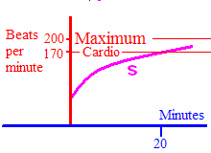
Domain of s:
What is the definition of maximum heart rate?
Can an individual reach their maximum heart rate as a limit?

Slide 13
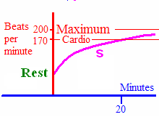
Domain and Range of s:
Domain of s =
[0, end of work out] = [0, 30] in minutes
Range of s =
[Rest, 185] in beats/min
= [60, 185] in beats/min

Slide 14
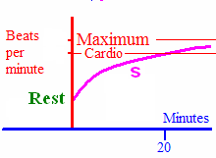
Conjecture - An individual’s maximum heart rate is 220 – age.
If x is their age, g(x) =
g(x) = 220 – x
What is the maximum
heart rate for a student
that is 20 years old?

Slide 15
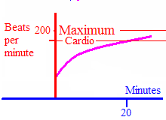
g(x) = 220 – x
g(20) = 220 – 20
g(20) =220 – 20= 200 beats/min.

Slide 16
What is the maximum heart rate for a student that is 18.5 years old?
g(x) = 220 – x
g(18.5) = 220 – 18.5
g(18.5) =220 – 18.5= 201.5 beats/min.

Slide 17
What is the maximum heart rate for a 75 year old? g(x) = 220 – x
A) 205
B) 175
C) 145
D) 85
E) 75

Slide 18
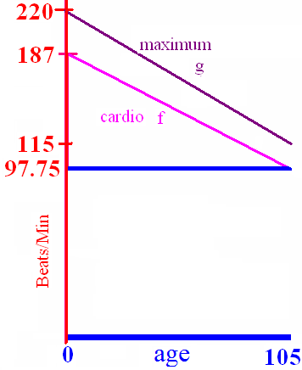
Suppose f is the cardio function and g is the maximum heart rate function. Thus f(x) = .85 g(x)
Domain of f = Domain of g
= {x | 0 x 105}
= [0, 105]

Slide 19
Range
All y’s or f(x)’s or f(t)’s that can be produced by a function
f(x) is the height of the graph of f over x.

Slide 20
Range
All y’s or f(x)’s or f(t)’s that can be produced by a function
f(x) is the height of the graph of f over x.

Slide 21
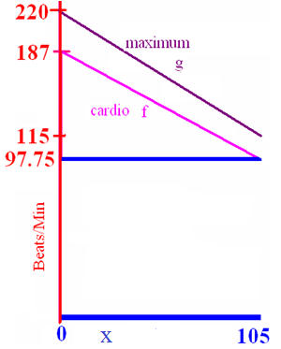
Range
All y’s or f(x)’s or f(t)’s that can be produced by a function
f(x) is the height of the graph of f over x.

Slide 22
Range
All y’s or f(x)’s or f(t)’s that can be produced by a function
f(x) is the height of the graph of f over x.

Slide 23
Range
All y’s or f(x)’s or f(t)’s that can be produced by a function
f(x) is the height of the graph of f over x.

Slide 24
Range
All y’s or f(x)’s or f(t)’s that can be produced by a function
f(x) is the height of the graph of f over x.

Slide 25
Range
All y’s or f(x)’s or f(t)’s that can be produced by a function
f(x) is the height of the graph of f over x.
f(28) =

Slide 26
Range
All y’s or f(x)’s or f(t)’s that can be produced by a function
f(x) is the height of the graph of f over x.
f(28) = 163

Slide 27
What is the range of f?
A) [97.75, 187]
B) [115, 220]
C) [97.75, 115]
D) [0, 97.75]
E) [0, 220]

Slide 28
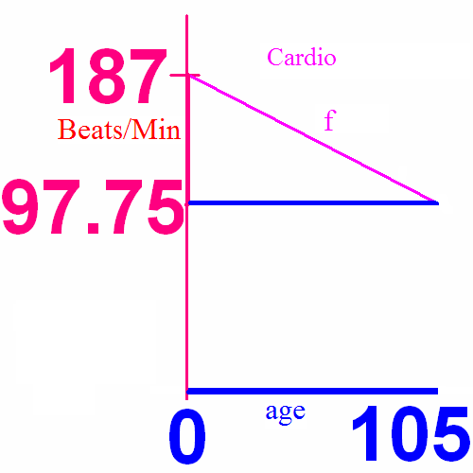
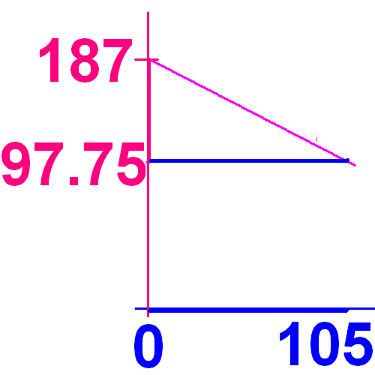
Range of f
Range is the set of cardio values
Range of f = [97.75, 187]

Slide 29
What is the range of g?
A) [97.75, 187]
B) [115, 220]
C) [97.75, 115]
D) [0, 97.75]
E) [0, 220]

Slide 30
What is the range of g?
A) [97.75, 187]
B) [115, 220]
C) [97.75, 115]
D) [0, 97.75]
E) [0, 220]

Slide 31
Range of g
g(x) = 220 – x ]
Range is the set of
maximum values
Range of g = [115, 220]
What is the slope of f ?

Slide 32

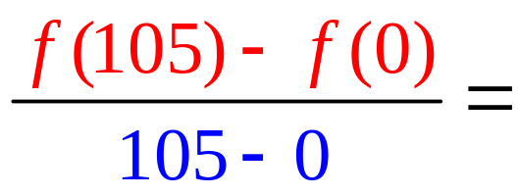
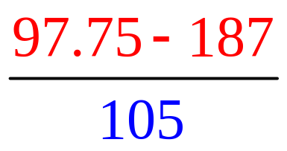
Slope
f(x) = 0.85(220 – x) = 187 – 0.85*x
Slope =
Slope =

Slide 33
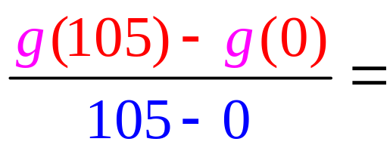
What is the slope of g?
g(x) = 220 – x = 220 –1x slope =
A) 2
B) 1
C) -2
D) -1.5
E) -1

Slide 34
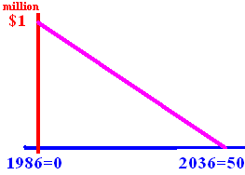
One million depreciated . linearly over 50 years. .
What is the slope?
-1/50 = - 0.02
(y – 1)/(x – 0) = - 0.02
y = -0.02x + 1
What is the book value in 2010?
You do it!

Slide 35
One million depreciated . linearly over 50 years. .
What is the slope?
-1/50 = - 0.02
(y – 1)/(x – 0) = - 0.02
y = -0.02x + 1
What is the book value in 2010?
y = -.02(24) + 1 = 0.52 million

Slide 36
Domain Algebraically
The denominator can not be zero
No negatives under the square root

Slide 37
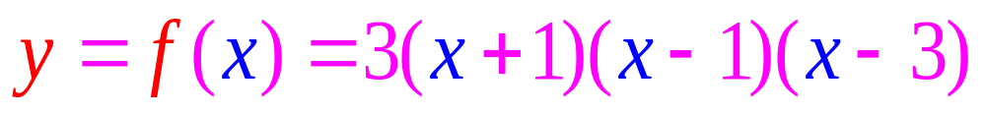
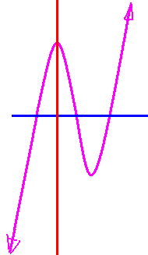
Domain
R
Reals
(-oo, +oo)

Slide 38
Range
R
Reals
(-oo, +oo)

Slide 39
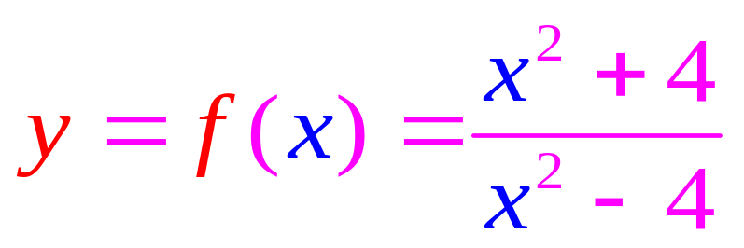
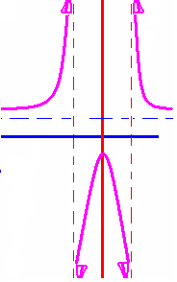
Domain
R – {-2, 2}
Reals except -2 and 2.
(-oo, -2) U (-2, 2) U (2, +oo)

Slide 40
Range
Remove (-1, 1] from the reals
R - (-1, 1].
(-oo, -1] U (1, +oo)

Slide 41
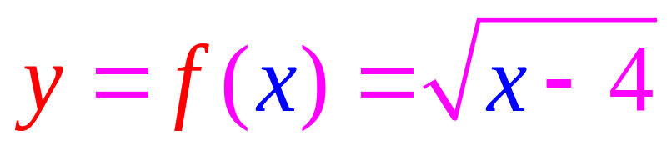
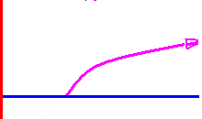
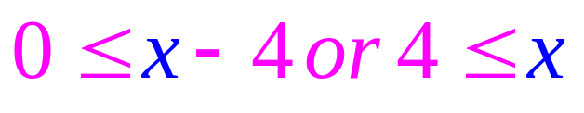
Domain
Reals greater than or equal to 4.
[4, +oo)

Slide 42
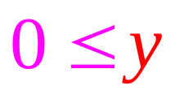
Range
Nonnegative reals.
[0, +oo)

Slide 43
Domain
The denominator can not be zero
No negatives under the square root

Slide 44
What is the domain of f(x) = 1/x?
A) R = reals
B) Z = integers
C) nonnegative reals
D) positive reals
E) all reals except x = 0

Slide 45
Domain
The denominator can not be zero
No negatives under the square root

Slide 46
What is the domain of f(x) = ?
A) R = reals
B) [-2, 2]
C)
D) positive reals
E)

Slide 47
What is the domain of f(x) = ?
A) R = reals
B) [-2, 2]
C)
D) positive reals
E)

Slide 48
Calculus
Limits
Derivatives
Integrals

