Slide 1
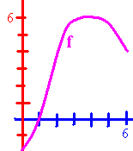
Tan Applied Calculus 2.3
f(0) =
Domain of f =
Range of f =
Find x so f(x) = 3.

Slide 2
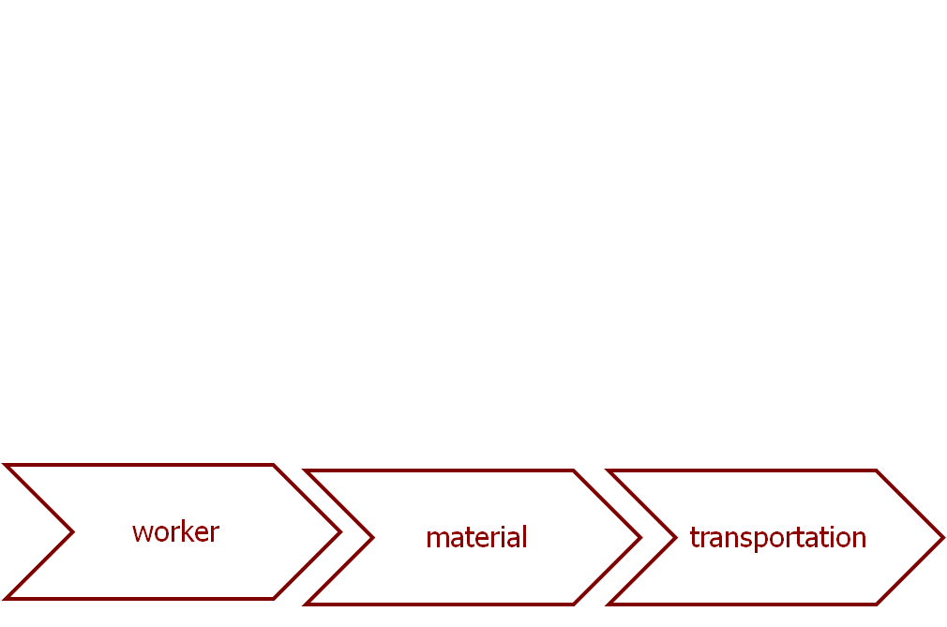
Tan Applied Calculus 2.3
Manufacture of speakers has monthly fixed costs of $23,000 and a production cost of $15.00 for each speaker.
What is the cost function?
C(x) = 15 x + 23000

Slide 3
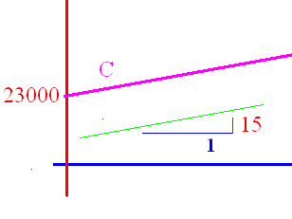
C(x) = 15 x + 23000
What is the slope? 15
What is the cost of producing
20000 speakers? 323000
What should we sell them for
to break even? 16.15

Slide 4
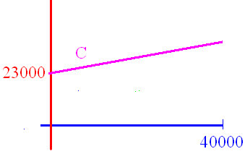
C(x) = 15 x + 23000
If the domain is [0, 40000], what is the range? [0, 623000]
If we sell them for 16.15,
find the revenue function.

Slide 5
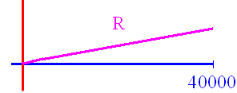
R(x) = 16.15 x
If we sell them for 16.15, find the revenue function.
What is the slope? 16.15
What is the revenue if we
sell 40000? 646000

Slide 6

Profit is P(x) = R(x) – C(x)
R(x) = 16.15 x C(x) = 15 x + 23000
P(x) = 16.15 x – (15 x + 23000)
P(x) = 1.15 x - 23000
P(40000) = 46000 - 23000
Money in

Slide 7

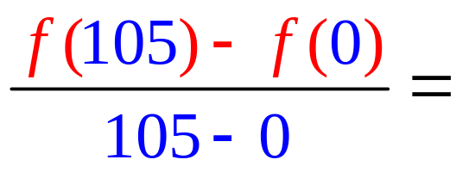
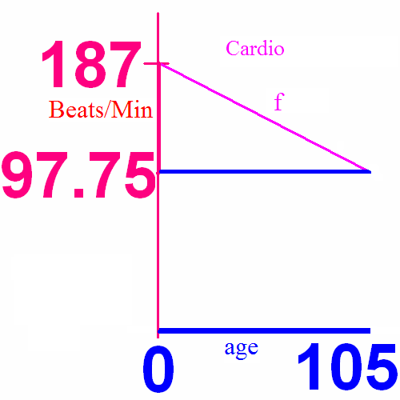
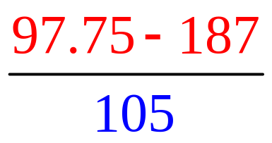
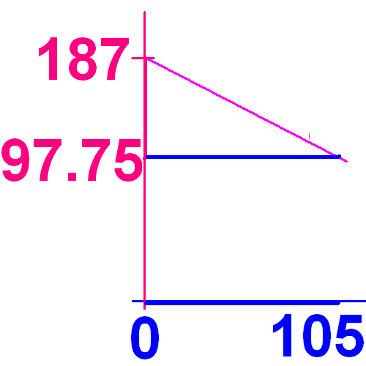
Slope
f(x) = 0.85(220 – x) = 187 – 0.85*x
Slope =
Slope =

Slide 8
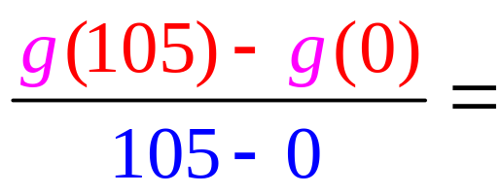
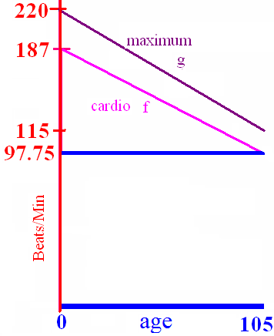
What is the slope of g?
g(x) = 220 – x = 220 –1x slope =
A) -2
B) -1
C) 2
D) 1.5
E) 1

Slide 9
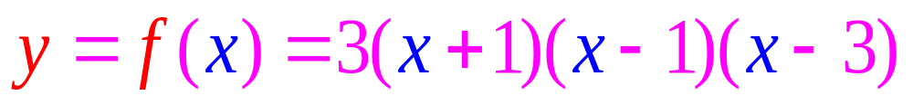
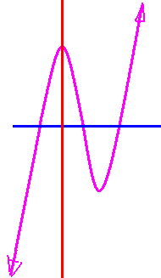
Domain
R
Reals
(-oo, +oo)

Slide 10
Range
R
Reals
(-oo, +oo)

Slide 11
Domain Algebraically
The denominator can not be zero
No negatives under the square root

Slide 12
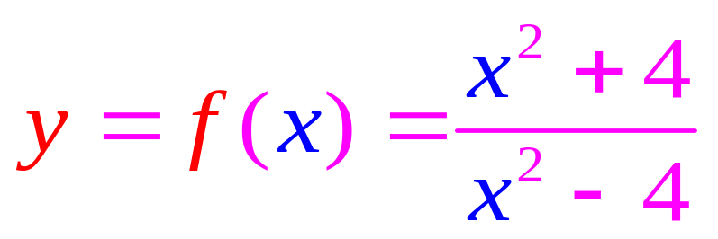
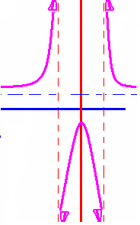
Domain
R – {-2, 2}
Reals except -2 and 2.
(-oo, -2) U (-2, 2) U (2, +oo)

Slide 13
Range
Remove (-1, 1] from the reals
R - (-1, 1].
(-oo, -1] U (1, +oo)

Slide 14
What is the domain of f(x) = 1/x?
A) R = reals
B) Z = integers
C) nonnegative reals
D) positive reals
E) all reals except x = 0

Slide 15
What is the domain of f(x) = ?
A) R = reals
B) [-2, 2]
C)
D) positive reals
E)

Slide 16
What is the domain of f(x) = ?
A) R = reals
B) [-2, 2]
C)
D) positive reals
E)

