Slide 1
Algebra of Functions
Let f and g be functions with domains
D and E respectively. Define new functions
from D E -> R by
(f+g)(x) = f(x) + g(x)
(f-g)(x) = f(x) - g(x)
(fg)(x) = f(x) * g(x)
(f/g)(x) = f(x) / g(x) if g (x) 0

Slide 2
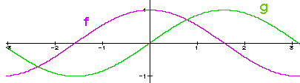
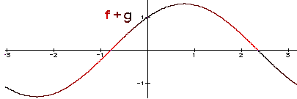
f + g
(f+g)(x) = f(x) + g(x)
f(-0.8) = 0.7
g(-0.8) = -0.7
(f+g)(-0.8) = 0

Slide 3
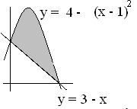
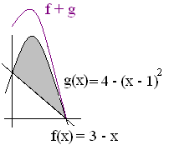
f + g
(f+g)(x) = f(x) + g(x)
(f+g)(x) = (3 – x) + [4 – (x – 1)²]
(f+g)(1) = (3-1) + [4 – 0² ]
= 2 + 4 = 6

Slide 4
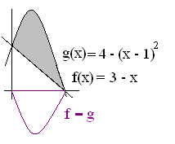
f - g
(f - g)(x) = f(x) - g(x)
= (3 – x) – [4 – (x – 1)²]
= -1 – x + [x² -2x +1]
= x² – 3x = x(x – 3)
(f – g)(1) = 1(1 – 3) = -2 or
(f – g)(1) = 2 – 4 = -2

Slide 5
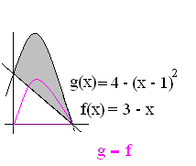
g – f
(g - f)(x) = g(x) - f(x)
= [4 – (x – 1)²] - (3 – x)
= 4 - [x² - 2x +1] – 3 + x
= 1 - x² + 2x -1 + x
= - x² + 3x = -x(x – 3)
(g - f)(1) = 4 – 2 = 2

Slide 6



Find f + g
(f+g)(x)=7 – x – (x – 1)²
(f+g)(x)= x(x - 3)
(f+g)(x)= -x(x - 3)

Slide 7


Evaluate (f+g)(0)
6.0
0.1

Slide 8

f*g(x) = f(x) g(x)
If f(x) = x² -1
and g(x) = x² + 10
find (fg)(2)
(f*g)(2) = f(2)g(2)
= 3 (14) = 42

Slide 9
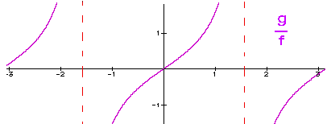
f/g(x) = f(x) / g(x)
If f(x) = x² -1
and g(x) = x² + 10
find (f/g)(2)
(f/g)(2) = f(2) / g(2)
= 3 / 14 = 0.214

Slide 10
If f(x) = x² -1 and g(x) = x² + 10 find (f*g)(1)
0.0
0.1

Slide 11
If f(x) = x² -1 and g(x) = x² + 8 find (f/g)(2)
0.25
0.1

Slide 12
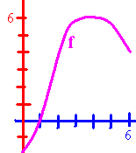
Tan Applied Calculus 2.3
f(0) =
Domain of f =
Range of f =
Find x so f(x) = 3.

Slide 13
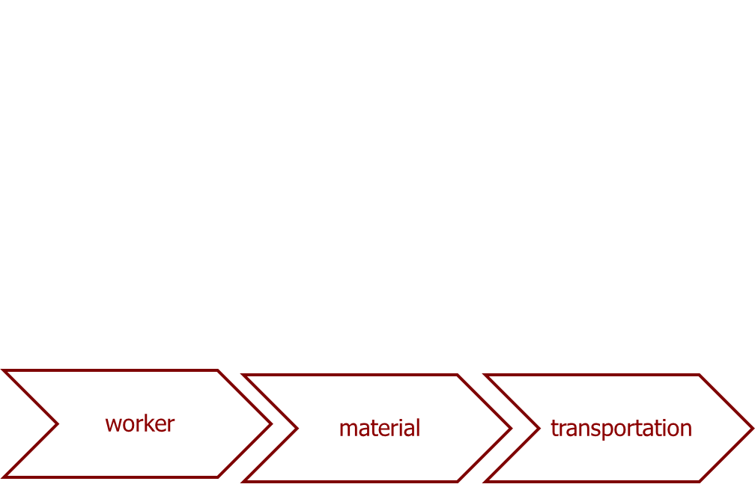
Tan Applied Calculus 2.3
Manufacture of speakers has monthly fixed costs of $23,000 and a production cost of $15.00 for each speaker.
What is the cost function?
C(x) = 15 x + 23000

Slide 14
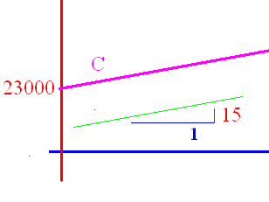
C(x) = 15 x + 23000
What is the slope? 15
What is the cost of producing
20000 speakers? 323000
What should we sell them for
to break even? 16.15

Slide 15
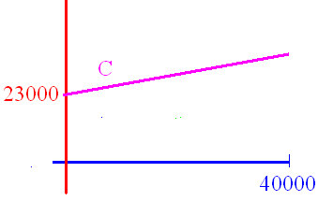
C(x) = 15 x + 23000
If the domain is [0, 40000], what is the range? [0, 623000]
If we sell them for 16.15,
find the revenue function.

Slide 16
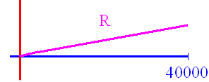
R(x) = 16.15 x
If we sell them for 16.15, find the revenue function.
What is the slope? 16.15
What is the revenue if we
sell 40000? 646000

Slide 17

Profit is P(x) = R(x) – C(x)
R(x) = 16.15 x C(x) = 15 x + 23000
P(x) = 16.15 x – (15 x + 23000)
P(x) = 1.15 x - 23000
P(40000) = 46000 - 23000
Money in

Slide 18
Find the total cost function.
A monthly fixed cost of $10000
and a variable cost of -0.0001x² + 10x
on the domain [0, 40000]
C(x) = -0.0001x² + 10x + 10000

Slide 19
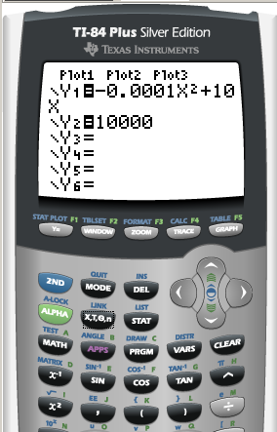
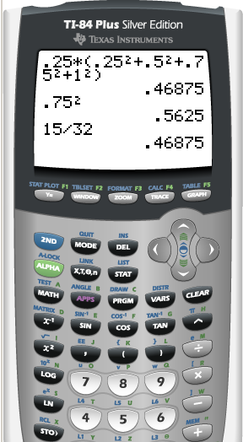
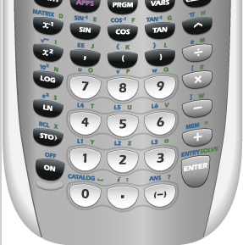
Find the total cost function.
A monthly fixed cost of $10000
f(x) = 10000
g(x) = -0.0001x² + 10x

Slide 20
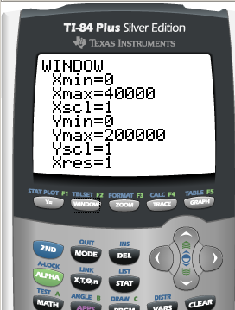
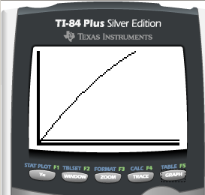
Domain = [0, 40000]
Range =
Fixed cost

Slide 21
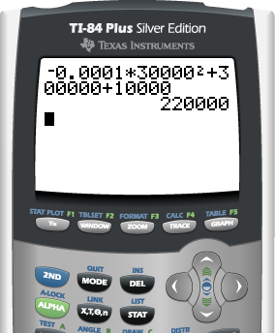
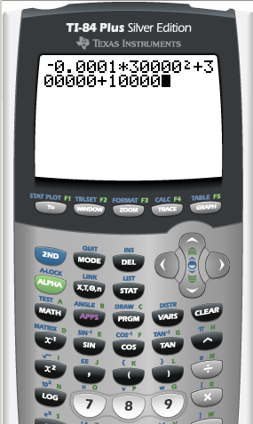
C(x) = -0.0001x² + 10x + 10000
What is the total cost for producing 30000 each month?
C(30000) = -0.0001(30000)² + 300000 + 10000
= $220000

Slide 22
Find the total cost of producing 1000 each month
C(x) = -0.0001x² + 10x + 10000
C(1000) =
-0.0001(1000000) + 10000 + 10000
= -100 + 20000
= $19900

Slide 23
C(x) = -0.0001x² + 10x + 10000
Find the cost for making 10
10100.0
0.02

Slide 24
The Revenue function.
The monthly revenue function R(x) =
-0.0005 x² + 20 x on [0, 40000]
How much revenue is received for the sale of 1000 in a month?
R(1000) =
-0.0005(1000000) + 20000 = $19500

Slide 25
R(x) = -0.0005 x² + 20 x
How much received for 100?
1995.0
0.1

Slide 26
Find the profit function.
A revenue function of R(x) =
-0.0005 x² + 20 x on [0, 40000]
C(x) = -0.0001x² + 10x + 10000

Slide 27
P(x) = R(x) – C(x)
A revenue function of R(x) =
-0.0005 x² + 20 x on [0, 40000]
C(x) = -0.0001x² + 10x + 10000
P(x) =
-0.0005 x² + 20 x – [-0.0001x² + 10x + 10000]
= -0.0004 x² + 10 x - 10000

Slide 28
P(x)=-0.0004 x² + 10 x - 10000
Find the profit if the company produces 10000 a month.
P(10000) =
-0.0004(10000*10000) + 100000 – 10000
= $50000 a month.

Slide 29
(f/g)(x) = f(x) / g(x)

Slide 30
(f/g)(x) = f(x) / g(x)

Slide 31
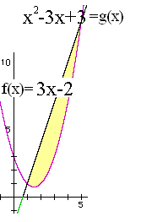
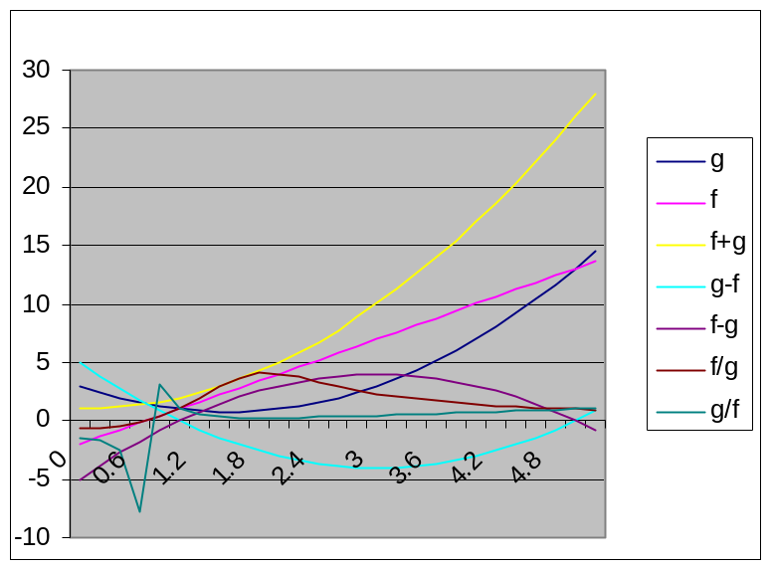
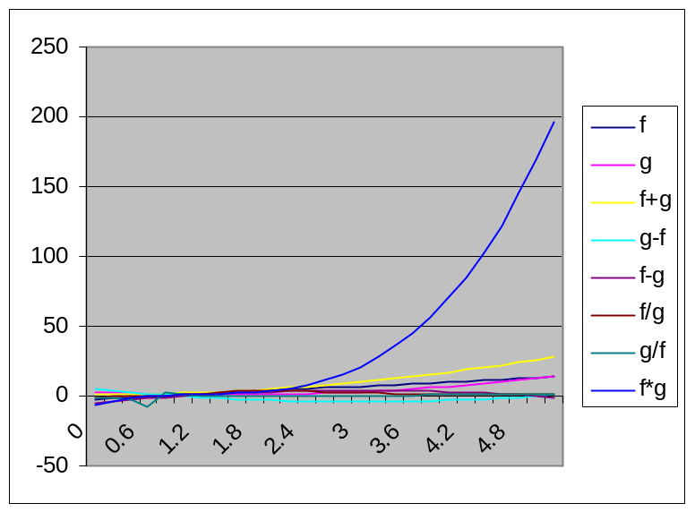
f*g(x) = f(x) g(x)

Slide 32
x | f | g | f+g | g-f | f-g | f/g | g/f | f*g
0 | -2 | 3 | 1 | 5 | -5 | -0.66667 | -1.5 | -6
0.2 | -1.4 | 2.44 | 1.04 | 3.84 | -3.84 | -0.57377 | -1.74286 | -3.416
0.4 | -0.8 | 1.96 | 1.16 | 2.76 | -2.76 | -0.40816 | -2.45 | -1.568
0.6 | -0.2 | 1.56 | 1.36 | 1.76 | -1.76 | -0.12821 | -7.8 | -0.312
0.8 | 0.4 | 1.24 | 1.64 | 0.84 | -0.84 | 0.322581 | 3.1 | 0.496
1 | 1 | 1 | 2 | 0 | 0 | 1 | 1 | 1
1.2 | 1.6 | 0.84 | 2.44 | -0.76 | 0.76 | 1.904762 | 0.525 | 1.344
1.4 | 2.2 | 0.76 | 2.96 | -1.44 | 1.44 | 2.894737 | 0.345455 | 1.672
1.6 | 2.8 | 0.76 | 3.56 | -2.04 | 2.04 | 3.684211 | 0.271429 | 2.128
1.8 | 3.4 | 0.84 | 4.24 | -2.56 | 2.56 | 4.047619 | 0.247059 | 2.856
2 | 4 | 1 | 5 | -3 | 3 | 4 | 0.25 | 4
2.2 | 4.6 | 1.24 | 5.84 | -3.36 | 3.36 | 3.709677 | 0.269565 | 5.704
2.4 | 5.2 | 1.56 | 6.76 | -3.64 | 3.64 | 3.333333 | 0.3 | 8.112
2.6 | 5.8 | 1.96 | 7.76 | -3.84 | 3.84 | 2.959184 | 0.337931 | 11.368
2.8 | 6.4 | 2.44 | 8.84 | -3.96 | 3.96 | 2.622951 | 0.38125 | 15.616
3 | 7 | 3 | 10 | -4 | 4 | 2.333333 | 0.428571 | 21
3.2 | 7.6 | 3.64 | 11.24 | -3.96 | 3.96 | 2.087912 | 0.478947 | 27.664
3.4 | 8.2 | 4.36 | 12.56 | -3.84 | 3.84 | 1.880734 | 0.531707 | 35.752
3.6 | 8.8 | 5.16 | 13.96 | -3.64 | 3.64 | 1.705426 | 0.586364 | 45.408
3.8 | 9.4 | 6.04 | 15.44 | -3.36 | 3.36 | 1.556291 | 0.642553 | 56.776
4 | 10 | 7 | 17 | -3 | 3 | 1.428571 | 0.7 | 70
4.2 | 10.6 | 8.04 | 18.64 | -2.56 | 2.56 | 1.318408 | 0.758491 | 85.224
4.4 | 11.2 | 9.16 | 20.36 | -2.04 | 2.04 | 1.222707 | 0.817857 | 102.592
4.6 | 11.8 | 10.36 | 22.16 | -1.44 | 1.44 | 1.138996 | 0.877966 | 122.248
4.8 | 12.4 | 11.64 | 24.04 | -0.76 | 0.76 | 1.065292 | 0.93871 | 144.336
5 | 13 | 13 | 26 | 0 | 0 | 1 | 1 | 169
5.2 | 13.6 | 14.44 | 28.04 | 0.84 | -0.84 | 0.941828 | 1.061765 | 196.384

Slide 33
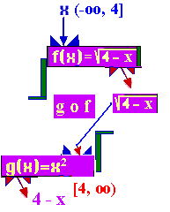
Algebra of Functions
Let f and g be functions with domains
D and E respectively. Define new functions
from D’ -> R by
(gºf)(x) = g(f(x))
D’ = {x|f(x) ε E}

Slide 34
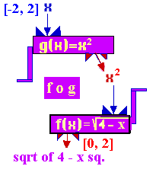
Algebra of Functions
Let f and g be functions with domains
D and E respectively. Define new functions
from E’ -> R by
(fºg)(x) = f(g(x))
E’ = {x|g(x) ε D}

Slide 35
Composition of functions
f(x) = x²
g(x) =
Evaluate f º g(0) and g º f (0)

Slide 36
g(x) = x² and f(x) = evaluate g º f(-2)
6.0
0.1

Slide 37
g(x) = x² and f(x) = evaluate f º g(-2)
0.0
0.1

