Slide 1
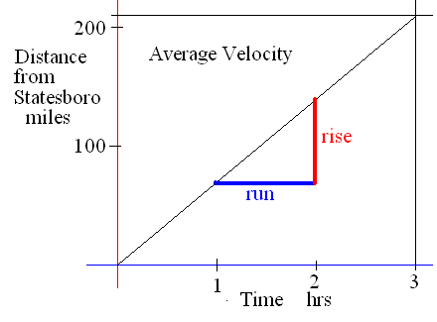
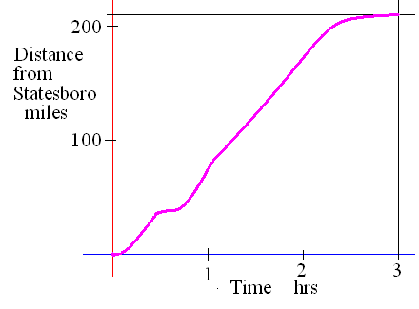
Limits
How far were you from Statesboro as t approaches 1 hour from both sides?
How long were you
Stopped?

Slide 2
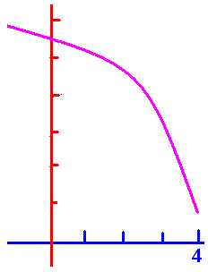
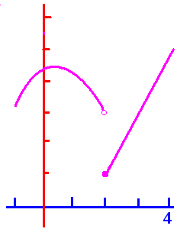
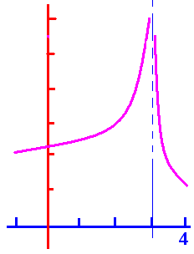
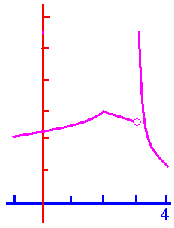
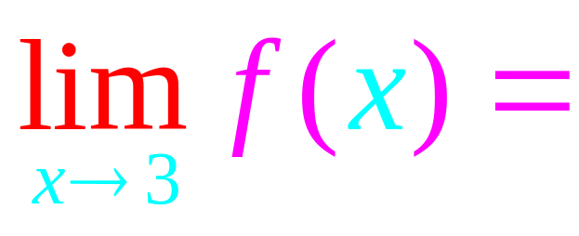
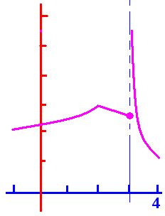
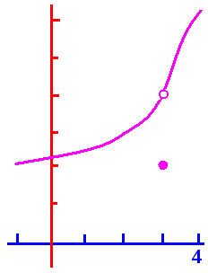
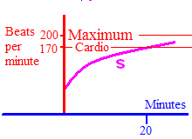


Limits from both sides

Slide 3
Limits

Slide 4
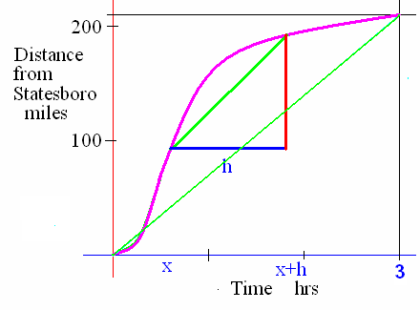
Limits
What was your average velocity over the 3 hours shown?
Over the h hours?

Slide 5
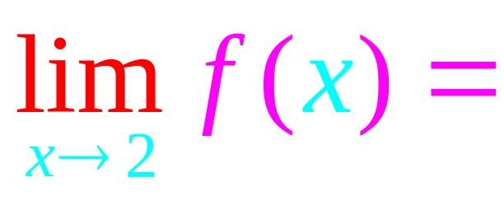


.
d.n.e.
2
3
4
5

Slide 6
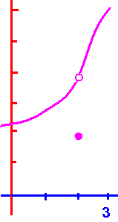
.
d.n.e.
2
3
4
5

Slide 7
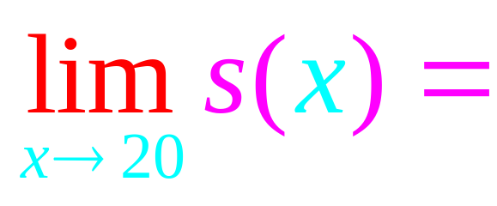
.
d.n.e.
100
170
200
230

Slide 8

.
d.n.e.
2
3
4
5

Slide 9

.
d.n.e.
2
3
4
5

Slide 10
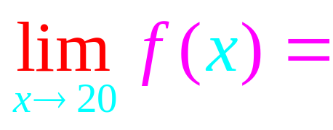
Limits

Slide 11
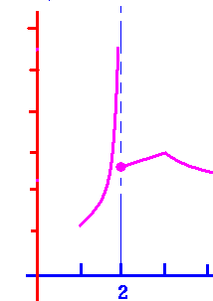
.
d.n.e.
2
3
4
5

Slide 12
.
d.n.e.
2
3
4
5

Slide 13
.
d.n.e.
2
3
4
5

Slide 14
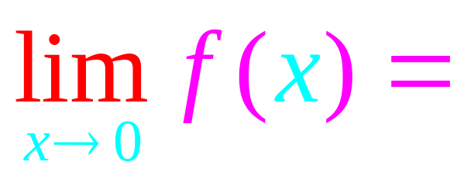
.
d.n.e.
1
2.5
4
5.5

Slide 15




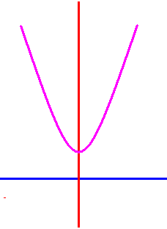
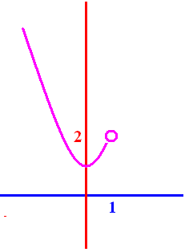
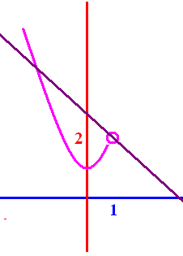
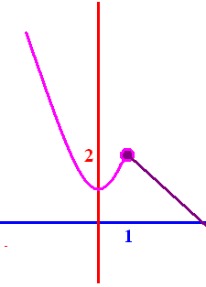
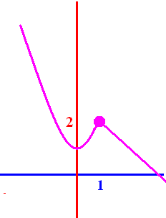

f (x) = x² + 1
if x 1
f (x) = 3 – x
if 1 < x

Slide 16




Slide 17
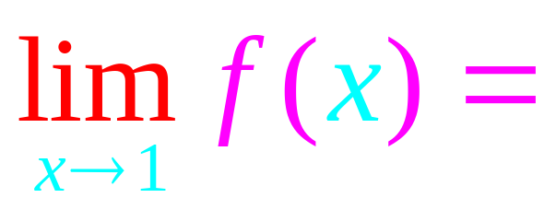
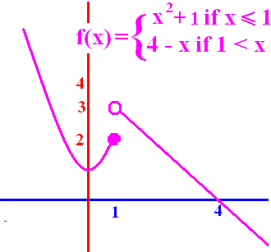
.
d.n.e.
1
2.5
4
5.5

Slide 18

.
d.n.e.
2
3
4
0

Slide 19
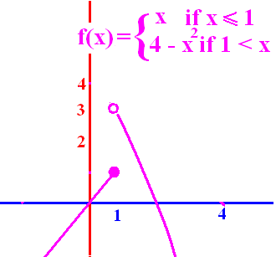
.
1
2
3
4
d.n.e.

Slide 20
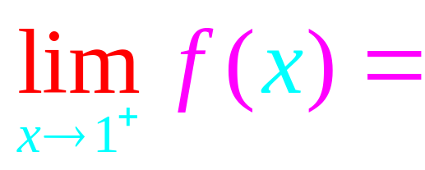
.
1
2
3
4
d.n.e.

Slide 21

.
d.n.e.
0
1
2
3

