Slide 1
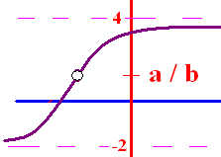
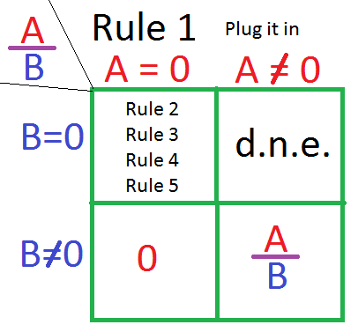
Limit Algebraic Rules
Rule 1 – Plug the x xalue
  into the equation
If you get a/b and
b 0, the answer is a/b
b = 0 and a 0, the answer is d.n.e.
you get 0/0 then go to higher rules

Slide 2
.

Slide 3

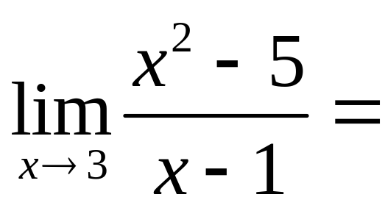
.

Slide 4


.
2.0
0.1

Slide 5
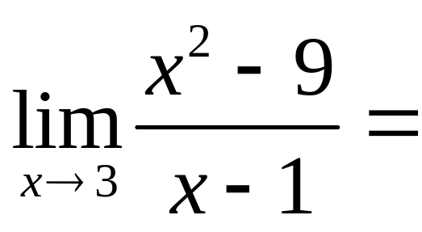
.

Slide 6
.
0.0
0.1

Slide 7
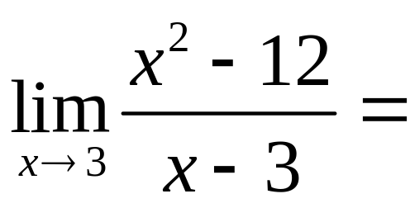
.
-3
0
d.n.e

Slide 8

.
-3
0
d.n.e

Slide 9
Limit Algebraic Rules
Rule 2 – Factor and cancel
  return to Rule 1
SOAP (a³ + b³) = (a + b)(a² – ab + b²)
Diff of 2 squares (a² - b²) = (a + b)(a – b)
a x² + bx + c Find two numbers whose product is ac, but add to b

Slide 10
Limit Algebraic Rules
Rule 2 – Factor and cancel
  return to Rule 1
a x² + bx + c Find two
numbers whose product is
ac, but add to b
2 x² + 3x - 9 Find two
numbers whose product is
-18, but add to 3
18 -1
9 -2
6 -3
3 -6
2 -9
1 -18

Slide 11
Limit Algebraic Rules
2 x² + 3x - 9 Find two
numbers whose product is
-18, but add to 3
= 2 x² + 6x - 3x - 9
=2x(x + 3) – 3(x + 3)
= (2x – 3)(x + 3)
18 -1
9 -2
6 -3
3 -6
2 -9
1 -18

Slide 12
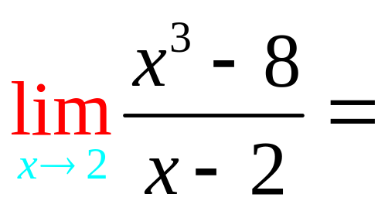
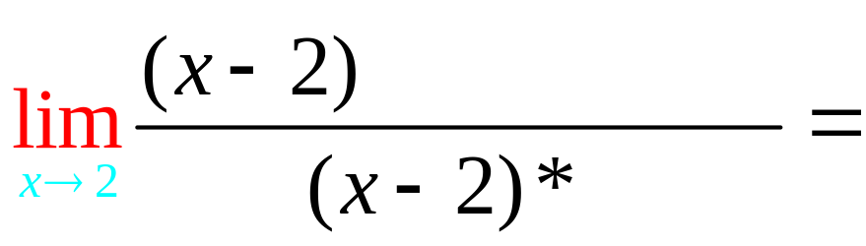
Rule 2 – Factor and cancel
SOAP (a³ + b³) = (a + b)(a² – ab + b²)

Slide 13
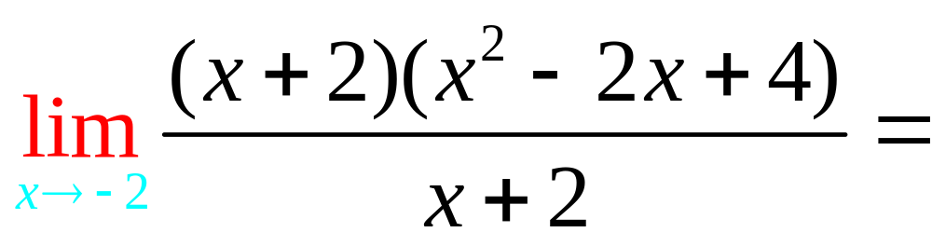
.

Slide 14
.
12.0
0.1

Slide 15
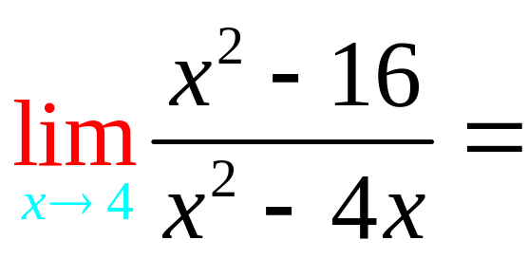
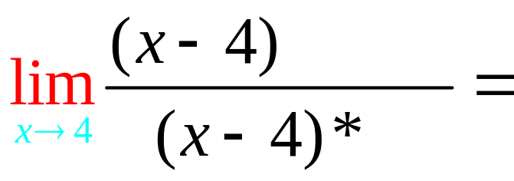

Rule 2 – Factor and cancel
Difference of two squares

Slide 16
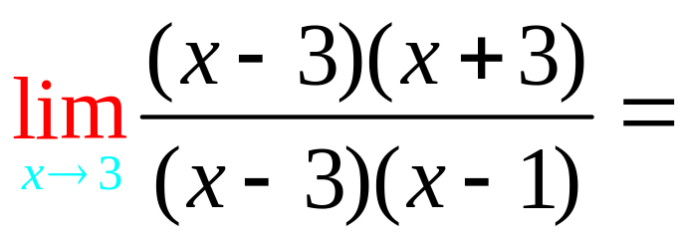
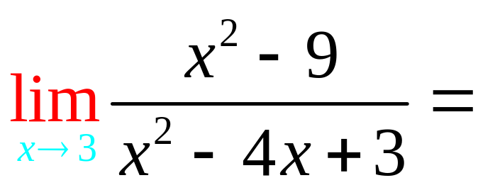
.

Slide 17
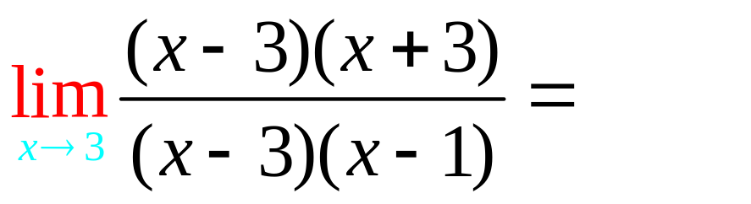
.
3.0
0.1

Slide 18
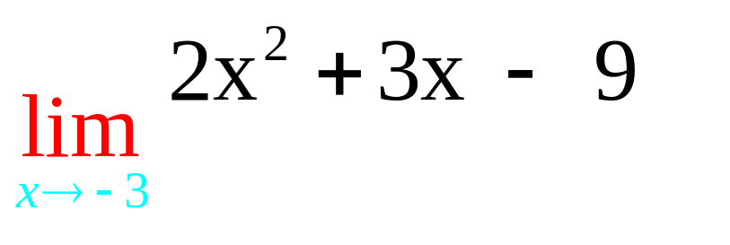
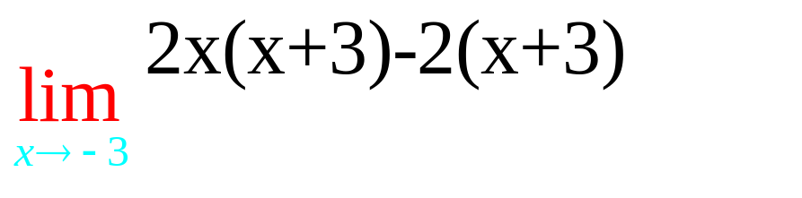
Rule 2 – Factor and cancel
a x² + bx + c Find two numbers whose product is ac, but add to b

Slide 19
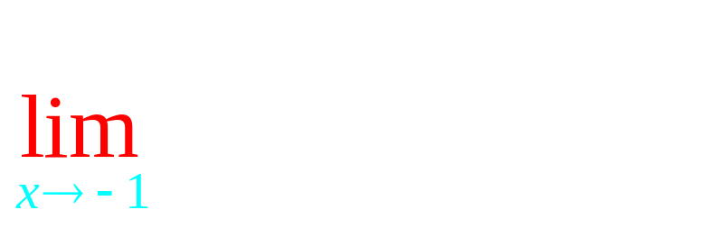
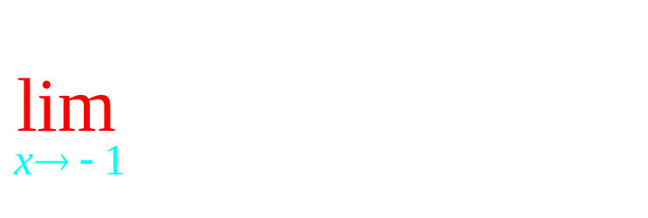
Rule 2 – Factor and cancel
a x² + bx + c Find two numbers whose product is ac, but add to b

Slide 20
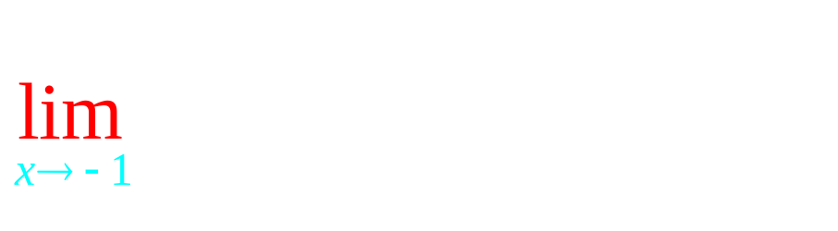
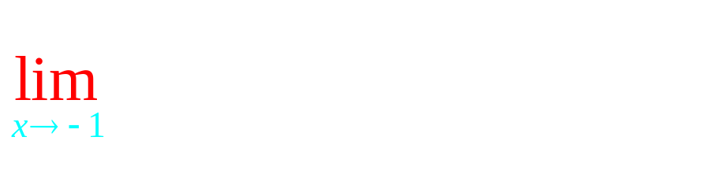
Rule 2 – Factor and cancel
a x² + bx + c Find two numbers whose product is ac, but add to b

Slide 21
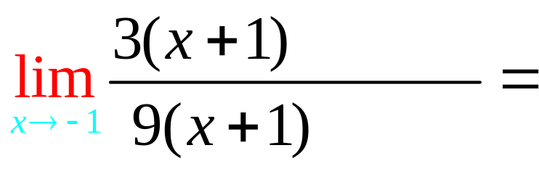
Rule 2 – Factor and cancel
a x² + bx + c Find two numbers whose product is ac, but add to b

Slide 22
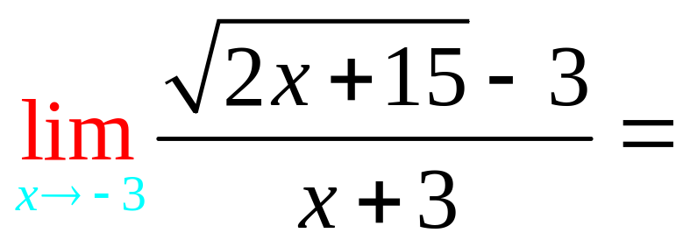
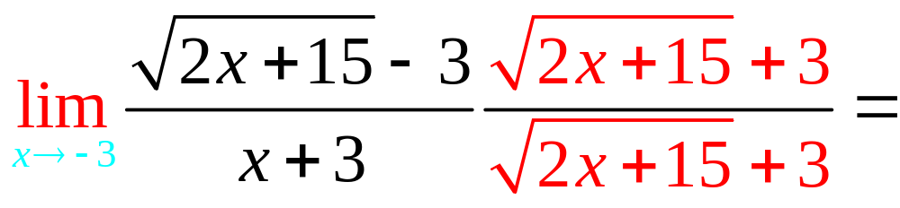
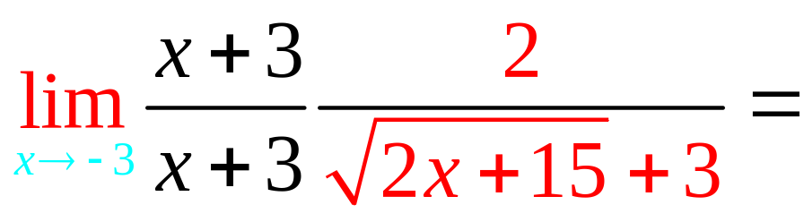
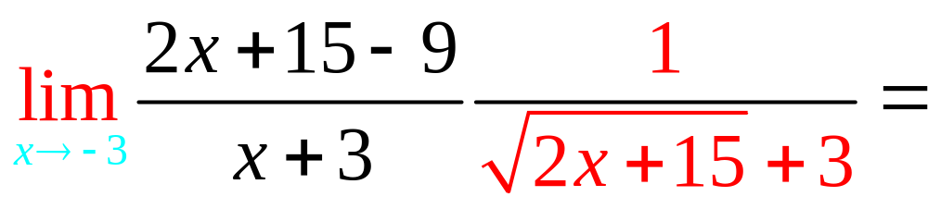
Rule 3 – Conjugate

Slide 23
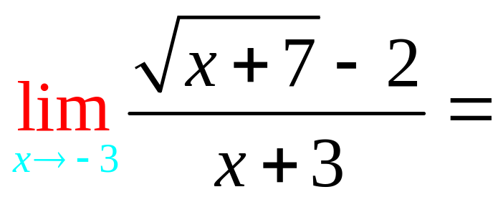
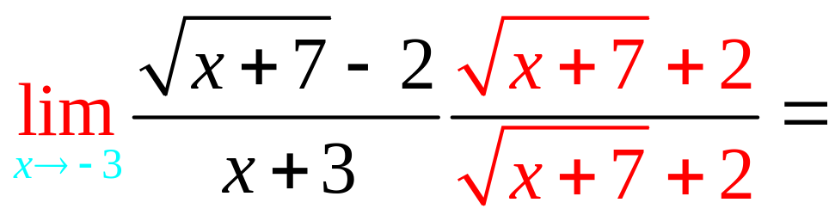
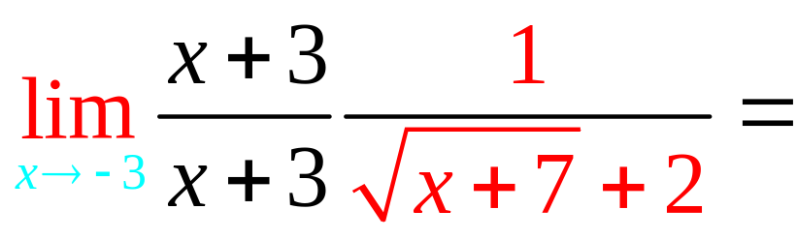
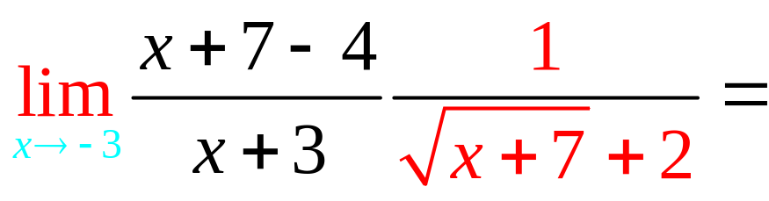
Rule 3 – Conjugate

Slide 24
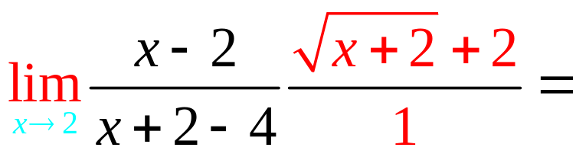
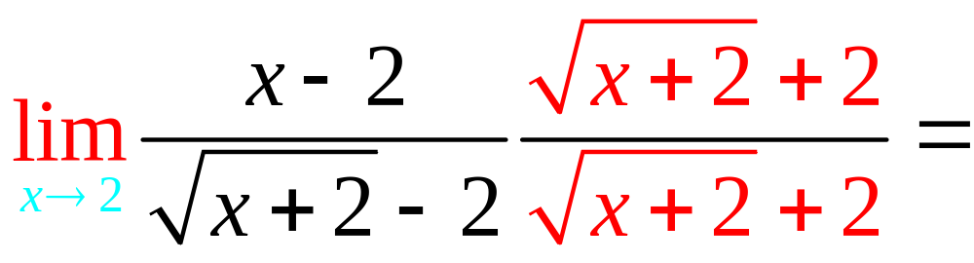
. 4
4.0
0.1

Slide 25
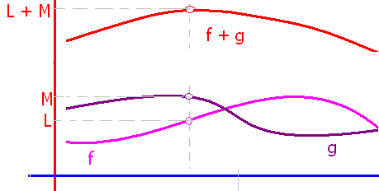
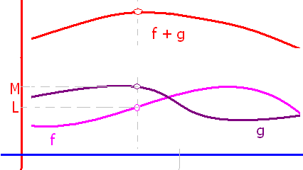
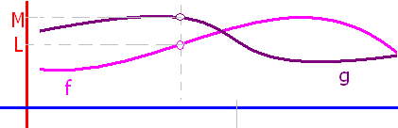
If lim f(x) = L and lim g(x) = M, then
lim(f(x) + g(x)) = L + M
lim(f(x) - g(x)) = L - M
lim(k f(x)) = k L
lim(f(x)g(x)) = L M
lim(f(x) / g(x)) = L / M
lim [f(x)^{n}]= L^{n}
lim

