Slide 1
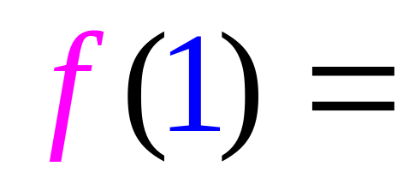
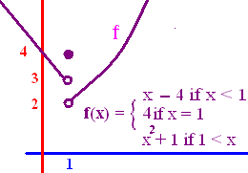


.
d.n.e.
2
3
4

Slide 2
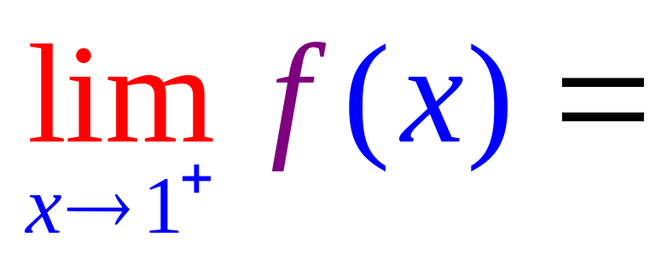
.
d.n.e.
2
3
4

Slide 3
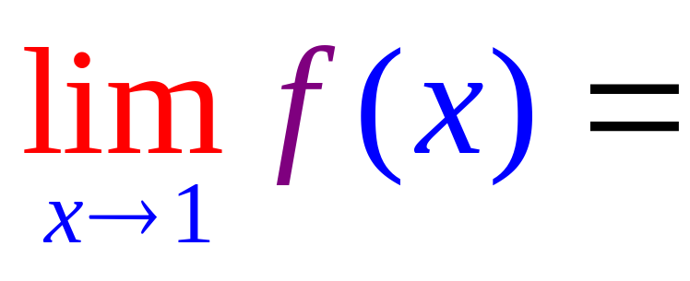
.
d.n.e.
2
3
4

Slide 4
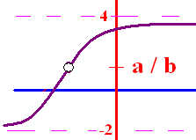
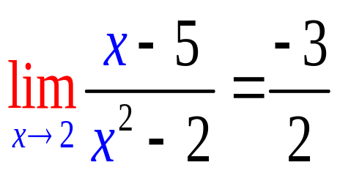
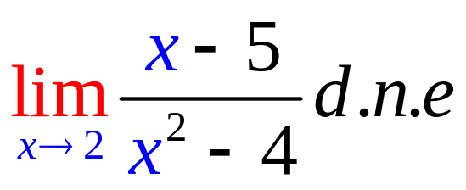
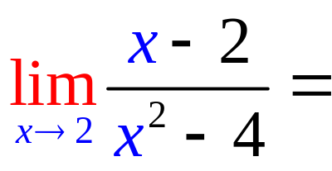
Limit Algebraic Rules
Rule 1 – Plug the x xalue
  into the equation
If you get a/b and
b 0, the answer is a/b
b = 0 and a 0, the answer is d.n.e
you get 0/0 then go to higher rules

Slide 5
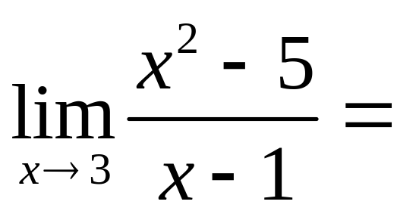

.
2.0
0.1

Slide 6
Limit Algebraic Rules
Rule 1 – Plug the x xalue
  into the equation
If you get a/b and
b 0, the answer is a/b
b = 0 and a 0, the answer is d.n.e
you get 0/0 then go to higher rules

Slide 7
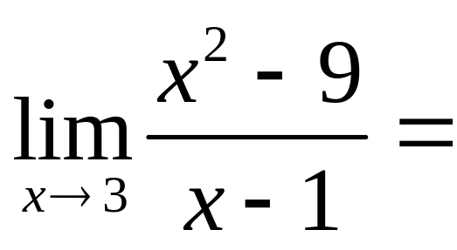
.
0.0
0.1

Slide 8
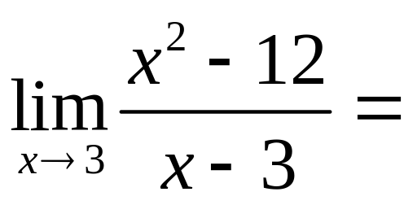
.
-3
0
d.n.e

Slide 9
Limit Algebraic Rules
Rule 2 – Factor and cancel
  return to Rule 1
SOAP (a³ + b³) = (a + b)(a² – ab + b²)
Diff of 2 squares (a² - b²) = (a + b)(a – b)
a x² + bx + c Find two numbers whose product is ac, but add to b

Slide 10
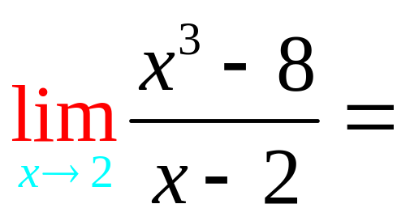
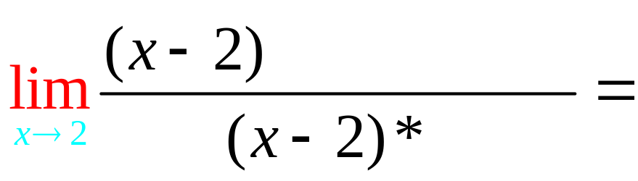
Rule 2 – Factor and cancel
SOAP (a³ + b³) = (a + b)(a² – ab + b²)

Slide 11
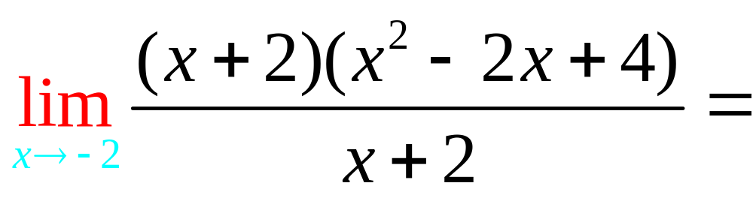
.
12.0
0.1

Slide 12
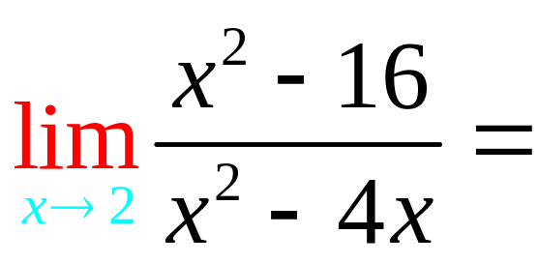
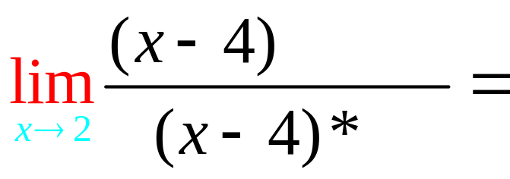
Rule 2 – Factor and cancel
Difference of two squares

Slide 13
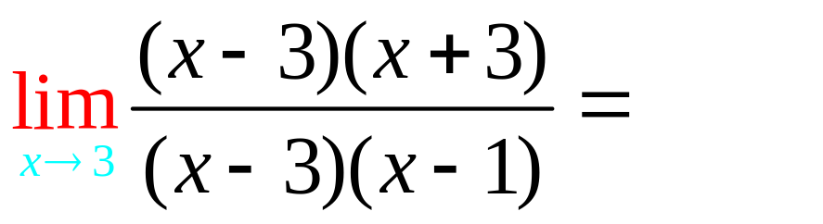
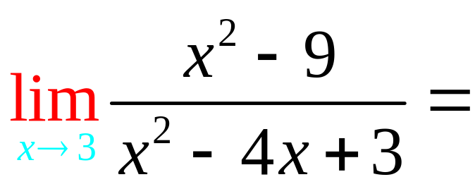
.
3.0
0.1

Slide 14
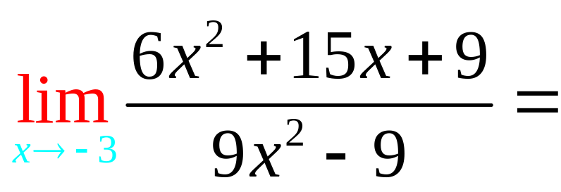
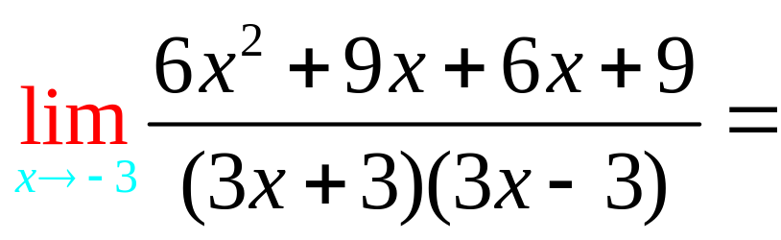
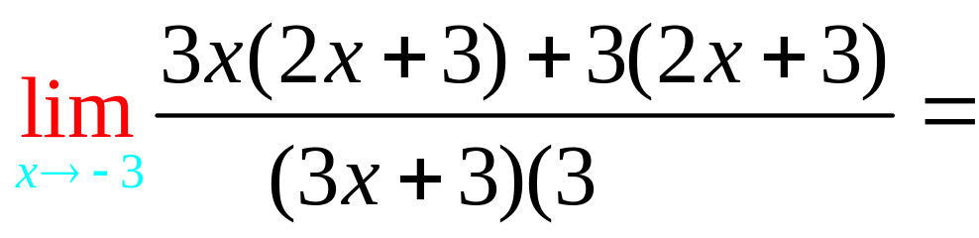
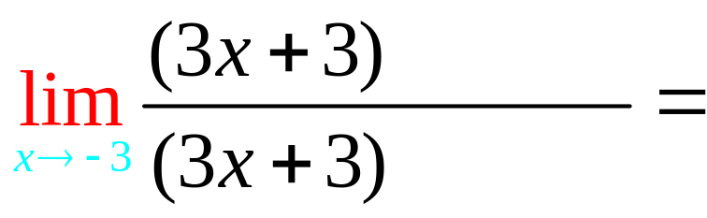
Rule 2 – Factor and cancel
a x² + bx + c Find two numbers whose product is ac, but add to b

Slide 15
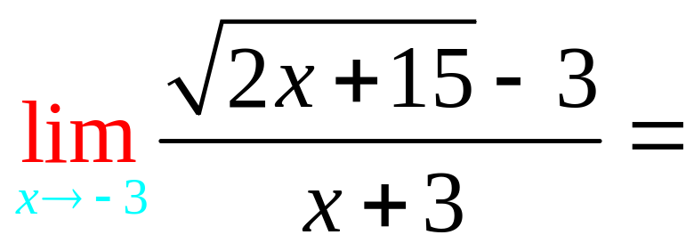
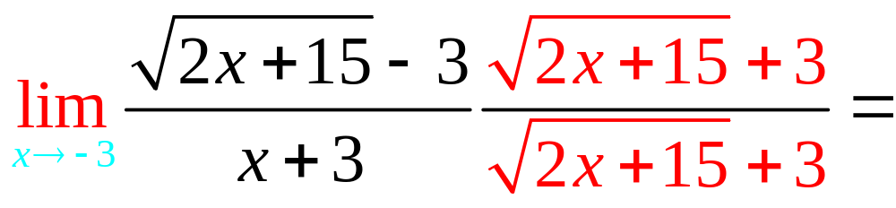
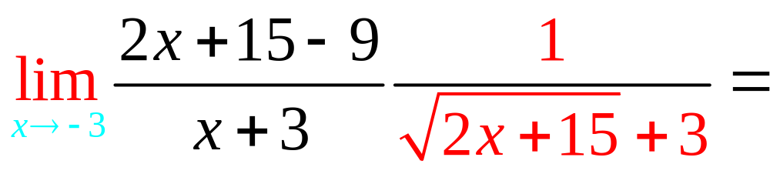
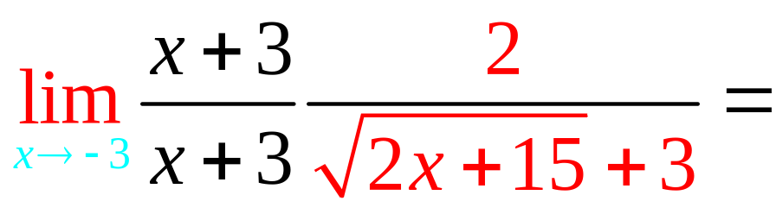
Rule 3 – Conjugate

Slide 16
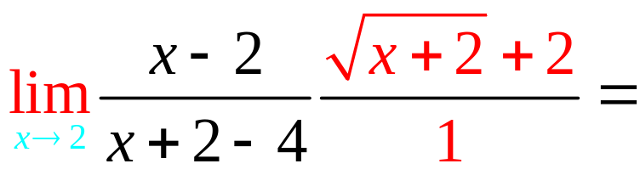
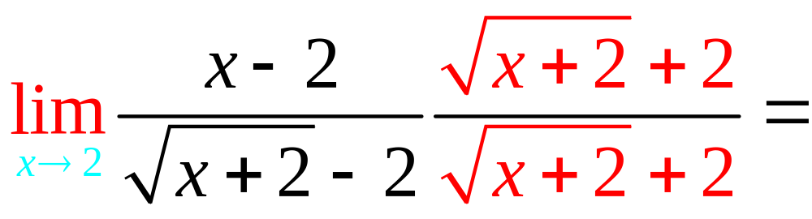
. 4
4.0
0.1

Slide 17
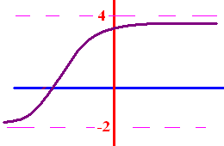
Limits as x goes to
+ or - infinity
What does y get close to
as x goes to + infinity?
What does y get close to
as x goes to - infinity?

Slide 18
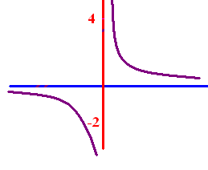
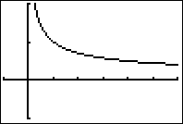

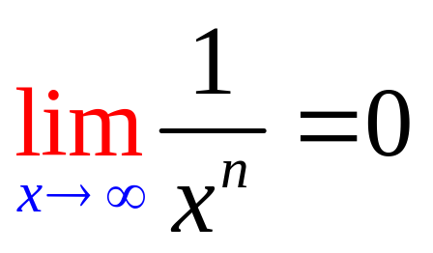
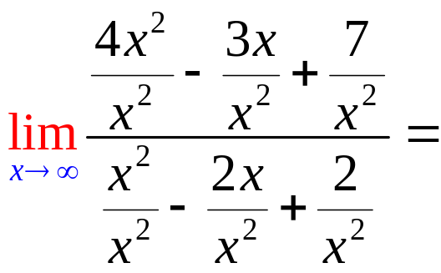
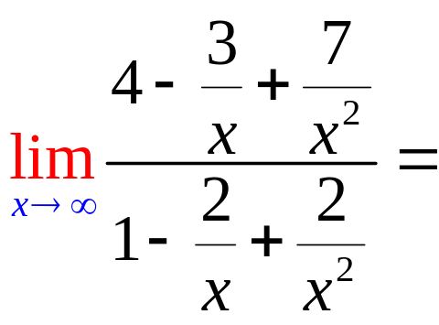
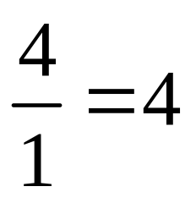
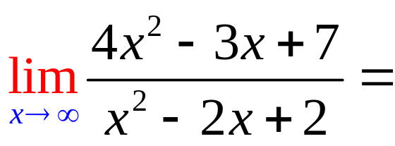
Limits as x goes to
+ or - infinity
To calculate the limit as x
goes to infinity, remember
if n 0.

Slide 19
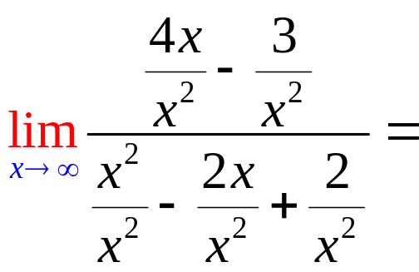
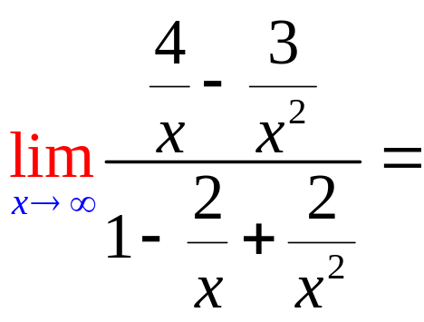
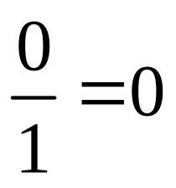
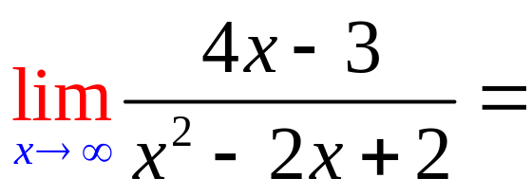
Limits as x goes to
+ or - infinity

Slide 20

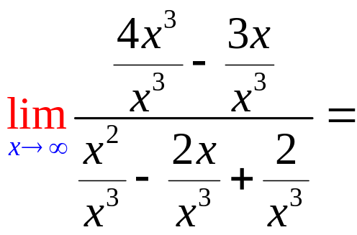
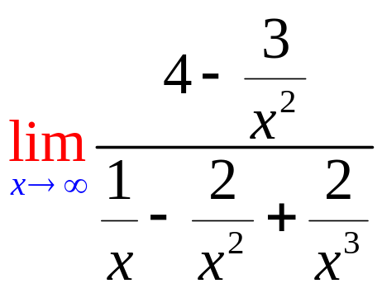
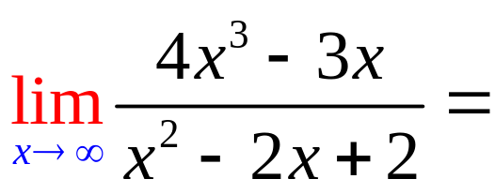
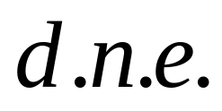
Limits as x goes to
+ or - infinity

Slide 21
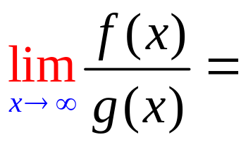
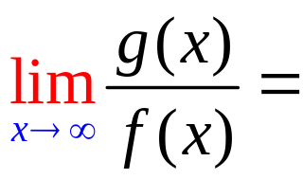
5
f(x)=3x⁵ - 3x³ + 2
g(x) = 2x² - 4x + 2

Slide 22
5
f(x)=3x⁵ - 3x³ + 2
g(x) = 2x⁵ - 4x + 2

Slide 23
5
f(x)=3x⁵ - 3x³ + 2
g(x) = 2x²¹ - 4x + 2

Slide 24
5
f(x)= x⁸ - 3x³ + 2
g(x) = 7x⁸ - 4x + 2

Slide 25
5
f(x)= x⁸ - 3x³ + 2
g(x) = 7x⁸ - 4x + 2

Slide 26
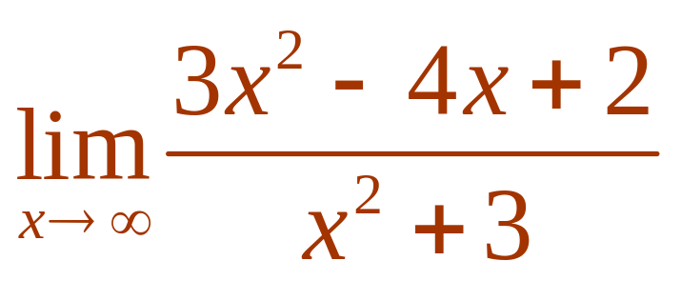
Evaluate .
3
1/3
d.n.e
0

Slide 27
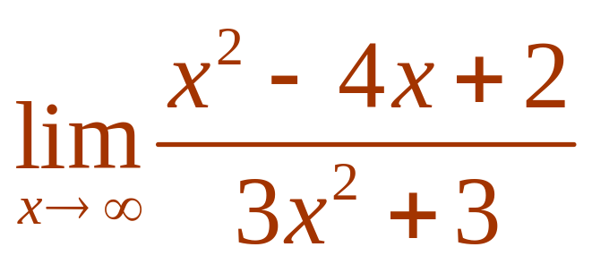
Evaluate .
3
1/3
d.n.e
0

Slide 28
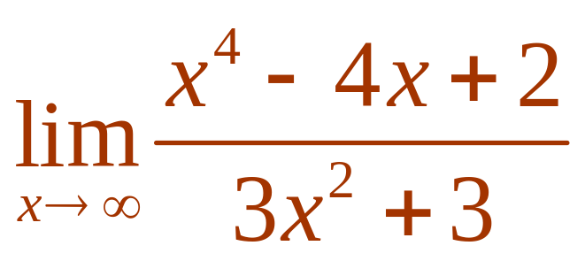
Evaluate .
3
1/3
d.n.e
0

Slide 29
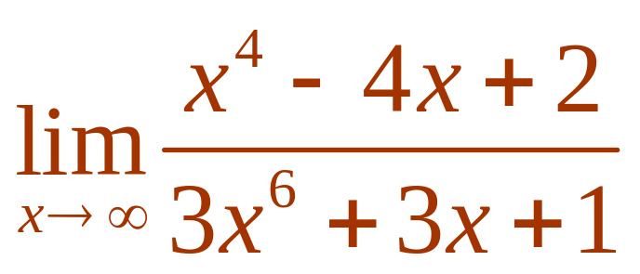
Evaluate .
3
1/3
d.n.e
0

Slide 30

0
d.n.e.
7

Slide 31

9/8
d.n.e.
0

