Slide 1

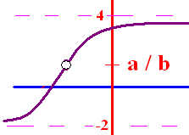
Limit Algebraic Rules
Rule 1 – Plug the x xalue
  into the equation
If you get a/b and
b 0, the answer is a/b
b = 0 and a 0, the answer is d.n.e
you get 0/0 then go to higher rules

Slide 2
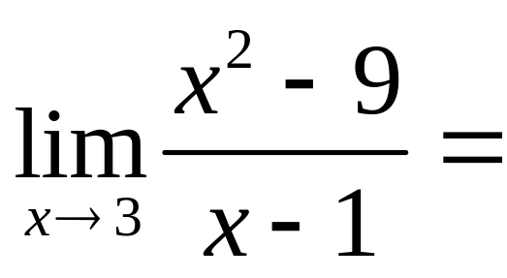


.
0.0
0.1

Slide 3

Limit Algebraic Rules
Rule 2 – Factor and cancel
  return to Rule 1
SOAP (a³ + b³) = (a + b)(a² – ab + b²)
Diff of 2 squares (a² - b²) = (a + b)(a – b)
a x² + bx + c Find two numbers whose product is ac, but add to b

Slide 4
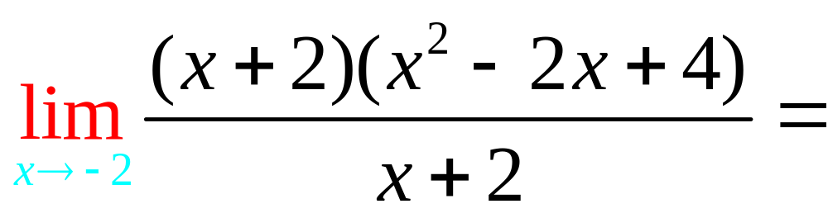
.
12.0
0.1

Slide 5
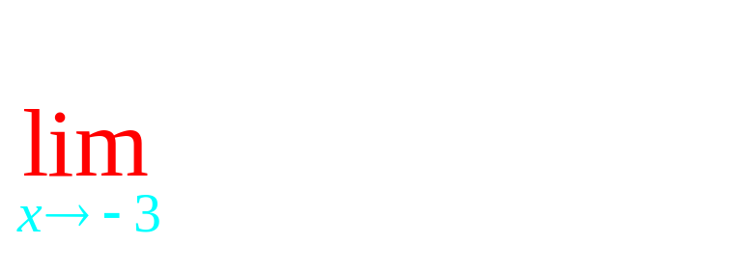
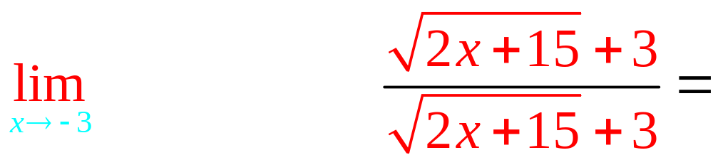
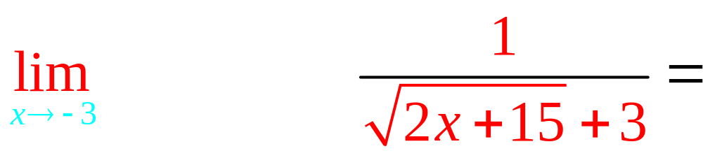
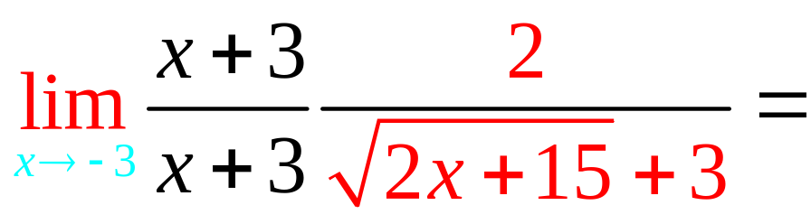
Rule 3 – Conjugate

Slide 6
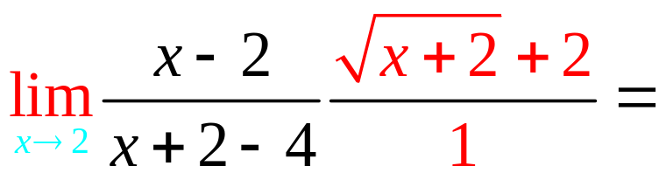
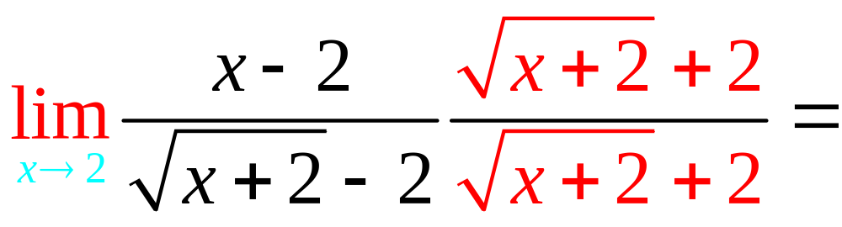
. 4
4.0
0.1

Slide 7
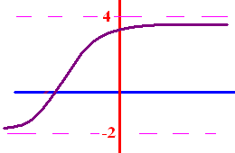
Limits as x goes to
+ or - infinity
What does y get close to
as x goes to + infinity?
What does y get close to
as x goes to - infinity?

Slide 8
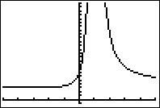

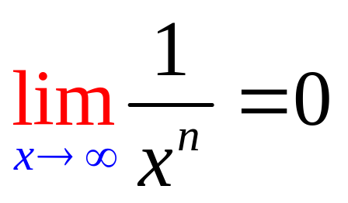
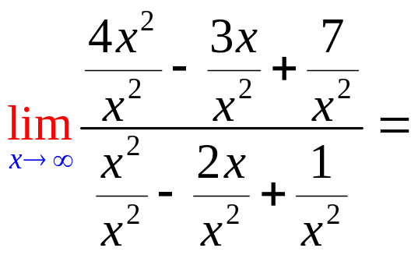
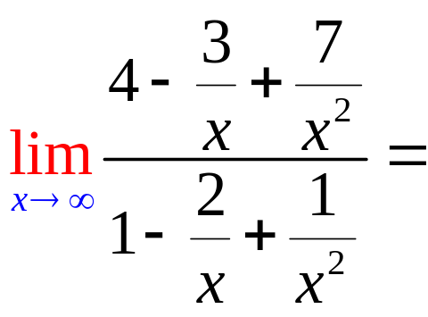
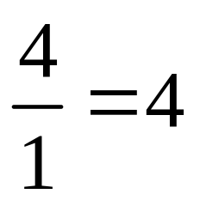
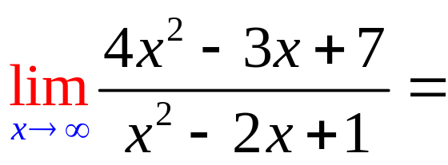
Limits as x goes to
+ or - infinity
To calculate the limit as x
goes to infinity, remember
if n > 0.

Slide 9
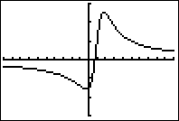
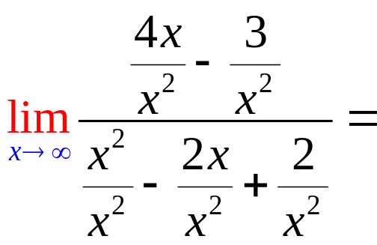
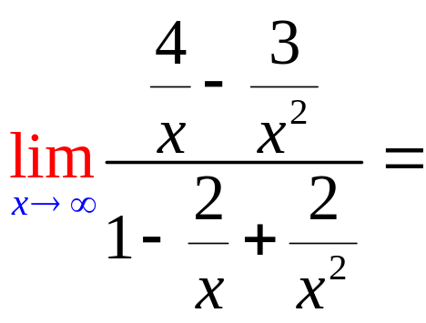
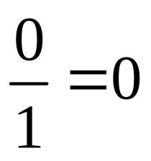
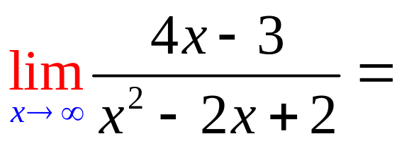
Limits as x goes to
+ or - infinity

Slide 10
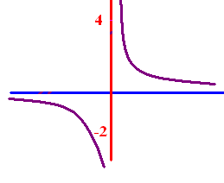

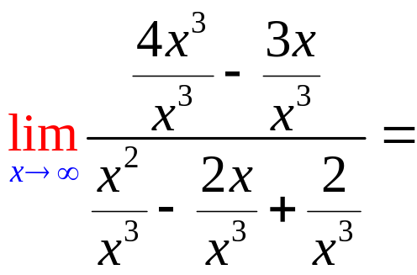
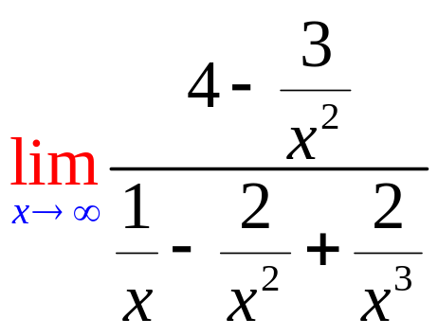
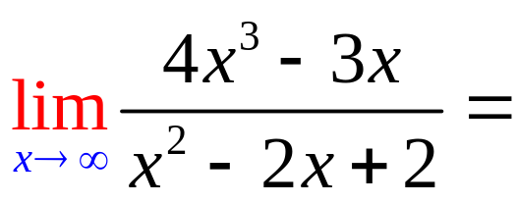
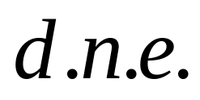
Limits as x goes to
+ or - infinity

Slide 11
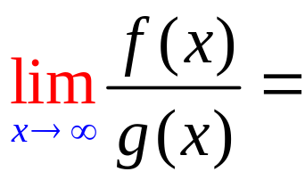
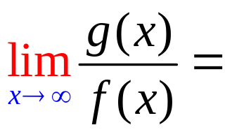
5
f(x)=3x⁵ - 3x³ + 2
g(x) = 2x² - 4x + 2

Slide 12
5
f(x)=3x⁵ - 3x³ + 2
g(x) = 2x⁵ - 4x + 2

Slide 13
5
f(x)=3x⁵ - 3x³ + 2
g(x) = 2x²¹ - 4x + 2

Slide 14
5
f(x)= x⁸ - 3x³ + 2
g(x) = 7x⁸ - 4x + 2

Slide 15
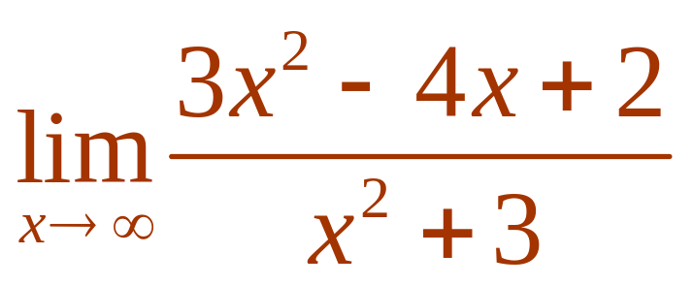

Evaluate .
3
1/3
d.n.e
0

Slide 16
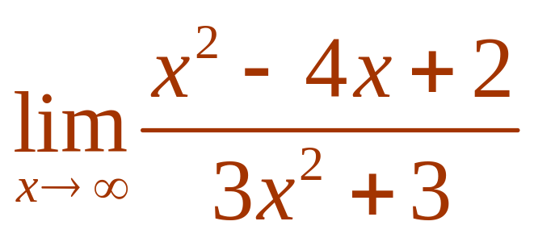
Evaluate .
3
1/3
d.n.e
0

Slide 17
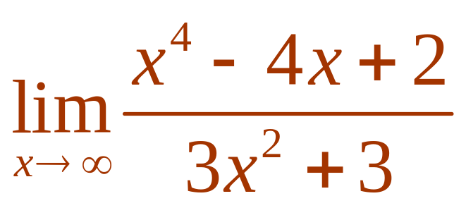
Evaluate .
3
1/3
d.n.e
0

Slide 18
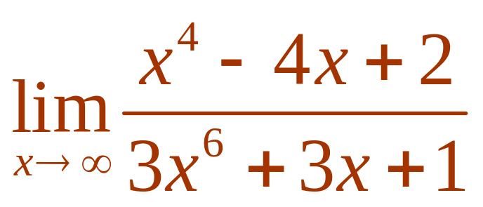
Evaluate .
3
1/3
d.n.e
0

Slide 19
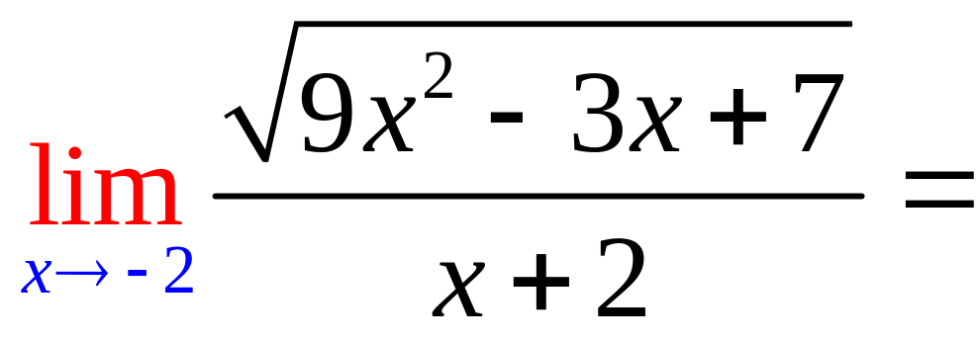
0
d.n.e.
7

Slide 20
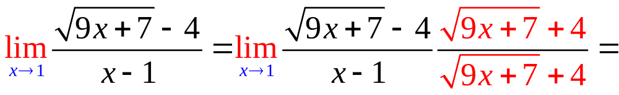
9/8
d.n.e.
0

Slide 21
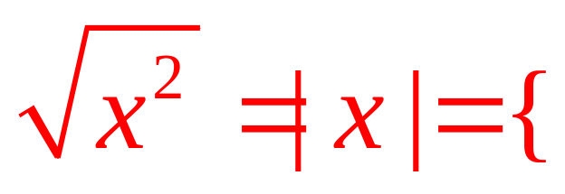
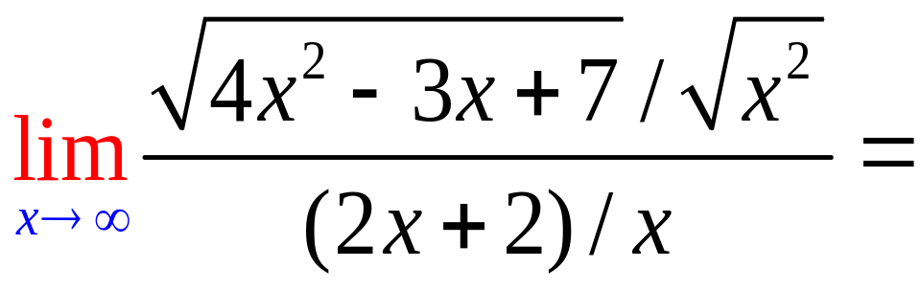
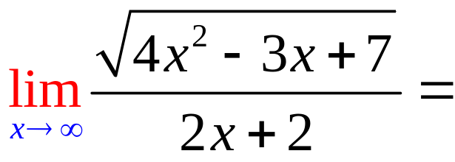
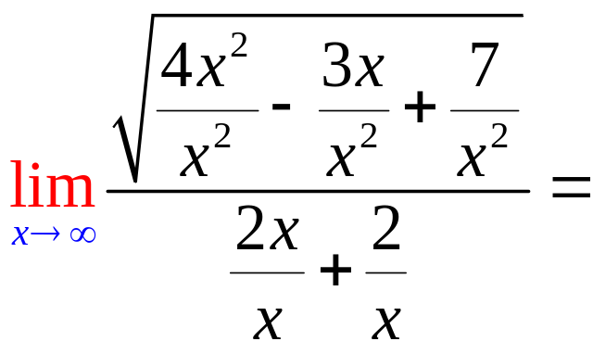
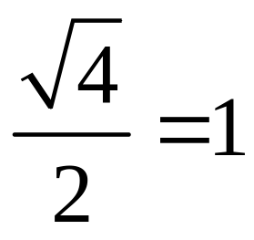
x, if 0 < x
-x, if x < 0

Slide 22
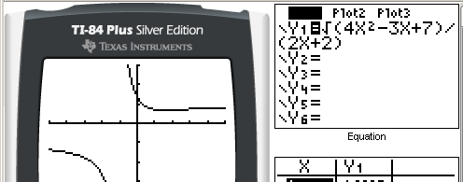
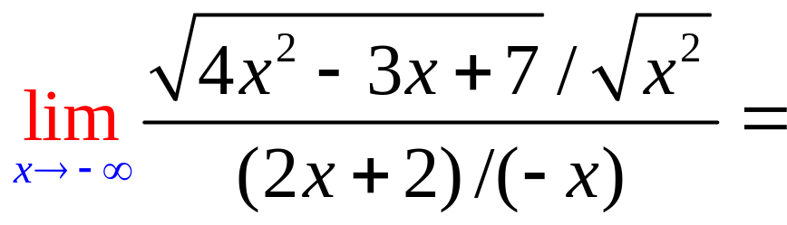
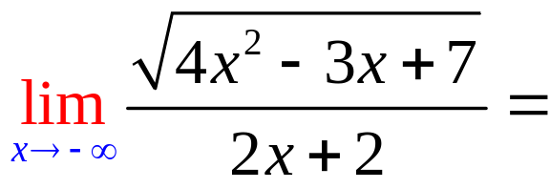
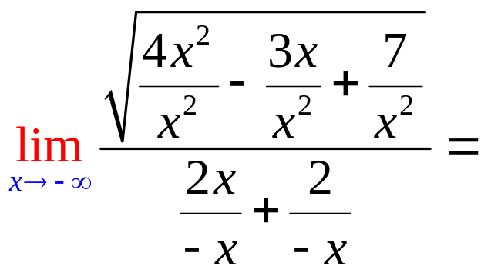
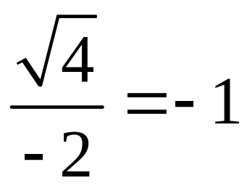
x, if 0 < x
-x, if x < 0

Slide 23
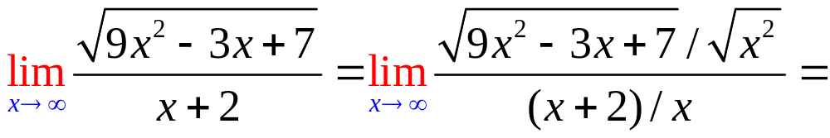
.
3.0
0.1

Slide 24
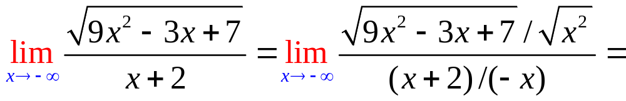
.
-3.0
0.1

