Slide 1
On [a,b], ARC =
On [1, 16], find ARC for

Slide 2
On [a,b], ARC =
On [1, 16], find ARC for
ARC = =

Slide 3
On [a,b], ARC =
On [1, 16], find ARC for
ARC = =

Slide 4
On [a,b], ARC =
On [1, 16], find ARC for
ARC = =

Slide 5
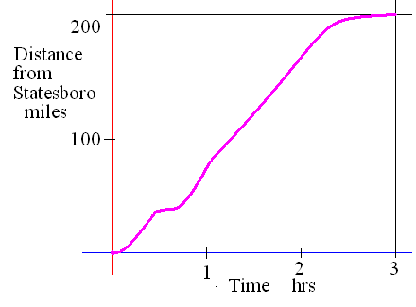
Continuity
This function is continuous on [0,3]
Definition
A function f is continuous at x = a means three things.
1) a is in the domain of f,
2)
3)

Slide 6
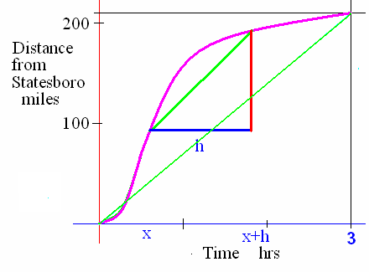
Continuity
f is continuous on [0, 3] means that f is
continuous at a for every a in [0, 3].

Slide 7
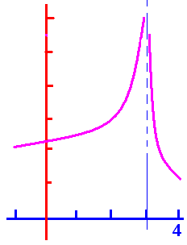
Continuity
f is continuous on [-1, 3) U (3, 4] means that f is continuous at x = a
for every a in [-1, 3) U (3, 4] .

Slide 8
Continuity
1) a is in the domain of f,
2)
3)

Slide 9
Continuity
Why wasn’t f continuous when x = 3?
Must lift your pencil
Not a valid reason

Slide 10
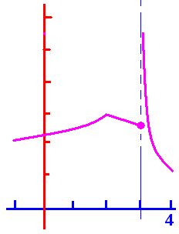
Continuity
1) a is in the domain of f,
2)
3)
Why not at x = 3?

Slide 11
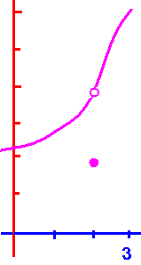
Continuity
1) a is in the domain of f,
2)
3)
Yes on [-.2, 2) U (2, 3.1]
Why not at x = 2?

Slide 12
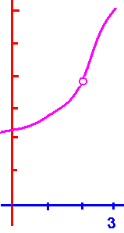
Continuity
1) a is in the domain of f,
2)
3)
Yes on [-.2, 2) U (2, 3.1]
Why not at x = 2?
Hole in the graph
Not a valid reason

Slide 13
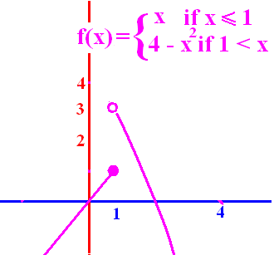
Why is f not continuous at x = 1?
1 is not in the domain of f
.
.
There is a hole in the graph
Must lift your pencil

Slide 14


Why is f not continuous at x = 1?
1 is not in the domain of f
.
.
There is a hole in the graph
Must lift your pencil

Slide 15
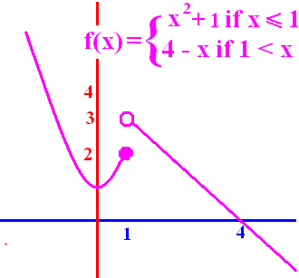
f is continuous at x = 1.
True
False

Slide 16
f is continuous at x = 1.
True
False

Slide 17
f is continuous at x = 4.
True
False

Slide 18
f is continuous at x = 4.
True
False

Slide 19
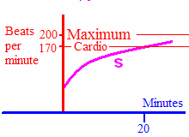
Why is s continuous at 20?
20 is in the domain
.
.
a, b, and c above
none of the above

Slide 20
Why is s continuous at 20?
20 is in the domain
.
.
a, b, and c above
none of the above

Slide 21
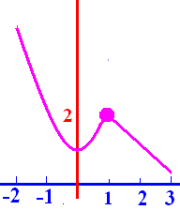
f is continuous on [-2, 3].
Yes
No

Slide 22
f is continuous on [-2, 3].
Yes
No

Slide 23
Why is f not continuous at x=1?
1 is not in the domain
.
.
All of the above

Slide 24
Why is f not continuous at x=1?
1 is not in the domain
.
.
All of the above

Slide 25
Why is f not continuous at x=2?
2 is not in the domain
.
.
All of the above

Slide 26
Why is f not continuous at x=2?
2 is not in the domain
.
.
All of the above

Slide 27
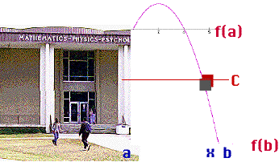
Having thrown a pebble from the roof of MPP, will it pass the floor of the 3rd floor?
The domain of this function is [a, b] representing the time it was thrown until the time the pebble struck the ground. The rule of the function, f, is "height of the pebble at time x".

Slide 28
Intermediate Value Theorem
If f is continuous on [a, b] and d is inbetween f(a) and f(b),
then c (a,b) such that f (c) = d.

Slide 29
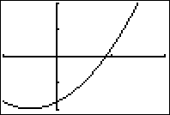
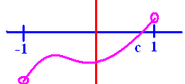
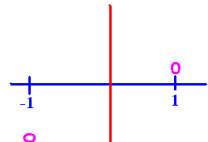
f(x) = x² + x – 1.7
Prove f has a zero on [-1, 1]
f(-1) = -1.7, f(1) = 0.3
f is continuous on [-1, 1]
0 (-1.7, 0.3) so by the IVT
a c (-1, 1) so that f(c)= 0.

Slide 30
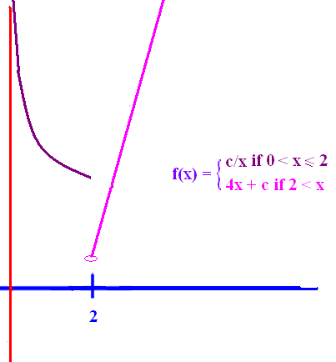
Find c to make f continuous
c/x must equal
4x + c
When x = 2
c/2 = 8 + c
-8 = c/2
-16 = c
f(2) = -8

Slide 31
Continuity
This function is continuous on [0,3]
d.n.e.
Similarly,
even though
d.n.e.

