Slide 1
Tangent Lines
Equation of lines
Equation of secant lines
Equation of tangent lines

Slide 2
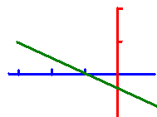
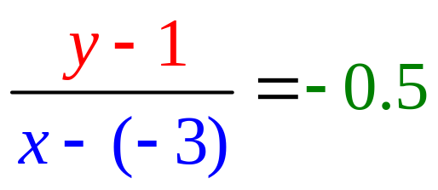

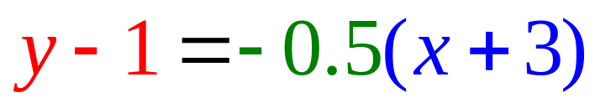
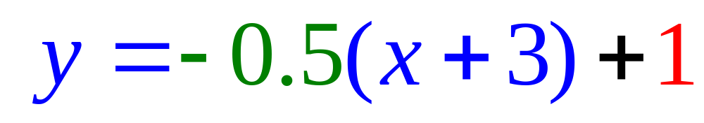
Equation of Lines
Write the equation of a line that passes through (-3, 1) with a slope of – ½ .
or
or

Slide 3
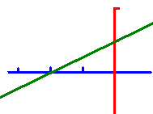
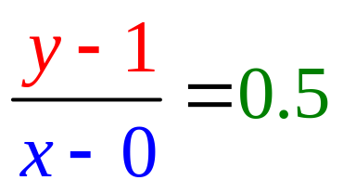
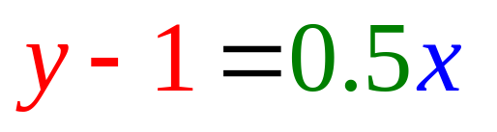
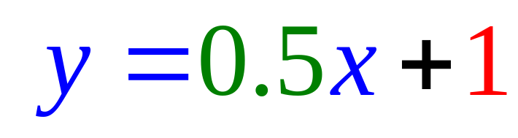
Equation of Lines
Write the equation of a line that passes through (0, 1) with a slope of ½ .
or
or

Slide 4
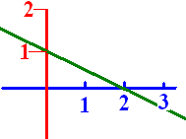
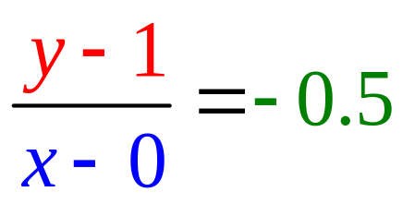
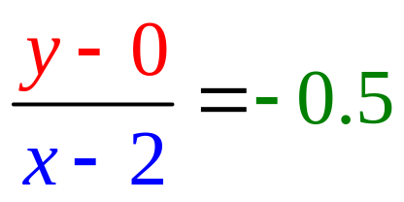
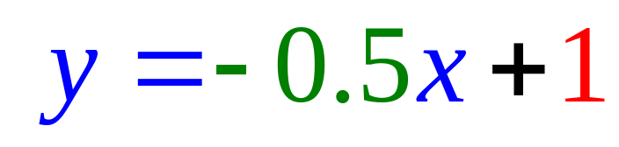
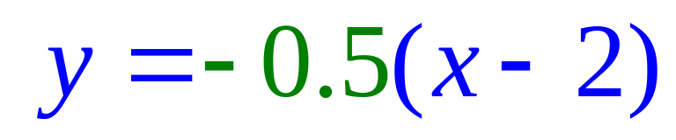
Equation of Lines
Write the equation of the line .
or
or

Slide 5
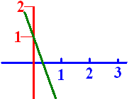
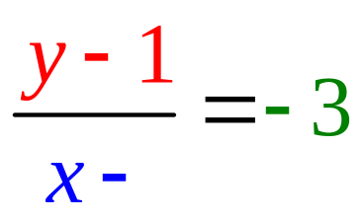
Lines
When writing the equation of a line that passes through (0, 1) with a slope of -3 .
What is the missing blue number?
Save your answer.

Slide 6

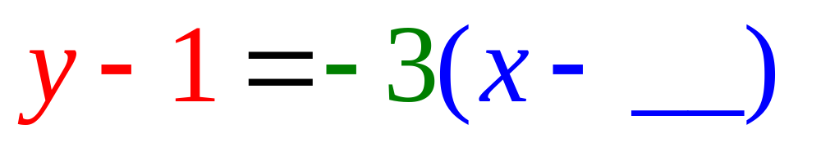


Passes through (0, 1) with a slope of -3. What is the missing blue number?
0.0
0.1

Slide 7

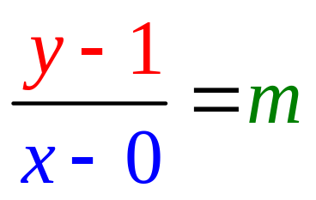

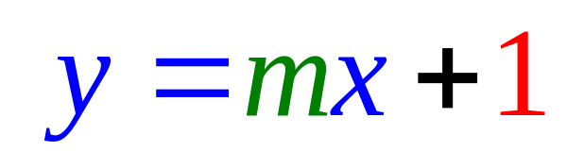
Write the equation of a green line that passes through (0, 1) with a slope of -3 .
What is the missing green number m?
-3.0
0.5

Slide 8
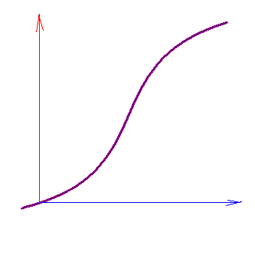
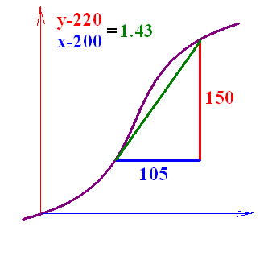
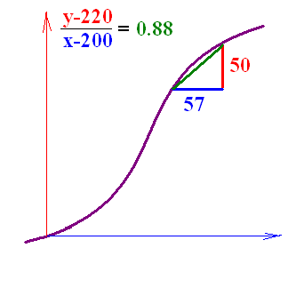
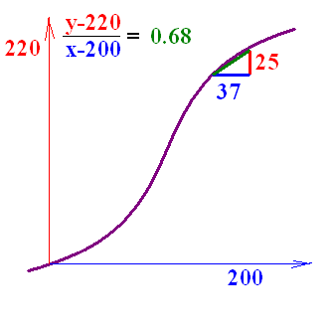
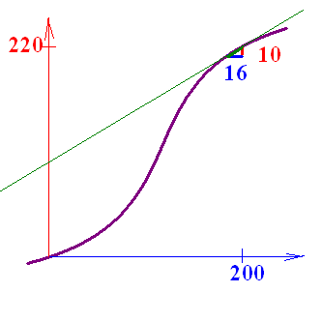
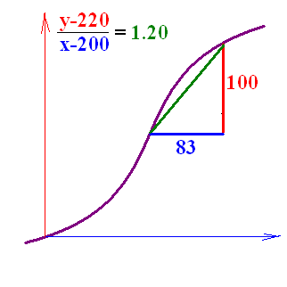
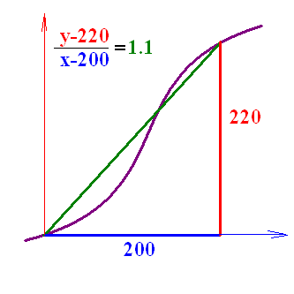
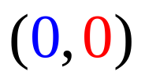






Secant Lines
Write the equation of the secant line that passes through
and (200, 220).

Slide 9
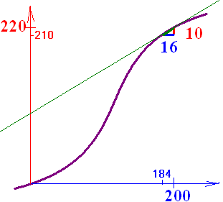
What is the slope of this secant line (184, 210) and (200, 220)?
0.625
0.2

Slide 10
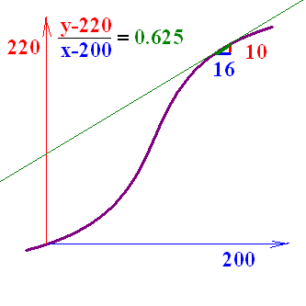
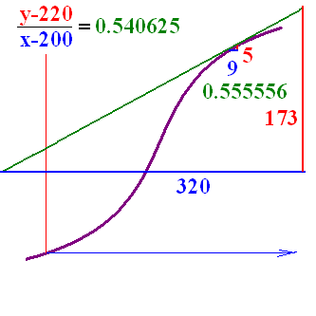
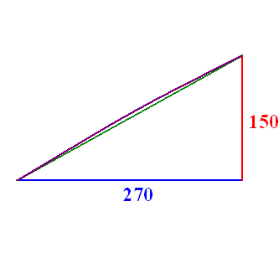
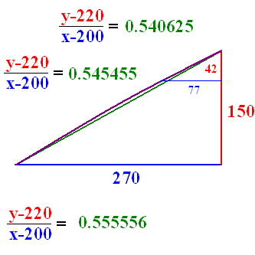

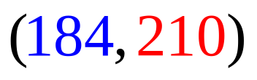
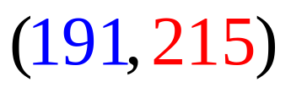
Secant Lines
Write the equation of the secant line that passes through
and (200, 220).

Slide 11
http://math.georgiasouthern.edu/~bmclean/java/p6.html Secant Lines
http://www.youtube.com/watch?v=P9dpTTpjymE Derive
http://www.9news.com/video/player.aspx?aid=52138&bw= Kids Invest

Slide 12
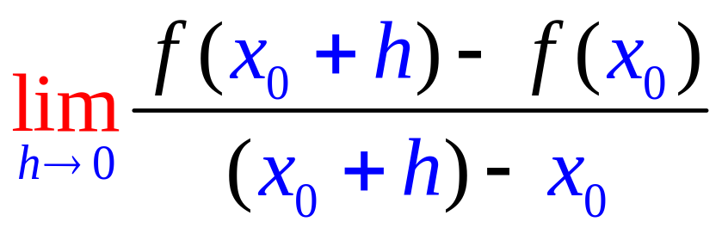
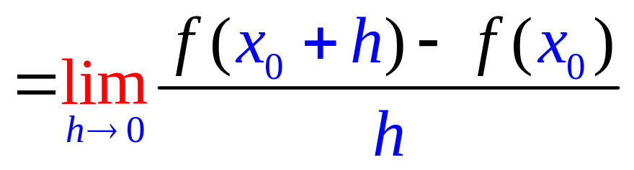
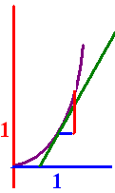
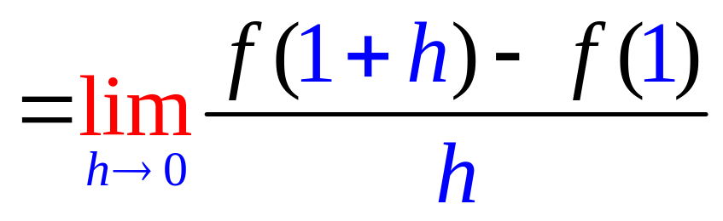
The slope of f(x) =x² when x=x₀ is
and when x = 1

Slide 13
Find the slope of the tangent line of f(x) = 2x + 3 when x = 1.
1. Calculate f(1+h) – f(1)
f(1+h) = 2(1+h) + 3
f(1) = 5
f(1+h) – f(1) = 2 + 2h + 3 – 5 =2h
2. Divide by h and get 2
3. Let h go to 0 and get 2

Slide 14
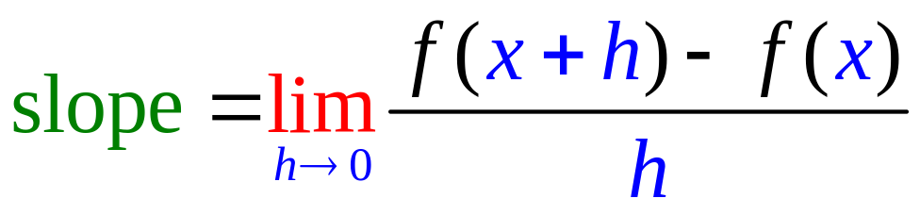
Find the slope of the tangent line of f(x) = x² when x = 1.
1. Calculate f(1+h) – f(1)
f(1+h) = 1² + 2h + h²
f(1) = 1²
f(1+h) – f(1) = 2h + h² .
2. Divide by h and get 2 + h
3. Let h go to 0 and get 2

Slide 15
Find the slope of the tangent line of f(x) = x² when x = x.
1. Calculate f(x+h) – f(x)
f(x+h) = x² + 2xh + h²
f(x) = x²
f(x+h) – f(x) = 2xh + h² .
2. Divide by h and get 2x + h
3. Let h go to 0 and get 2x

Slide 16


Find the slope of the tangent line of f(x) = x². f(x+h) - f(x) =
(x+h)² – x²
x² + h² – x²
(x+h)(x – h)

Slide 17
(x+h)² – x² =
x² + 2xh + h²
h²
2xh + h²

Slide 18
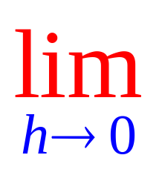
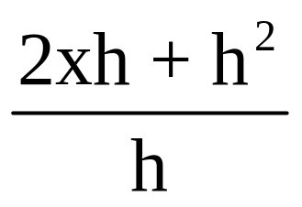
=
2x
2x + h²
2xh

Slide 19

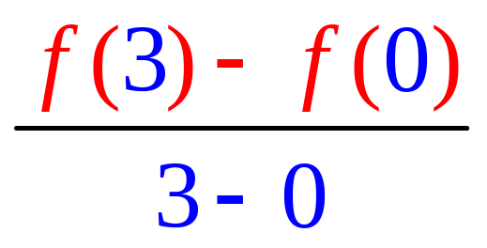
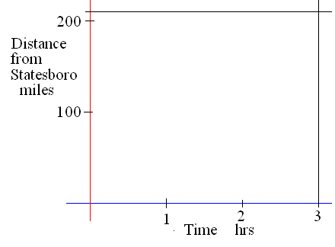
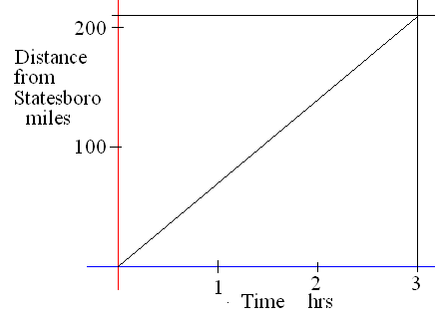
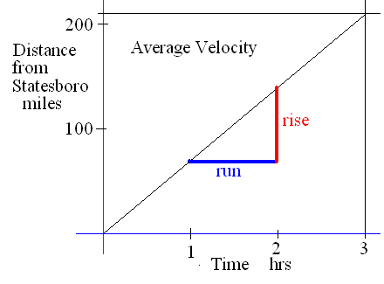
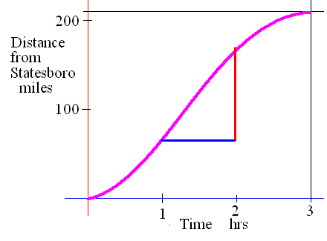
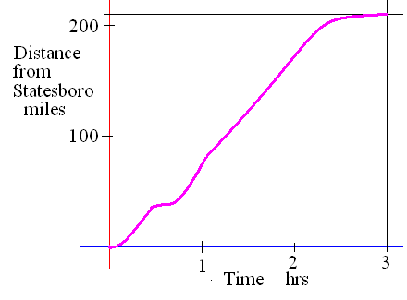
Average slope
Find the rate of change if it takes 3 hours to drive 210 miles.
What is your average speed or velocity?

Slide 20
If it takes 3 hours to drive 210 miles then we average
1 mile per minute
2 miles per minute
70 miles per hour
55 miles per hour

Slide 21
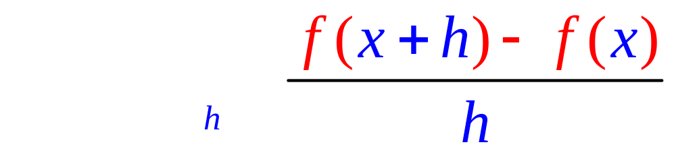
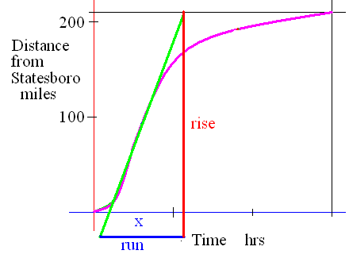
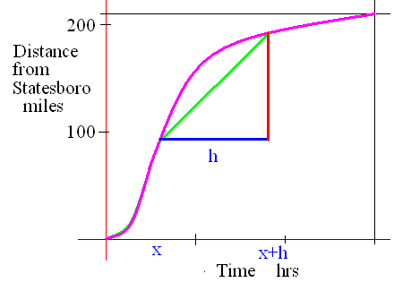
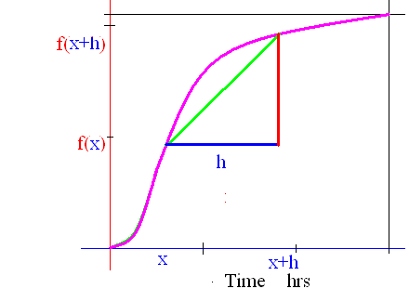


Instantaneous slope
What if h went to zero?

Slide 22




Derivative
if the limit exists as one real number.

Slide 23

.
Definition
If f : D -> K is a function then the derivative of f is a new function,
f ' : D' -> K' as defined above if the limit exists.
Here the limit exists every where except at x = 1

Slide 24

Guess at

Slide 25

.
Guess at

Slide 26

Thus
d.n.e.

Slide 27
.
Guess at
f’(0) – slope of f when x = 0

Slide 28
Guess at f ’(3)
-1.0
0.49

Slide 29
Guess at f ’(-2)
-3.0
1.99

Slide 30
Note that the rule is
f '(x) is the slope at the point ( x, f(x) ),
D' is a subset of D, but
K’ has nothing to do with K

Slide 31
K is the set of distances from home
K' is the set of speeds
K is the set of temperatures
K' is the set of how fast they rise
K is the set of today's profits ,
K' tells you how fast they change
K is the set of your averages
K' tells you how fast it is changing.

Slide 32

Theorem If f(x) = c where c is a real number, then f ' (x) = 0.
Proof : Lim [f(x+h)-f(x)]/h =
Lim (c - c)/h = 0.
Examples
If f(x) = 34.25 , then f ’ (x) = 0
If f(x) = π² , then f ’ (x) = 0

Slide 33
If f(x) = 1.3 , find f’(x)
0.0
0.1

Slide 34

Theorem
If f(x) = x, then f ' (x) = 1.
Proof : Lim [f(x+h)-f(x)]/h =
Lim (x + h - x)/h = Lim h/h = 1
What is the derivative of x grandson?
One grandpa, one.

Slide 35


Theorem If c is a constant,
(c g) ' (x) = c g ' (x)
Proof : Lim [c g(x+h)-c g(x)]/h =
c Lim [g(x+h) - g(x)]/h = c g ' (x)

Slide 36
Theorem If c is a constant,
(cf) ' (x) = cf ' (x)
( 3 x)’ = 3 (x)’ = 3 or
If f(x) = 3 x then
f ’(x) = 3 times the derivative of x
And the derivative of x is . .
One grandpa, one !!

Slide 37

If f(x) = -2 x then f ’(x) =
-2.0
0.1

Slide 38




Theorems
1. (f + g) ' (x) = f ' (x) + g ' (x), and
2. (f - g) ' (x) = f ' (x) - g ' (x)

Slide 39
1. (f + g) ' (x) = f ' (x) + g ' (x)
2. (f - g) ' (x) = f ' (x) - g ' (x)
If f(x) = 3² x + 7, find f ’ (x)
f ’ (x) = 9 + 0 = 9
If f(x) = x - 7, find f ’ (x)
f ’ (x) = - 0 =

Slide 40
If f(x) = -2 x + 7, find f ’ (x)
-2.0
0.1

Slide 41
If f(x) = x^{n} then f ' (x) = n x ^{(n-1)}
If f(x) = x⁴ then f ' (x) = 4 x³
If

Slide 42

If f(x) = x^{n} then f ' (x) = n x^{n-1}
If f(x) = x⁴ + 3 x³ - 2 x² - 3 x + 4
f ' (x) = 4 x³ + . . . .
f ' (x) = 4x³ + 9 x² - 4 x – 3 + 0
f(1) = 1 + 3 – 2 – 3 + 4 = 3
f ’ (1) = 4 + 9 – 4 – 3 = 6

Slide 43
If f(x) = x^{n} then f ' (x) = n x ^{(n-1)}
If f(x) = πx⁴ then f ' (x) = 4π x³
If f(x) = π⁴ then f ' (x) = 0
If

Slide 44
If f(x) = then f ‘(x) =

Slide 45

Find the equation of the line tangent to g when x = 1.
If g(x) = x³ - 2 x² - 3 x + 4
g ' (x) = 3 x² - 4 x – 3 + 0
g (1) =
g ' (1) =

Slide 46

If g(x) = x³ - 2 x² - 3 x + 4 find g (1)
0.0
0.1

Slide 47
If g(x) = x³ - 2 x² - 3 x + 4 find g’ (1)
-4.0
0.1

Slide 48



Find the equation of the line tangent to f when x = 1.
g(1) = 0
g ' (1) = – 4

Slide 49


Find the equation of the line tangent to f when x = 1.
If f(x) = x⁴ + 3 x³ - 2 x² - 3 x + 4
f ' (x) = 4x³ + 9 x² - 4 x – 3 + 0
f (1) = 1 + 3 – 2 – 3 + 4 = 3
f ' (1) = 4 + 9 – 4 – 3 = 6

Slide 50

Find the equation of the line tangent to f when x = 1.
f(1) = 1 + 3 – 2 – 3 + 4 = 3
f ' (1) = 4 + 9 – 4 – 3 = 6

Slide 51
Write the equation of the tangent line to f when x = 0.
If f(x) = x⁴ + 3 x³ - 2 x² - 3 x + 4
f ' (x) = 4x³ + 9 x² - 4 x – 3 + 0
f (0) = write down
f '(0) = for last question

Slide 52

Write the equation of the line tangent to f(x) when x = 0.
y - 4 = -3x
y - 4 = 3x
y - 3 = -4x
y - 4 = -3x + 2

Slide 53
http://www.youtube.com/watch?v=P9dpTTpjymE Derive
http://www.9news.com/video/player.aspx?aid=52138&bw= Kids
http://math.georgiasouthern.edu/~bmclean/java/p6.html Secant Lines

