Slide 1
News
On June 6, 2008, the jobless rate hit 5.5%. This was the highest value since 2006.
The increase was 0.5%. This was the highest rate increase since 1986.

Slide 2
y = x⁴+3x³-2x²-3x+4
dy/dx =
4x³ +
9x² –
4x –
3

Slide 3
f(x) = x⁴+3x³-2x²-3x+4
f ’(x) = 4x³ + 9x² – 4x – 3

Slide 4
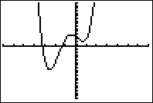
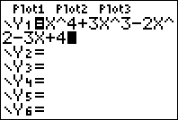
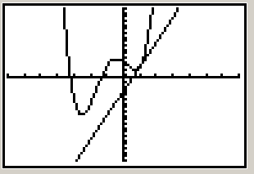

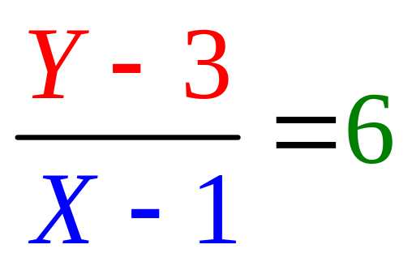
Find the equation of the line tangent to f when x = 1.
f (1) = 1 + 3 – 2 – 3 + 4 = 3
f '(1) = 4 + 9 – 4 – 3 = 6

Slide 5
Write the equation of the tangent line to f when x = 0.
If f(x) = x⁴ + 3 x³ - 2 x² - 3 x + 4
f ' (x) = 4x³ + 9 x² - 4 x – 3 + 0

Slide 6

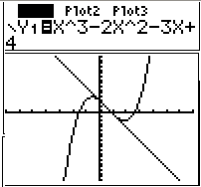


If g(x) = x³ - 2 x² - 3 x + 4 find g (1)
0.0
0.2

Slide 7
If g(x) = x³ - 2 x² - 3 x + 4 find g’ (1)
-4.0
0.1

Slide 8


Write the equation of the line tangent to g when x=1. Recall g(1)=0 and g’(1)=-4
Y = - 4
Y = - 4X + 1
Y = - 4X - 4
Y = - 4X + 4

Slide 9
Theorem 1
The product rule
[f(x) g(x)]’ =
copy diff. copy diff.
f(x) g’(x) + g(x) f ’(x)

Slide 10
The product rule
If k(x) = f(x) g(x) , then
k’(x) = f(x) g’(x) + g(x) f ’(x)
Suppose k(x) = (3x²-2x) (4x⁴+1)
k’(x) = (3x²-2x) (16x³) + (4x⁴+1)(6x-2)

Slide 11
Theorem 1
The product rule
[f(x) g(x)]’ =
f(x) g’(x) + g(x) f ’(x)

Slide 12
The product rule
[f(x) g(x)]’=f(x)g’(x) + g(x)f ’(x)
If y =(x²-3x+1)(1/x+3x) find dy/dx
dy/dx =
(x²-3x+1)(-x⁻²+3) +(1/x+3x) (2x-3)

Slide 13
If f(x) = x^{n} then f ' (x) = n x ^{(n-1)}
If
then

Slide 14
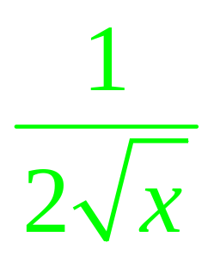
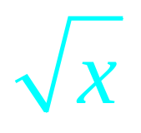
The product rule
[f(x) g(x)]’ = f(x) g’(x) + g(x) f ’(x)
[ (3x-1)]’ = (3) +(3x-1)

Slide 15
If y = (x-1)(3x²+2) find dy/dx or y’
6x
(x-1) 6x + (3x²+2)
(x-1) 6x
3x²+2

Slide 16
If y = (x²-x)(-3x²+2) find dy/dx or y’
(2x-1) (-6x)
(x²-x)(-3x+2) + (-3x²+2)(2x-1)
(x²-x)(-6x) + (-3x²+2)(2x-1)

Slide 17
If y = (x²-x)(x³-3x²+2) find dy/dx or y’
(x²-x) (3x² - 6x) + (x³ - 3x²+2) (2x-1)
(x²-x) (2x-1) + (x³ - 3x²+2) (3x²-6x)
(2x-1) (3x² - 6x)
(x²-x) (3x² - 6x) - (x³ - 3x²+2) (2x-1)

Slide 18
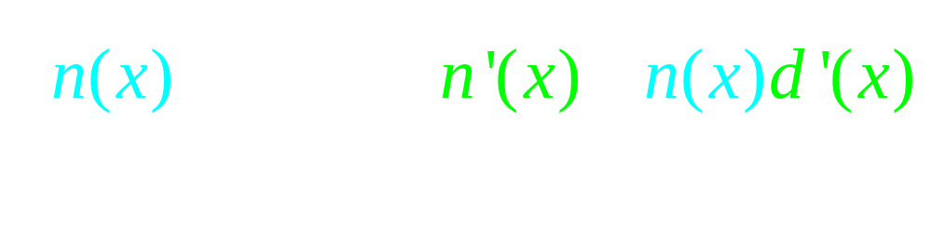
Theorem 2
The quotient rule

Slide 19
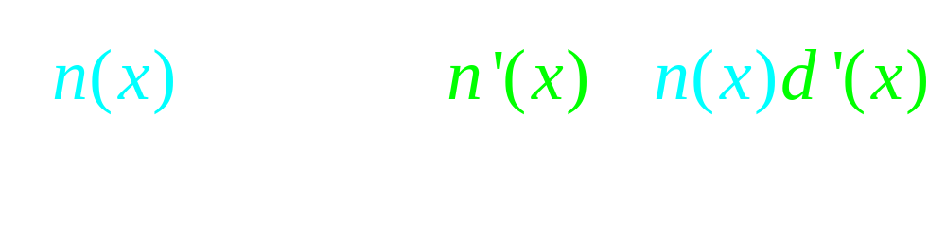
Theorem 2
The quotient rule
Never cancel across the minus sign

Slide 20


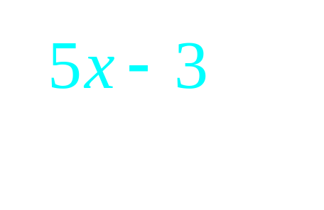

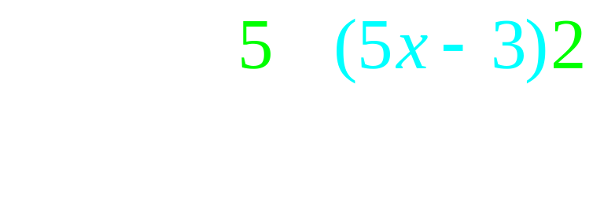
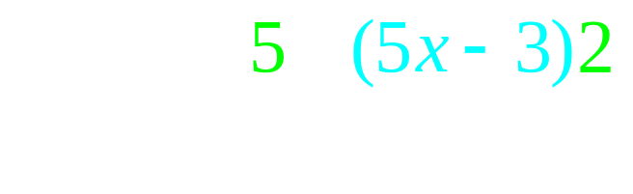
The quotient rule

Slide 21
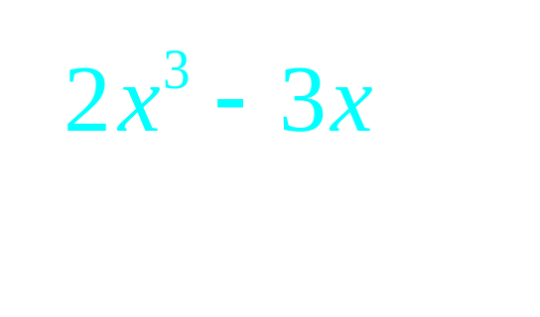
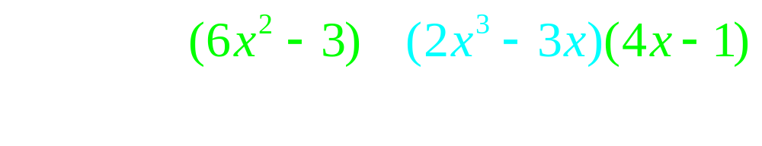
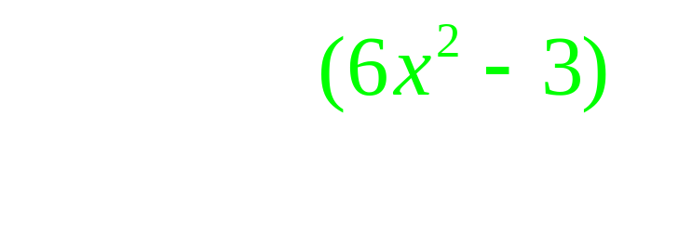
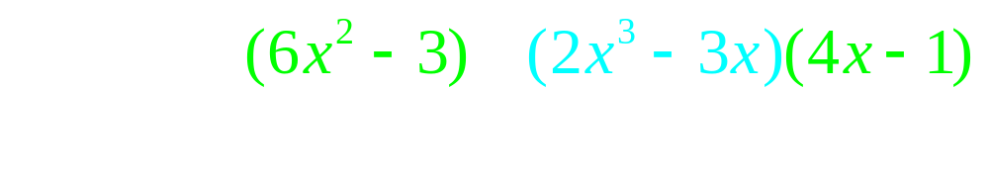
The quotient rule

Slide 22
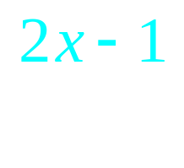
If f(x)= find f ’(1)
-11
-5

Slide 23

The product rule
If k(x) = f(x) g(x) , then
k’(x) = f(x) g’(x) + g(x) f ’(x)

Slide 24
The product rule
k’(x) = f(x) g’(x) + g(x) f ’(x)

Slide 25
The product rule
k’(x) = f(x) g’(x) + g(x) f ’(x)

Slide 26
The product rule
k’(x) = f(x) g’(x) + g(x) f ’(x)

