Slide 1
f’(x) f’’(x) f’’’(x) f^{iv}(x) f^{v}(x) f⁽⁴⁾(x) f⁽⁵⁾(x)
D¹f(x) D²f(x) D³f(x) D⁴f(x) D⁵f(x)
y’, y’’, y’’’, y^{iv}, y^{v},

Slide 2
y = x⁵-3x⁴+4x³-2x²+x-8
y’ = 5x⁴ - 12x³ +12x² - 4x +1
y’’ = 20x³ - 36x² + 24x – 4
y’’’ = 60 x² -72 x + 24
y⁽⁴⁾ = 120 x – 72
y⁽⁵⁾ = 120
y⁽⁶⁾ = 0

Slide 3
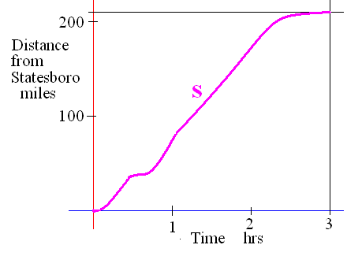
If s is the distance from home
Velocity v(t) = s ’(t) - stopped <=> v(t)= 0
Speed = |v(t)|

Slide 4
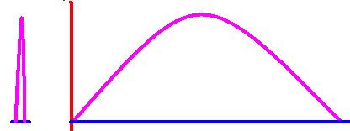
v(t) = s ’(t) stop <=> v(t)= 0
If a ball is thrown straight up and the height is always s(t) = -16t² + 64t

Slide 5
s(t) = -16t² + 64t
Find velocity as a function of t.
v(t) =

Slide 6
v(t) = -32t + 64
What was the initial veolcity?
v(0) = feet/sec

Slide 7
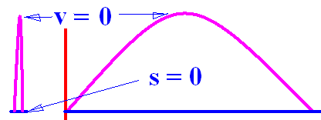

s(t) = -16t² + 64t v(t) = -32t + 64
How high did it go?
v(t) = -32t + 64 = 0 feet/sec
64 = 32t or 2 = t
s(t) = -16t² + 64t or
s(2) = -64 +128 = 64

Slide 8
s(t) = -16t² + 64t v(t) = -32t + 64
Find velocity and speed when t = 3
v(t) = -32t + 64 feet/sec so v(3) =
v(3) = -96 + 64 = -32 feet/sec
Speed= | v(3) | = 32 feet/sec

Slide 9



s(t) = -16t² + 64t How high when t = 3?
1
24
48
56

Slide 10
s(t) = -16t² + 64t v(t) = -32t + 64
How high was the ball after 3 seconds?
s(t) = -16t² + 64t or s(3) =
s(3) = -144 + 192 = 48
v(3)=

Slide 11
Find the total distance traveled.
| s(2) – s(0) | + |s(4) – s(2) | =
64 + 64 = 128

Slide 12
If s is the distance from home
Acceleration is a(t) = v’(t) = [f ’(t)]’ = f’’(t)
Jerk is j(t) = a’(t) = v’’(t) = f’’’(t)

Slide 13
v(t) = -32t + 64
Find the acceleration as a function of t.
a(t) = v’(t) =
-32 feet/sec per sec at every value of t

Slide 14
v(t) = -32t + 64
Find the jerk as a function of t.
j(t) = a’(t) = v’’(t) =
0 feet/sec² per sec at every value of t

Slide 15
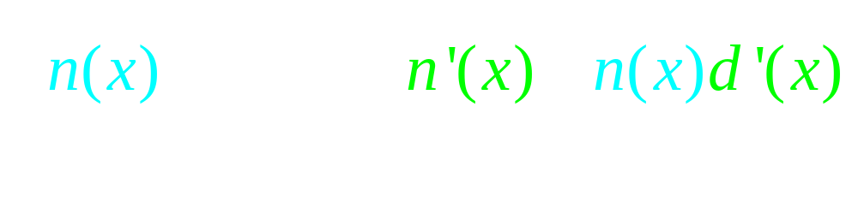

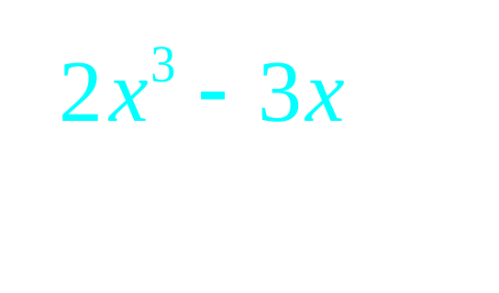
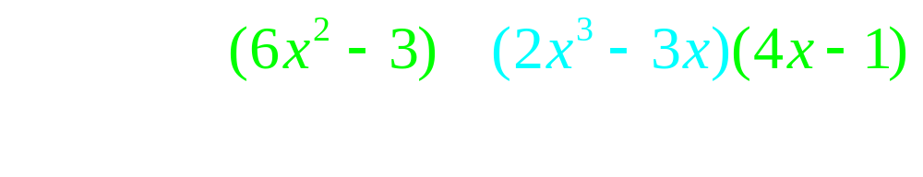

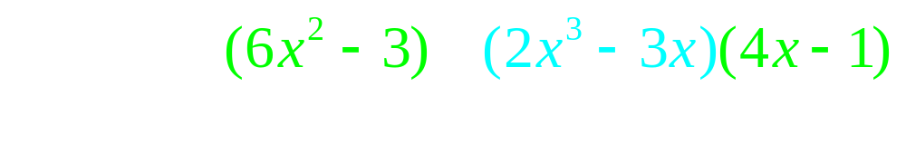
The quotient rule

Slide 16


If s(t) = find the velocity when t=2
-2.0
0.1

Slide 17
Theorem 1
The product rule
[f(x) g(x)]’ =
copy diff. copy diff.
f(x) g’(x) + g(x) f ’(x)

Slide 18
If s(t) = ( t² - 3 )( t + 3) find the acceleration when t = 1
12.0
0.2

Slide 19
s(t) = ( t² - 3 )( t + 3)
Find the velocity when the acceleration is zero.
-6.0
0.1

