Slide 1


Power Rule
k(x) = g^{n}(x) = [g(x)]^{n}
k’(x) = n [g (x)] ^{n-1} g’(x)

Slide 2
Power Rule
k(x) = [x² + x ] ³
k’(x) = 3 [x² + x] ² (2x+1)

Slide 3
Power Rule
k(x) = 2[3x³ + x ] ⁴
k’(x) = 8 [3x³ + x] ³ (9x²+1)

Slide 4


k(x) = (x³ + 2x)⁴ k’(x)=
4 (x³ + 2x)³ (3x² + 2)
4 (x³ + 2x)³ (3x + 2)
4 (x³ + 2x)³ (3x + 2x)

Slide 5
Power Rule
k(x) = 2[3x³ - x⁻² ]²⁰
k’(x) = 40 [3x³ - x⁻²] ¹⁹ (9x²+2x⁻³)

Slide 6
t(x) = (2x⁵ + 3x² + 2)⁴ t’(x)=
4 (2x⁵ + 3x² + 2)³(10x + 6x + 2)
4 (10x⁴ + 6x)³
4 (2x⁵ + 3x² + 2)³ (10x⁴ + 6x)

Slide 7
s(t)=3(t-2/t)⁷ = 3(t-2t⁻¹)⁷ s’(t) =
21t - 42
21(t - 2/t)⁶ (1 + 2t ⁰)
21(t - 2/t)⁶ (1 - 2t ⁻¹)
21(t - 2/t)⁶ (1 + 2t ⁻²)

Slide 8
Power Rule
=[3x³ - x² ]^{1/2}
k’(x) = ½ [3x³ - x²]^{-1/2} (9x²-2x)

Slide 9
rewrite y using algebra .
.
.
.

Slide 10
= dy/dx=
.
.
.

Slide 11
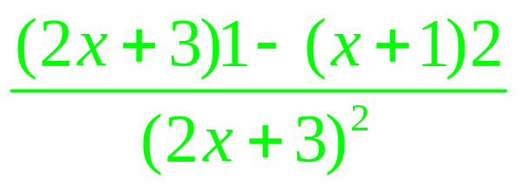

Slide 12
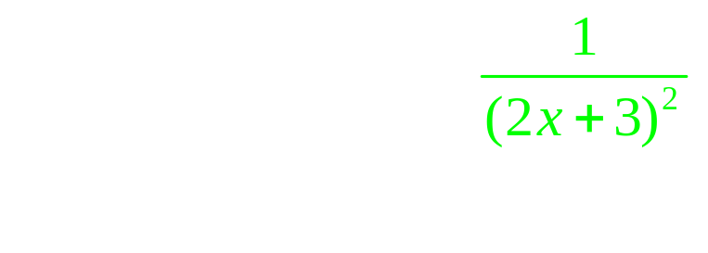
.

Slide 13
.
.
.
.

Slide 14
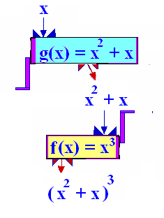
The composition function
k(x) = (f º g)(x) = f (g(x))
g
R--->[-¼,+oo)
f
---->[-1/64 , +oo)

Slide 15
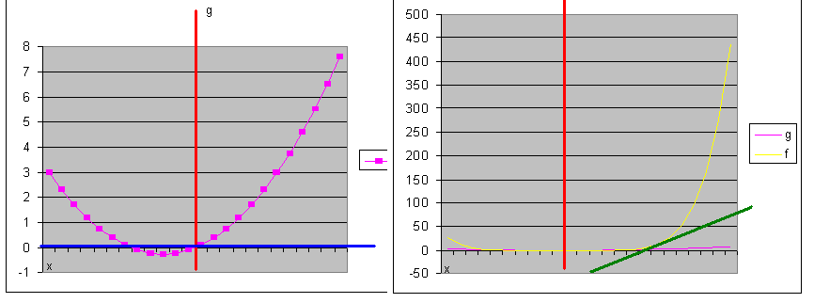
The composition function
k(x) = (f º g)(x) = f (g(x))
R-g->[-¼,+oo)-f->[-1/64 , +oo)

Slide 16
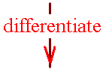
Theorem 1
The chain rule
If k(x) =f (g(x)), then
k’(x) = f ’ ( g(x) ) g’(x)

Slide 17
If k(x) =f (g(x)), then k’(x) = f ’ ( g(x) ) g’(x)
k(x) = f (g(x)) = ( x² + x)³
g(x) = ( x² + x)
f (x)= (x) ³

Slide 18
If k(x) =f (g(x)), then k’(x) = f ’ ( g(x) ) g’(x)
k(x) = ( x² + x)³
k’(x) = 3 ( x² + x)²(2x +1)

Slide 19
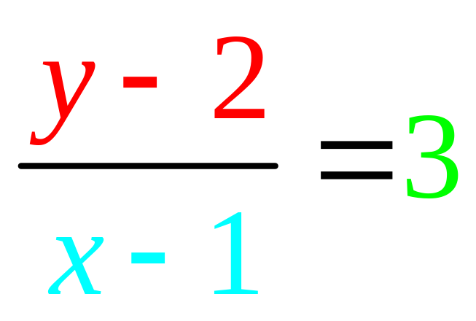
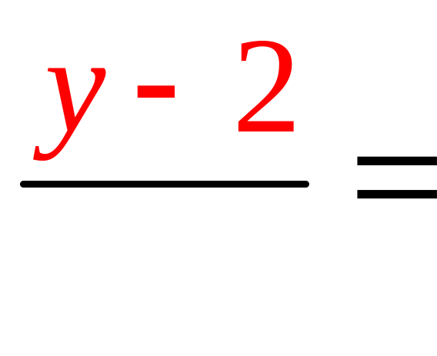
Write the equation of a line passing through (1,2) with a slope of 3

Slide 20
k(x) = ( x² + x)³. Evaluate k(1)
2
4
6
8

Slide 21
k(x) = ( x² + x)³ Evaluate k’(x)
3( x² + x)²(2x+1)
3(2x+1) ²
3( x² + x)(2x+1)

Slide 22
k’(x) = 3( x² + x)²(2x+1) Evaluate k’(1)
22
24
36
38

Slide 23
Write the equation of a line passing through (1,2) with a slope of 3

Slide 24
Write the equation of the tan- gent line to k(x) = ( x² + x)³ when x = 1. k(1) = 8 and k’(1)=36
(y-8)/(x-1) = 36
(y-1)/(x-36) = 8
(y-8)/(x-36) = 1
(y-1)/(x-8) = 1/36

Slide 25
t(x) = t’(x)=
.
.

Slide 26
#69-The assets of socially responsible funds in billions
f(t) = 23.7(0.2t+1)^{1.32} on [0,11]
0 is code for 1991
What were the assets in 1991?
What were the assets in 2000?

Slide 27
f(t) = 23.7(0.2t+1)^{1.32} on [0,11] & 0 is code for 1991
What were the assets in 1991?
23.7 * ( 1) = $23.7 billion
What were the assets in 2000?
=23.7*(1.8+1)^1.32=$92.26 billion

Slide 28
f(t) = 23.7(0.2t+1)^{1.32} on [0,11] 0 is code for 1991
How fast are the assets changing?
f’(t) = 1.32(23.7)[0.2t+1] ^{0.32} [0.2]

Slide 29
f’(t) = 1.32(23.7)[0.2t+1] ^{0.32} [0.2]
How fast are the assets changing in 1991?
f’(0) = 1.32(23.7)[1] ^{0.32} [0.2] =
$6.26 billion per year
How fast in 2000?
f’(9) = 1.32(23.7)[0.2(9)+1] ^{0.32} [0.2] =
$8.7 billion per year

Slide 30
The chain rule
If y = (u)³ and u(x) = x² + x
then dy/dx = dy/du du/dx
dy/du = 3(u)² du/dx = 2x + 1
dy/dx = 3(u)² (2x + 1)
= 3(x² + x)² (2x + 1)

