Slide 1
Eq. of line tangent to y = g(x) when x = a.
[y-g(a)]/[x-a] = g’(a)
y-g(a) = [x – a]g’(a)
g(x) = 2/x x = 3

Slide 2


If g(x)=2/x=2x⁻¹, find g’(x)
-2x⁰ = -2
-2x⁻² = -2/x²
2x⁻² = 2/x²

Slide 3
g’(x) = -2x⁻² = -2/x² g’(3) =
-2/9
18
-18
-9/2

Slide 4
Eq. of line tangent to y = g(x) = 2x⁻¹ when x = 3.
g(x) = 2/x x = 3
g(3)=2/3
g’(x) =-2/x² g’(3)=-2/9
y - 2/3 = [x – 3] [-2/9]

Slide 5
g(x) = g’(x) =
1/x²
-1/x²
1/( )
-1/( )

Slide 6
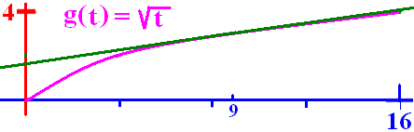

Eq. of line tangent to y = g(x) when x = a.
[y-g(a)]/[t-a] = g’(a)
y-g(a) = [t – a]g’(a)
g(t) = root(t) t = 9
g(9) = 3

Slide 7

g(9)=3 & g’(9) = 1/6 Write the equation of the tangent line
y - 3 = [t-9]/6
y - 6 = [t-9]/3
y - 9 = [t-3]/6
y - 3 = [t-9]/3

Slide 8
Higher order derivatives
f f’ f’’ f’’’ f^{iv} f^{v} f^{vi} . . . f^{(n)}
y dy/dx d(dy/dx)/dx = d²y/dx²
d³y/dx³ d⁴y/dx⁴ . . . d^{n}y/dx^{n}
y Dy D²y D³y D⁴y . . . D^{n}y

Slide 9
Find all of the derivatives of y = 3x⁴ - 2x³ + 6x - 8
Dy = 12x³ - 6x² + 6
D²y = 36x² - 12 x
D³y = 72x – 12
D⁴y = 72
D^{n}y = 0 for n > 4

Slide 10
y = - 2x³ + 6x – 8 D²y =
-6
-12x + 6
-6x² + 6
-12x

Slide 11
y = x^{3/2}
dy/dx = 3/2 x^{½}
d²y/dx² = 3/4 x ^{-½}
d³y/dx³ = -3/8 x
Domain = (0, +oo)

Slide 12
y = x^{9/4} find d²y/dx² =
9/4 x^{5/4}
45/16 x^{1/4}
-9/4 x^{5/4}

Slide 13
If y = 3/2(x²+2)^{4/3}, find y’’
y’ = 2(x²+2) 2x
y’’ = 2(x²+2) 2 +
2x(2/3) (x²+2)
Domain = R

Slide 14
Y= (3x²-2)⁴ Dy =
4(3x²-2)³6x
4(3x²-2)³
- 4(3x²-2)³

Slide 15
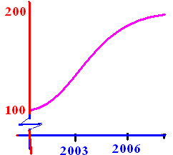
I(t) = -0.2t³ + 3t² + 100 on [0, 9] where 0 is 2000
The CPI is given by the above equation
Find the inflation rate 1/1/2006 (I’/I)
I’(t)/I(t) = [-0.6t² + 6t]/[-0.2t³+3t²+ 100]
I’(6)/I(6) = 14.4/164.5 = 0.0874

Slide 16
I(t) = -0.2t³ + 3t² + 100
I’(t) = -0.6t² + 6t
I’’(t) = -1.2t + 6
I’’(6) = -1.2

Slide 17
I(t) = -0.2t³ + 3t² + 100 on [0, 9] where 0 is 2000
The CPI is given by the above equation
Find the inflation rate 1/1/2006 (I’/I)
I’(t)/I(t) = [-0.6t² + 6t]/[-0.2t³+3t²+ 100]
I’(6)/I(6) = 14.4/164.5 = 0.0874

Slide 18
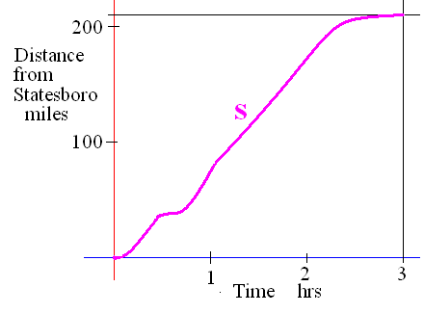
If s is the distance from home
Velocity v(t) = s ’(t) - stopped <=> v(t)= 0
Speed = |v(t)|

Slide 19
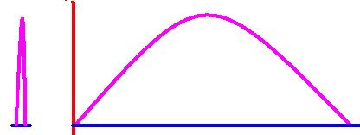
v(t) = s ’(t) stop <=> v(t)= 0
If a ball is thrown straight up and the height is always s(t) = -16t² + 64t

Slide 20
s(t) = -16t² + 64t
Find velocity as a function of t.
v(t) =

Slide 21
v(t) = -32t + 64
What was the initial veolcity?
v(0) = feet/sec

Slide 22
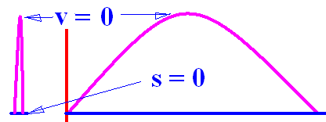

s(t) = -16t² + 64t v(t) = -32t + 64
How high did it go?
v(t) = -32t + 64 = 0 feet/sec
64 = 32t or 2 = t
s(t) = -16t² + 64t or
s(2) = -64 +128 = 64

Slide 23
s(t) = -16t² + 64t v(t) = -32t + 64
Find velocity and speed when t = 3
v(t) = -32t + 64 feet/sec so v(3) =
v(3) = -96 + 64 = -32 feet/sec
Speed= | v(3) | = 32 feet/sec

Slide 24
s(t) = -16t² + 64t How high when t = 3?
1
24
48
56

Slide 25
s(t) = -16t² + 64t v(t) = -32t + 64
How high was the ball after 3 seconds?
s(t) = -16t² + 64t or s(3) =
s(3) = -144 + 192 = 48
v(3)=

Slide 26
If s is the distance from home
Acceleration is a(t) = v’(t) = [f ’(t)]’ = f’’(t)
Jerk is j(t) = a’(t) = v’’(t) = f’’’(t)

Slide 27
v(t) = -32t + 64
Find the acceleration as a function of t.
a(t) = v’(t) = s’’(t)
-32 feet/sec per sec at every value of t

Slide 28
v(t) = -32t + 64
Find the jerk as a function of t.
j(t) = a’(t) = v’’(t) = s’’’(t)
0 feet/sec² per sec at every value of t

